Slide 1
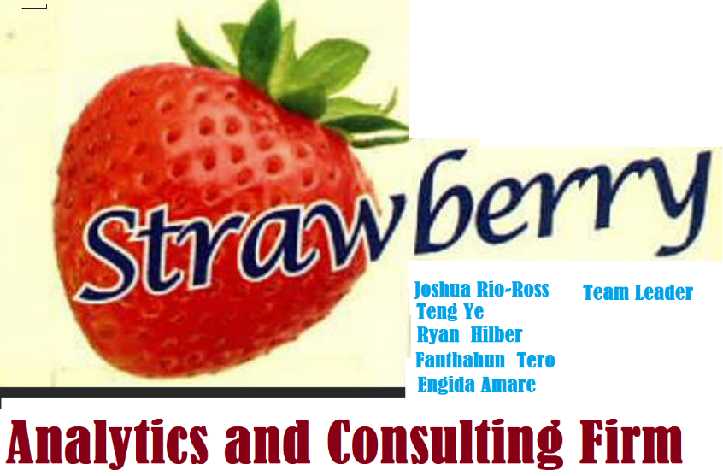
Analysis results and Recommendation made to App trader company
Introduction
Strawberry Analysis and Consulting Firm would like to thank App
trader company for the trust they put on us in order to accomplishment their
requirement .

Slide 2
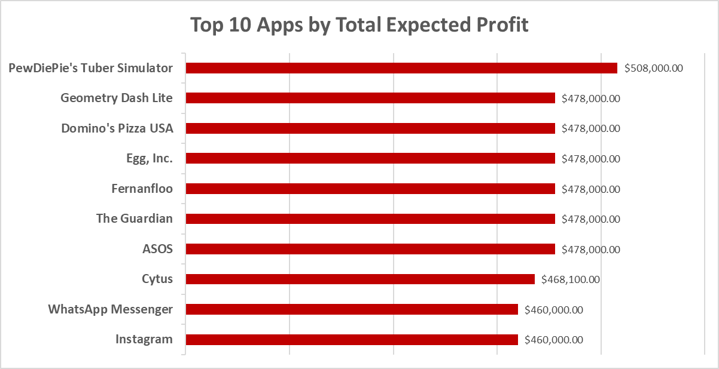

The Bottom Line
🍓
All apps are common to both the App Store and Google Play Store
Tie breaker by app’s review count
Maximum Profit: PewDiePie’s Tuber Simulator

Slide 3
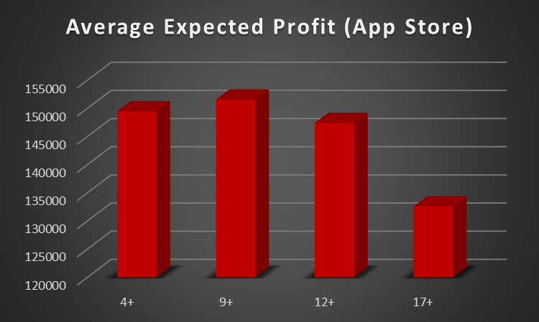
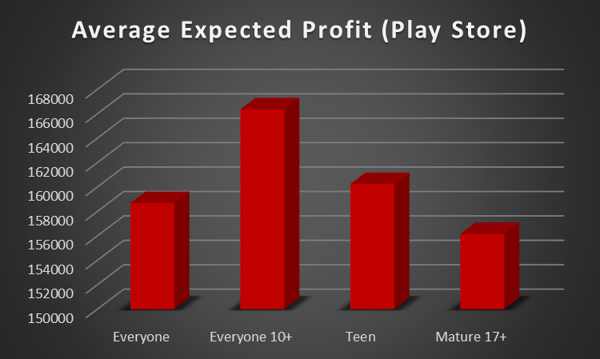
Average Expected Profit by Content Rating
🍓

Slide 4
Average Expected Profit by Content Rating
🍓
4+
Geometry Dash Lite
Domino's Pizza USA
Egg, Inc.
9+
PewDiePie's Tuber Simulator
Clash of Clans
Temple Run
12+
The Guardian
Instagram
Pinterest
17+
MORTAL KOMBAT X
WGT Golf Game by Topgolf
Swamp Attack

Slide 5
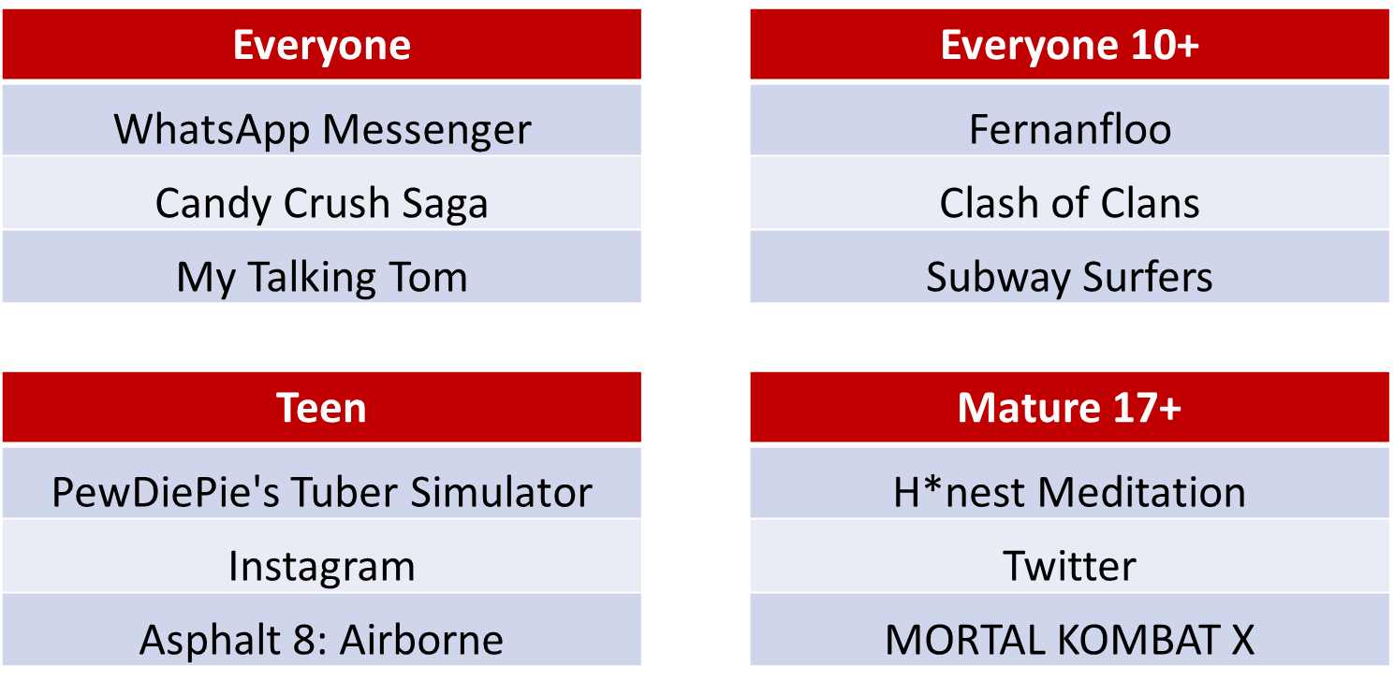
Average Expected Profit by Content Rating
🍓

Slide 6

Top Genres for Each Store
🍓

Slide 7
Comparison Between the stores
🍓

Slide 8
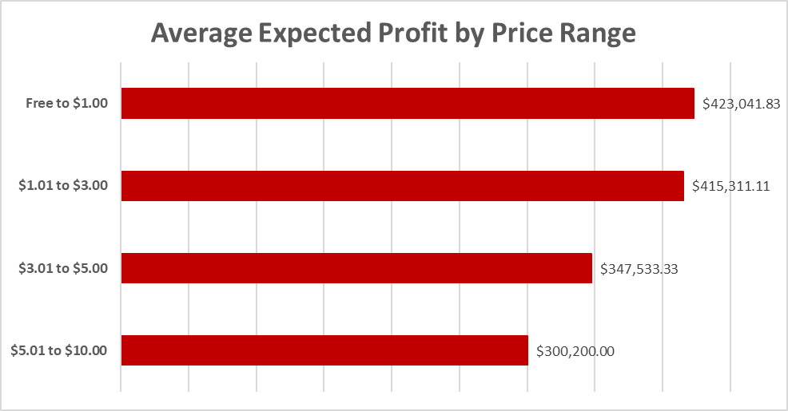
Price Range
🍓

Slide 9
Bests of the Bests
Our team come up with the Plan-B recommendation in case app trader wants to narrow their selection due to some unforeseen circumstances . In case best top 3 or best top 5
In this Bottom-line recommendation we tried to emphasize on Apps that fulfills all or many of the selection criteria aforementioned .
Apps found in both Apple Store and Play store .
Apps that generate Maximum expected Profit.
Apps that demanded Minimum possible cost
Apps that having a genre of maximum choice.
Apps that are a chosen across the different Text content.
Apps having a maximum possible review count or maximum installation count
On the left best recommended top 3 Apps .
Rank | Application Name
1 | PewDiePie's Tuber Simulator
2
3

