Slide 1
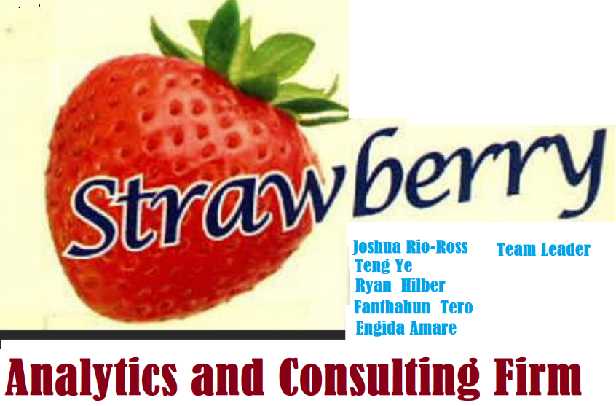
App Trader
Apps to Target for Black Friday 2021

Slide 2
The Breakdown
🍓
Refined Analysis and Recommendations for Targeted Licensing
Content Rating
Genre
Price Range
The Bottom Line: Most Profitable Apps Common to Both Stores

Slide 3
Content Rating
🍓

Slide 4
Average Expected Profit by Content Rating for Each Store
🍓

Slide 5
Most Profitable Apps by Content Rating (App Store)
🍓
4+
Geometry Dash Lite
Domino's Pizza USA
Egg, Inc.
9+
PewDiePie's Tuber Simulator
Clash of Clans
Temple Run
12+
The Guardian
Instagram
Pinterest
17+
MORTAL KOMBAT X
WGT Golf Game by Topgolf
Swamp Attack

Slide 6
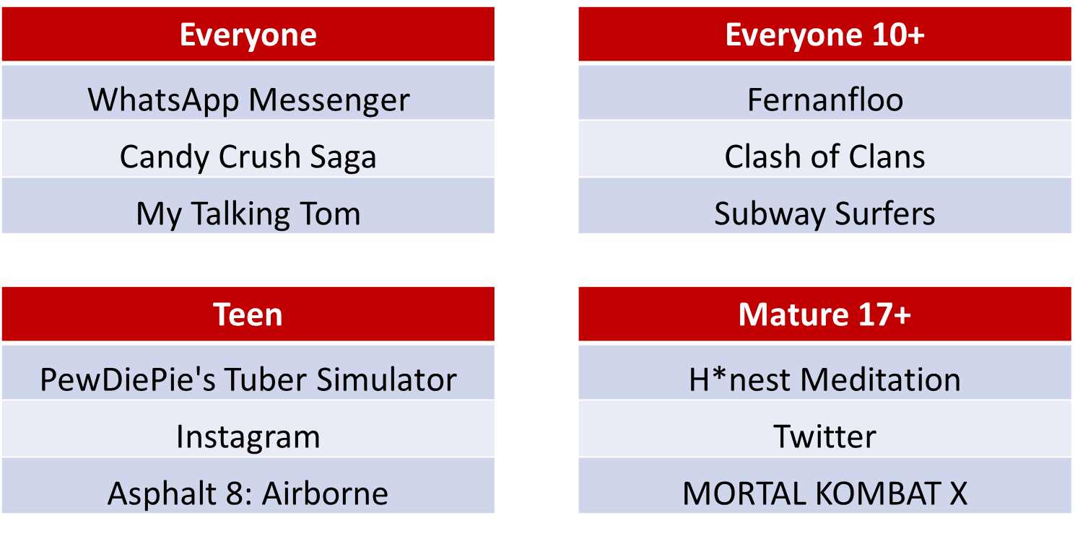
Most Profitable Apps by Content Rating (Google Play Store)
🍓

Slide 7
Genre
🍓

Slide 8
Most Profitable Genres for Each Store
🍓

Slide 9
Comparing Most Profitable Genres for Both Stores
🍓

Slide 10
Price Range
🍓

Slide 11
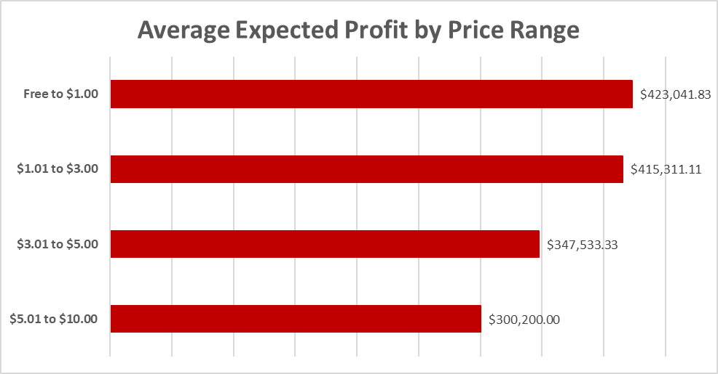
Most Profitable Price Ranges (Apps Common to Both Stores)
🍓

Slide 12
Most Profitable Apps by Price Range (Apps Common to Both Stores)
🍓
Free to $1.00
PewDiePie's Tuber Simulator
Geometry Dash Lite
Domino's Pizza USA
$1.01 to $3.00
*Cytus
H*nest Meditation
Where's My Water?
$3.01 to $5.00
Dr. Panda & Toto's Treehouse
Battleheart Legacy
F-Sim Space Shuttle
$5.01 to $10.00
The EO Bar
RollerCoaster Tycoon® Classic
My Movies Pro - Movie & TV Collection Library

Slide 13
The Bottom Line
🍓

Slide 14
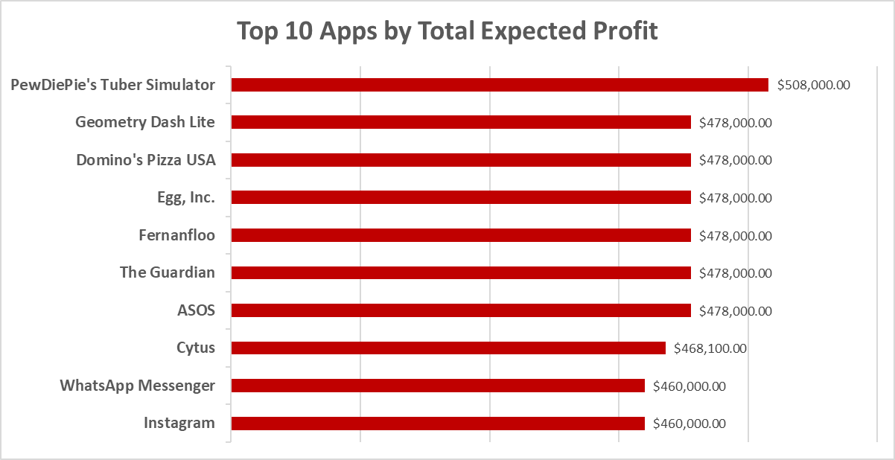

Most Profitable Apps (Common to Both Stores)
🍓
All apps are common to both the App Store and Google Play Store
Tie breaker by app’s review count
Maximum Profit: PewDiePie’s Tuber Simulator

Slide 15
Thank You, App Trader
🍓

