Slide 1
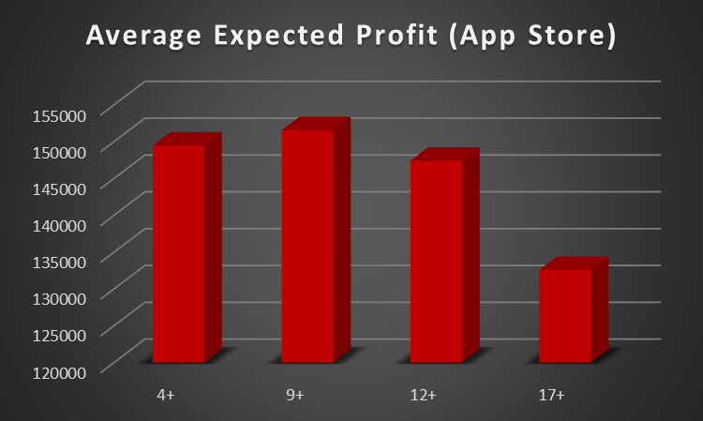
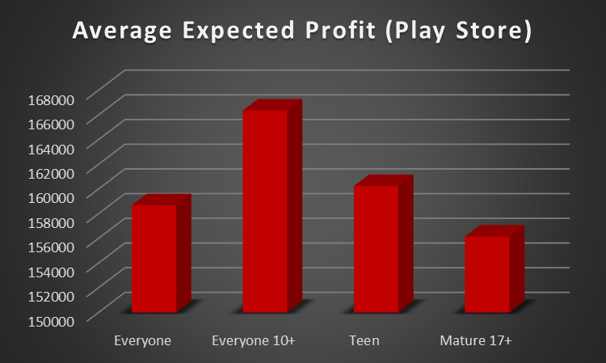
Average Expected Profit by Content Rating

Slide 2
Best Apps in Each Content Rating (App Store)
4+
Geometry Dash Lite
Domino's Pizza USA
Egg, Inc.
9+
PewDiePie's Tuber Simulator
Clash of Clans
Temple Run
12+
The Guardian
Instagram
Pinterest
17+
MORTAL KOMBAT X
WGT Golf Game by Topgolf
Swamp Attack

Slide 3
Best Apps in Each Content Rating (Play Store)
Everyone
WhatsApp Messenger
Candy Crush Saga
My Talking Tom
Everyone 10+
Fernanfloo
Clash of Clans
Subway Surfers
Teen
PewDiePie's Tuber Simulator
Instagram
Asphalt 8: Airborne
Mature 17+
H*nest Meditation
Twitter
MORTAL KOMBAT X

