Slide 1

Fantastic Five App Trader Recommendations
Iulia Goike Jasmine Drumright
Phil George
Scott Schriver
Notes:
Thank you App Trader for meeting with us today, we are Fantastic Five, (list names)

Slide 2
Fantastic Five App Trader Recommendations
Iulia Goike
Jasmine Drumright
Phil George
Scott Schriver
App Trader??
Notes:
Perhaps you could be our fifth member?

Slide 3
Presentation Overview
Criteria for App selection
Additional Criteria
Reasoning for Additional Criteria
Top 10 Apps Recommendation
App Selection
App Lifespan
App Revenue over Lifespan
General Recommendations and Guidance
Notes:
Just read the slide

Slide 4

Criteria For App Selection
Apps that App Trader owns rights to in both stores
Apps with average rating of 3.5 or higher
Apps with more than 100 reviews
Apps with a price <$1
Focusing on apps with the highest potential profit
Notes:
We are only looking at apps with the same name in both app stores.

Slide 5
Pertinent Calculations for App Performance
Estimated Application Lifespan
Years
Months
Patented Proprietary CalculationⓇ™
Estimated Spending
Cost of advertising the app over its lifetime
Estimated Revenue
Over app lifetime
Estimated Downloads
From both app stores as of today

Slide 6
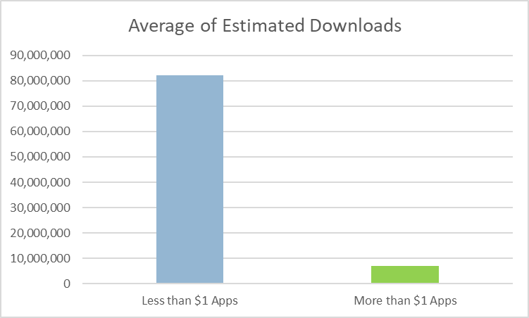
Focusing on Less Than a Dollar
Apps <$1 are estimated to be installed almost a dozen times more than paid apps*.
Our team will focus on <$1 applications
* - For the top 1000 apps by app_lifespan

Slide 7
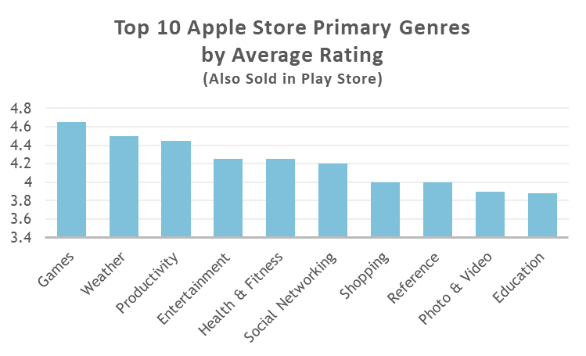
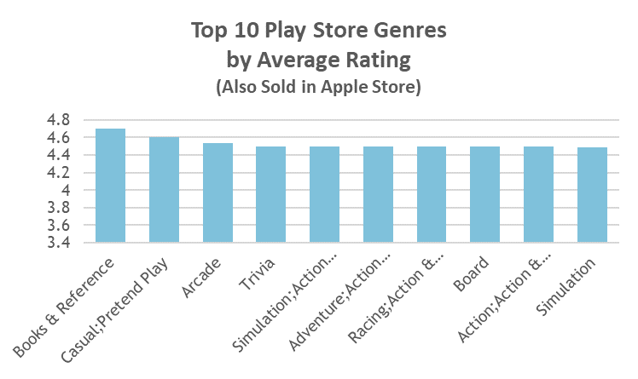
Recommendations - Popular Genres
With the exception of the Bible, the category of ‘Games’ is the most highly rated genre, on average.

Slide 8
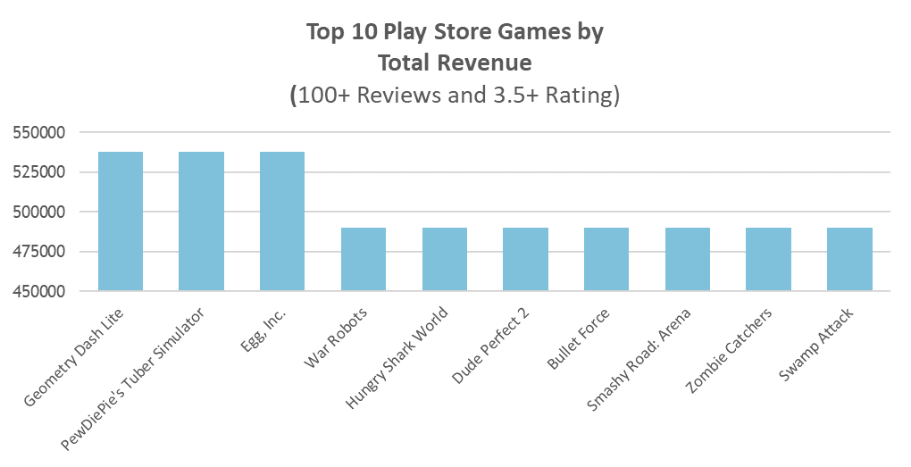
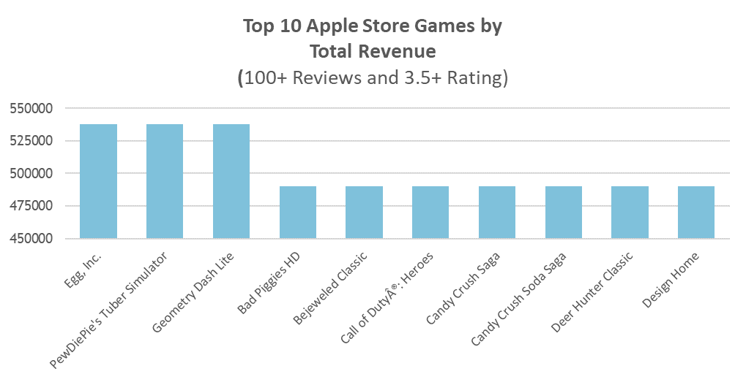
Recommendations - <$1 ‘Games’ Genre
Games are the majority of the top performers in both app stores
We recommend focusing on casual games
Most of the top games are rated “E” for everyone, which also appeals to the broadest group of customers

Slide 9
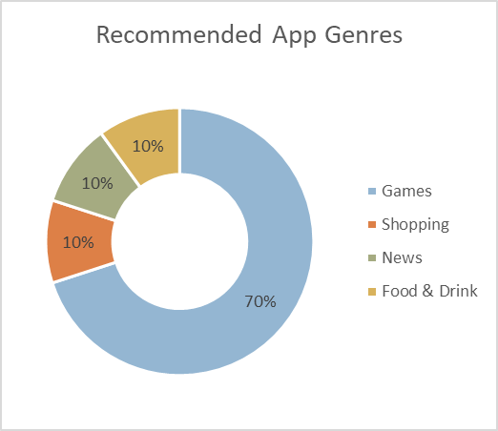
Our Top 10 App Recommendations
PewDiePie's Tuber Simulator
The Guardian
ASOS
Domino's Pizza USA
Egg, Inc.
Geometry Dash Lite
Fernanfloo
Solitaire (1)
Solitaire (2)
Clash of Clans
Notes:
People like games?

Slide 10
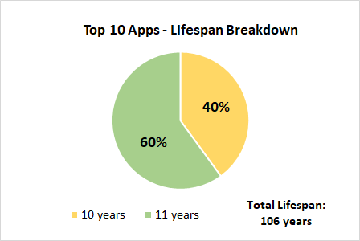
Top 10 Apps - App lifespan
11 Year Lifespan:
PewDiePie's Tuber Simulator
The Guardian
ASOS
Domino's Pizza USA
Egg, Inc.
Geometry Dash Lite
10 Year Lifespan:
Fernanfloo
Solitaire (1)
Solitaire (2)
Clash of Clans
Notes:
Lifespan = CAST(round((a.rating+p.rating)/2*2+1,1) AS int)

Slide 11
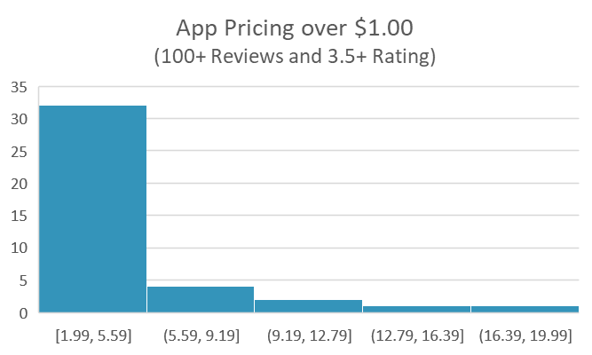
Recommendations - >$1 Apps
The majority of paid apps are less than $5.
The majority of apps over $1.00 would not exceed an App Trader purchase cost of $55,900
There are 230 free apps meeting these criteria costing $10,000

Slide 12
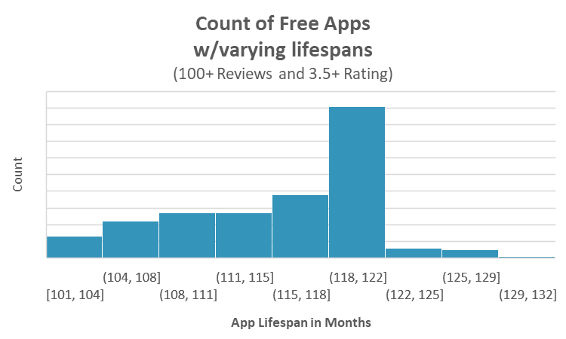
Recommendations - <$1 Apps
There are hundreds of very profitable apps that are less than a dollar or totally free.
The majority of our selections are casual games, as that is one of the most popular genre/type of application on both app stores.
Notes:
Fleshing this slide out still

Slide 13
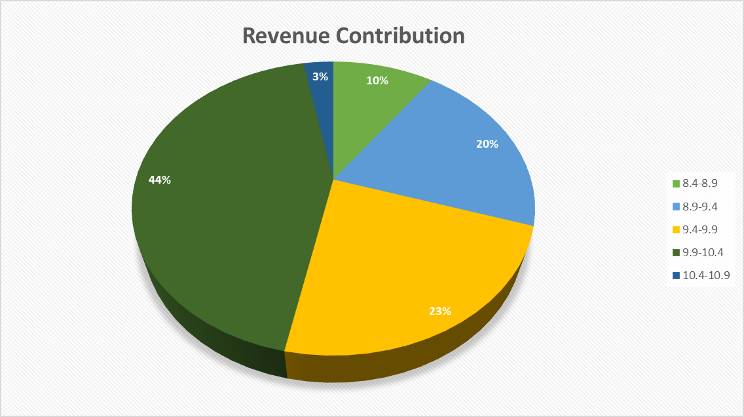
App Lifespan Revenue Contribution by Lifespan
Almost half of all applications less than $1 have a lifespan of ~10 years.
We will focus on the highest performing apps regardless of genre.
Notes:
I added the left chart to its own slide

Slide 14
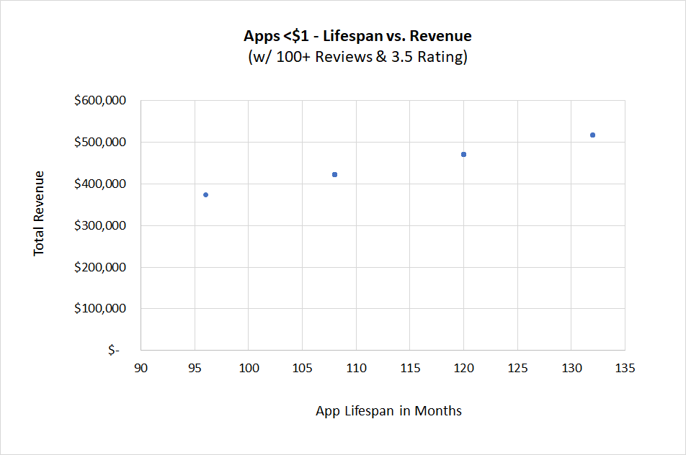
Recommendations - Lifespan vs. Revenue
There is a very consistent revenue stream for these free applications over the lifespan of the app.
Notes:
We plan on receiving a very consistent revenue stream with these low cost applications

Slide 15
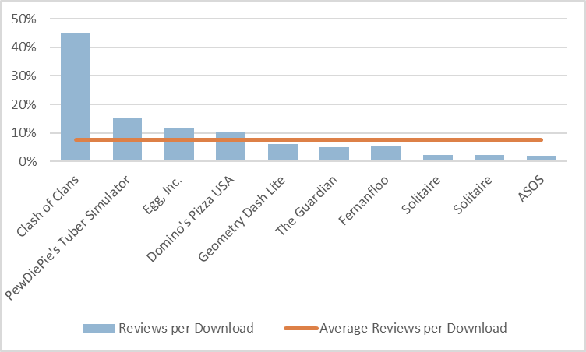
Most Reviewed Apps
Clash of Clans has a review per download almost 6 times higher than the average (7.6%)
This high ratio is prevalent in games that provide in-app incentive for review.

Slide 16
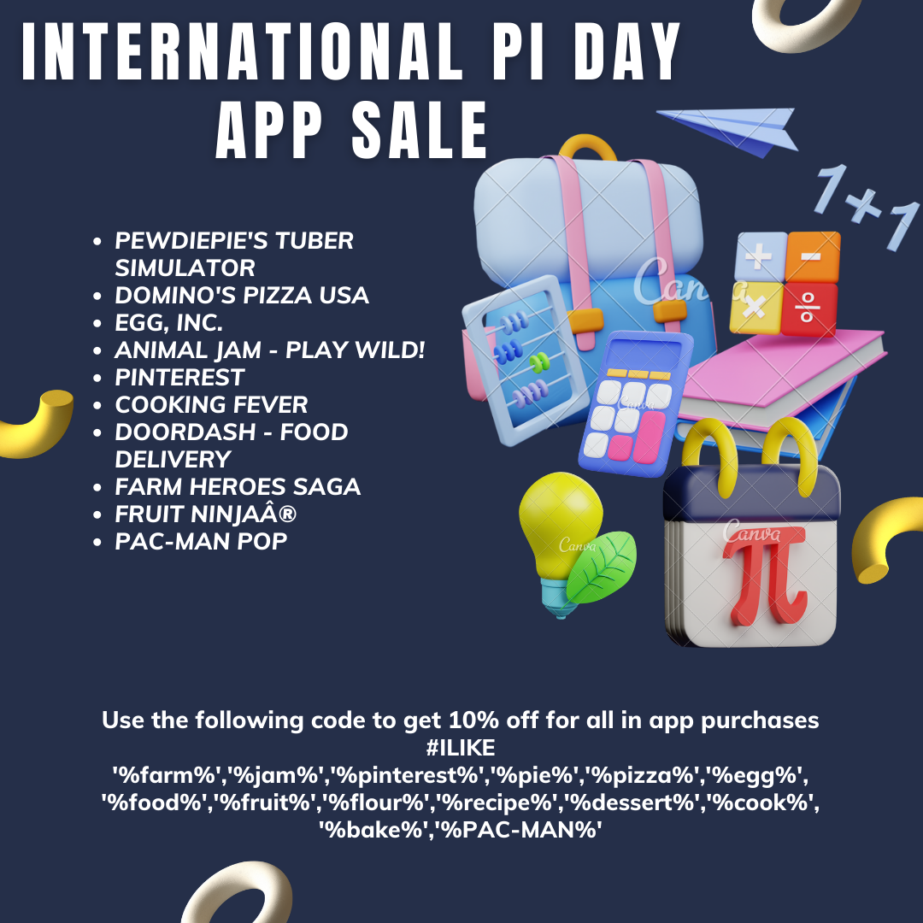
Notes:
Here we have a mockup of a previous iteration of a Pi Day promotion, our marketing team made this, etc. We will be able to slightly modify the app selection to better “theme” a holiday if requested by App Trader(?)

Slide 17
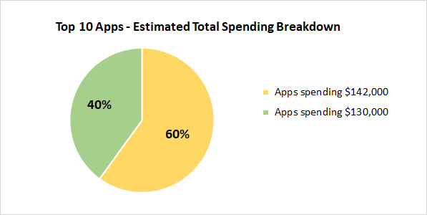
Top 10 Apps - Spending over app lifespan
Apps spending $142,000:
PewDiePie's Tuber Simulator
The Guardian
ASOS
Domino's Pizza USA
Egg, Inc.
Geometry Dash Lite
Apps spending $130,000:
Fernanfloo
Solitaire (1)
Solitaire (2)
Clash of Clans
Total Spending: $1,372,000
Notes:
Spending = Initial $10,000 to buy the app + $1,000 a month x lifespan in months

Slide 18
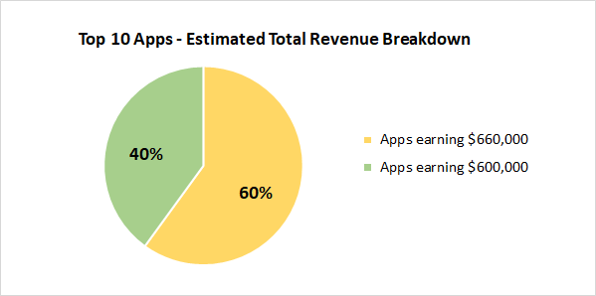
Top 10 Apps - Revenue over app lifespan
Apps earning $660,000:
PewDiePie's Tuber Simulator
The Guardian
ASOS
Domino's Pizza USA
Egg, Inc.
Geometry Dash Lite
Apps earning $600,000:
Fernanfloo
Solitaire (1)
Solitaire (2)
Clash of Clans
Total Revenue: $6,360,000
Notes:
Revenue = $5,000 from in-app ads and purchases x lifespan in months

Slide 19
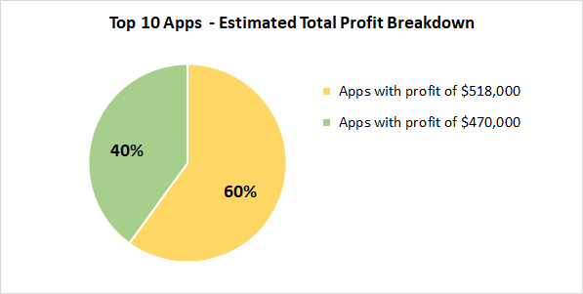
Top 10 Apps - Profit over app lifespan
App developers retain all money from users purchasing the app, and they retain half of the money made from in-app purchases.
Total Profit: $4,988,000
÷ 2
=
$2,494,000
App Trader final profit
Notes:
Profit = Revenue - Spending
Profit = ($5,000 from in-app ads and purchases x lifespan in months) - (Initial $10,000 to buy the app + $1,000 a month x lifespan in months)
Final Profit = Profit / 2

Slide 20

Questions & Further Discussion
This guy probably downloaded our recommended apps

