Slide 1
App Trader Recommendations:
The 10 Apps You Should Pursue This Pi Day
Presented by the X-Cel Men:
Lance Roller, Megan Grim, Rob Schulteis, Aurora Vickers, and Abi Inglis
Notes:
Welcome! :)

Slide 2
Important Considerations
Maximize revenues as compared to expenses
Profitability decreases as the purchase price increases
Maximize return on investment
Apps with a presence in both app stores are preferable due to the possibility of shared advertising costs
Maximize length of investment return period
Higher user ratings imply app longevity, and subsequently total profitability
Notes:
-profitability decreases as the purchase price increases, meaning that App Trader needs to be cautious when investing in apps with a higher price, since they will be spending more and it will take more revenue to offset the expense before profit can come.
-since App Trader gets twice the bang for their buck when they advertise an app that has a presence in both the App Store and the Play Store, the ROI (return on investment) would be much greater when investing in apps that have twice the potential client base by being available on both platforms.
-it’s important to keep an eye on user reviews and ratings of apps, because there is a direct correlation between the star rating of an app and the projected longevity of said app – the longer an app is viable and in-use, the longer App Trader has to profit off of the returns from their investment. <next slide>

Slide 3
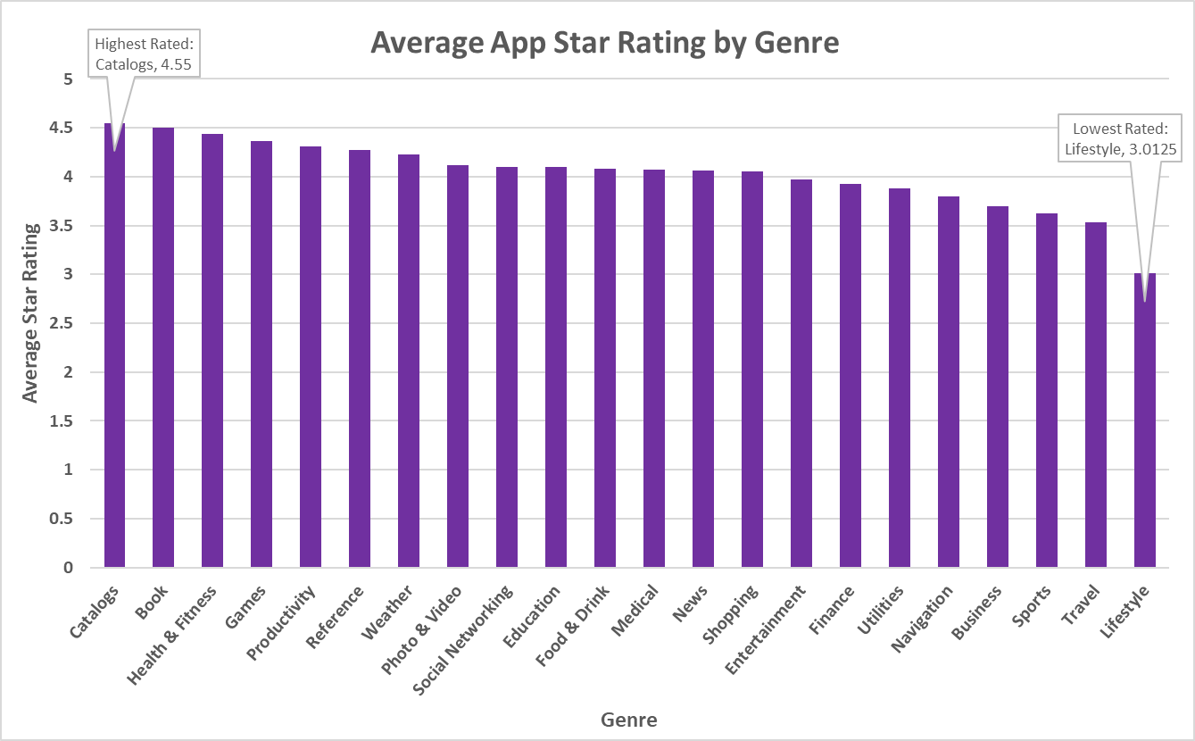
An Interesting Trend
Notes:
In our research and preparations, we did notice that some genres tend to perform better than others, and more notably, some categories tend to perform worse than others.
For example, lifestyle apps tend to have worse ratings, while catalog apps have the highest average rating of all the categories. This is interesting to consider, because app rating is a key indicator for projected longevity of an app, so it is reasonable to assume that a well-rated app category would have, in general, successful and long-lasting apps.
There are caveats here that are worth noting – each category has a different quantity of apps in the sample, which means outliers may affect some categories more than others – and similarly, some categories will have more reliable average figures than others. For example, the GAMES genre has about 6 times the quantity of apps in our sample than the next most populous category (Entertainment).
It is also worth noting that some categories perform well in one success test, but not in others. App Trader needs to consider lots of different metrics when making decisions on which apps to pursue. For example, Catalogs is the top-performing category based on this calculation, but this is not always the case. <next slide>

Slide 4
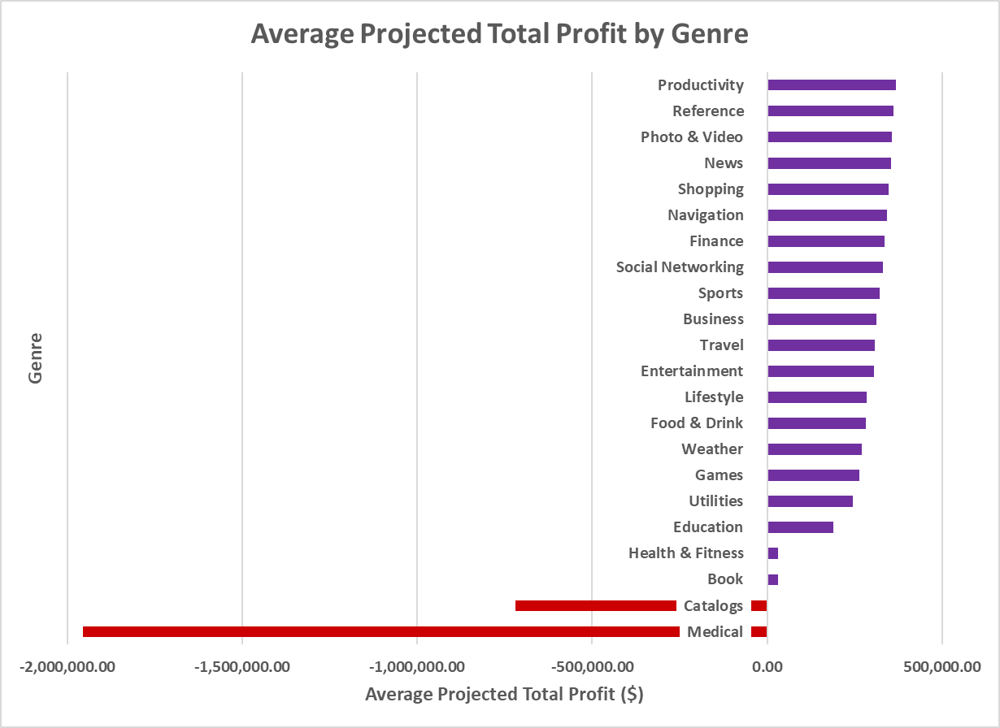
An Interesting Trend
Notes:
As you see here, Catalog apps – which was the highest-performing category in the previous slide in terms of average app rating – are one of the least profitable genres in terms of TOTAL projected profit throughout the predicted lifespan of the app. This calculation considers purchase/investment price, revenue, and longevity, and based on our calculations, apps in the catalogs and medical categories are predicted to have a net loss on average.
There is a balance when considering profitability – even if an app is well-reviewed and has a long lifespan, if it is expensive to the user (and to App Trader, by proxy), it will likely be unable to make up the revenue difference to cover the high expenses, making these apps not worth investing in. <change slide and speaker>

Slide 5
App Recommendations
Name
Total Projected Profit
Genre
PewDiePie's Tuber Simulator
The Guardian
Domino's Pizza USA
ASOS
Egg, Inc.
Geometry Dash Lite
Fernanfloo
Zombie Catchers
Narcos: Cartel Wars
Toy Blast
$418,000.00
$418,000.00
$418,000.00
$418,000.00
$418,000.00
$418,000.00
$380,000.00
$380,000.00
$380,000.00
$380,000.00
Games
News
Food & Drink
Shopping
Games
Games
Games
Games
Games
Games
Notes:
All of that being said, our calculations and analysis have led us to the list you see here as our top-ten recommendations of apps that App Trader should pursue.
[read and summarize table on slide]
You will likely note that a majority of these apps are games. Games was one of the higher-scoring categories in most calculations we ran, and was the category with the most entries in the sample, making the projections more reliable than other groups.

Slide 6

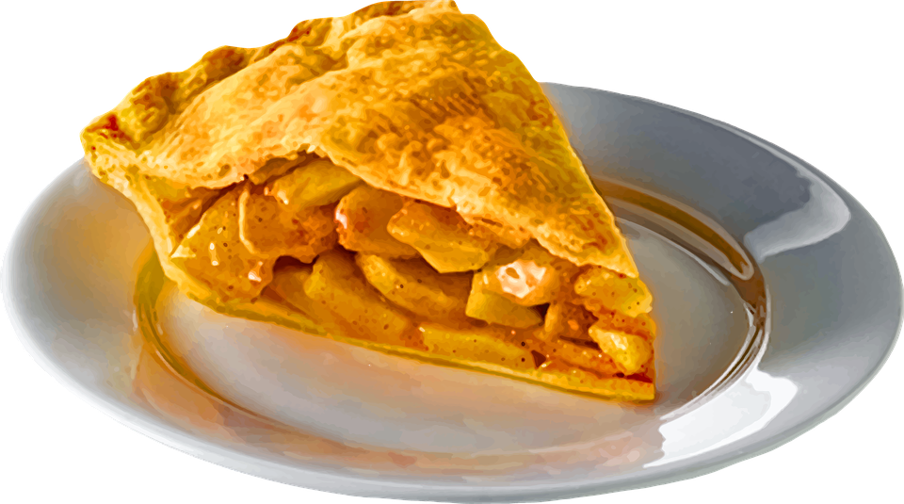


App Recommendations
Name
Total Projected Profit
Genre
PewDiePie's Tuber Simulator
The Guardian
Domino's Pizza USA
ASOS
Egg, Inc.
Geometry Dash Lite
Fernanfloo
Zombie Catchers
Narcos: Cartel Wars
Toy Blast
$418,000.00
$418,000.00
$418,000.00
$418,000.00
$418,000.00
$418,000.00
$380,000.00
$380,000.00
$380,000.00
$380,000.00
Games
News
Food & Drink
Shopping
Games
Games
Games
Games
Games
Games
Notes:
And, to boot, several of these apps have potential for fun pi-day spins! PewDiePIE, Domino’s pizza PIE, geometry uses the mathematical constant PI frequently… the possibilities are too good to pass up!

Slide 7
Decision-Making Process
Projected longevity
Average rating
Yearly profit
Average rating of primary genre
Minimizing advertising cost
Notes:
These 10 apps were determined from an equation that involved the projected longevity of the app based on a metric that was determined by the rating of the app multiplied by the app’s yearly profit.
Also considered in the determination of these 10 apps, was the average rating of the primary genre of the apps. These calculations were done on apps available in both stores, as that was a primary focus of App Trader to minimize advertising cost.

Slide 8
Other Considerations
Sample size
Growth/Trendability
Popularity
Target Population
Fun
Want/Necessity
Size of the App
App Permissions
Interoperability
Must like Pi/Pie (The food, mathematical constant, greek organization, book/movie (Life of Pi), or song/movie (American Pie))
Notes:
Sample size: Some apps may have high ratings/numbers due to a small sample size, so it’s important that we meticulously examines the details of those apps before choosing to invest in them.
Growth/Trendability: Is this app in a growing and/or trending industry where profitability and longevity is estimated to be higher than originally predicted? It’s also important be aware that trending apps can end up as fads and have a shorter longevity than predicted, so do your research when investing in one of these apps.
Target Population: We want to invest in an app that targets a wide audience and is appealing to all demographics.
Size of the App: Will the app take up alot of space on my device and/or make in run slower?
App Permission: Certain applications want permission to access certain things on a device which the user may or may not be comfortable with.
Want/Necessity: Does this app fulfill a want or need for the user.
Interoperability: The characterisitc of a product or system to work with other products and system (In this case computer software).

