Slide 1
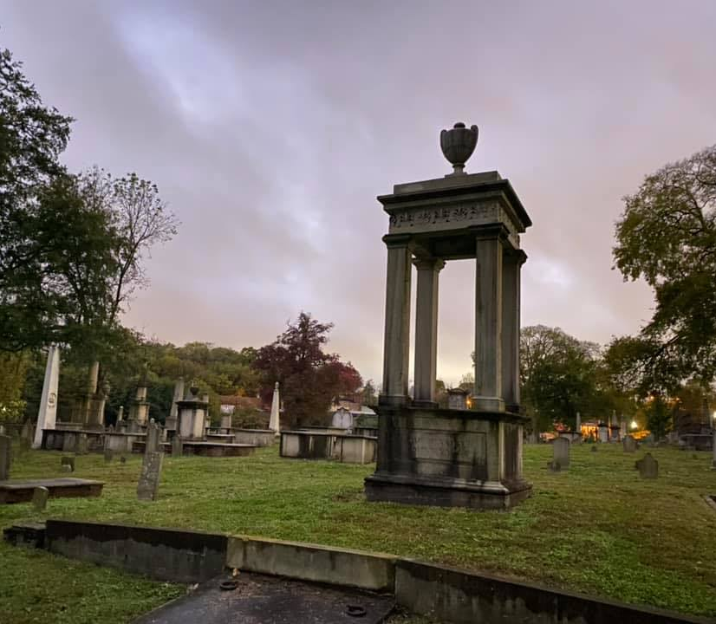
Nashville City Cemetery
Travel Guide: The better way to enjoy Nashville’s Historic Site

Slide 2
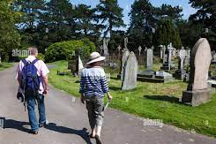
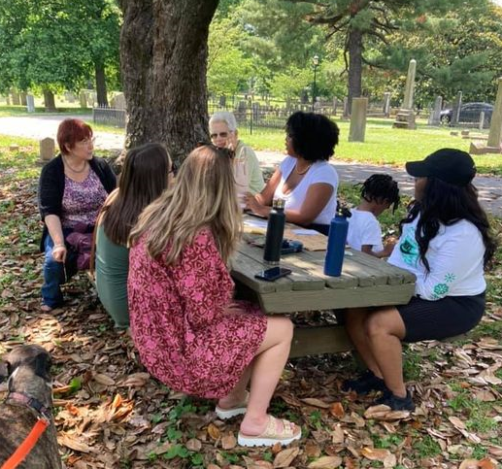

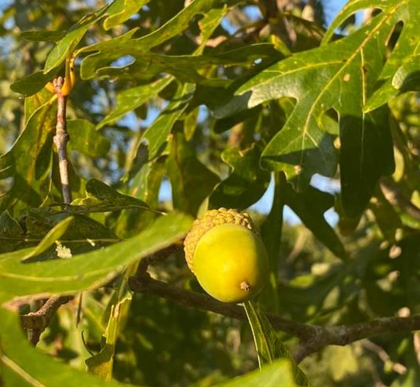

Choose an Experience
Take a Walk
History Tour
Volunteer
Nature Watch
Fun

Slide 3
Did you know?
It has maximum burials during the year 1864-1866 .Top causes are diseases like Tuberclosis,Cholera,Pneumonia and casualties due to Battle of Nashville.
It has nearly equal percentage of male and female tombs. To know more about notable Women at Cemetery ,join the special event Women of the Nashville City Cemetery
It includes the tombs of 22,000 people, 6,000 of whom were African Americans.
Notable Persons buried:
Nashville's founders, Tennessee Governor, Nashville Mayors and more
Robertson ,James - Father of Nashville
Bedford, Lucinda -Wealthiest African American woman

Slide 4
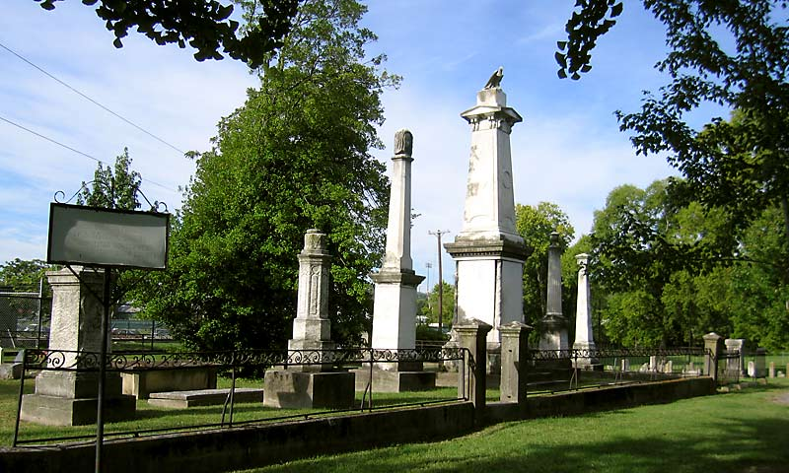
Thank You
Nashville City Cemetery Association, Inc. (thenashvillecitycemetery.org)

