Slide 1
Progress by Eligibility Category
Nashville Software School

Slide 2
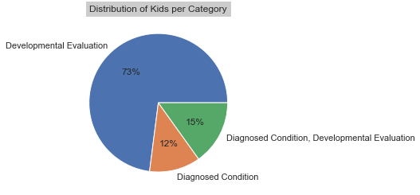
Summary
Kala to input chart/table for overall progress similar to summary tab excel just split by elig category
Notes:
- we’ll go into progress by individual evaluation scores from entry to exit points. i.e. social change, knowledge change, and appropriate action change.

Slide 3
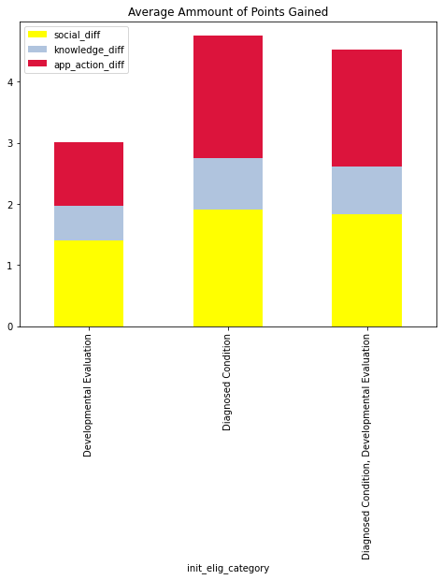
Increase by Eligibility Category
Notes:
Avg score increase per eligibility category. i.e. for developmental evaluation, we are saying that the children increased an average of 1.4 points from entry to exit for social change
Robert going to work on flip flopping the charts to have the elig categories be on the X axis and each chart represent a different evaluation category.

Slide 4
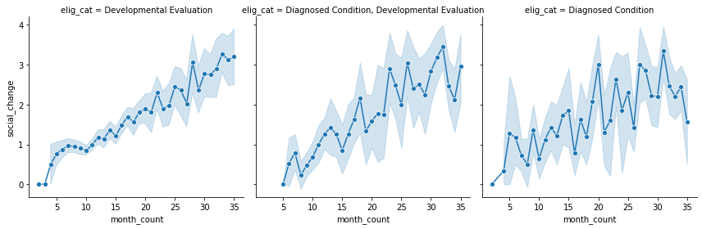
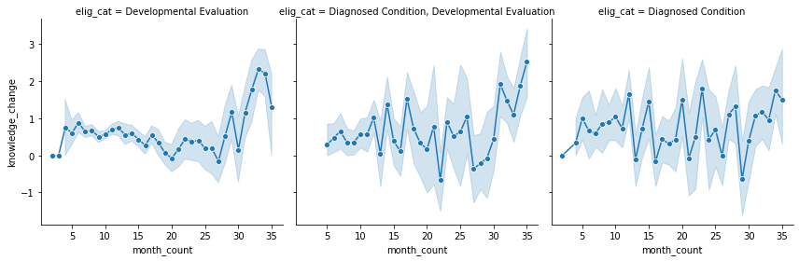
Time of Service Impact
3 groups of charts – based on testing category social, knowledge, app action
Notes:
How does time in service affect progress by evaluation category and eligibility category
- Adrianne to add trend lines to be more visually apparent if time in service correlates with positive/negative change

Slide 5
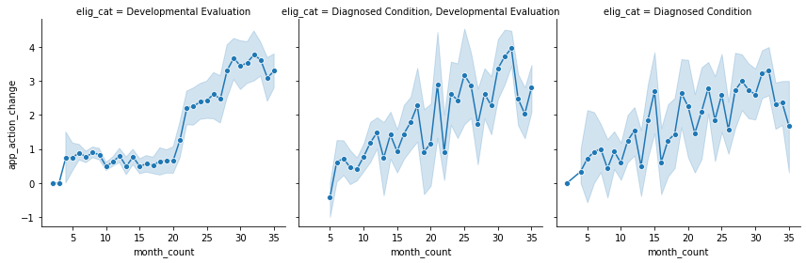
Time of Service Impact cont..

Slide 6
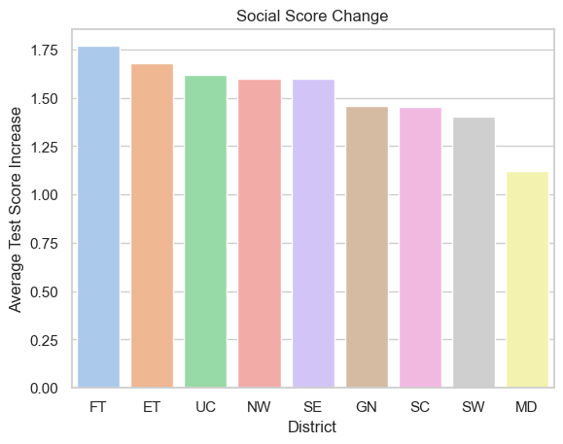
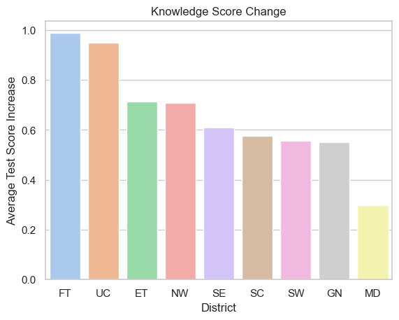
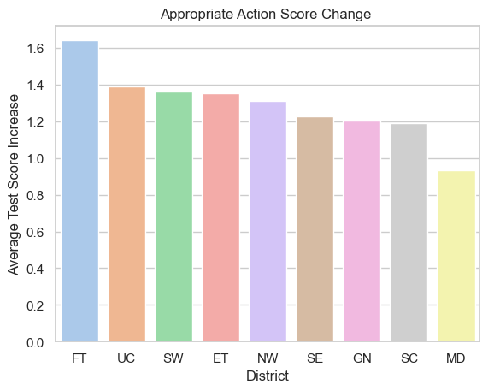
Change by POE
Amount of change based of of entry point
Average score increase (1-7 points) between entrance and exit score per POE. 3 charts one for each test (social, knowledge, app action). Jonathon to see if he can add value labels

Slide 7
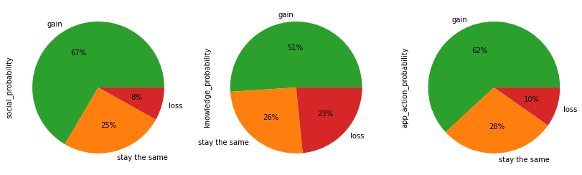
Probability for Progress

