Slide 1

If it’s July, please don’t die: PSA paid for by the Nashville Cemetery

Slide 2
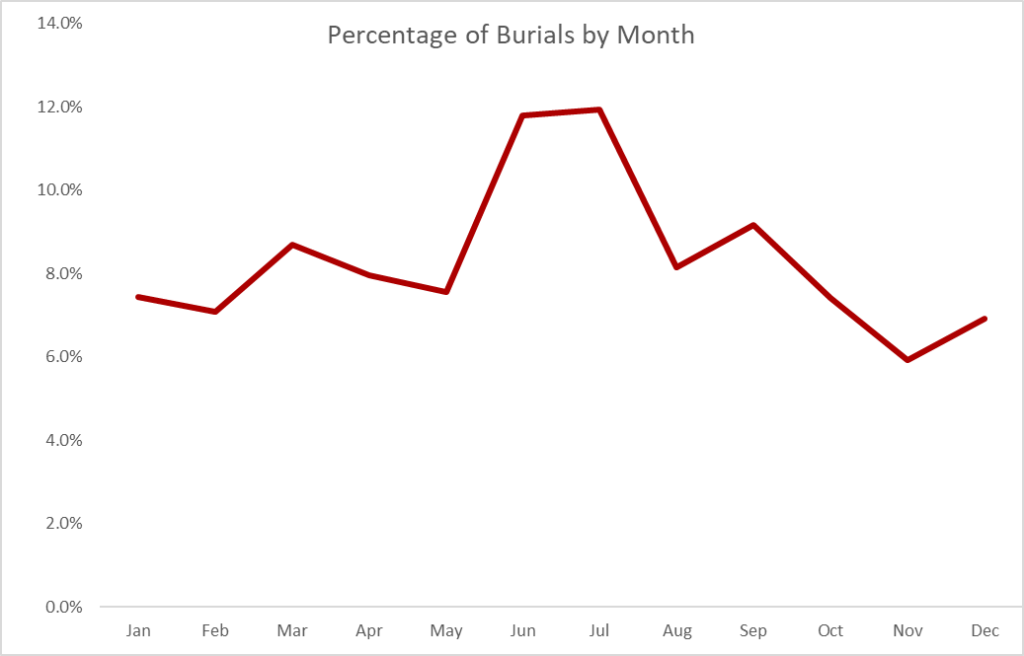
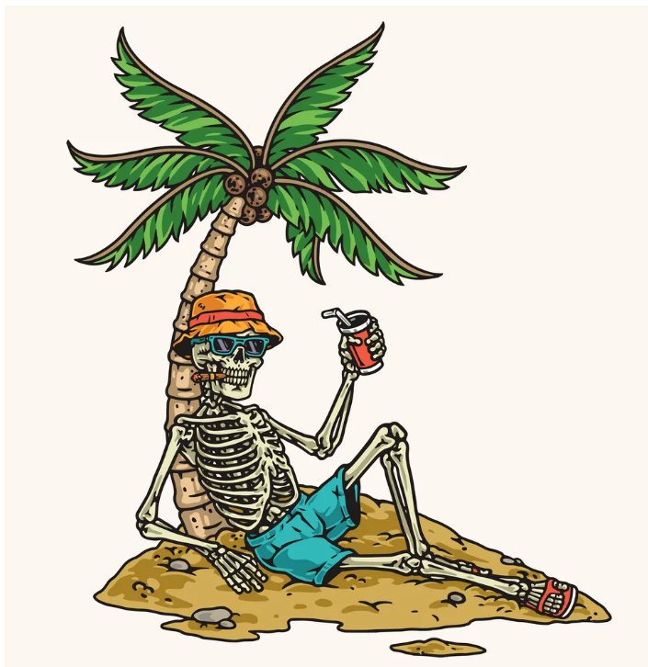
Summer-time, and the dying’s easy…

Slide 3

Remember to stay hydrated (with feces-free water)
Cholera is an acute diarrhoeal infection caused by ingestion of food or water contaminated with the bacterium Vibrio cholerae

Slide 4
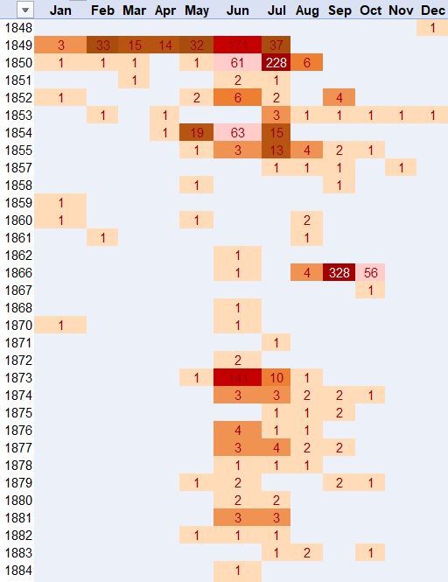
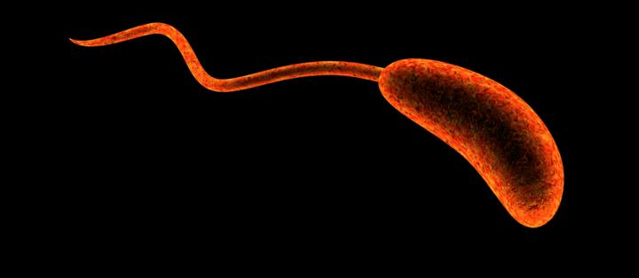
Cholera Deaths by Month
Outbreaks of cholera often come on in spurts
Some years are more explosive than others
Cholera is the #2 cause of death in Nashville’s history

Slide 5
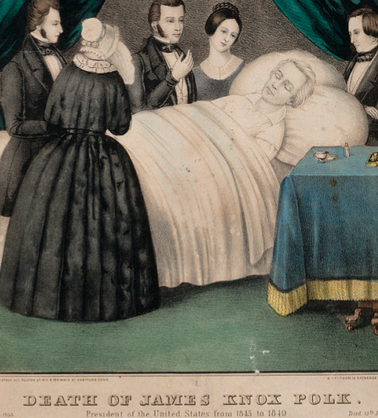
FUN CHOLERA FACTS!
FACT: Not only is feces-free water healthier for you, it also tastes better!
FACT: No one wants to wear a suit to a funeral outdoors during the summer.
FACT: President James K. Polk died in Nashville in June 1849, from cholera.
FACT: It’s surprisingly expensive to pay grave-diggers time-and-a-half during “busy season”.

Slide 6


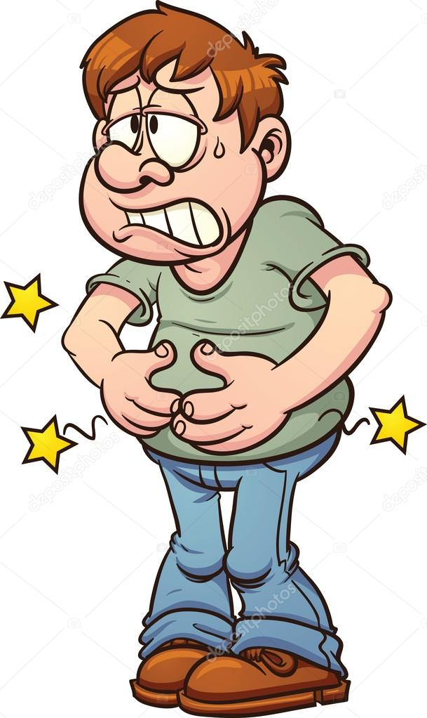
This Summer… THINK BEFORE YOU DRINK!

Slide 7
