Slide 1
The unnamed infants of Nashville
The Unnamed Interred Infants of Nashville City Cemetery

Slide 2
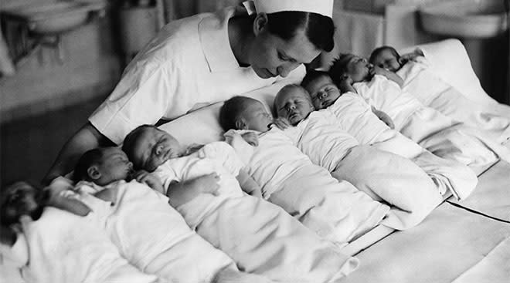
31% of the interred in Nashville City Cemetery are completely unnamed infants. From 1846 until 1916, there were 6,069 unnamed infants buried in the cemetery grounds. 99% of those were before 1875.

Slide 3
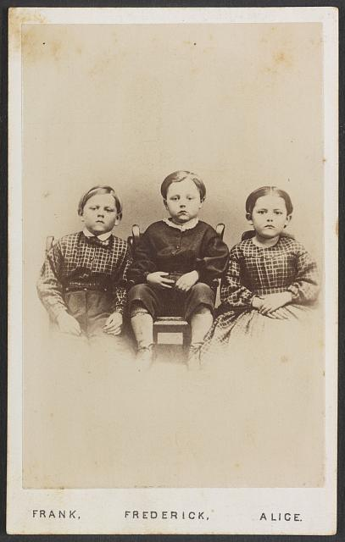
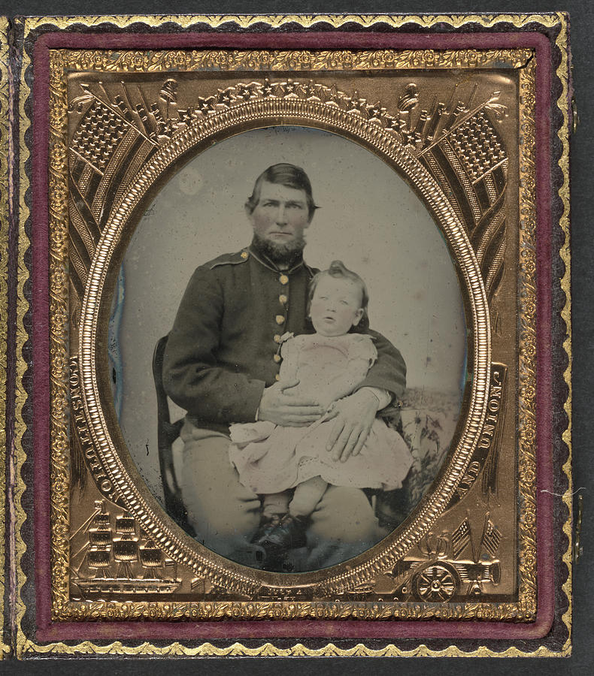
The total of the unnamed infants interred just during the Civil War alone was 1,879, or just under 1/3rd of the total unnamed infants, also accounting for 9.5% of the entire population of the cemetery. During the years of 1863-1865, 1,412 were buried.

Slide 4
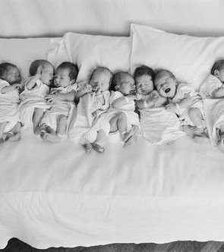

After 1874, these numbers drop sharply until ending completely in 1916. We believe this is likely due to more requirements for burials, and perhaps better recordkeeping.

