Slide 1

Scooters
Where? When? Why?
How Many?

Slide 2
Scooter Companies
Bird
Lime
JUMP
Bolt Mobility
Lyft
Spin

Slide 3
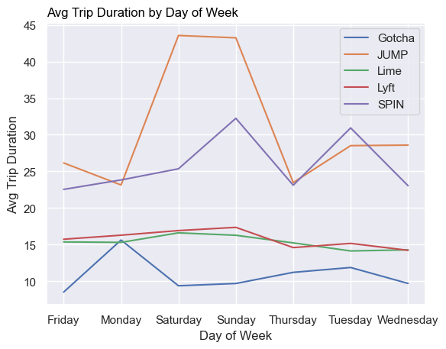
Avg Trip Duration by Week Day

