Slide 1
What are the unintended effects of the Civil War on disease?

Slide 2
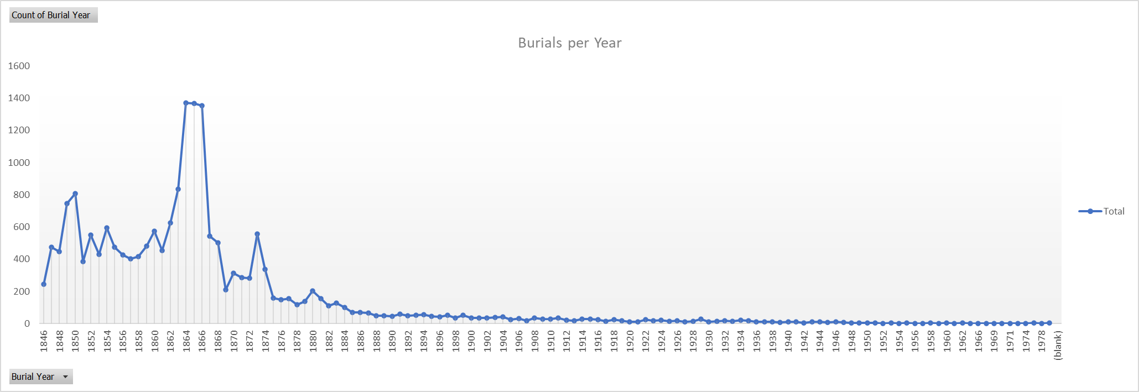

Slide 3
Civil War dates
April 12, 1861 – May 26, 1865
Franklin-Nashville Campaign December 15-16, 1864
https://americancivilwar.com/statepic/tn/Nashville-Tennessee-Civil-War.html
Estimated Casualties: 6,602 total (US 2,140; CS 4,462)
Unable to find list of soldiers contained within data
There should be 269 Confederates buried there. (https://thenashvillecitycemetery.org/civil-war-interments)
33,000 veterans, spouses, and dependents are buried at the Nashville National Cemetery (https://www.nps.gov/nr/travel/national_cemeteries/tennessee/nashville_national_cemetery.html)

Slide 4
