Slide 1
Marathons
Can’t Think of Sum Puns

Slide 2
 |  |  |  |  |  |  |  |  |  | Scott Wietecha - Next Fastest
Year | Race | Fastest | Fastest 25% (1st Quartile) | Median (2nd Quartile) | Fastest 75% (3rd Quartile) | Slowest | Mean | Beat Oprah | % Beat Oprah | Scott Wietecha
2016 | half_marathons | 1:11:15 | 2:08:18 | 2:26:18 | 2:50:11 | 4:54:41 | 2:31:57
2017 | half_marathons | 1:10:58 | 2:18:17 | 2:39:34 | 3:05:10 | 6:18:24 | 2:43:59
2018 | half_marathons | 1:09:25 | 2:07:21 | 2:25:32 | 2:51:16 | 4:48:06 | 2:31:46
2019 | half_marathons | 1:10:03 | 2:07:04 | 2:26:07 | 2:51:30 | 5:03:35 | 2:32:07
2016 | marathons | 2:25:42 | 4:13:00 | 4:45:19 | 5:22:01 | 7:00:00 | 4:47:48 | 1099 | 37.20% | 0:09:01
2017 | marathons | 2:40:25 | 4:29:30 | 4:58:14 | 5:22:44 | 6:38:19 | 4:54:26 | 615 | 24.90% | 0:16:03
2018 | marathons | 2:28:16 | 4:12:54 | 4:48:21 | 5:23:41 | 6:34:41 | 4:48:23 | 756 | 36.00% | 0:01:36
2019 | marathons | 2:34:59 | 4:07:56 | 4:41:57 | 5:15:29 | 6:43:55 | 4:42:09 | 793 | 39.20% | 0:00:25
Overall | half_marathons |  |  | 2:29:38 |  |  | 2:35:15
Overall | marathons |  |  | 4:48:53 |  |  | 4:48:27

Slide 3
Dibran vs. Oprah
Dibran ran in the 2016 half marathon.
How does his race time compare to Oprah?
Compare Dibran’s half marathon time to Oprah’s time if she had competed in the 2016 marathon.
Name |  | Distance | Placement | Pace (time/mi) | 2016 Average Pace | 2016 Median Pace | 2016 Number of Runners
Dibran Rexhepi | 2:08:35 | 13.1 | 25.30% | 0:09:49 | 0:11:36 | 0:11:10 | 17917
Oprah Winfrey | 4:29:20 | 26.2 | 37.20% | 0:10:17 | 0:10:59 | 0:10:53 | 2952

Slide 4
2017 Marathon Weather
2017 Marathon was run on an unusually hot day in Nashville
April 29th, 2017: high of 91ºF and 73ºF with 84% humidity at start time
April 30th, 2016: high of 75ºF and 57ºF with 78% humidity at start time

Slide 5
2016 vs 2017
218 runners ran marathon in both years
2016 average: 4:38:41 (vs. 4:47:48 overall)
2017 average: 4:52:19 (vs. 4:54:26 overall)
 | count | 2016 average | 2016 Percentile | 2017 average | 2017 Percentile | average difference
faster in 2017 | 68 | 5:07:54 | 0.67 | 4:41:50 | 0.33 | -0:26:04
faster in 2016 | 150 | 4:25:26 | 0.34 | 4:57:04 | 0.49 | 0:31:38

Slide 6
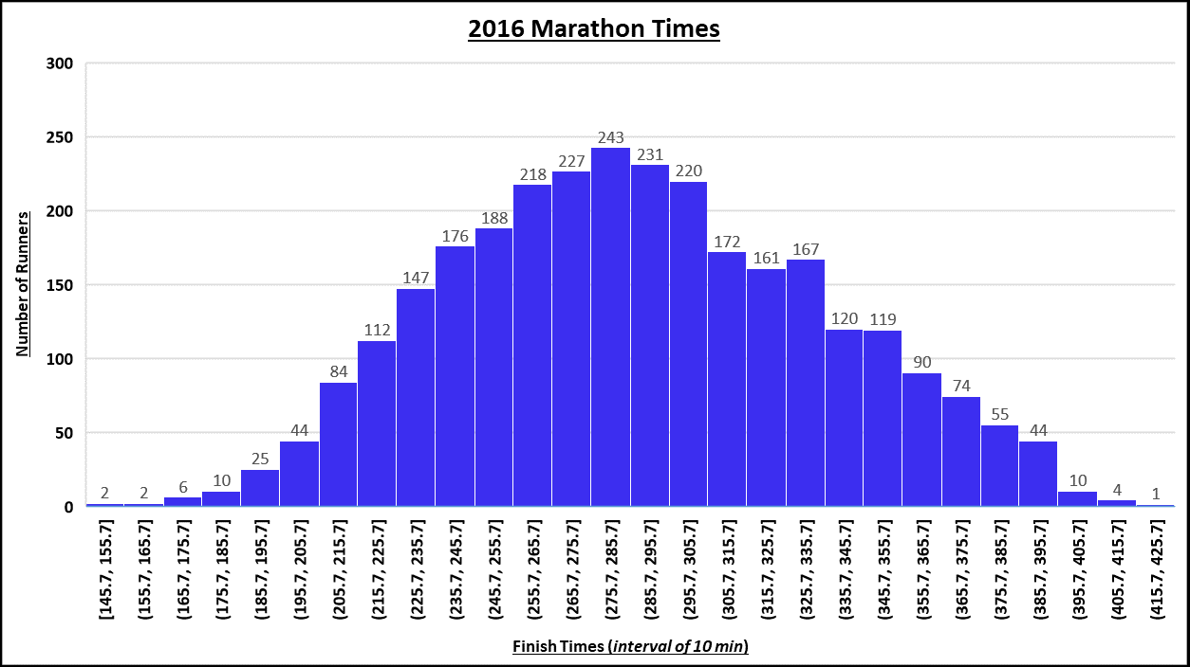
Notes:
Mean 287.8 mode 293.9

Slide 7
