Slide 1

Analytics Jumpstart
Joining Dataframes
Nashville Software School

Slide 2
For today
More pandas
Merging vs Concatenating
Aggregating

Slide 3
df.groupby(col) – groups the DataFrame by the specified column
df.groupby(col).size() – groups by a column and gets the size of each group
df.groupby([col_a, col_b]).agg(func) – groups the DataFrame by col_a and col_b, then performs the specified aggregation function on each group
df.reset_index() – useful for resetting the index after aggregation (moves the aggregation column from the row index to a column and uses zero-based row indexing)
Notes:
The pandas data frame `groupby()` function lets you group your data frame by one or more columns so that you can perform aggregations functions for each group. Examples of aggregation functions might be counts, averages, or sums. If you save your resulting data to a new data frame, it is often helpful to reset the index.

Slide 4

Get Data 🡪 Process + Clean Data 🡪 Exploratory Data Analysis
Merging two DataFrames:
pd.merge(<df1>, <df2>, on = <col or list of cols to join on>, how = <join_type>)
Same concept as a SQL join
Notes:
The way you combine data frames depends on the data frames you are joining and your intent. (whiteboard example) For data frames that have one or more columns in common, where you want to join them by the common column(s) or key, use the pandas merge function. Specify the common key to join on using the `on` argument (use `right_on` and `left_on` if the column names are different) and tell pandas what kind of join with the `how` argument.
If you simply want to paste one data frame to another (row-wise or column-wise) use the pandas `concat` function. In this slide, 3 data frames – all with the same columns – are concatenated into one.

Slide 5
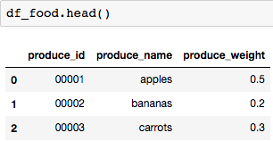
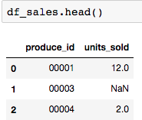
DataFrame A
DataFrame B

Slide 6
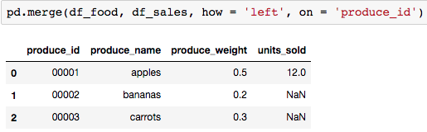
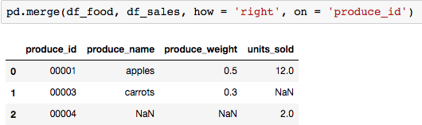
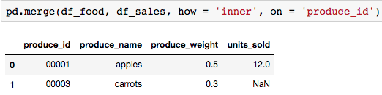
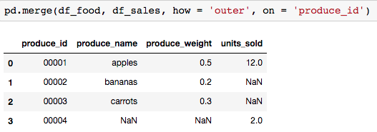
Left Join - Keep A, Match B
Right Join - Keep B, Match A
Inner Join - Keep Matches
Outer Join - Keep Everything

Slide 7
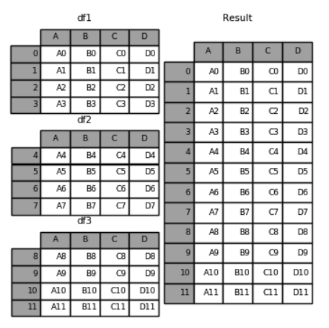
Concatenating two DataFrames:
pd.concat([<df1>, <df2>, <df3>])
Same columns
Like pasting them together

Slide 8
Questions?

