Slide 1
Analytics Jumpstart
Introduction

Slide 2
Mahesh Rao, Instructor/Data Scientist at Amira Learning
Justin Rothbart, Instructor/Data Analyst at Ingram Content Group
Mary van Valkenburg, Instructor/Program Manager at NSS

Slide 3
Your name
The place you call home
Something people are usually surprised to discover about you

Slide 4
Classroom guidelines
Ask lots of questions
Help each other; learn from each other
Get comfortable with discomfort. Making mistakes, figuring them out, and then correcting them is part of the learning process
After working through the assignment, form your own ideas and do your own exploration beyond what has been suggested

Slide 5
Class format
Concepts/Code Lecture
Coding practice
Interactive with instruction team and other students!

Slide 6
Goals for the class
Get hands-on experience of what it might be like to work as a data analyst or data scientist
Get an idea of whether or not this might be a good fit for a career
Learn some tools to help you on personal analysis projects
Make discoveries and have fun

Slide 7
Goals for today
Define the Data Science Process – a basic mental model for analysis
Define different types of analytics and differentiate between Data Analytics and Data Science
Jupyter Notebook walkthrough/orientation
Analysis Guide walkthrough
Get started on the project!

Slide 8
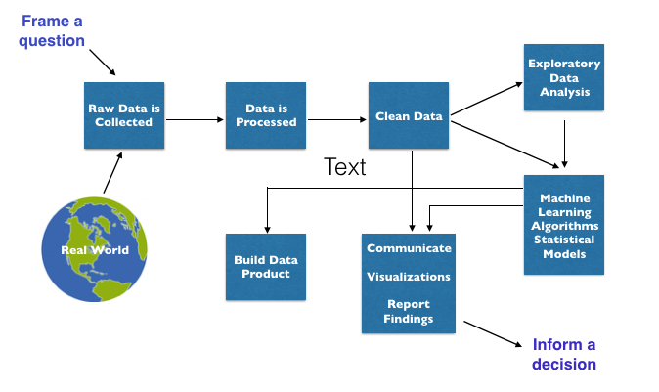
The Data Science Process
Notes:
Starts (ideally) with a question. Get data, process + clean data, explore + get to know the data really well, communicate findings, build a model, test a hypothesis.

Slide 9
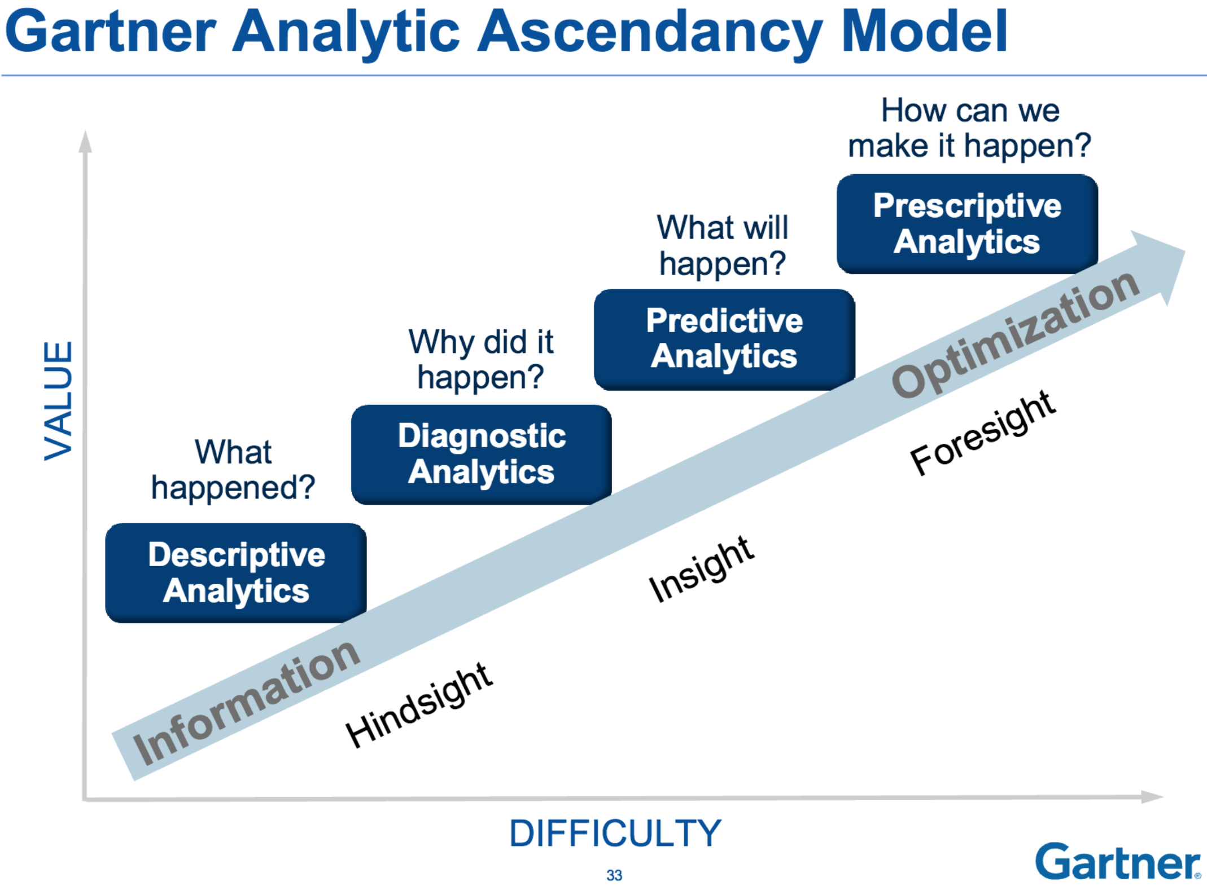
Data Science
Data Analysis
Notes:
Data Analysts generally focus on what has happened in the past, using descriptive analytics to describe what happened and diagnostic analytics to explain why it happened. Data Scientists are additionally future-focused. They are generally responsible for predictive analytics and prescriptive analytics to predict and shape what will happen.

Slide 10
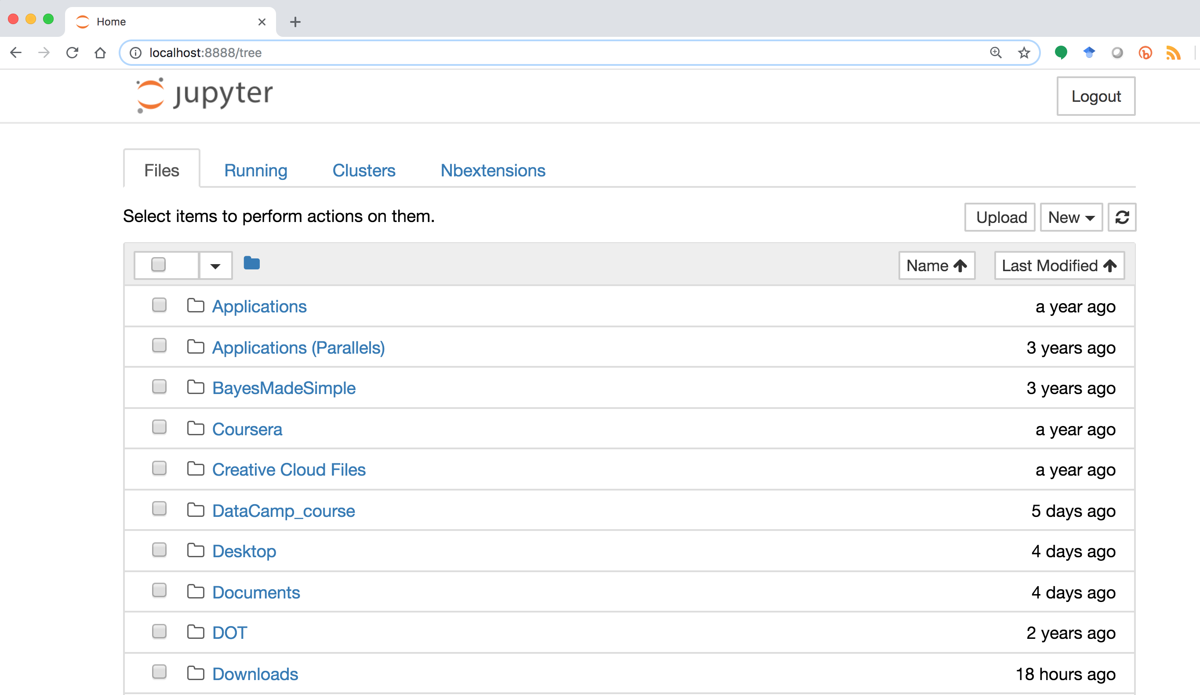
Notes:
Launch a jupyter notebook and follow along as we look at the parts of the notebook server. This is the files tab. It shows your computer’s directory structure like finder on mac or explorer on windows.

Slide 11
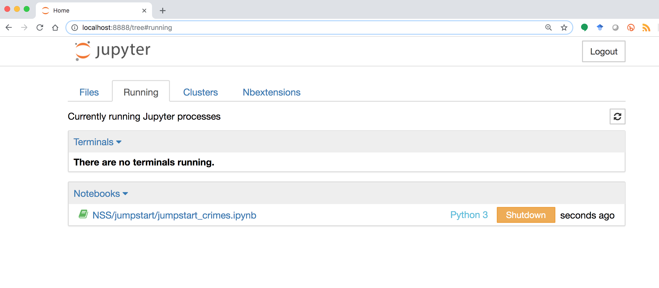
Notes:
You can look at the `Running` tab to see what notebooks are currently running. This is where you will go if you want to shutdown a single notebook and not the entire notebook server.

Slide 12
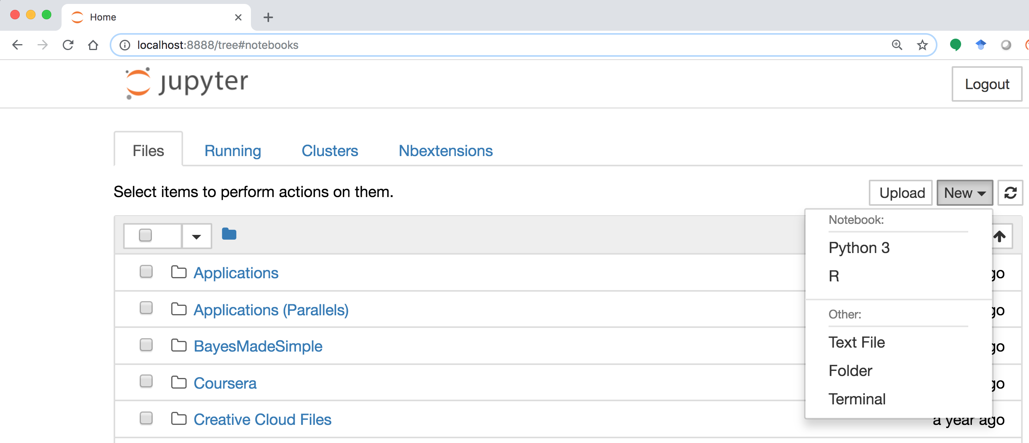
Notes:
Use the `New` menu to launch a new notebook.

Slide 13
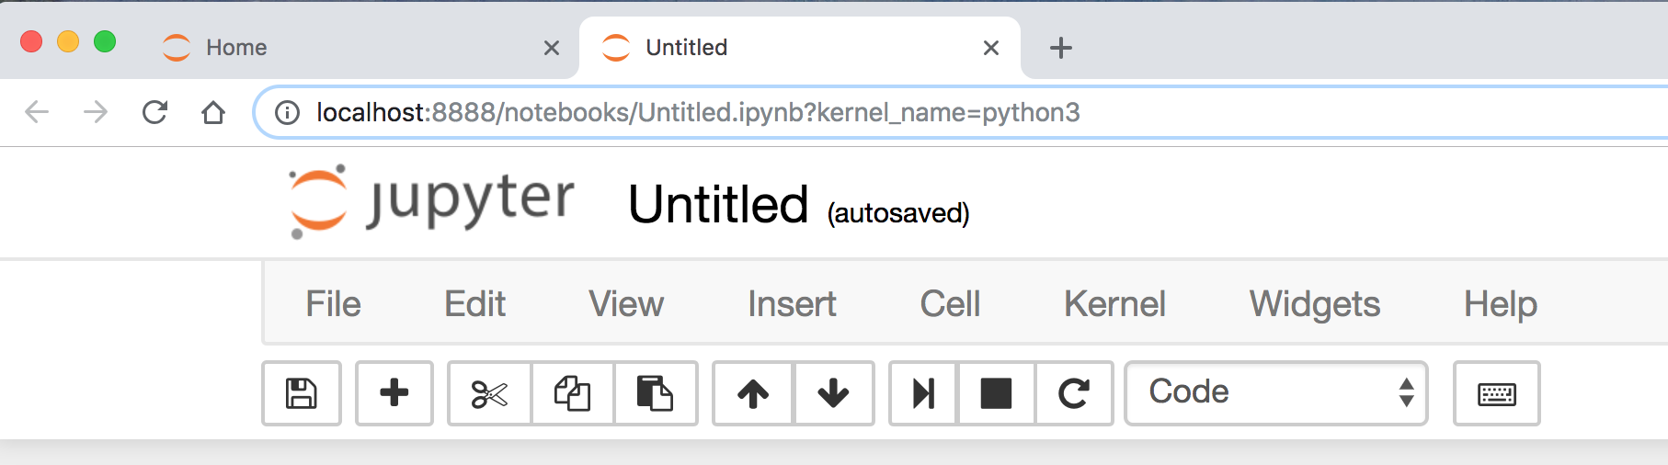
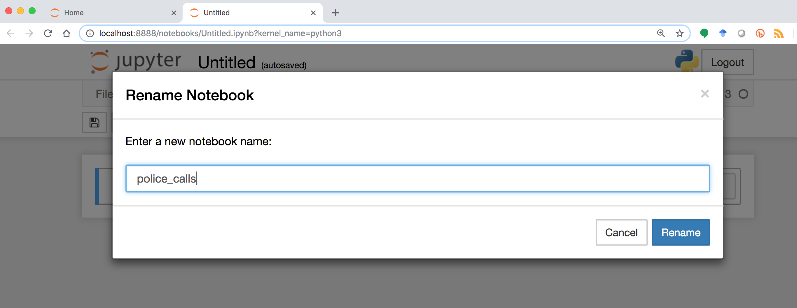
meaningful
no spaces

Slide 14
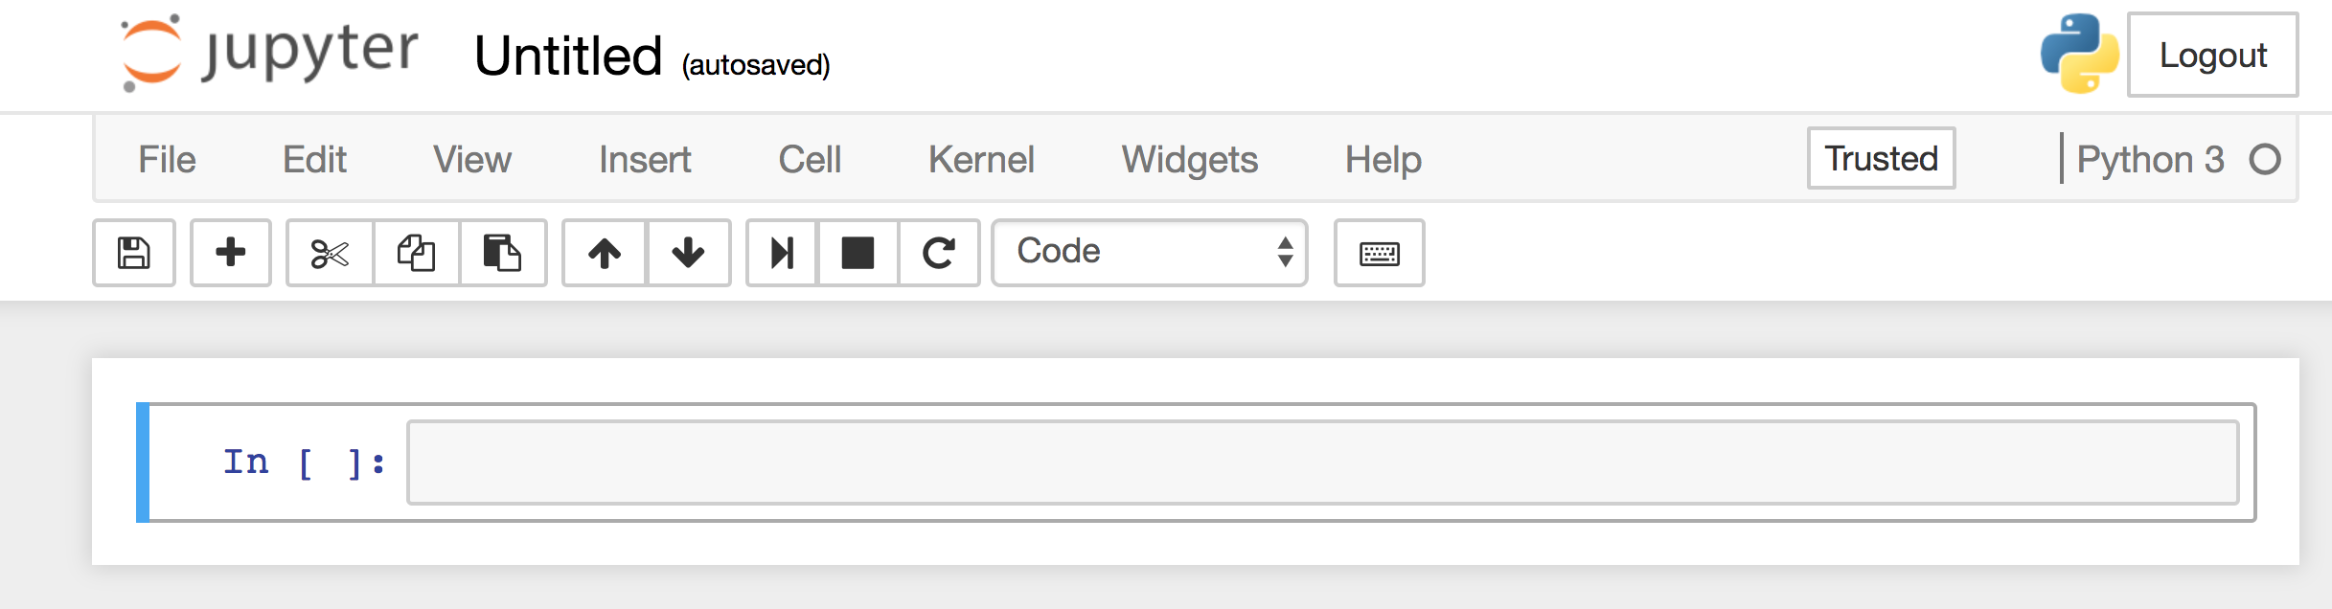
run cell (shift + enter)
save add cell cut cell
move cell (up/down)
toggle between markdown and code
Notes:
Here are some of the basic operations you can do.

Slide 15
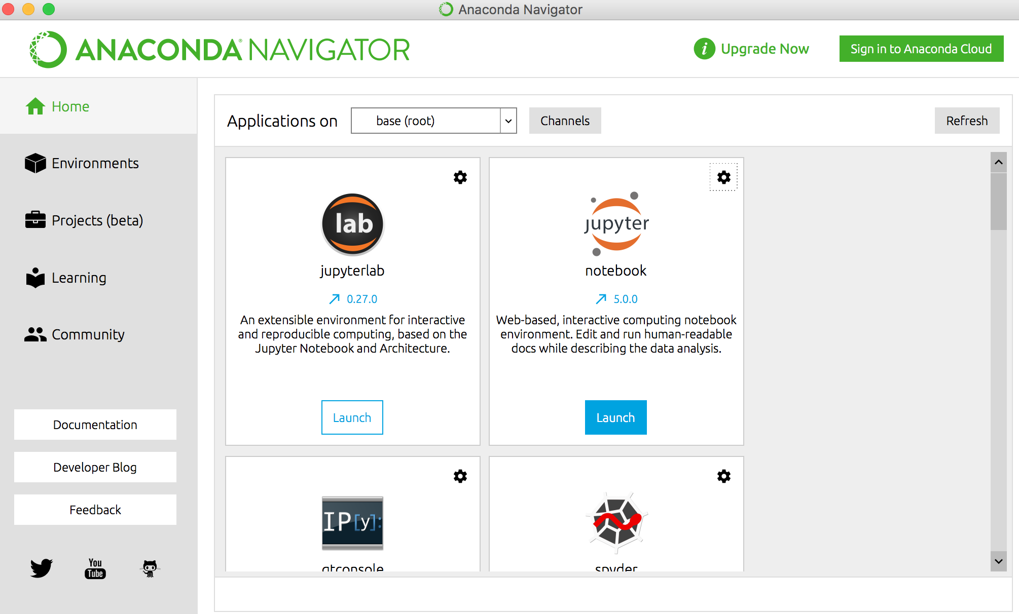
Open Anaconda Navigator and launch Jupyter

Slide 16
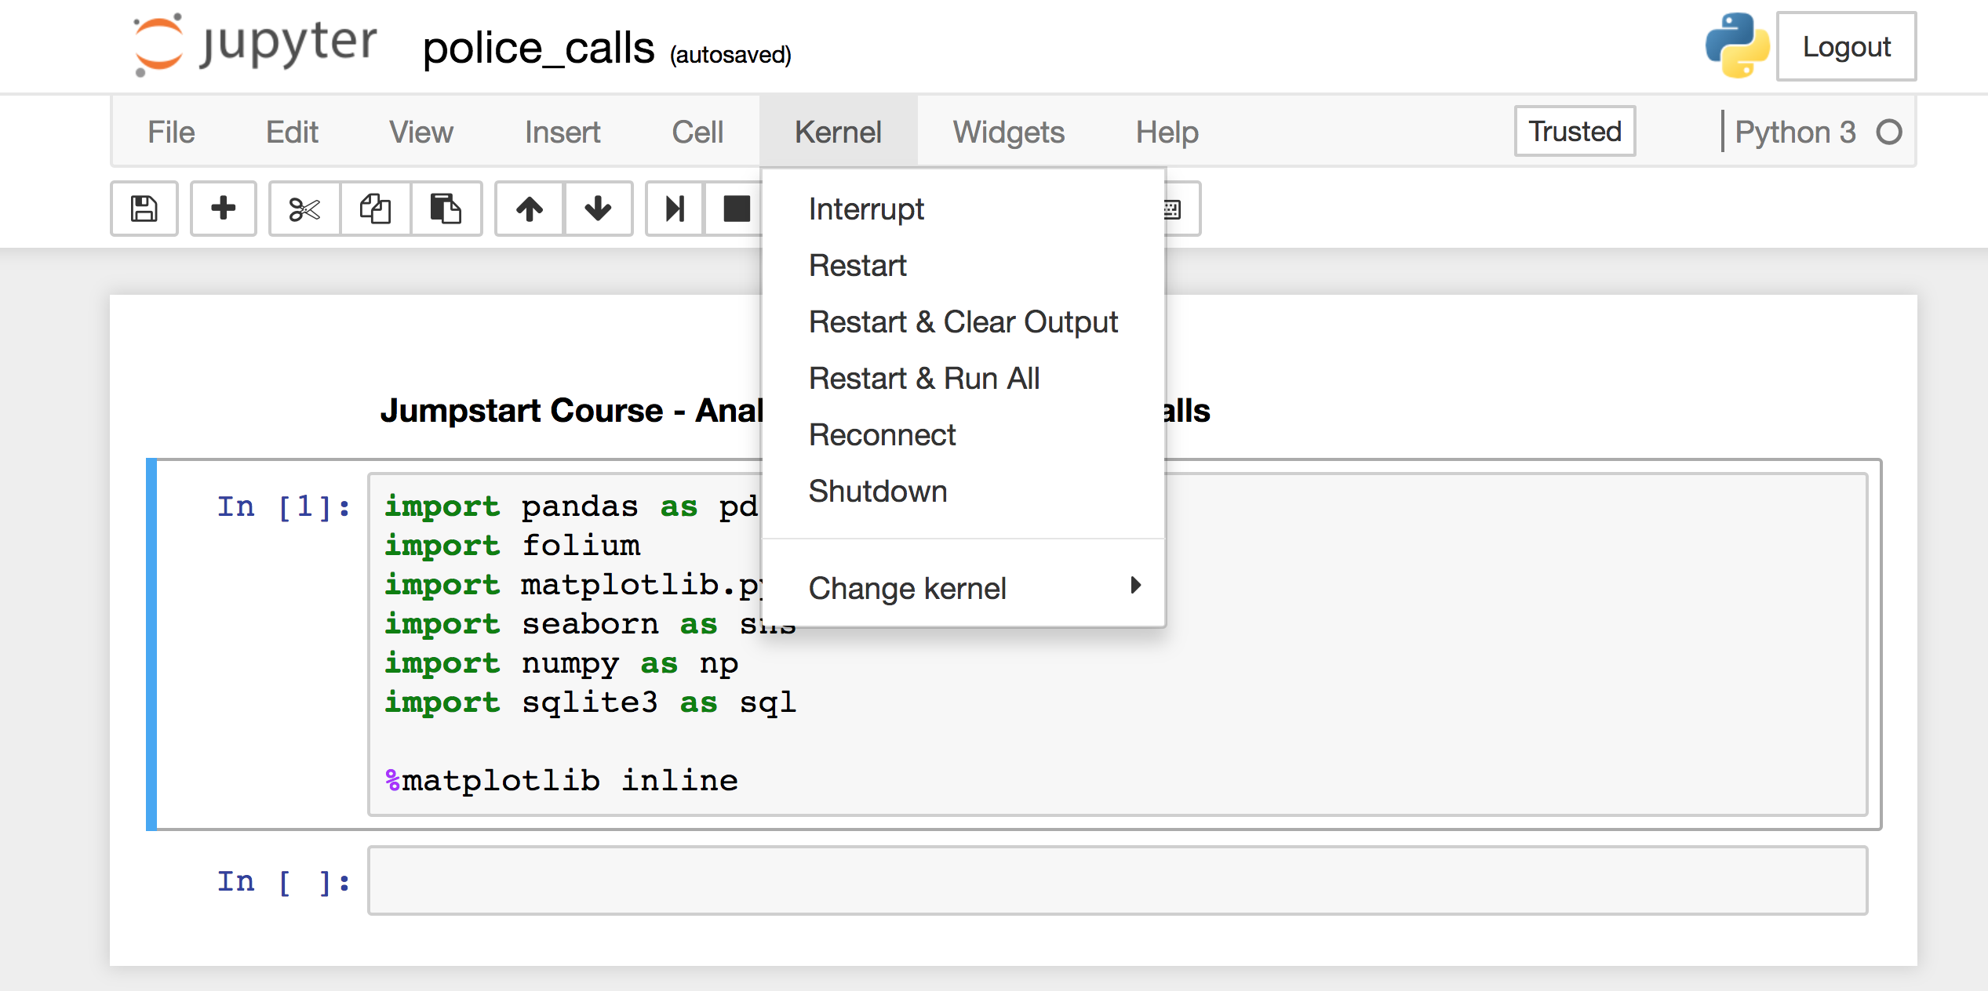
Notes:
If your notebook seems to be running longer than it should be or seems hung up, you can either interrupt the kernel/notebook here or restart it.

Slide 17
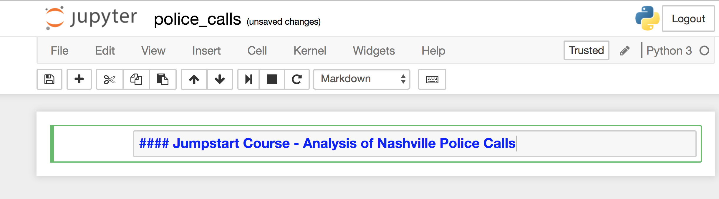
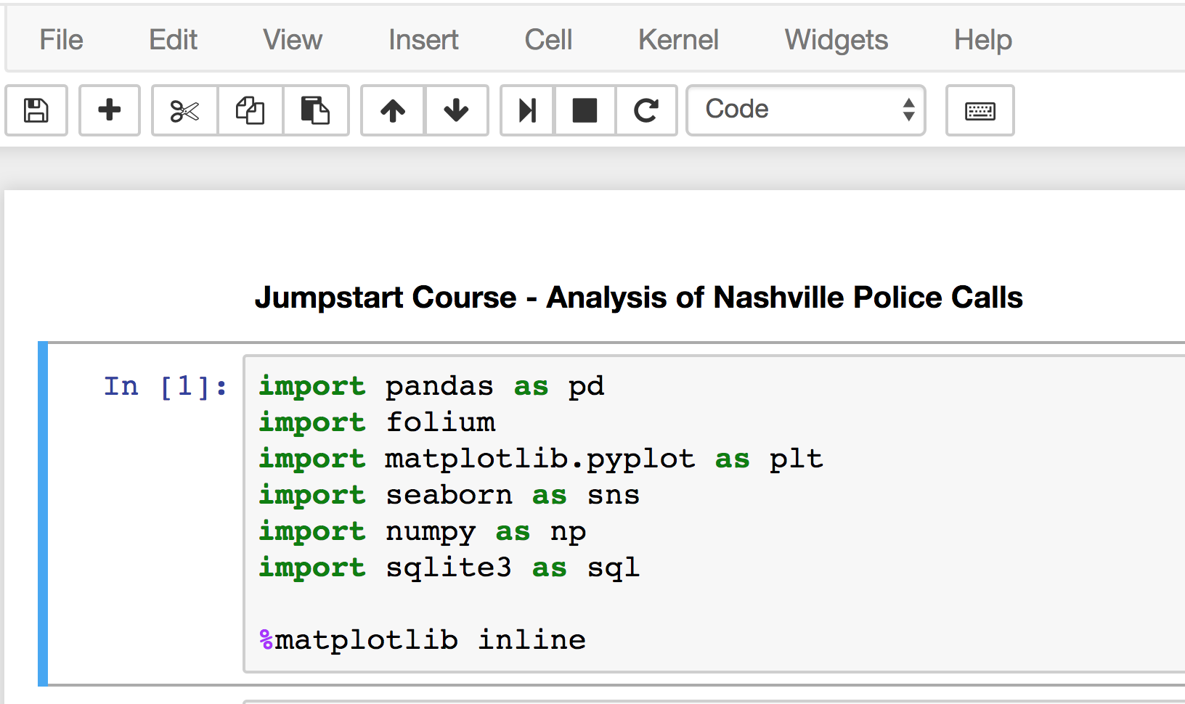
Notes:
You will toggle between markdown for annotating your work and code to execute your analysis. You change that here.

Slide 18
Next up:
walk through analysis guide

