Slide 1
Analytics Jumpstart
folium maps and df.iterrows()
Nashville Software School

Slide 2
For today
folium maps
df.iterrows()

Slide 3
Folium
Python package built upon the leaflet javascript library
Create interactive maps
Build markers
Easily customized popups

Slide 4
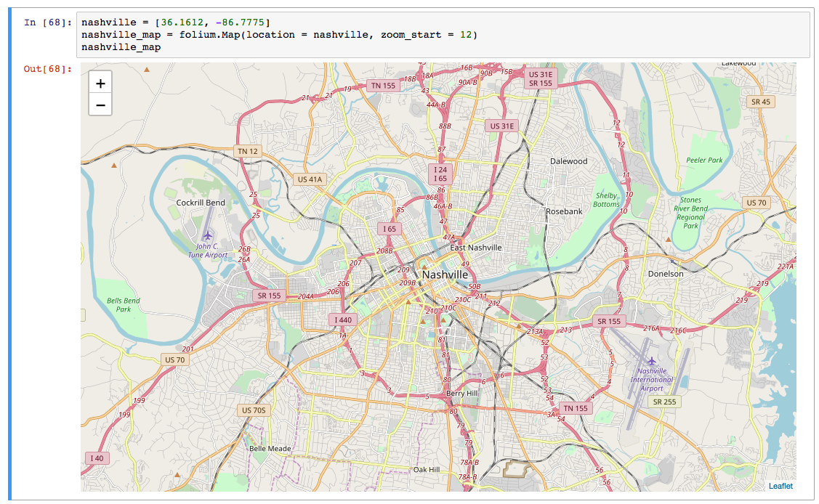
To initialize a map in folium, you need a location + (optionally) a beginning zoom_level:
a folium location is a list with latitude first and longitude second
the zoom_start tells folium how close to zoom into the location
pass location and zoom_start to the folium.Map() constructor
call the map in jupyter to display it

Slide 5
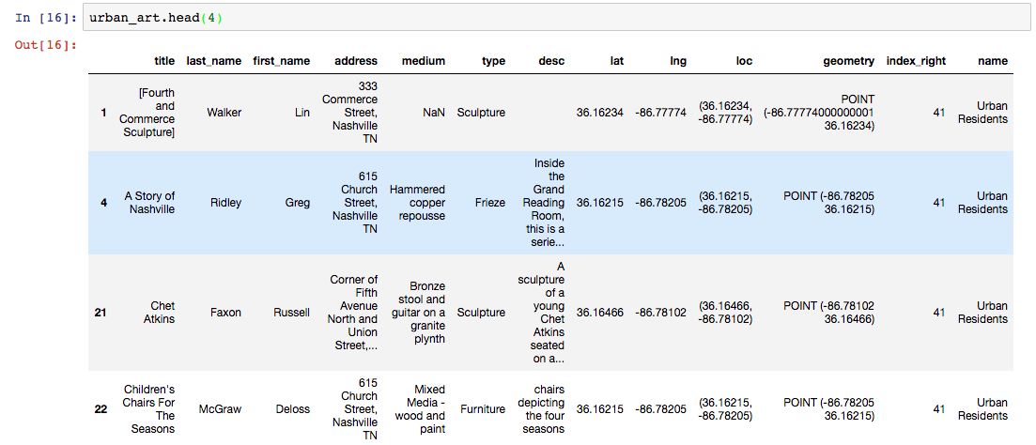
You will use iterrows() to build markers with popups for your folium maps, so let’s look at how that works. Here are the first 4 rows of urban_art, a data frame of public art in Nashville.

Slide 6
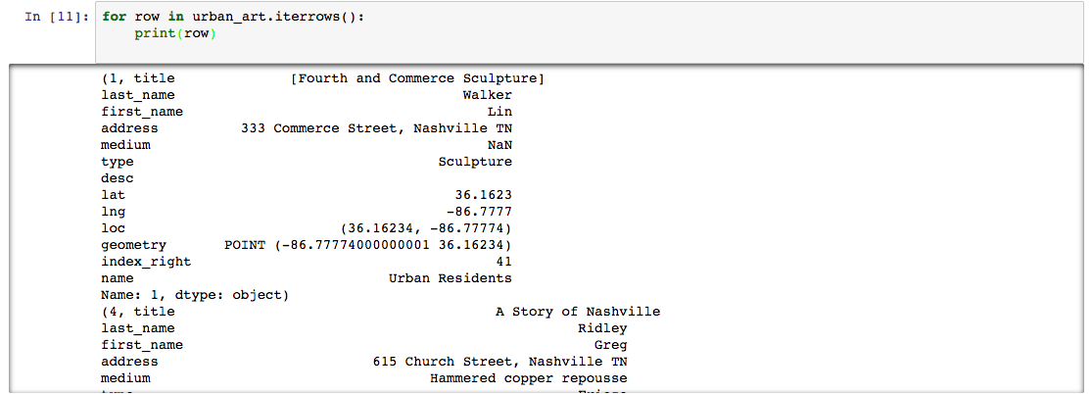
Here we use a for-loop with iterrows() to iterate through the urban_art data frame. We grab each row, print it, then move on to the next row, grab it, print it, until we reach the end of the data frame:

Slide 7
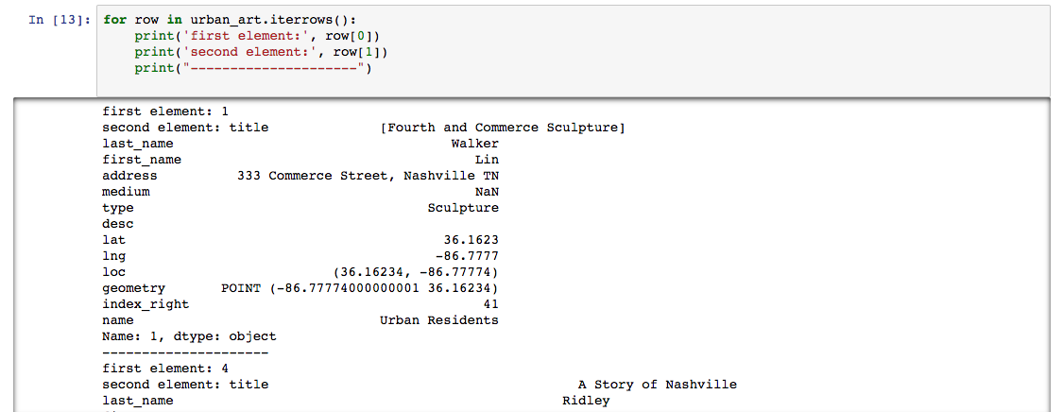
Each data frame row returned with iterrows() is a tuple with 2 elements. The first element is the row id and the second element holds all of the values for that row.

Slide 8
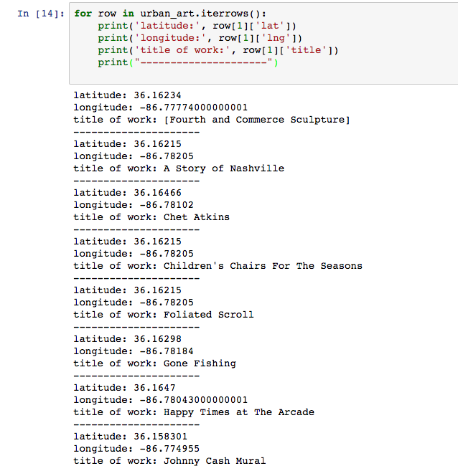
We can drill further down in each data frame row using iterrows() by using slicing a column by name from the row values. Here we are grabbing and printing the locations and title of each art work in the urban_art data frame.

Slide 9
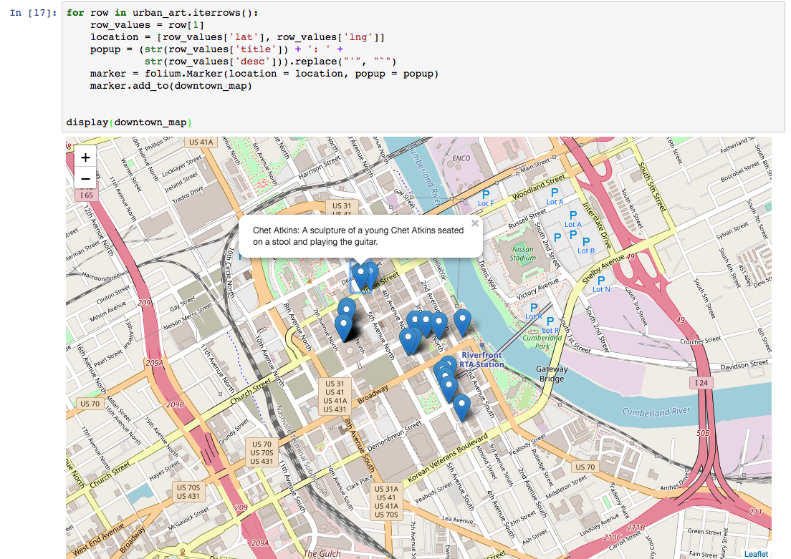
By using iterrows() in a for-loop, we create a location from each row’s latitude and longitude values and popups from each row’s title and description.
We create a marker each time through the loop by passing the location and the popup to the folium.Marker() constructor.
We use the .add_to() method to add the marker to the map.
After exiting the loop, we display the map.

Slide 10
Questions?

