Slide 1

Analytics Jumpstart
pandas methods for exploratory analysis
Nashville Software School

Slide 2
For today
More pandas
Value Counts
Describe
Info
Intro to Exploratory Data Analysis

Slide 3
Get Data 🡪 Process + Clean Data 🡪 Exploratory Data Analysis
Statistics and other info
series.value_counts() – returns the frequency of each unique value in a pandas series (or data frame column)
df.describe() – to get summary statistics about quantitative data
df.info() – to get information about the DataFrame
df.isnull().sum() – to get counts of missing values
Notes:
Here are some other pandas methods you will want to try out when you are exploring your data.

Slide 4
Get Data 🡪 Process + Clean Data 🡪 Exploratory Data Analysis
Exploratory Plots
import matplotlib.pyplot as plt
import seaborn as sns
https://matplotlib.org/api/_as_gen/matplotlib.pyplot.plot.html#examples-using-matplotlib-pyplot-plot
https://seaborn.pydata.org/examples/index.html
Notes:
Here are the links to the matplotlib pyplot API and to seaborn, a plotting library built on top of matplotlib that assists with making prettier plots.

Slide 5
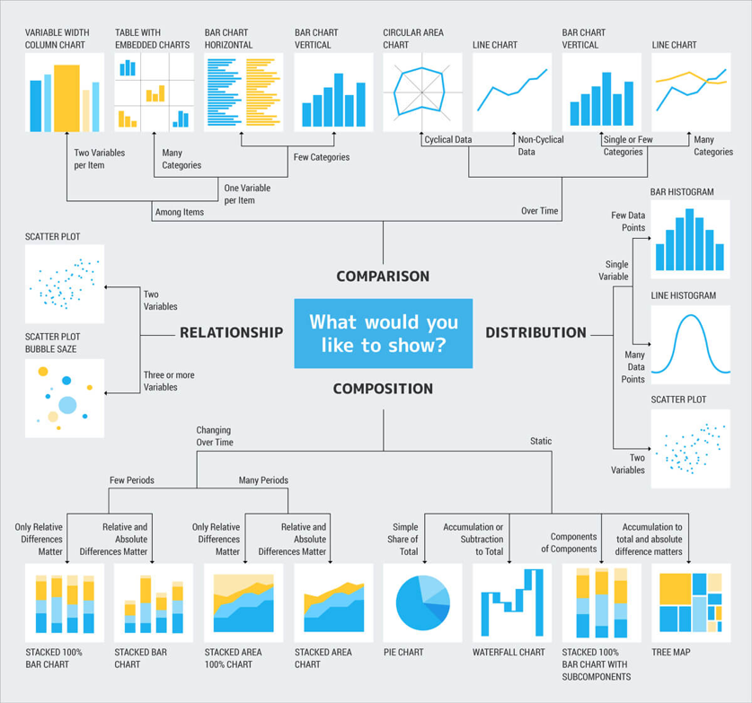
https://twooctobers.com/blog/8-data-storytelling-concepts-with-examples/
Notes:
The type of plot you choose when creating exploratory data visualizations depends on what you want to show. If you want to see how two things are related, a scatterplot is a common way to do that, while if you want to see the distribution of values for a particular measure, a histogram is a better option.

Slide 6
Reminders
Build upon your work in the same notebook each week. Just open it and add to it.
If the code in a cell did not run as expected, modify the code in that cell (not a new one)
Remove any unused/un-useful cells
Beware of the changing state of objects in your notebook
Example – if you create a df and drop 3 columns and then go back to add code to look at the head() in the same cell you are re-running the command to drop the 3 columns which are no longer there!

Slide 7
Questions?

