Slide 1
Analytics Jumpstart
Resources for Help
Nashville Software School

Slide 2

Resources for help when you get stuck
Google
Stack Overflow
Doc Strings

Slide 3

Be as specific as you can: search for python + package + what you are trying to do.
Copy the error from Jupyter and paste it right in the search box
Pay attention to the dates of results - sometimes blog posts, etc. are outdated
If you’re not sure what text to use try asking your question exactly like you would ask another person!

Slide 4

Many times your google search will lead you here
The question is at the top. Remember this is someone’s question and not the answer! Skim the question to ascertain that the issue is similar to yours.
Scroll through the answers looking for:
A green check – this means the original poster accepted this as the best solution.
The largest number – this means the most people agreed this is the best solution. Sometimes the largest number is next to the question. This just means a lot of people had the same question!

Slide 5
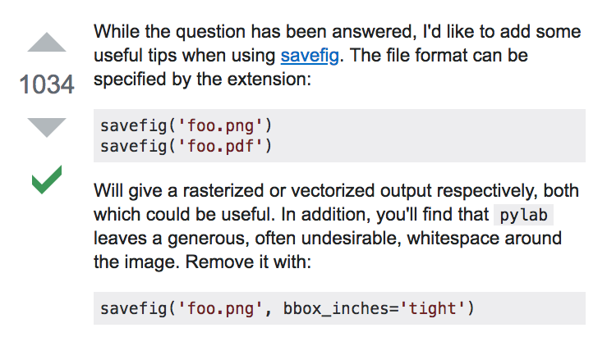

Slide 6
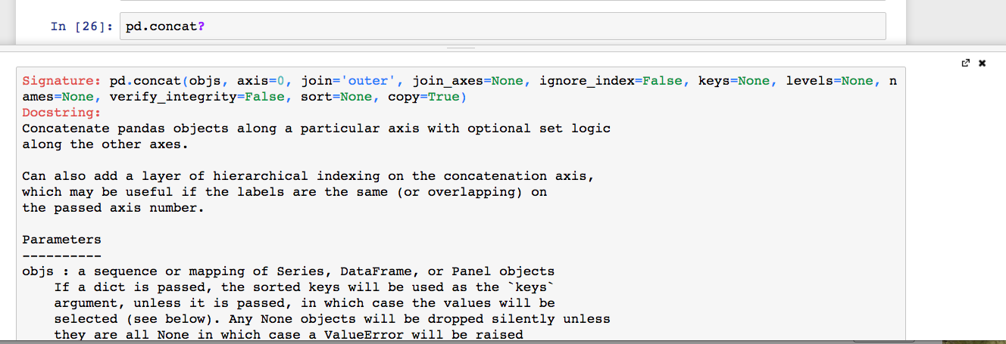
Docstrings
shift + tab after keyword in a Jupyter cell
? + keyword in a Jupyter cell

Slide 7
Questions?

