Slide 1

Analytics Jumpstart
Presentation + Storytelling
Nashville Software School

Slide 2
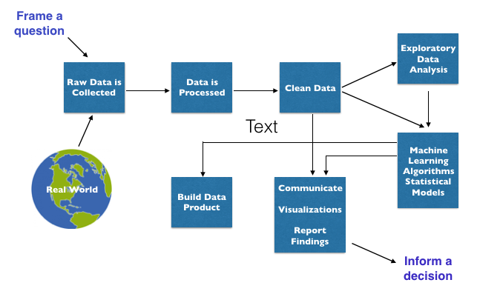
The Data Science Process

Slide 3
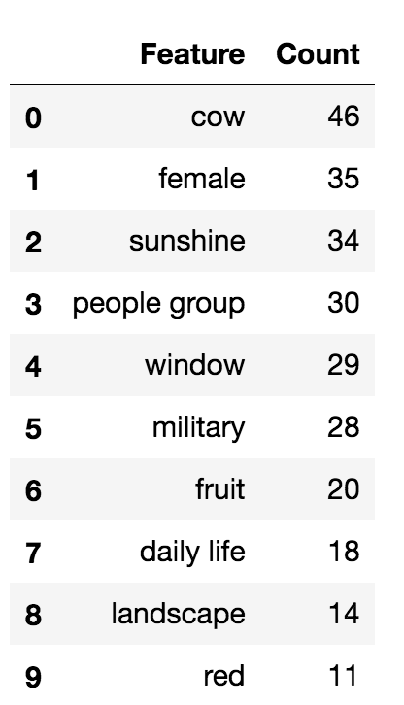
Stories will stick with your listener more effectively than statistics will.
Consider an analysis of features that were common to prize winning art in China.
We could display the data in tabular form:

Slide 4
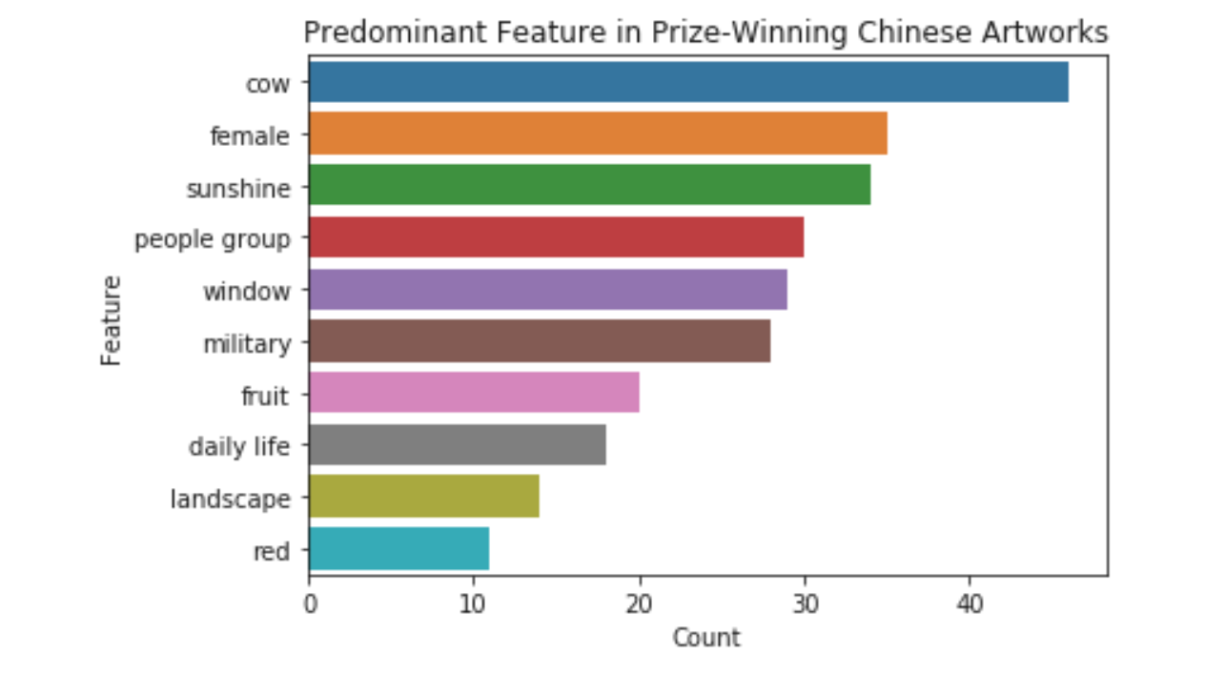
Or create a visualization:

Slide 5
But storytelling makes more of an impact:
https://youtu.be/w9w08-NPivM

Slide 6
Some things to keep in mind when creating your presentation
Why should/does your listener care?
What is compelling about your findings?
What narrative should accompany your findings?
What visualization is appropriate to the insights you want to communicate?

Slide 7
More examples and inspiration:
Hans Rosling is a classic example of effective data storytelling. Here is his TED Talk along with some others.
https://bigdata-madesimple.com/best-ted-videos-on-data-visualization/
There are many ways to think about your data and the story it tells. Here are a few.
https://bi-notes.com/examples-data-storytelling-analytics/

Slide 8
Think like a designer when creating effective visualizations
Highlight the important stuff
Keep it clean
Make it approachable

Slide 9
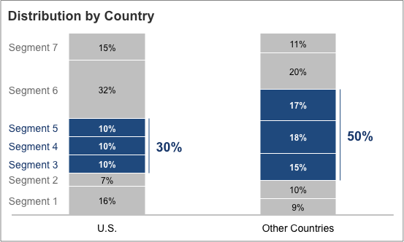
Highlight the important stuff
Bold
Italics
Underline
Color
Size
Arrows/Lines

Slide 10
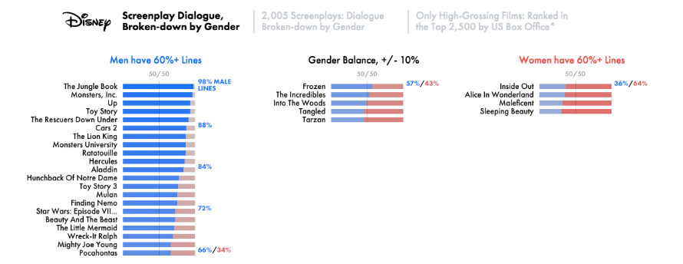
Keep it clean
Embrace Whitespace
Watch Alignment
Consistent Colors

Slide 11
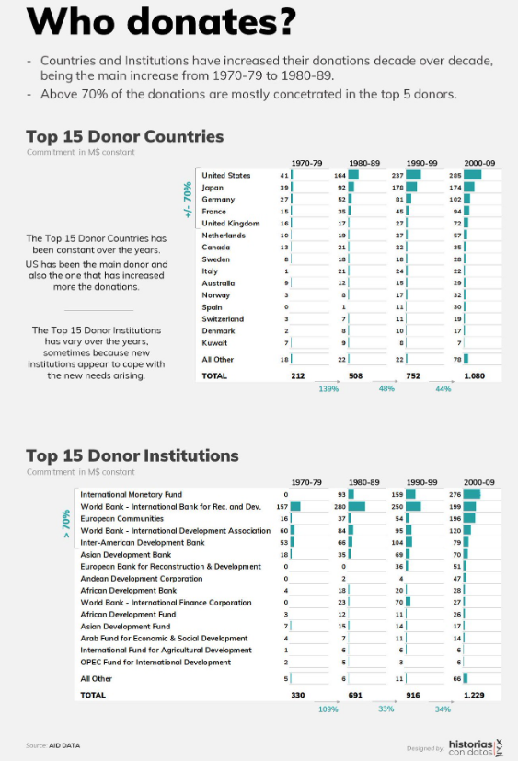
Make it approachable
Clean Labels
Check Accessibility
Avoid Jargon

Slide 12
Questions?

