Slide 1
Analytics Jumpstart
Intro to commonly used pandas methods
Nashville Software School

Slide 2
Goals for today
Learn some pandas methods
Work on coding tasks
Use the pandas API to understand methods and their signatures

Slide 3
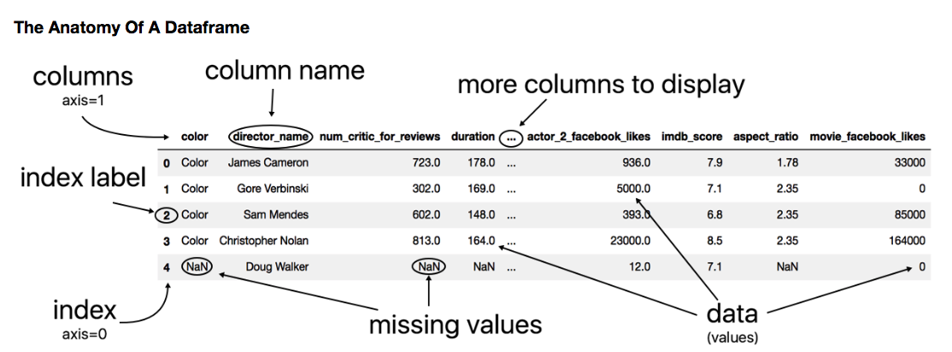
So, when thinking about axes..
Axis = 0 --> Rows
Axis = 1 --> Columns
You see this when running dataframe.shape --> (n_rows,n_cols)

Slide 4
Get Data → Process + Clean Data → Exploratory Data Analysis
CSV Workflow
Open the file in text editor to determine
- is there a header? pandas default is header = ‘infer’
- are there notes (non-data) at the top? pandas default is skiprows = None
- are there footnotes or other (non-data) at the bottom? pandas default is nrows = None
Read the file into a pandas DataFrame df = pd.read_csv()
Check the top and the bottom to ensure all data was read df.head() and df.tail()
Look at the dimensions df.shape
Notes:
It’s good practice to check your data in a text editor before importing it with pandas. If you find problems down the line, you can always go back and correct for them upstream – but early detection of footnotes or other data issues usually means less work!

Slide 5
Get Data → Process + Clean Data → Exploratory Data Analysis
Workflow
Clean column names
Drop unnecessary columns (avoid using inplace = True since it will be deprecated next year, instead assign the df back to itself or use method chaining)
Notes:
It’s important to note here that if you want an operation on your data frame to be persistent, either assign the operated on df back to itself or use the `inplace = True` argument when available.

Slide 6
pandas – https://pandas.pydata.org/pandas-docs/stable/api.html
pd.read_csv() – read a comma delimited file; always look at the raw file in a text editor (not excel); additional arguments may be needed to handle extra rows at the top and extra data (footnotes) at the bottom.
df.head() – looks at the top of the DataFrame; 5 rows by default
df.tail() - looks at the bottomof the DataFrame; 5 rows by default
df.shape – returns a tuple with number of rows and number of columns
df.drop() – drop the specified labels (either rows or columns) from the DataFrame
df.columns – column labels attribute
df.rename() – rename values (can pass in a dictionary with existing columns as the key and new ones as the values)
Notes:
Here is a link to the pandas api documentation. You can read about all the methods, properties of series and dataframes here. In these notes, `df` is a placeholder for whatever your data frame is named. The .loc and .iloc methods get a slice of your data frame either by names (for .loc) or index numbers (.iloc). Whiteboard example.

Slide 7
df.loc[] – pass in row name and column name to access data at that location
df.iloc[] - pass in row index and column index to access data at that location (python is 0 indexed)
df.query() – pass an expression to filter data in the DataFrame
df[[ ]] - creates a slice (subset) of the DataFrame including just the columns passed in

Slide 8
Let’s open our first shared notebook - public_art1.ipynb

