Slide 1
MAY Deaths Historic Nashville Cemetery
Pherius Wilhoite​

Slide 2
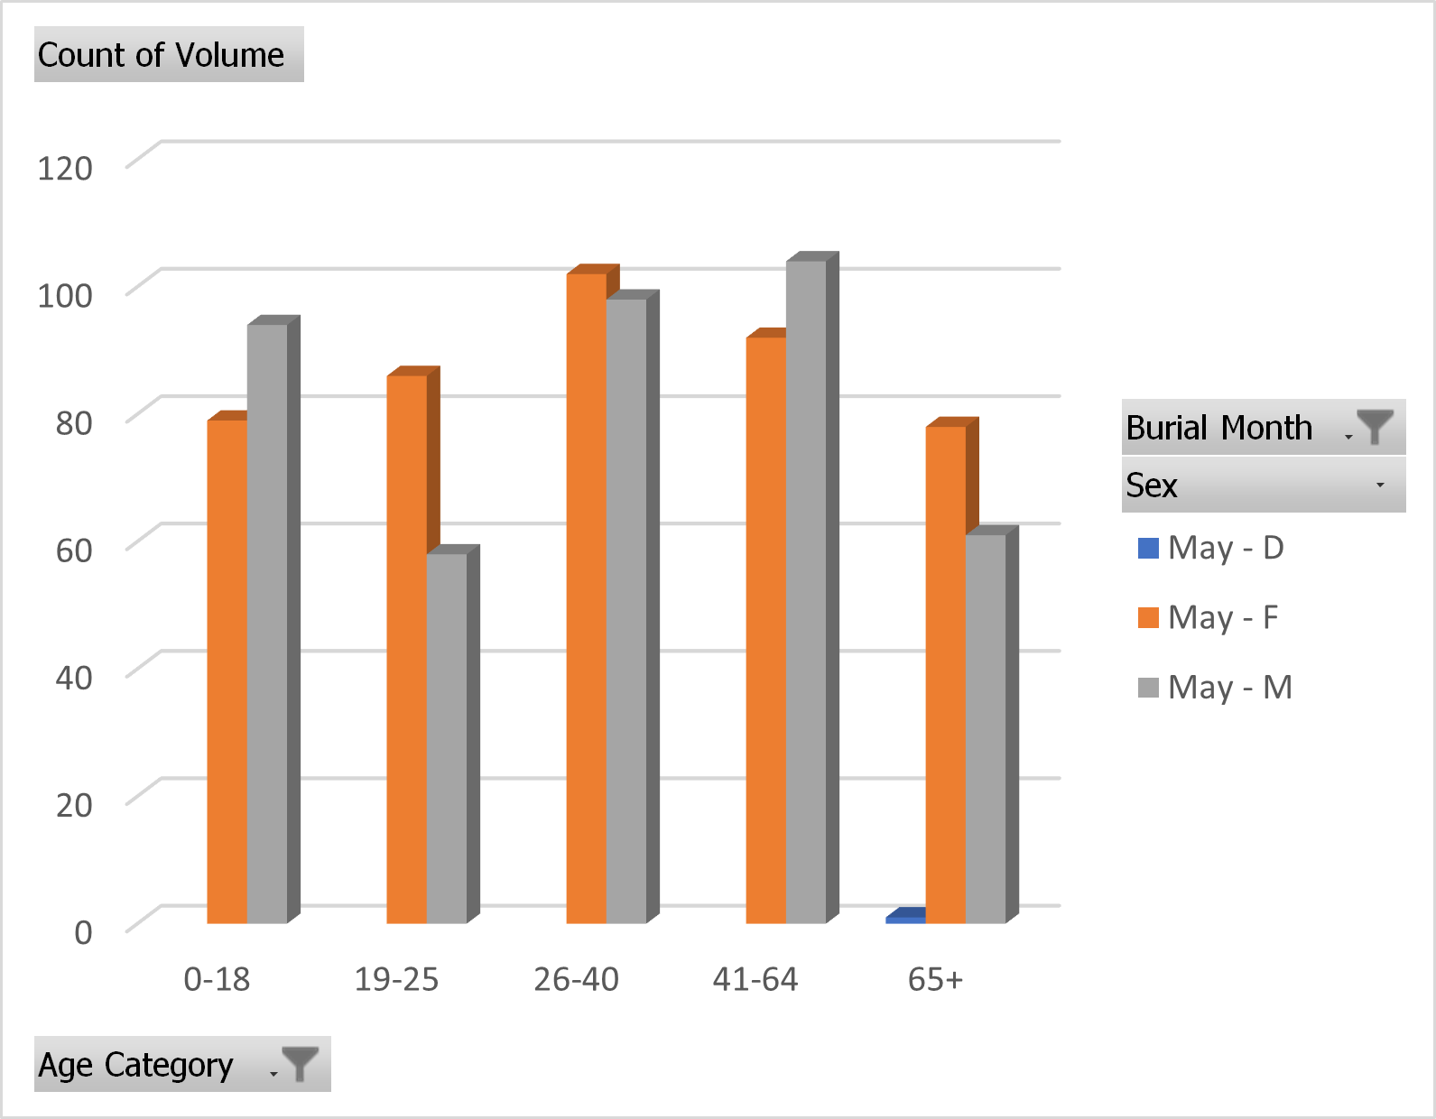


Month of MAY
A
*The total May deaths-853
*Females = More Deaths
*Common Age 26-40
Count of Volume | Column Labels
 | May |  |  | May Total | Grand Total
Row Labels | D | F | M
0-18 |  | 79 | 94 | 173 | 173
19-25 |  | 86 | 58 | 144 | 144
26-40 |  | 102 | 98 | 200 | 200
41-64 |  | 92 | 104 | 196 | 196
65+ | 1 | 78 | 61 | 140 | 140
Grand Total | 1 | 437 | 415 | 853 | 853

Slide 3
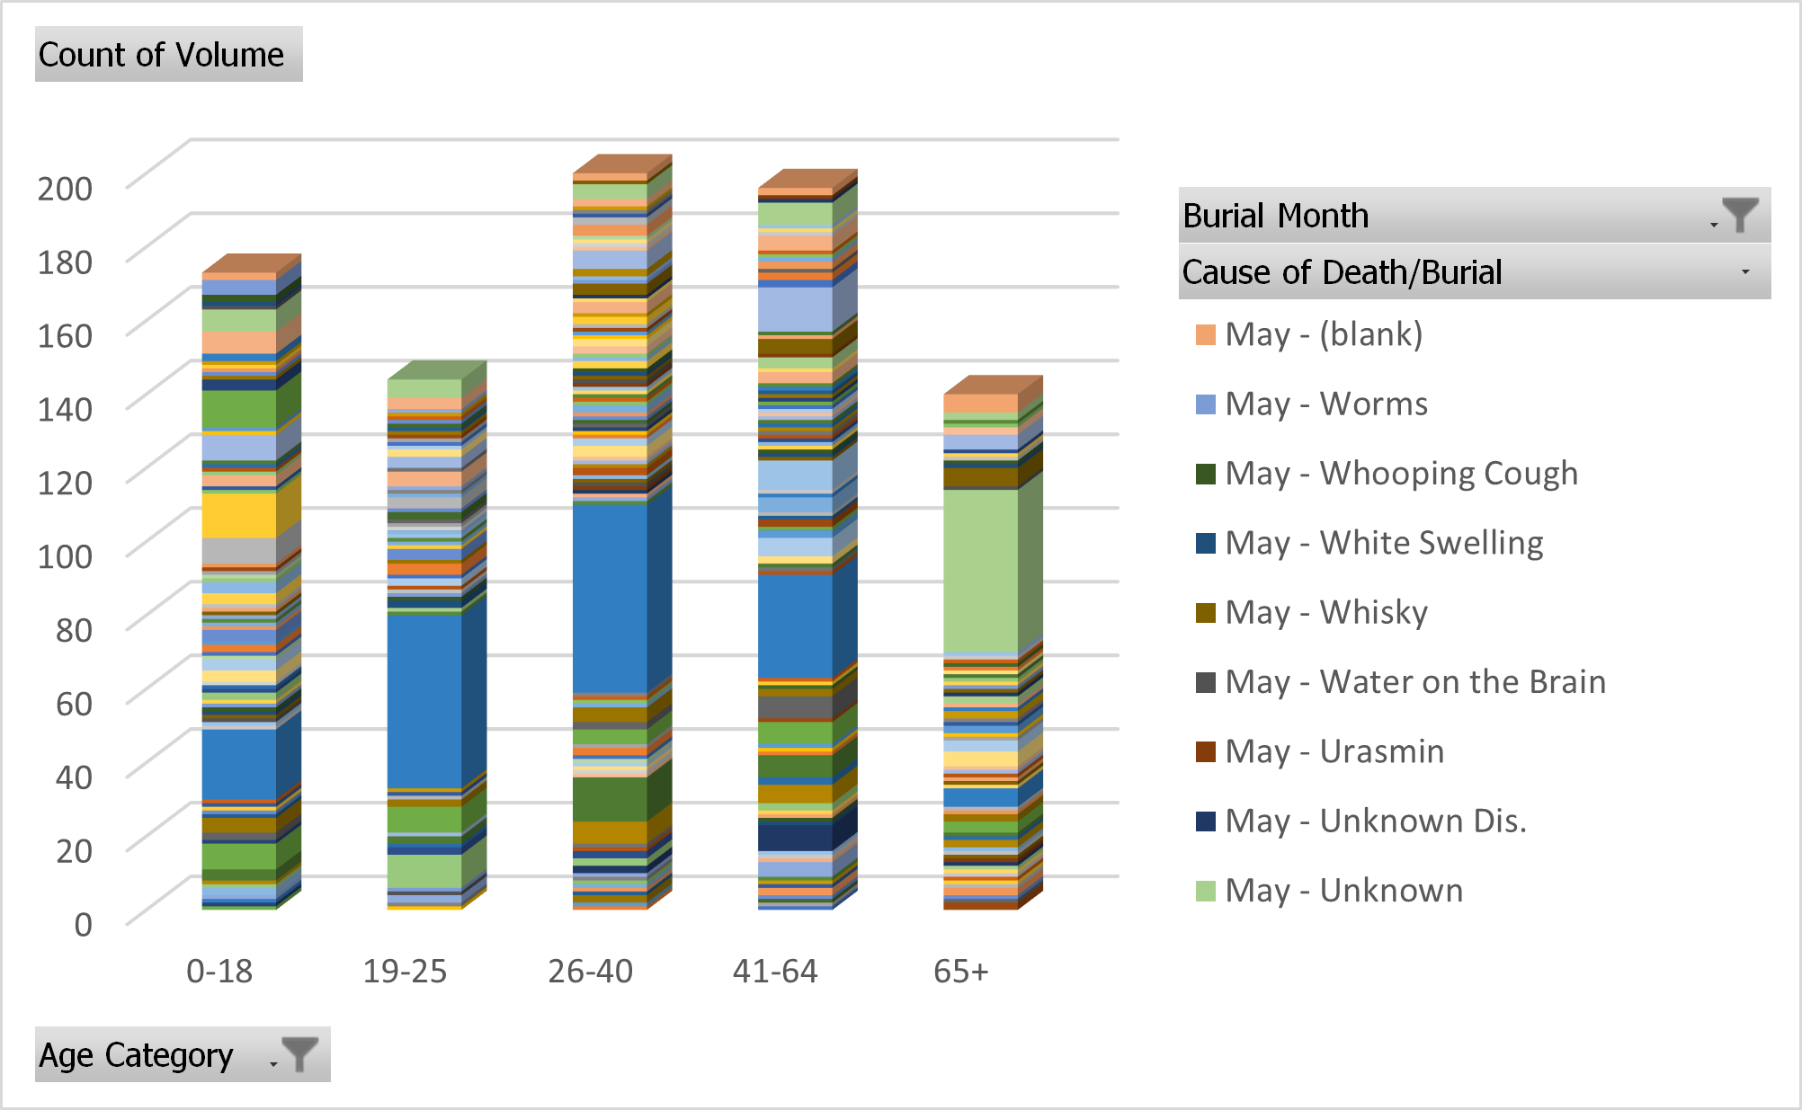
Cause Of Death in each age group of month of May 0-18 Worms 19-25 Worms 26-40 Worms 41-64 Worms 65+Unknown

