Slide 1

We don’t just see dead people.

Slide 2
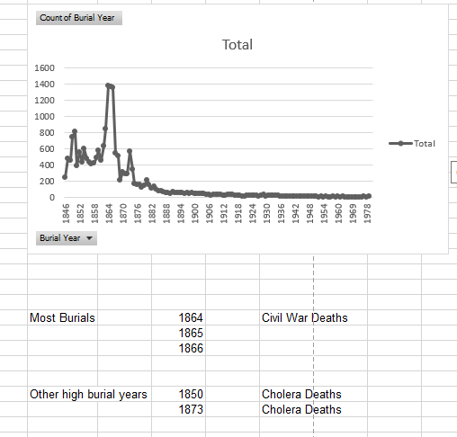
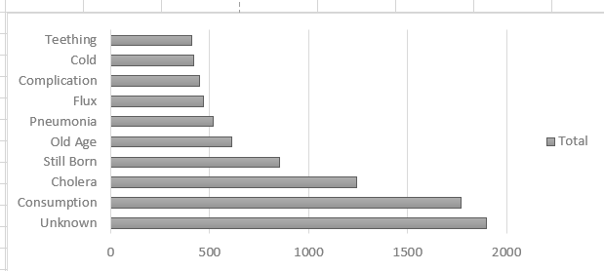
We see the cholera pandemic of the 1850’s.

Slide 3
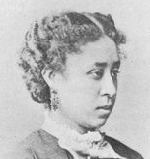
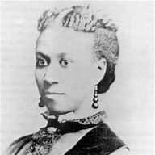
We see Fisk Jubilee singers.
Ella Sheppard Moore and Mabel Lewis Imes were part of the original group of Fisk Jubilee
singers who traveled the States performing and raising money for Fisk University. They launched the first tour on October 6, 1871. The day is still celebrated by Fisk every
year in the cemetery on October 6, Jubilee Day.
Moore was buried in the cemetery on June 11, 1914.
Imes was buried on August 8, 1935.

Slide 4
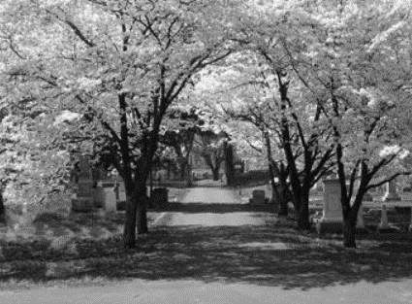
We see trees and blooms.
5 trees won Nashville Tree Foundation’s “Big Old Tree Contest” in 2011.
Designated an arboretum by the Nashville Tree Foundation
Home to 30 species of trees and 10 species of shrubs.
Second Saturday Tours led by Master Gardeners of Davidson County.

Slide 5
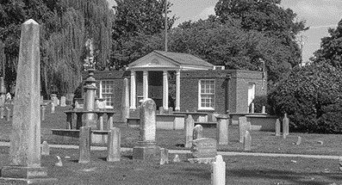
We see architecture.
The brick building in the cemetery that was long used by the cemetery sexton and to store records was designed by renowned local architect Edwin Keeble, who also designed the L&C tower further north on 4th Avenue downtown.

Slide 6
We see women.

Slide 7
We see history. We Nashville’s history. Come see what we see. 1001 Fourth Ave South

