Slide 1
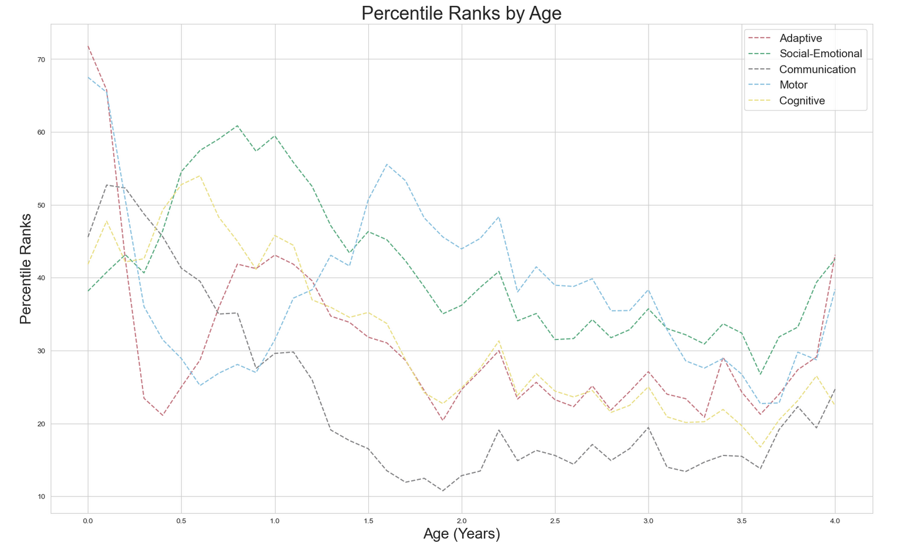
Does Age Impact Scores?
When looking at the average Percentile Rank of each domain, it’s difficult to see a clear, distinct pattern.
However, when looking from ages 1.5 to 4, each domain follows a similar trend (decreases until 2, peaks at 2.2, falls with bumps until 3.6)

Slide 2
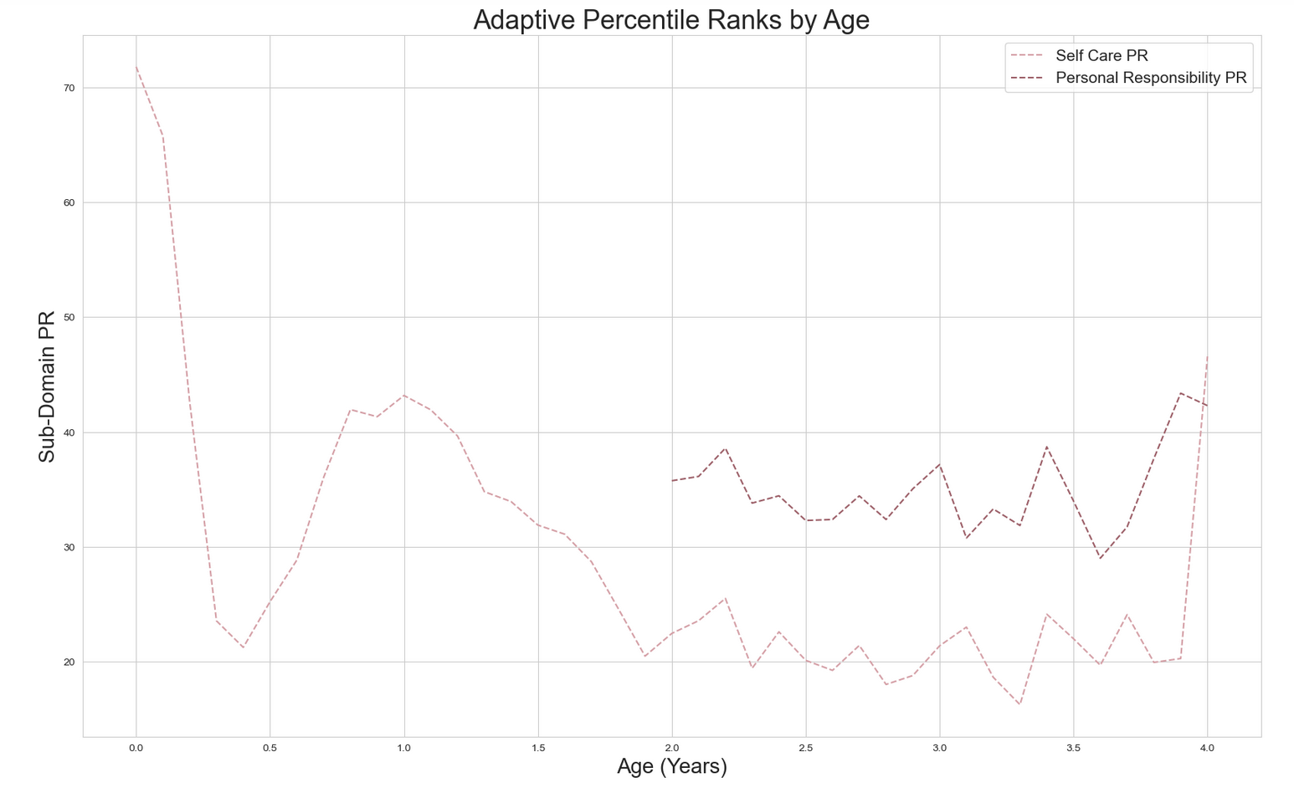
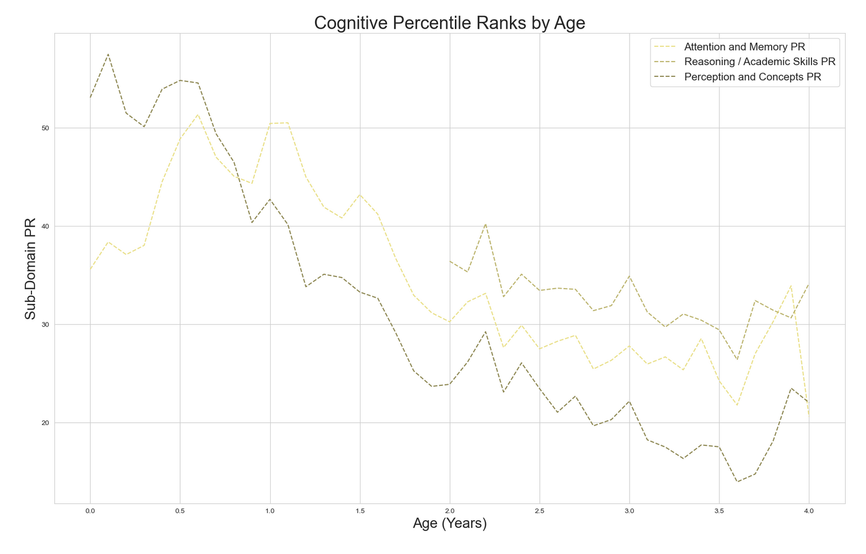
Most domains have an assessment that is not offered to children younger than 2.
This affects how the Sum of Scaled Scores is measured. As such, we are not using SS because it is skewed.

Slide 3
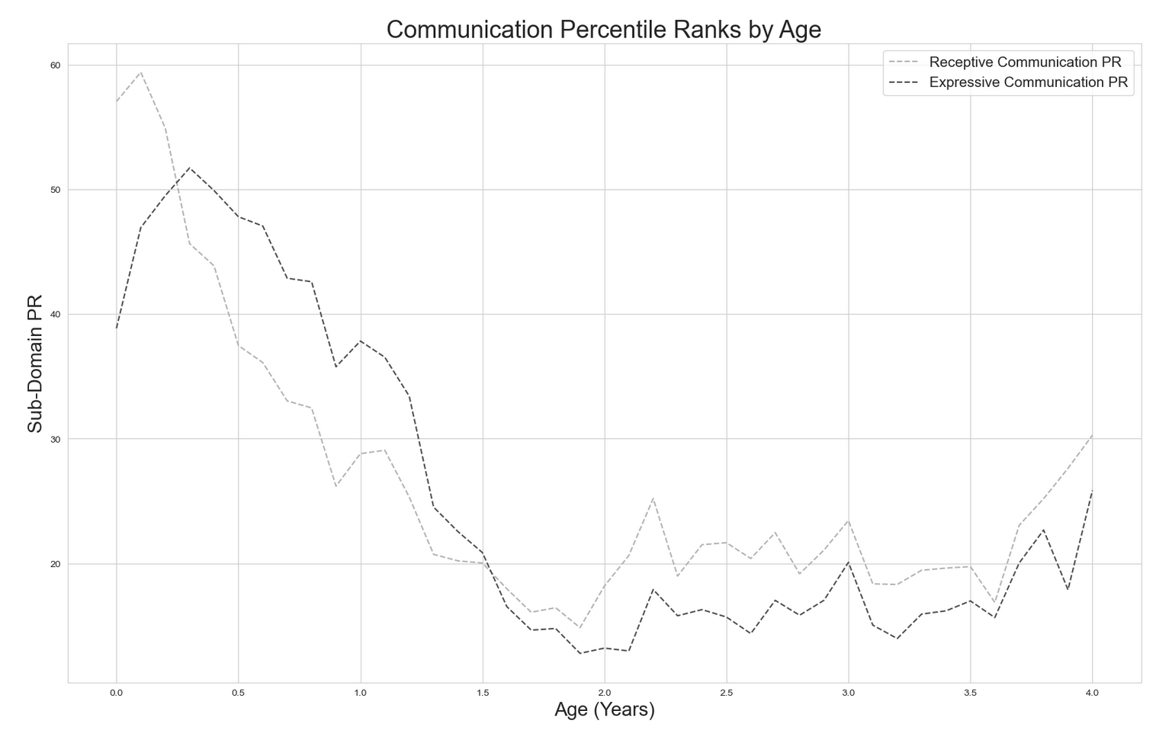
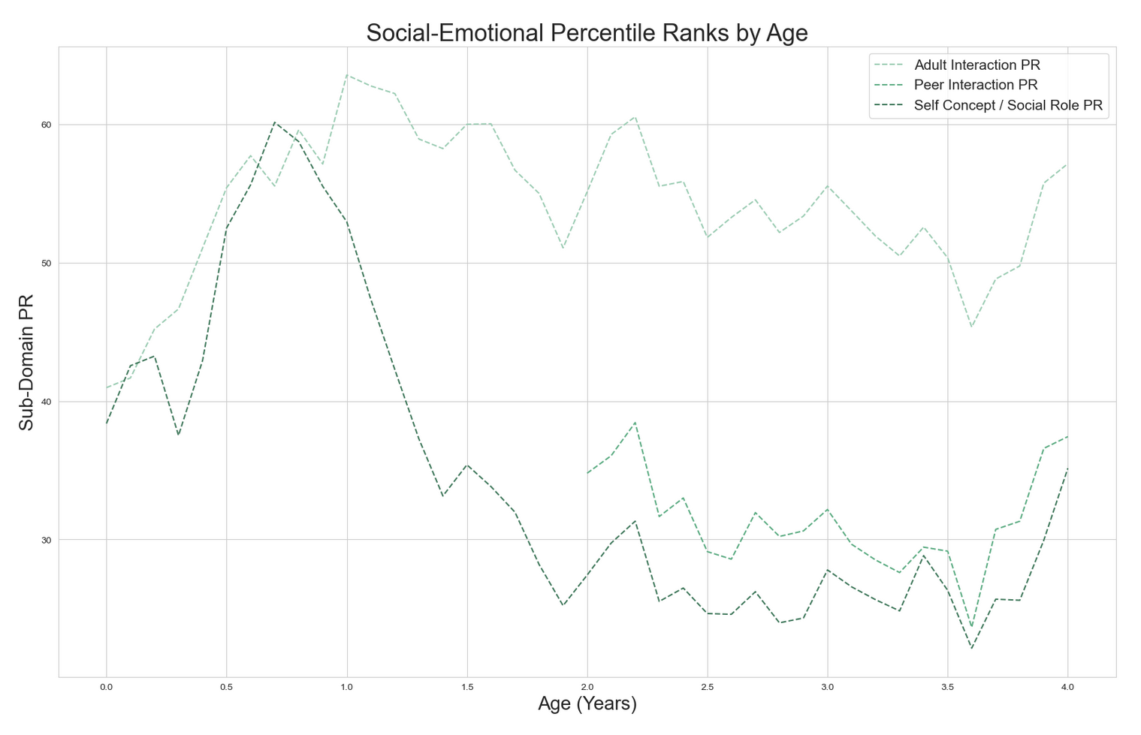
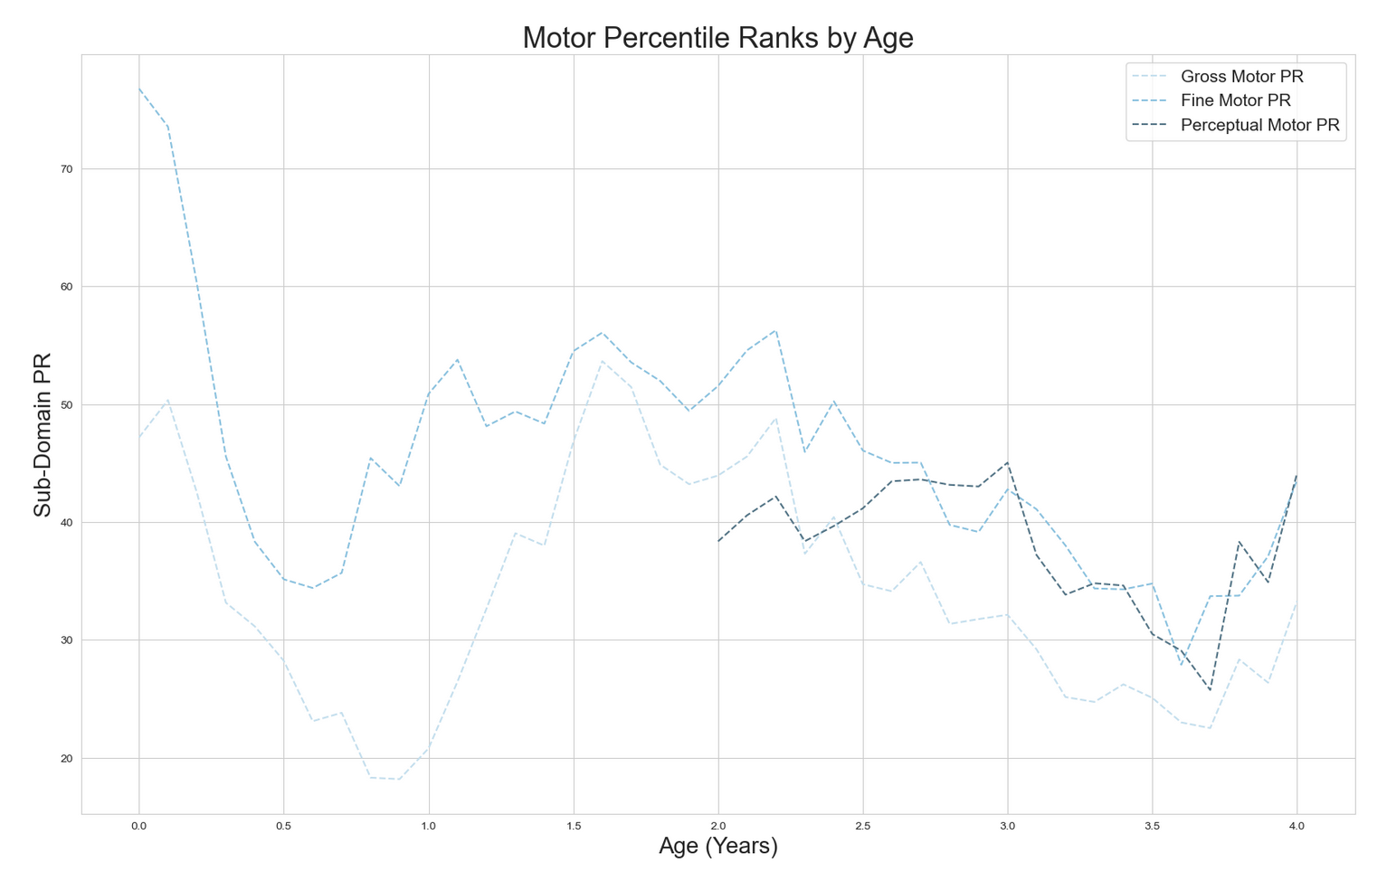
Looking above, Communication is the only domain where every sub-domain assessment is given to all ages.
Seeing all the domains broken down by sub-domain, it becomes even less clear if there is a pattern between age and what score a child gets.

