Slide 1
Nashville City Cemetery
Burials 1846 through 1979
Presented by Melissa Wilmarth

Slide 2
Causes of Death
Cause of Death | Count
Consumption | 1852
Cholera | 1405
Stillborn | 1301
Pneumonia | 671
Old Age | 623
Teething | 596
Diarrhea | 503
Measles | 497
Flux | 476
Complication | 447

Slide 3
Peaks in Burials
1850 Cholera outbreak
1866 Cholera outbreak
1873 Cholera outbreak

Slide 4
Burials by Month
Year | Jan | Feb | Mar | Apr | May | Jun | Jul | Aug | Sep | Oct | Nov | Dec | Grand Total
1846 | 20 | 26 | 25 | 22 | 26 |  |  |  | 35 | 39 | 23 | 30 | 246
1847 | 43 | 34 | 38 | 35 | 26 | 47 | 40 | 61 | 35 | 47 | 36 | 34 | 476
1848 | 36 | 36 | 49 | 37 | 41 | 47 | 65 | 39 | 23 | 26 | 21 | 27 | 447
1849 | 46 | 64 | 64 | 43 | 62 | 231 | 96 | 36 | 28 | 18 | 24 | 33 | 745
1850 | 24 | 26 | 43 | 29 | 37 | 120 | 370 | 52 | 22 | 27 | 28 | 31 | 809
1851 | 26 | 31 | 27 | 29 | 26 | 37 | 49 | 35 | 32 | 42 | 14 | 37 | 385
1852 | 37 | 32 | 39 | 37 | 58 | 84 | 76 | 54 | 31 | 32 | 36 | 36 | 552
1853 | 35 | 39 | 35 | 31 | 36 | 54 | 47 | 32 | 34 | 27 | 28 | 31 | 429
1854 | 35 | 33 | 34 | 43 | 61 | 137 | 95 | 44 | 34 | 25 | 25 | 30 | 596
1855 | 30 | 22 | 20 | 34 | 38 | 58 | 75 | 42 | 54 | 33 | 32 | 38 | 476
1856 | 29 | 34 | 30 | 33 | 35 | 42 | 51 | 37 | 38 | 43 | 28 | 28 | 428
1857 | 31 | 34 | 34 | 34 | 34 | 37 | 36 | 35 | 38 | 32 | 23 | 34 | 402
1858 | 38 | 28 | 34 | 37 | 34 | 28 | 43 | 47 | 21 | 34 | 29 | 42 | 415
1859 | 41 | 61 | 36 | 35 | 42 | 53 | 42 | 35 | 35 | 34 | 35 | 33 | 482
1860 | 41 | 35 | 35 | 38 | 53 | 64 | 64 | 49 | 62 | 51 | 39 | 44 | 575
1861 | 43 | 41 | 38 | 37 | 30 | 30 | 50 | 51 | 34 | 31 | 35 | 35 | 455
1862 | 41 | 42 | 67 | 47 | 44 | 65 | 35 | 29 | 44 | 61 | 77 | 75 | 627
1863 | 57 | 53 | 76 | 77 | 75 | 86 | 91 | 69 | 69 | 68 | 44 | 71 | 836
1864 | 97 | 104 | 154 | 135 | 110 | 141 | 154 | 149 | 99 | 69 | 74 | 86 | 1372
1865 | 121 | 85 | 138 | 114 | 121 | 142 | 153 | 84 | 98 | 115 | 94 | 101 | 1366
1866 | 108 | 101 | 92 | 76 | 62 | 64 | 69 | 89 | 441 | 140 | 48 | 64 | 1354
1867 | 46 | 41 | 60 | 44 | 37 | 51 | 48 | 52 | 44 | 44 | 32 | 43 | 542
1868 | 54 | 44 | 62 | 32 | 31 | 50 | 71 | 45 | 33 | 29 | 24 | 29 | 504
1869 | 17 | 16 | 21 | 22 | 7 | 18 | 15 | 4 | 26 | 21 | 19 | 23 | 209
1870 | 31 | 20 | 31 | 20 | 26 | 28 | 37 | 44 | 22 | 19 | 15 | 19 | 312
1871 | 21 | 14 | 31 | 25 | 16 | 31 | 23 | 24 | 30 | 33 | 18 | 19 | 285
1872 | 27 | 17 | 23 | 29 | 18 | 23 | 29 | 28 | 27 | 19 | 18 | 25 | 283
1873 | 21 | 14 | 38 | 40 | 17 | 242 | 71 | 27 | 25 | 28 | 15 | 21 | 559
1874 | 21 | 20 | 27 | 40 | 32 | 46 | 44 | 30 | 33 | 25 | 12 | 7 | 337
1875 | 12 | 11 | 17 | 11 | 10 | 14 | 18 | 17 | 19 | 18 | 8 | 4 | 159
1876 | 5 | 11 | 15 | 20 | 8 | 14 | 8 | 17 | 13 | 15 | 14 | 8 | 148
Outbreaks seem to span one month, usually in or close to the summer
There is a Consumption (Tuberculosis) peak from 1864 – 1866 as well

Slide 5
More Charts
Percent Burials by Sex
Burials by Age and Year Groups

Slide 6
Last Names
Name entries without a comma
Most Common
Infants
Unknown/Strangers
Written First Last instead of Last, First
Just one name given
Notes:
I deleted all history from my brain to make room for cat facts, but the website says President James K. Polk.

Slide 7
Burials in 1864
Mean Age
Date
Last Infant
Child – 9.6 years
Adult – 41.6 years
Excel does not recognize dates before 1900 as dates
An infant was buried on 12/29/1864
Notes:
Used 1964 in separate column to sort

Slide 8
Medical History Tour
Changes in how we view disease over time
Changes in sanitation and effects on outbreaks
Games to engage the attendees
Fun (but respectful) facts:
First mention here of Tuberculosis as Tuberculosis and not one of the many other names for it was June 1875 even thought the name was coined in 1834.
Mode of Transportation | Related Deaths
Railroad
Auto
Horse
Wagon

Slide 9
Medical History Tour
Changes in how we view disease over time
Changes in sanitation and effects on outbreaks
Games to engage the attendees
Fun (but respectful) facts:
First mention here of Tuberculosis as Tuberculosis and not one of the many other names for it was June 1875 even thought the name was coined in 1834.
Mode of Transportation | Related Deaths
Railroad | 34
Auto | 9
Horse | 10
Wagon | 5

Slide 10
Causes of Death?
House fell on them
King’s Evil
Supposed to be murdered
Going the wrong way on the Railroad
Ganders
Overflow of water to the brain
Brights Disease
Run over by a laundry wagon
Bees
Women’s troubles
Choked on a grain of coffee
Vaccination
Summer Complaint
Killed by a tree
Phthisis
Fell through the hatch on boat
Bit by dog
Killed by horses running away
Notes:
History of Disease Tours? Learning about how disease was named over time.
Some people love that stuff; note popular podcast Sawbones

Slide 11
Causes of Death?
House fell on him
King’s Evil (aka Scofula, aka TB)
Supposed to be murdered (41 known)
Going the wrong way on the Railroad
Ganders (aka jaundice 42)
Overflow of water to the brain
Brights Disease (aka nephritis)
Run over by a laundry wagon
Bees
Women’s troubles
Choked on a grain of coffee
Effects of Vaccination (live vaccines)
Summer Complaint (summer diarrhea)
Killed by a tree
Phthisis (Greek for Tuberculosis)
Fell through the hatch on boat
Bit by dog
Killed by horses running away (10 horse)
Notes:
History of Disease Tours? Learning about how disease was named over time.
Some people love that stuff; note popular podcast Sawbones

Slide 12
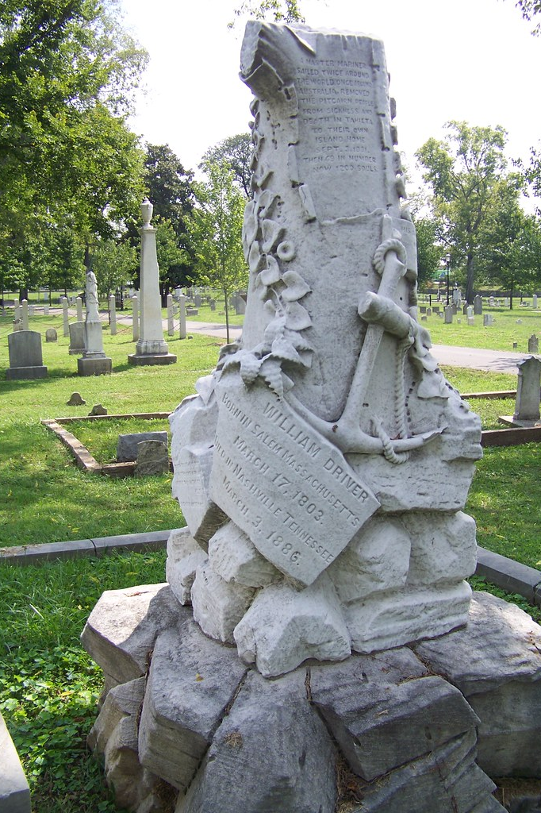
Thanks!
Various Names for TB
Consumption
Phthisis
White Plague
King’s Evil
Scofula
Schachepheth
Tabes
Notes:
History of Disease Tours? Learning about how disease was named over time.
Some people love that stuff; note popular podcast Sawbones

