Slide 1
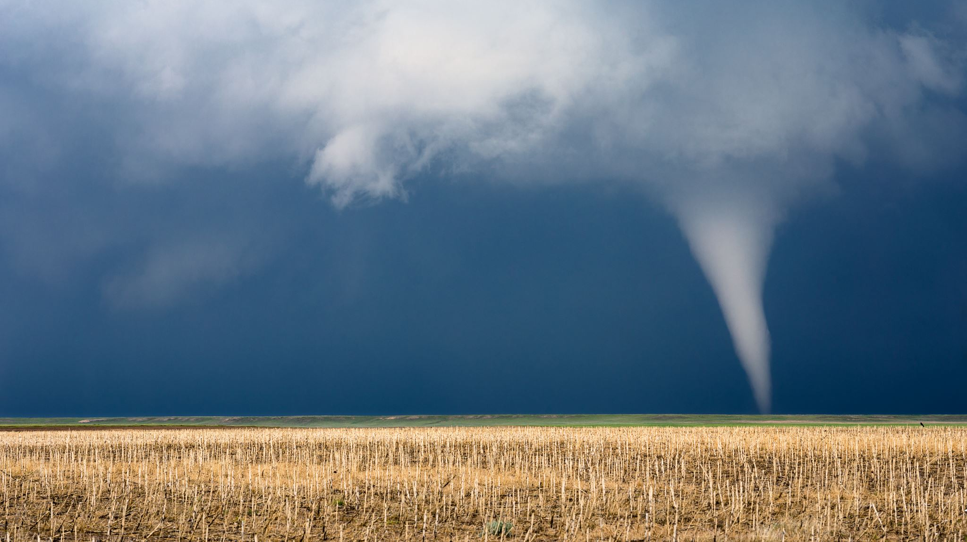
TORNADO

Slide 2
Motivation

Slide 3
MOST COMMON TIMES OF YEAR FOR TORNADOES

