Slide 1
Davidson County: A Data-Driven Guide for Future Homebuyers
Capstone by: Jaime Garcia

Slide 2
Motivation
In the past year I made the biggest decision of my life in buying my first home. Davidson County was where I decided to settle down and so far, I've been happy with my decision. Looking to make a major financial decision like buying or moving into a new home can be very difficult and a lot of research is necessary. With my capstone, I hope to make that decision easier for next person considering moving into Davidson County.

Slide 3
How does Nashville Commute?

Slide 4
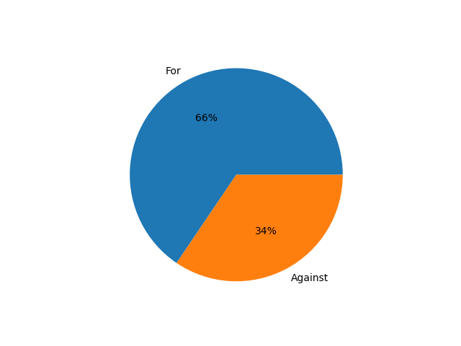
Metropolitan Transit Ordinance Vote 2024

Slide 5
What is the Transportation Improvement Plan?
All Access Corridors
Complete Streets
Sidewalks
Frequent Networks
Local Service Improvement
New Connector
Express Service Routes
WeGo STAR
New Routes
Smart Signals
Transit Centers
Park and Rides
Stop Improvements

Slide 6
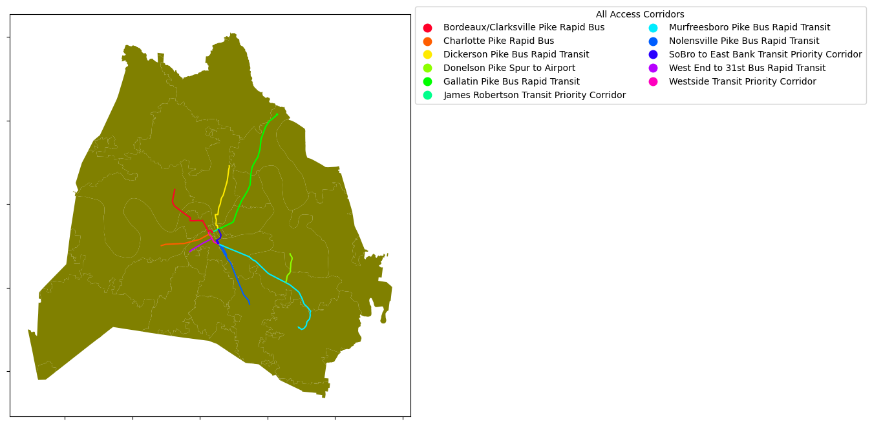
All Access Corridors
These corridors are where we improve everything with better sidewalks, smarter signalized intersections, reliable transit service every 15 minutes or better, and improve safety conditions. They form the backbone of bus rapid transit network, and their design will be determined with additional community input with neighborhoods in mind.

Slide 7
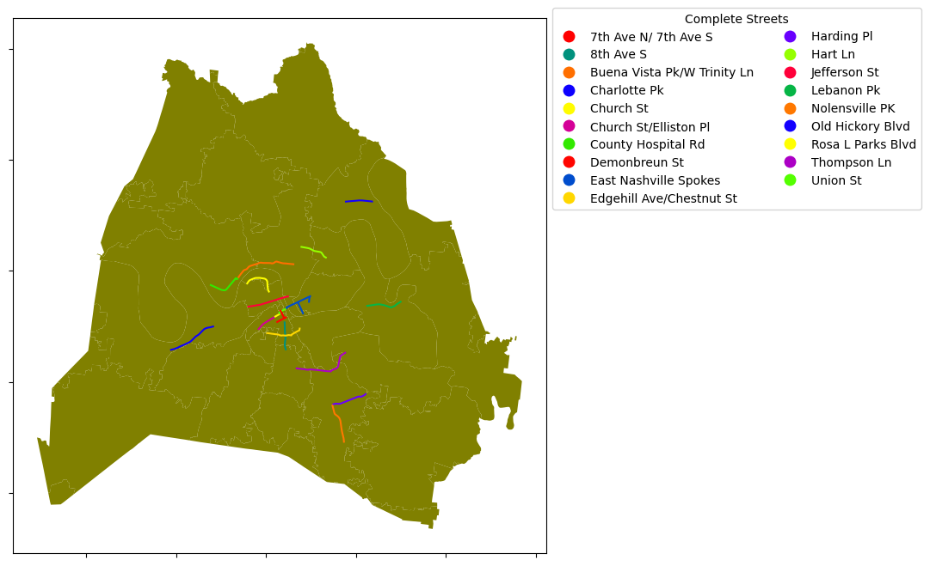
Complete Streets
These streets are where we expand mobility options and safety at the same time. These areas have been identified as priorities for sidewalks, bikeways, and safety improvements. They include some locations where we have more serious injuries and fatalities on our streets. Their design will be determined with additional community input.

Slide 8
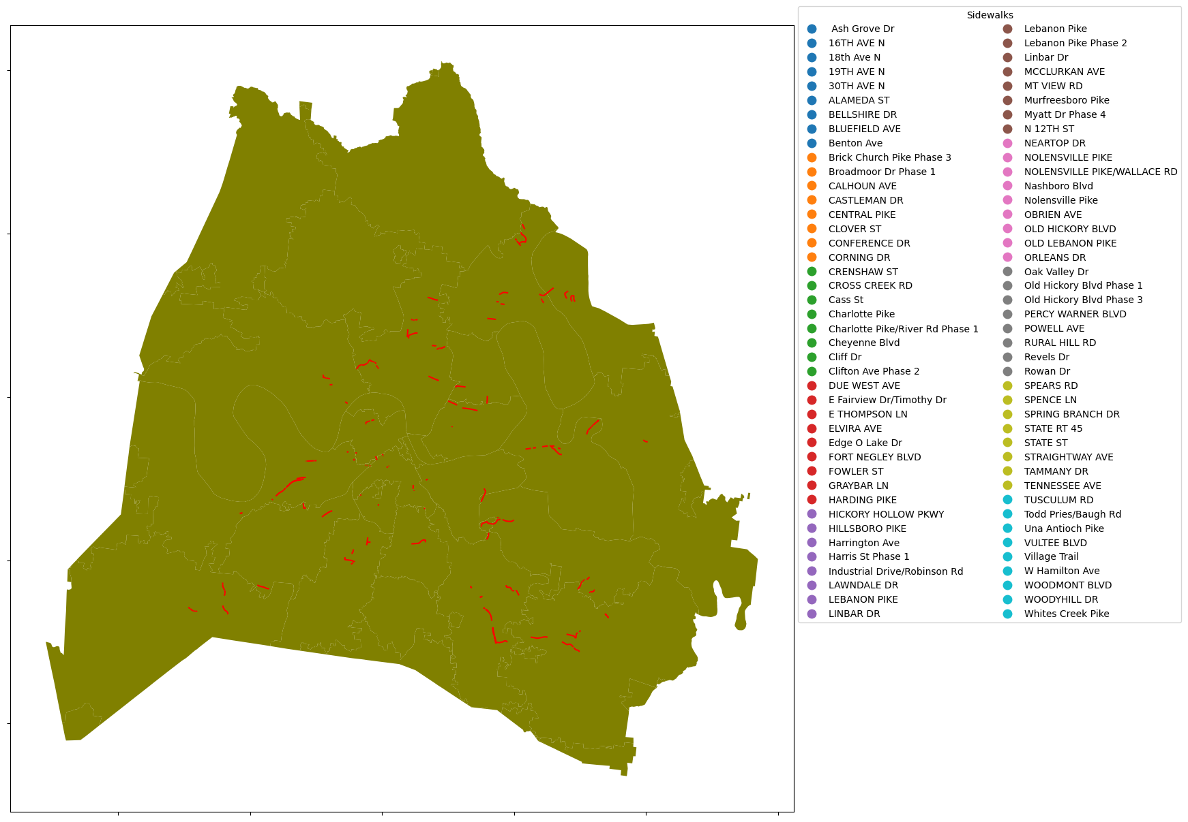
Sidewalks
These are proposed new sidewalks identified in the Choose How You Move Transportation Improvement Program.

Slide 9
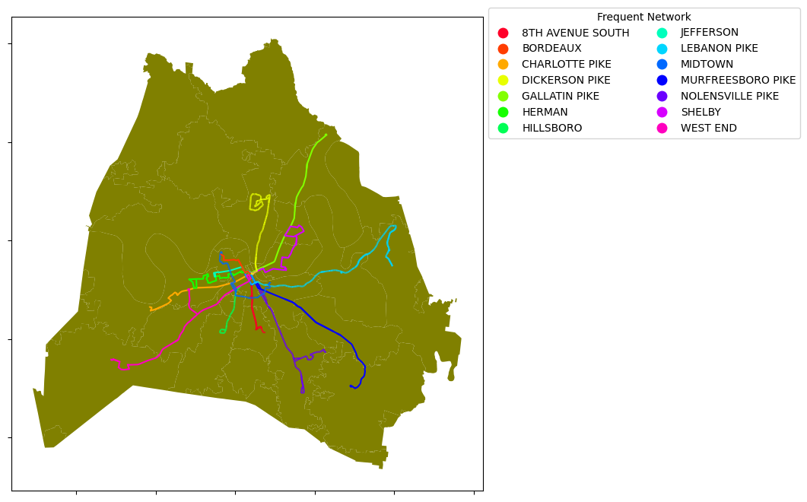
Frequent Network
These are proposed bus service routes in the Choose How You Move Transportation Improvement Program with increased frequency to 15 minutes or better during the day and operate 24/7.

Slide 10
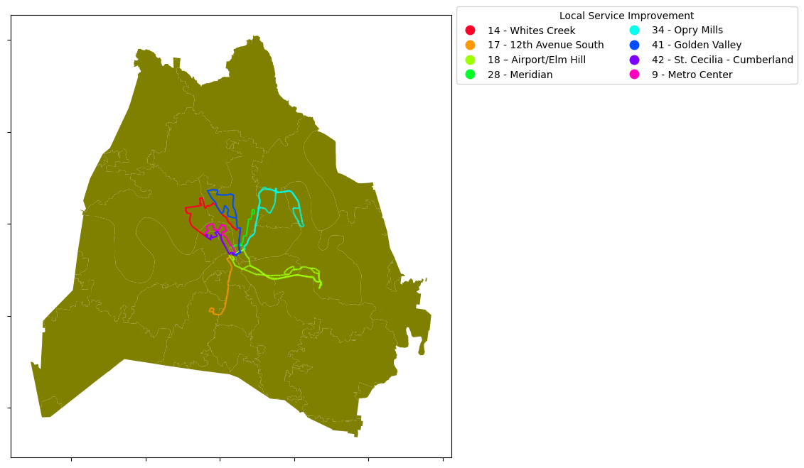
Local Service Improvement
These are existing bus service routes in the Choose How You Move Transportation Improvement Program with upgrades to service every 20-30 minutes during the day and operations until 12 a.m.

Slide 11
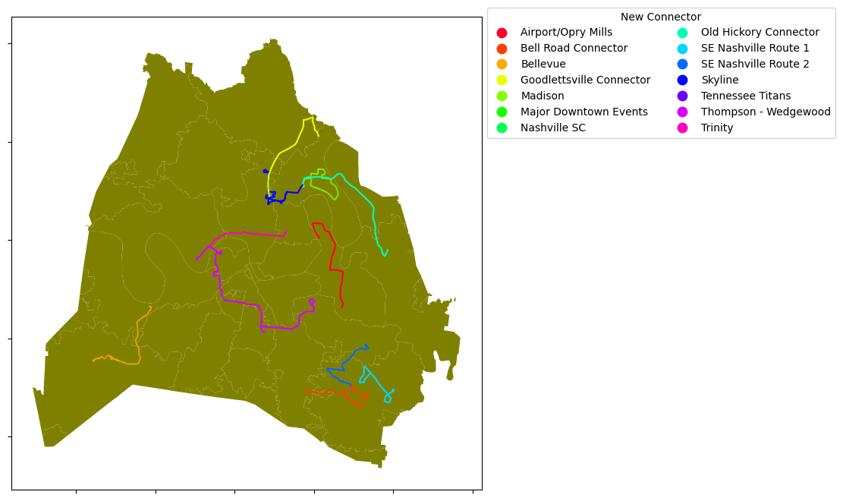
New Connector
These are new or expanded bus service routes in the Choose How You Move Transportation Improvement Program with service every 20-30 minutes during the day.

Slide 12
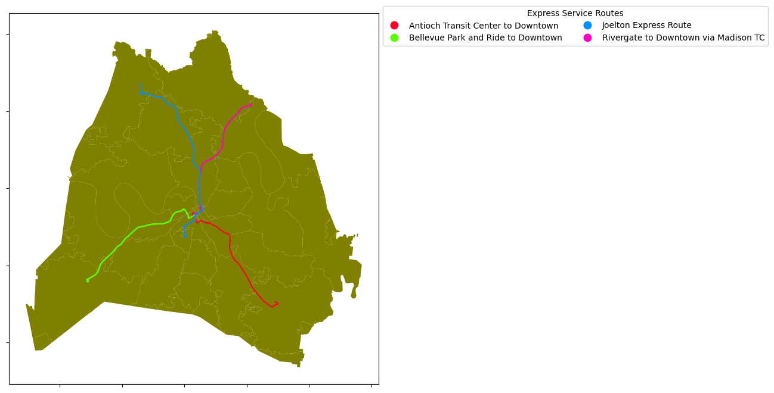
Express Service Routes
These are new express bus service routes in the Choose How You Move Transportation Improvement Program from Park and Rides to Downtown during peak times.

Slide 13
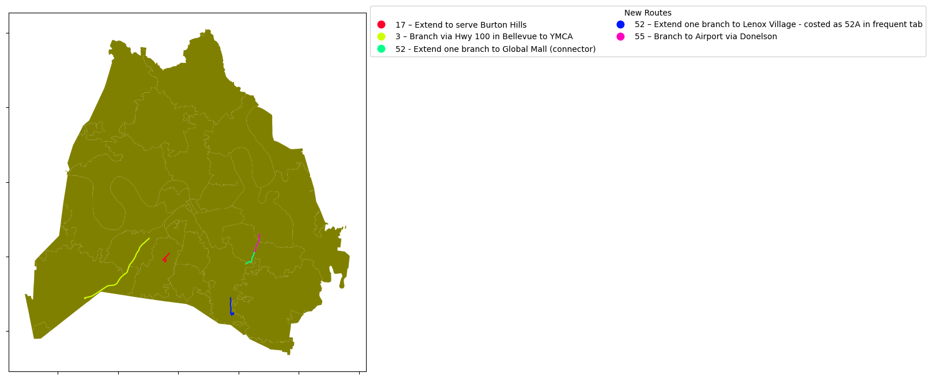
New Routes
These are extensions of bus service routes in the Choose How You Move Transportation Improvement Program to additional destinations.

Slide 14




Interactive Maps
Smart Signals
Transit Centers
Park and Rides
Stop Improvements

