Slide 3
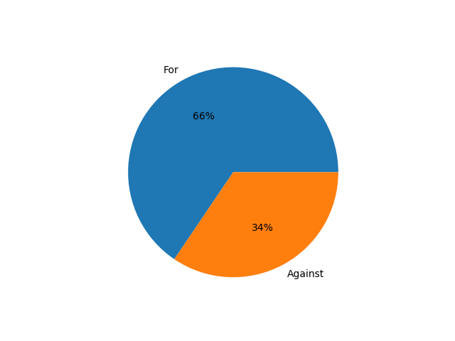
Metropolitan Transit Ordinance Vote 2024

Slide 4
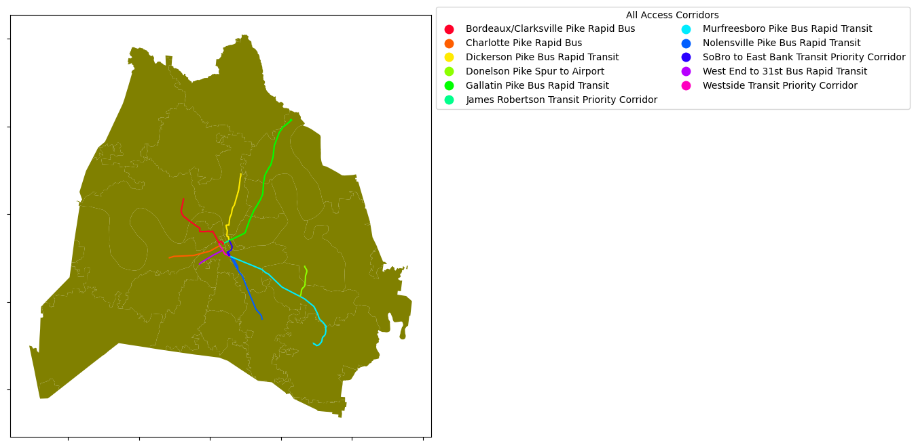
All Access Corridors
Proposed All-Access Corridors are identified in the Choose How You Move Transportation Improvement Program. These corridors are where we improve everything with better sidewalks, smarter signalized intersections, reliable transit service every 15 minutes or better, and improve safety conditions. They form the backbone of bus rapid transit network, and their design will be determined with additional community input with neighborhoods in mind.

Slide 5
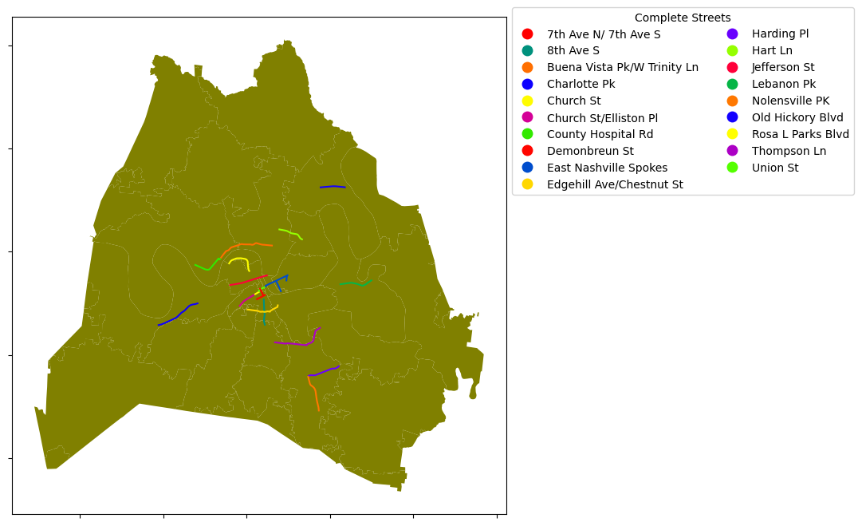
Complete Streets
Proposed Complete Streets are identified in the Choose How You Move Transportation Improvement Program. These streets are where we expand mobility options and safety at the same time. These areas have been identified as priorities for sidewalks, bikeways, and safety improvements. They include some locations where we have more serious injuries and fatalities on our streets. Their design will be determined with additional community input.

Slide 6
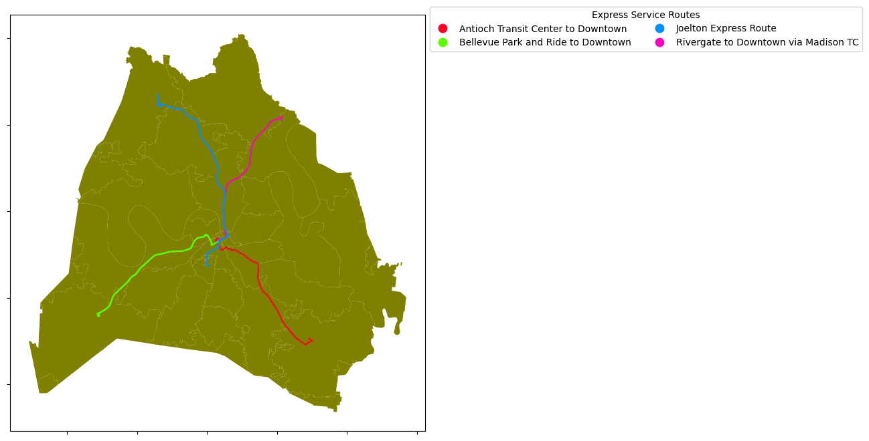
Express Service Routes
These are new express bus service routes in the Choose How You Move Transportation Improvement Program from Park and Rides to Downtown during peak times.

Slide 7
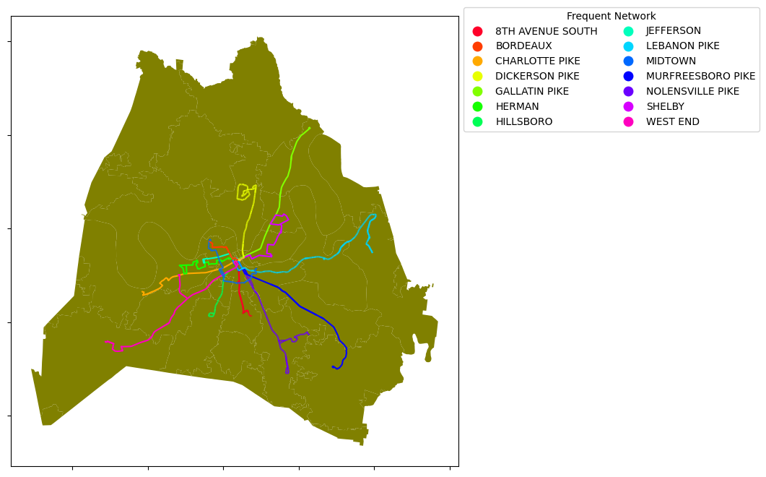
Frequent Network
These are proposed bus service routes in the Choose How You Move Transportation Improvement Program with increased frequency to 15 minutes or better during the day and operate 24/7.

Slide 8
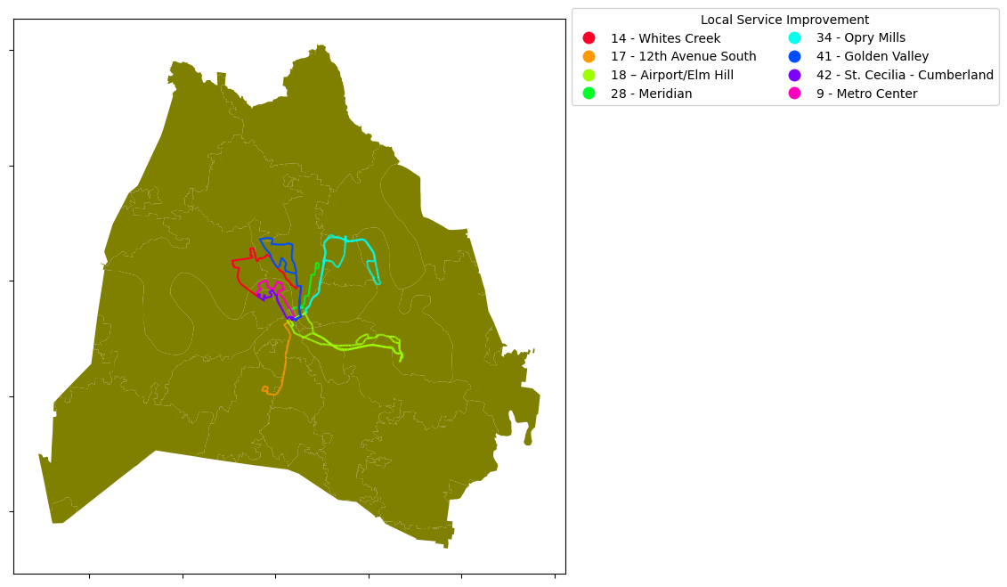
Local Service Improvement
These are existing bus service routes in the Choose How You Move Transportation Improvement Program with upgrades to service every 20-30 minutes during the day and operations until 12 a.m.

Slide 9
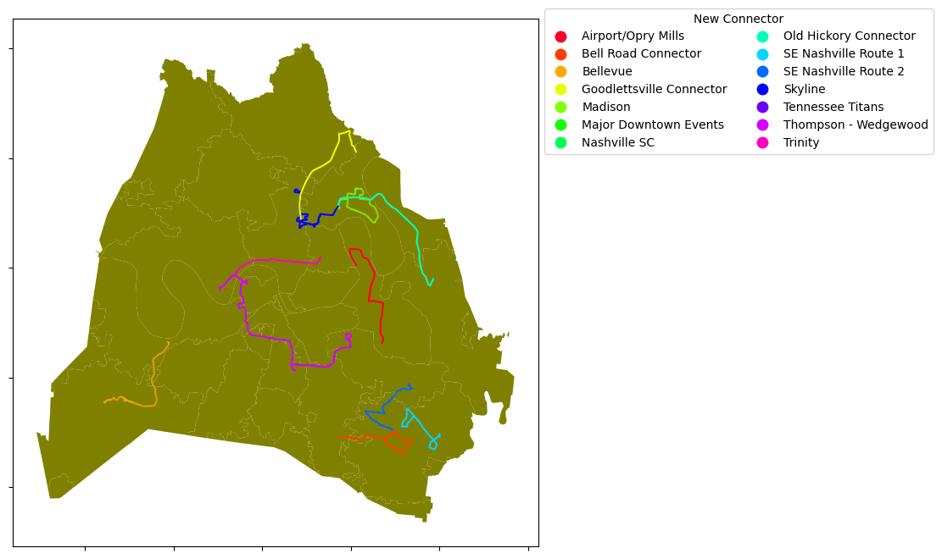
New Connector
These are new or expanded bus service routes in the Choose How You Move Transportation Improvement Program with service every 20-30 minutes during the day.

Slide 10
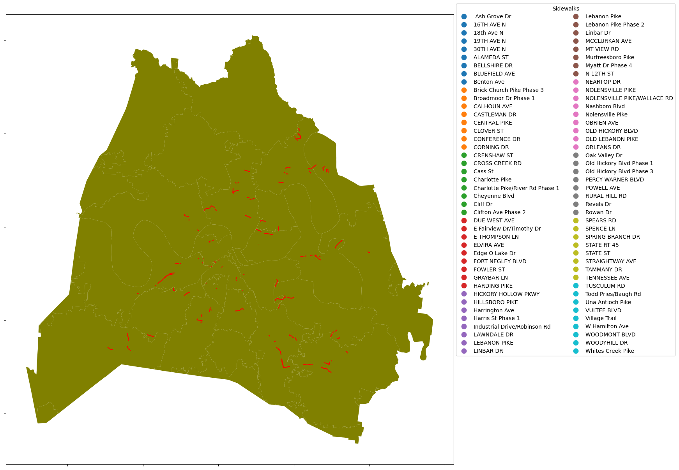
Sidewalks

