Slide 1
oml_sales_order_line_id
FROM sales_order_lines
oml_sales_order_id
FROM sales_order_lines
oml_part_id
FROM sales_order_lines
jmp_job_id

Slide 2
jmp_job_id
FROM jobs
jmp_source_method_id
FROM jobs
ima_method_id
FROM jobs
jmp_job_id
FROM jobs
jmp_part_id
FROM jobs

Slide 3
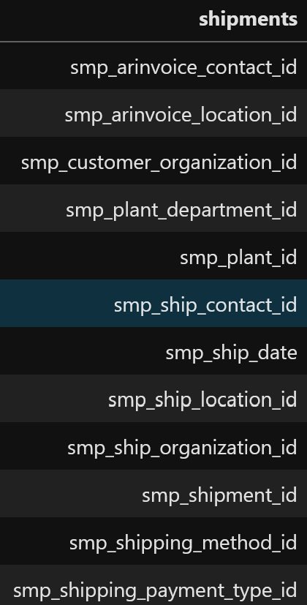
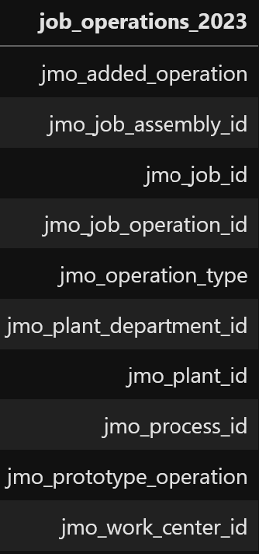
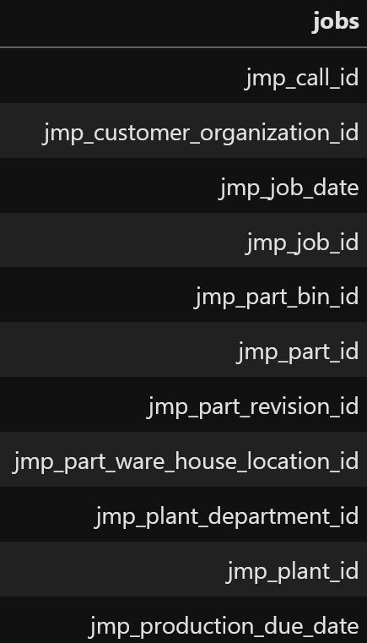
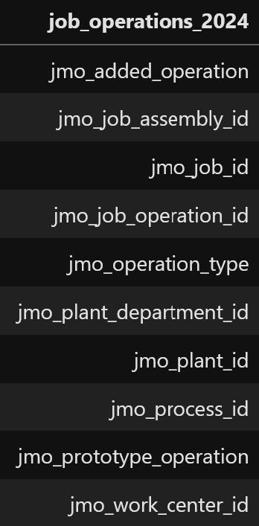
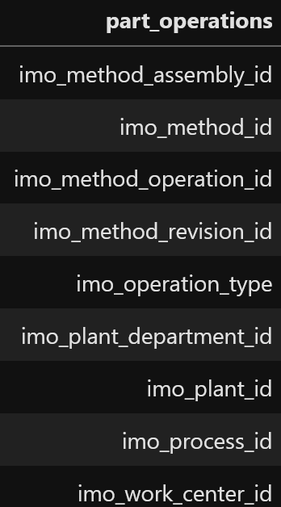
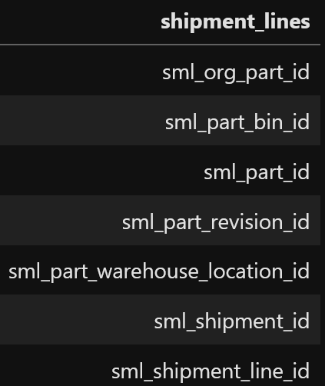
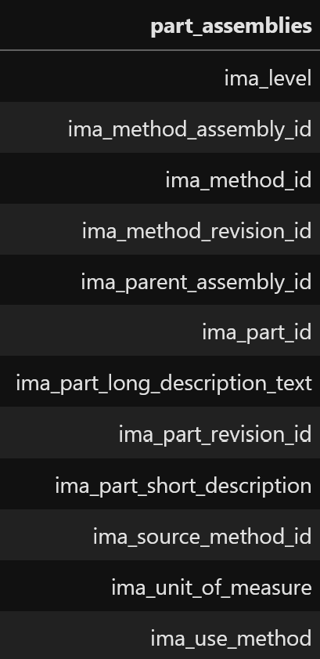
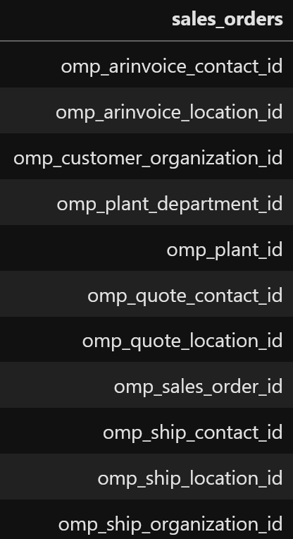
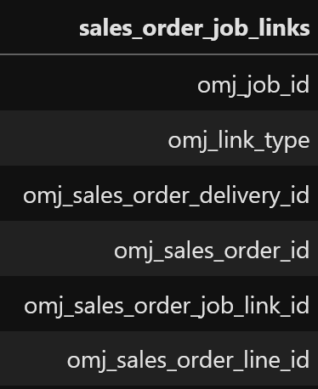
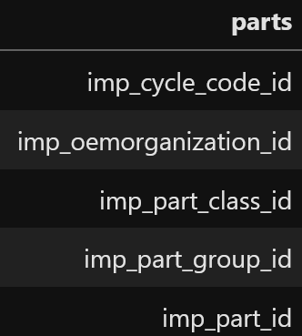
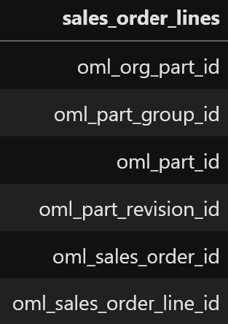
EDITOR

Slide 4
