Slide 1
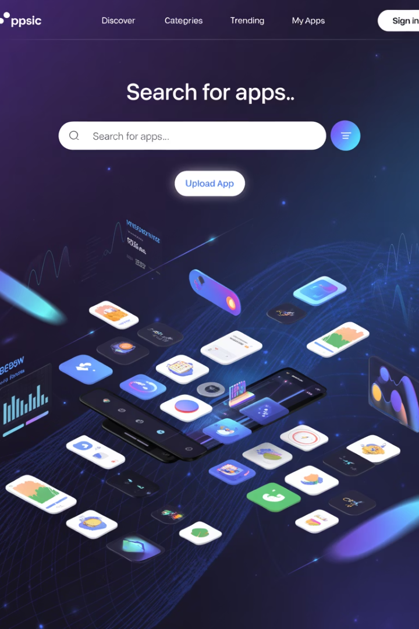
App-Trader Market Analysis
Strategic analysis of app marketplace data to identify highest potential acquisition targets based on ratings, pricing, and profitability metrics
By: Ricky Cortes, Jenni Roselle, Main Im(Andrew)
Notes:
Our team used data from both Apple and Google app stores to find highest potential profitability on app purchases.

Slide 2
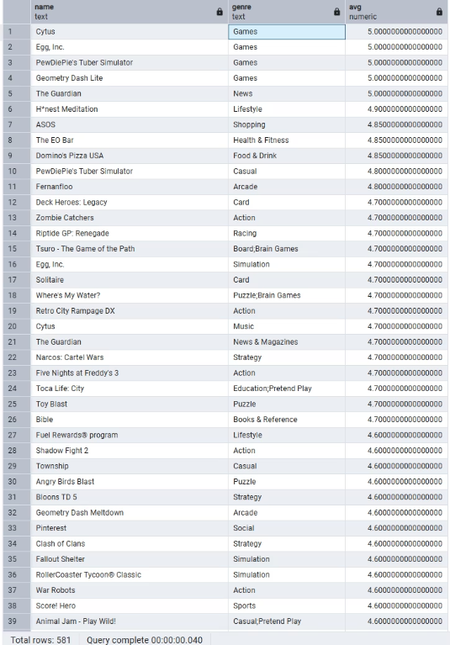
Optimal Price & Genre Strategy
Price Point
Free apps maximize download potential
Zero barrier to entry drives user acquisition
Target Genres
Games and News show highest ratings
Data merged from both app stores
Union analysis revealed rating trends
Notes:
We looked at multiple metrics to determine potential profitability. When it comes to price point- apps that are free to download provide easiest access to all users.
The most popular app genres based on rating trends from both stores are Games and News.

Slide 3

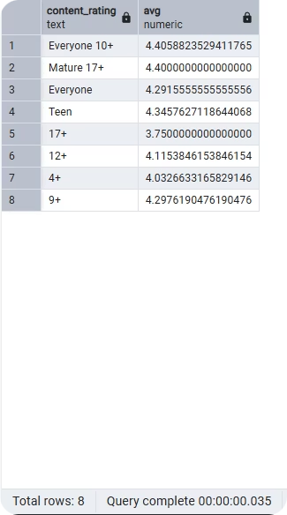



Content Rating Analysis
Everyone 10+ performs best
Highest average rating across platforms
Cross-platform analysis
Combined App Store and Play Store data
Rating correlation
Wider audience = better performance
Notes:
And the highest rated apps are those that are suited for Everyone ages 10 and up. By combining the data from Apple and Google, we were able to deduce that a wider audience equals better performance.

Slide 4
Acquisition Cost
Quality Filter
Longevity Forecast
Interchangeability
Based on initial price
Top-rated apps (4.7+)
Projected earnings over time
9 free apps with 4.7 rating
Notes:
We then used these findings to determine the ten apps that would provide us with the most potential profit. Based on acquisition cost, monthly cost, potential earnings and expected lifespan we selected the above ten apps as our portfolio for highest return on investment. It is worth noting that there were a total of 9 apps that show the same acquisition price and longevity and therefore the same return on investment. Those 9 apps are interchangeable in terms of profit.

Slide 5




Recommended 4th of July Campaign
Trivia Crack
Pinterest
Family-friendly gaming
Party inspiration platform
Multi-generational appeal
Strong visual discovery engine
Instagram
Cooking Fever
Connection and planning tool
Practice your cookout skills
High engagement metric
before the big day!
Notes:
For an upcoming 4th of July campaign, we chose four apps that both cater to the spirit of a typical 4th celebration and demonstrate high profitability based on acquisition cost and longevity. Pinterest is an excellent resource for party planning-from recipes to décor to outfit inspiration, you can find it all in one place. Instagram is a one stop shop for connecting with friends, sharing invitations, and collecting all your favorite memories. Trivia Crack provides endless entertainment for gatherings of all ages. And Cooking Fever will give you all the simulated cookout practice you need!
We performed all of our analysis in pgAdmin using SQL and exported data to Excel to create tables. We worked with data that was provided to us. We were limited in our analysis by incomplete data on current download rates, which would have aided us in predicting popularity of apps across the board. With this limitation in mind, we have made our most informed recommendations on profitability and targeted ad campaigns. Thank you.

