Slide 1

COST/PROFIT ANALYSIS FOR MOBILE APPS
Ooty Tamilnadu India
Team Lead: Jyothi
Lillian
William

Slide 2
What we did
Based on our research, we created formulas to identify the most profitable apps by utilizing Common Table Expressions (CTEs) in our SQL queries.
We used our CTEs to analyze and identify general app characteristics that AppTrader can target to maximize profitability.
We determined the most profitable genre was “Games”, the optimal price range was 0 to $2.50, the optimal content rating was “Everyone” and it is invaluable that the app is in both stores, since both stores means essentially double income.
Our queries allowed us to identify the top 10 most profitable apps overall, as well as the top 4 most profitable apps suited for a Fourth of 4th of July.

Slide 3
Continued...
To figure out what apps would be profitable for the 4th of July theme we relied on secondary data from:
“National Retail Federation” for consumer behavior on the 4th in general, and “American Automobile Association” for travel behavior, since we noticed that this 4th of July falls on a weekend (same as last year).
After reviewing the secondary data, we determined that the genres that the apps in stores would fall into would be the Apple genres “Travel”, “Food & Drink” and “Social Networking”.
From here, we used our previous CTE to query the most profitable apps in these genres, making judgements from there.

Slide 4
Top 10 apps
name | net_income | aquire_cost | rounded_rating | longevity_months
ASOS | $1,109,000.00 | $25,000.00 | 4.75 | 126
Cytus | $1,109,000.00 | $25,000.00 | 4.75 | 126
Domino's Pizza USA | $1,109,000.00 | $25,000.00 | 4.75 | 126
Egg, Inc. | $1,109,000.00 | $25,000.00 | 4.75 | 126
PewDiePie's Tuber Simulator | $1,109,000.00 | $25,000.00 | 4.75 | 126
The Guardian | $1,109,000.00 | $25,000.00 | 4.75 | 126
The EO Bar | $1,064,100.00 | $69,900.00 | 4.75 | 126
Adobe Illustrator Draw | $1,055,000.00 | $25,000.00 | 4.5 | 120
AJ Jump: Animal Jam Kangaroos! | $1,055,000.00 | $25,000.00 | 4.5 | 120
Angry Birds Blast | $1,055,000.00 | $25,000.00 | 4.5 | 120

Slide 5
Cost analysis – CTE breakdown
We used a CTE’s to determine profitability based on the assumptions that the AppTrader’s research told us we needed to:
Find the higher price between Apple and Google,
Then find the lower rating between Apple and Google.
Then round the rating to the nearest 0.25,
Calculate the longevity months from the rounded rating;
rounded_rating * 24 + 12 AS longevity _months
Then calculate the acquire cost; ROUND(lowest_rating/0.25) * 0.25 AS rounded_rating
And finally calculate the net income;
((longevity_months * 9000 - aquire_cost::numeric)/1000000)::money AS net_income_in_millions

Slide 6
Top 4 Apps
“Facebook” – People can find public events and they can communicate with their families.
“Paprika Recipe Manager” – people can find recipes for their get-togethers
“Airbnb” – people will be out of town and need lodging, or a space to host their family
“Fly Delta” – consumer data shows that when 4th of July falls on weekend, people tend to travel by air more
name | net_income | apple_genre
Airbnb | $947,000.00 | Travel
Paprika Recipe Manager | $922,100.00 | Food & Drink
Facebook | $839,000.00 | Social Networking
Fly Delta | $731,000.00 | Travel

Slide 7
Secondary data – National Retail Federation
From Retail Wire:
“According to the National Retail Federation (NRF), 87% of consumers plan to celebrate Independence Day this year. In comparison, data and tech company Numerator expects a slightly lower outcome of 73%. Per the company’s verified purchase data and a sentiment survey of more than 5,500 consumers, the top Fourth of July plans include:
Spending time with family and friends (58%)
Grilling or barbecuing (56%)
Participating in public events (31%)
Preparing food at home (26%)
Hosting gatherings at their residence (18%)”

Slide 8
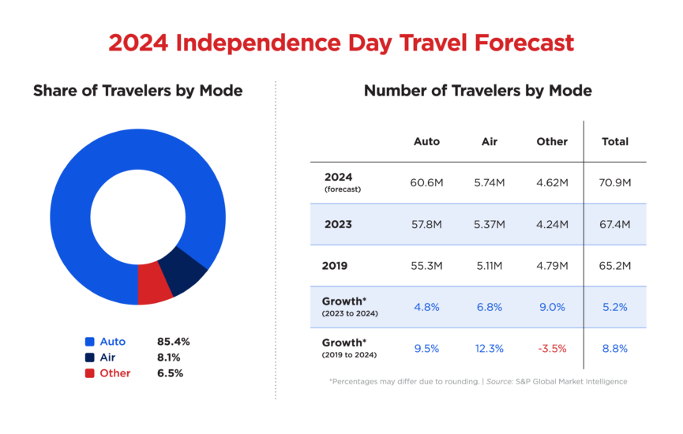
Secondary Data – “American automobile association”

