Slide 1
Firstly, this chart is showing the top causes of death for the duration of the civil war (1861-1865) and the year after the war ended for some added context (1866).
You’ll notice in this list of top reasons for death that illness is accounting for most of them.
You’ll also notice that the further into the war it gets, the higher the burials will increase.
However, I believe the increase in deaths is not entirely due to the actual fighting of the war.
After looking specifically at burials for fighting age males (which is 18-45) the number of females and males buried in the cemetery is still very similar.
Despite females not fighting in the war their burial numbers still increase as the war progresses and because of the large number of females buried in the cemetery it can be deduced that this cemetery was most likely primarily used for civilians even during the war.
Nashville was captured very early in 1862 meaning the city spent most of the war under Union occupation and very few battles happened around Nashville.
While the city is under the Union Army’s control, there are several restrictions enforced that limit the ability of the civilians and the city overall to function properly.
A critical part of city infrastructure is having medical care (even in the 1860s) and I believe that while under Union occupation these critical medical necessities were inhibited, therefore leading to the indirect increase of civilian fatalities in Nashville.
Aside from just medical care there are several problems that a military occupation will inflict on a city's population so there were no doubt many reasons why life in Nashville got considerably worse during that time, leading to more deaths.
It's unlikely the Union would have sacrificed their own supplies for the people they were occupying, especially in a time of war.
I have included the year following the end of the war to highlight that while the fighting had ended, burials related to illness continued as I believe this was the residual effect of the occupation and the city was still recovering from the war.
Although during the war, soldiers both Union and Confederate were buried here, many of them were re-buried after the war’s conclusion in other military specific cemeteries nearby.

Slide 2
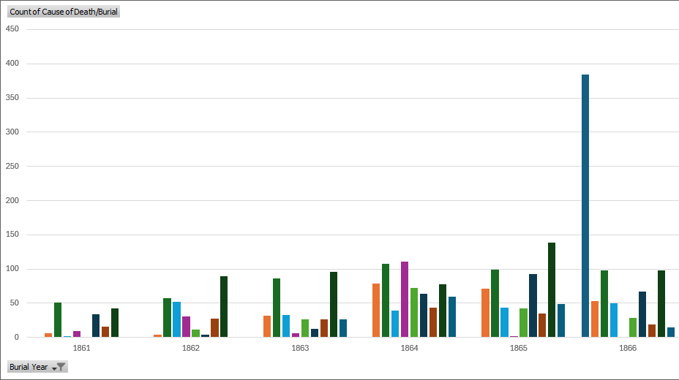
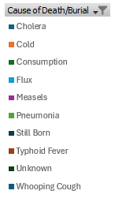
Top Causes of Death During Civil War Era Nashville
Number of Burials
Year

