Slide 1
Tennessee Opioid Use Trends
Team Atlantis

Slide 2
Intro
Information from the Centers for Medicare & Medicaid Services and the Tennessee Department of Economic and Community Development were combined to search for possible trends in opioid prescriptions, overdose deaths, and unemployment across the period of 2013 to 2018.
Our team examined a variety of possible relationships between these variables to explore how opioid use has changed in the state.

Slide 3
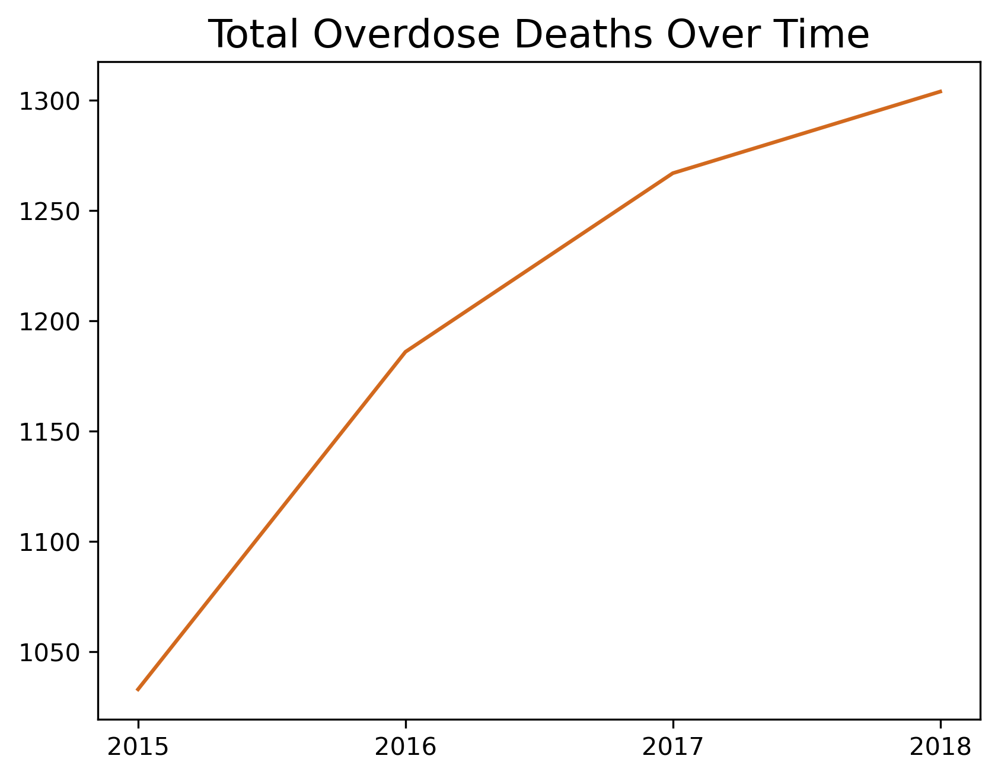
Deaths Over Time
The rate at which overdose deaths increasing is slowing down
The increase might be due to population growth

Slide 4
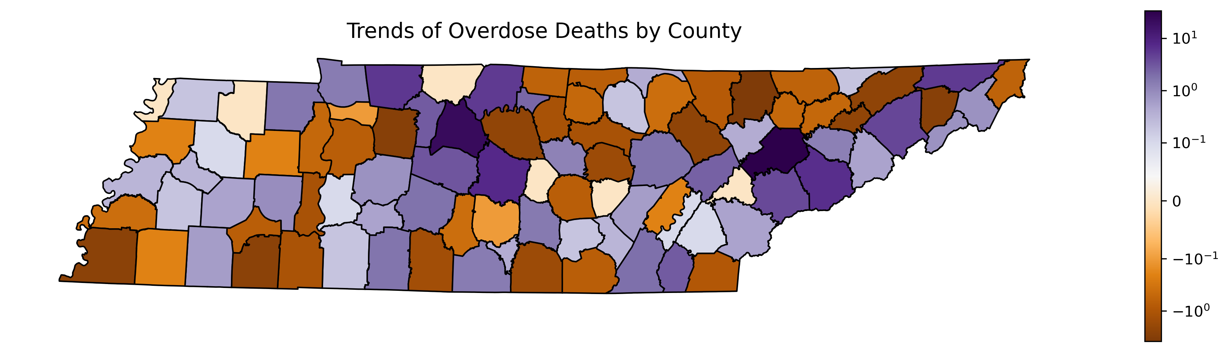
Deaths Over Time
Davidson and Knox have major increases in overdose deaths possible due to the population
Shelby however seem to buck that trend with downward trend in overdose deaths

Slide 5
Spending on Opioids
Next we looked at how the amount spent on opioids related to overdose deaths, both in strict numbers and as compared to non-opioid prescription spending.
To normalize the available data, we compared annual averages per capita across the counties of Tennessee.

Slide 6
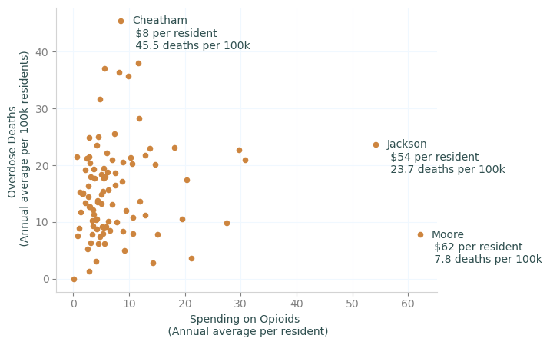
Death rates vary within narrow band of spending
Most Tennessee counties spend, on average, less than $10 per resident on opioid prescriptions each year, but average annual overdose death rates per hundred thousand range from zero to over 40.

Slide 7
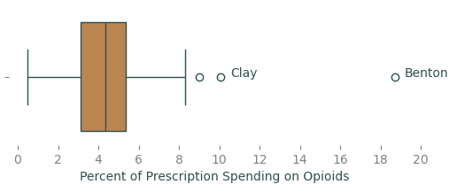
Percent of prescription spending on opioids
For over 75% of Tennessee counties, less than 6% of prescription drug costs go to opioids. But for Clay, Coffee, and Montgomery counties, that number is over 8%, and in Benton 18.7% of prescription costs are for opioids.

Slide 8
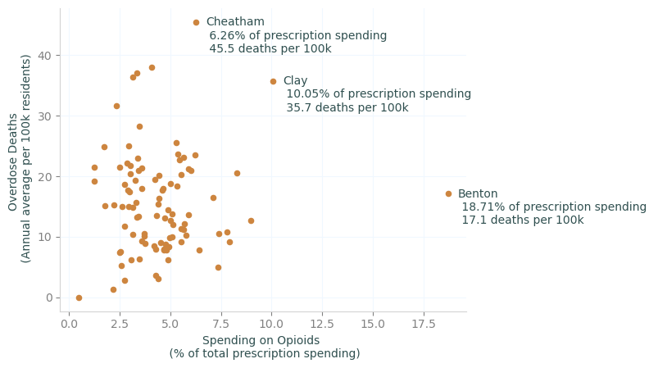
Increased proportion of opioid spending not related to death rate
The percentage of prescription costs spent on opioids has no strong correlation with the overdose death rate across Tennessee counties, with a correlation coefficient of 0.054.

Slide 9
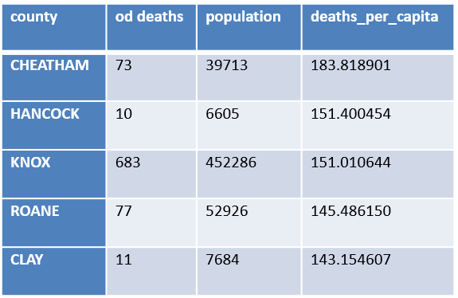
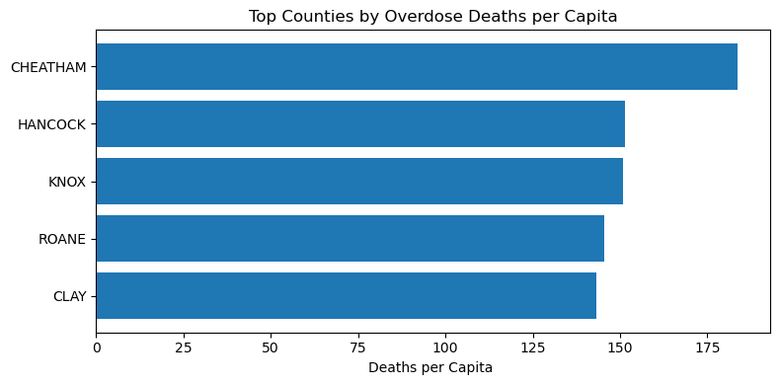
Overdose Deaths Per Capita
Cheatham has the highest overdose death rate (184 per 100000).
Rural counties (Hancock, Clay, Roane) also show higher deaths per capita

Slide 10
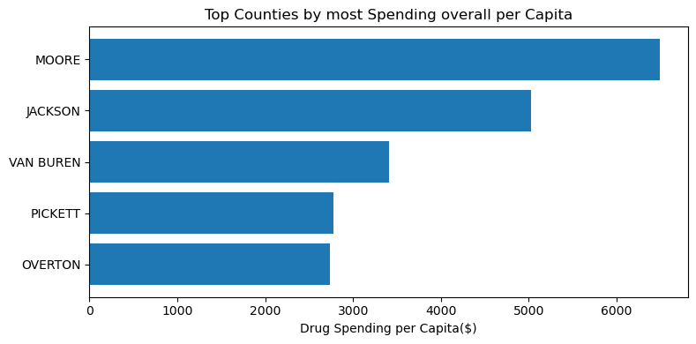
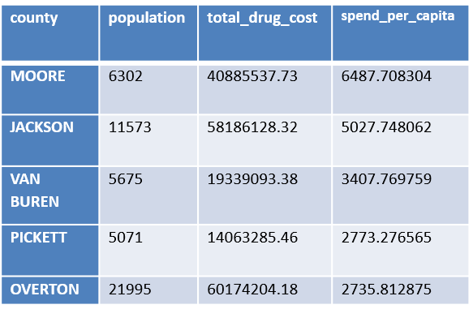
Spending Overall Per Capita
Moore leads with $6,488 per person in drug spending.
High spending concentrated more in small rural counties.
Spending does not correlate with population size.

Slide 11
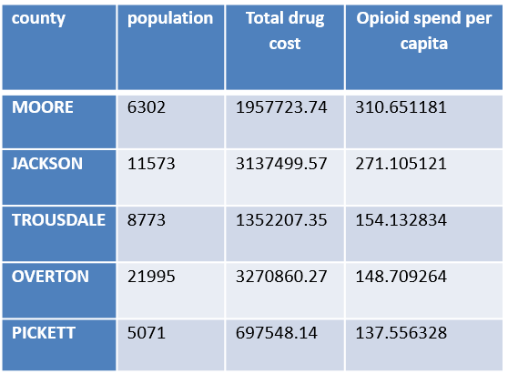
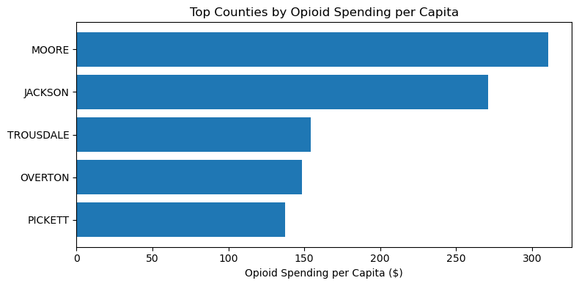
Opioid Spending Per Capita
Moore leads $311 per person
High opioid spend overlaps with high total spend counties.
Systemic prescribing patterns, not isolated cases.
Jackson, Trousdale, Overton show elevated levels.

Slide 12
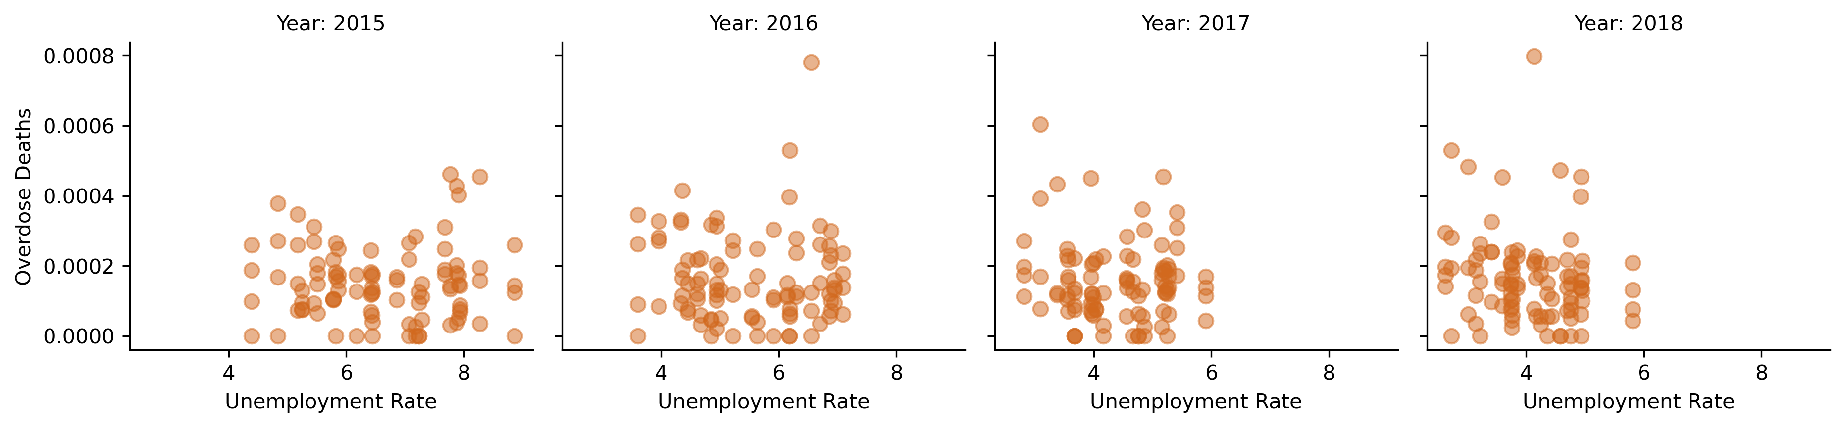
Unemployment
The unemployment rate has been going down but the number of deaths has not

Slide 13
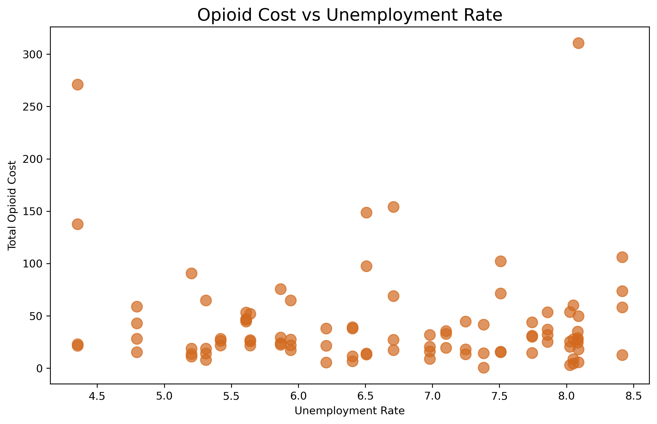
Unemployment
Unemployment does not impact the cost of Opiods

Slide 14
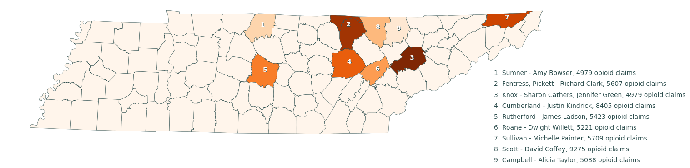
Top Prescribers of Opioids
The top ten prescribers of opioids, by number of claims, are scattered in the northeastern part of the state, but are particularly concentrated in the counties north of Knoxville.

Slide 15
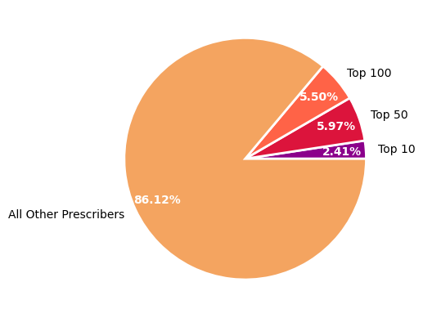
Top Prescribers of Opioids
The top hundred prescribers by number of opioid claims account for 13.9% of all opioid claims in Tennessee, despite accounting for only 1% of physicians who prescribed opioids from 2013 – 2017.

Slide 16
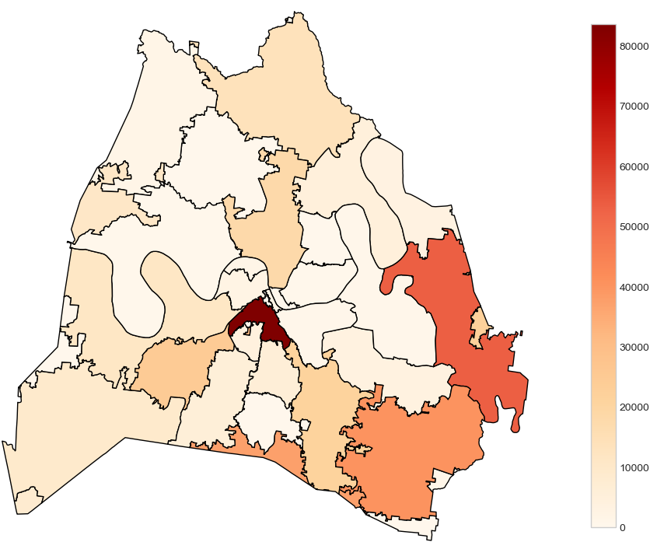
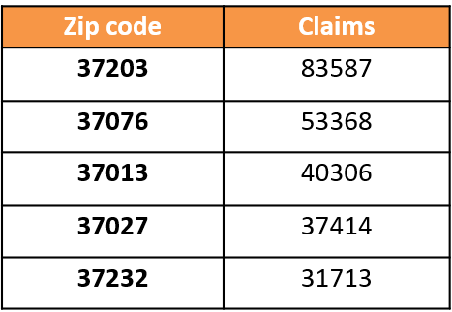
Davidson County
Zip codes with most opioids prescribed

Slide 17
Conclusion
Because the prescription claim data was only available as an aggregate over the 2013 – 2017 period, analysis of changes in trends over time was not possible. A more granular data set would allow for greater awareness of trends.
Additionally, prescriber addresses were tied to their specific zip code rather than a county. Because some zip codes span multiple counties, any analysis done on claims numbers on a per-county basis will count the entirety of claims from those prescribers, meaning the prescriber’s claims may be double or triple counted.
The data available about overdose deaths does not state whether those deaths are caused by overdoses on opioids or other types of drugs, and does not contain information on whether they were prescribed medications or not. This additional information would allow for valuable further analysis.
Finally, there are many other factors that may influence the use of opioids that cannot be predicted by or measured with these data sets. A broader look may find additional facts that help in identifying at-risk areas or proposing solutions to overuse of opioids.

Slide 18
Further Notes About the Data
Data on prescription claims, prescriber locations, and overdose deaths were retrieved from the Centers for Medicare & Medicaid Services, and supplemented by unemployment and population data from the Tennessee Department of Economic and Community Development (ECD).
Data on prescription claims covers the years 2013 – 2017 as an aggregated amount.
Overdose death data covers the years 2015 – 2018.
Unemployment data covers the years 2011 – 2017.

