Slide 1
Missed Trash Pickups in Nashville
Team Atlantis

Slide 2
Project Goals
Our team will be analyzing data on missed trash pickups for the city of Nashville and applying three different formulas for fines to calculate the impact to Nashville’s trash hauling services.
We will also generally summarize where misses tend to occur in the city, by both zip code and pickup route, and provide recommendations for future analysis to ensure equal access to services for all residents.

Slide 3
Data Retrieval & Cleaning
Data on missed trash pickups from November 2017 through October 2019 was collected via hubNashville from customer complaints about trash services.
Data was filtered for relevancy by looking for “missed pickups”, “[trash] not picked up”, and similar patterns.
Street addresses were extracted and normalized to identify the street and building number.
Complaints submitted on behalf of an entire street made up less than 1% of the data and were discarded for consistent analysis.
Complaints with no address associated were less than 0.25% of data and were also discarded.
Duplicate requests for the same address on the same day were also discarded.

Slide 4
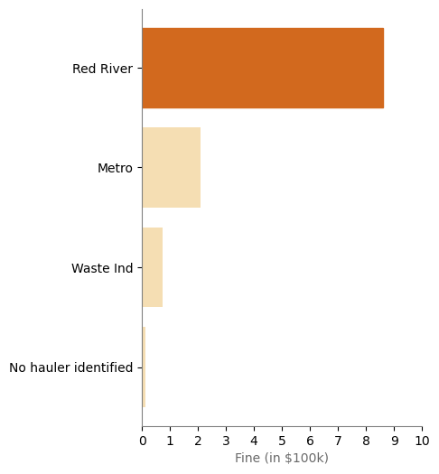
Damages for Chronic Missed Pickups
If charged a $200 fine for every missed pickup at an address after the first, Red River Waste Solutions would owe over $850,000.
Additionally, around $13,000 could potentially be available to the city if the complaint tracking system more thoroughly identified the haulers responsible for pickups at the caller’s address.

Slide 5
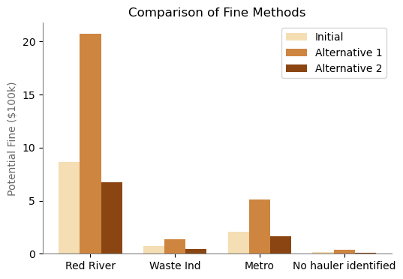
Other Fine Structures
Alternative method 1 would nearly double the fine amount each company pays compared to the initial method, while alternative method 2 would be slightly lower for each.
Alternative 1: $1,500 for every combination of three missed pickups at a single address within 180 days.
Alternative 2: $1,500 for each three missed pickups at an address within 180 days.

Slide 6
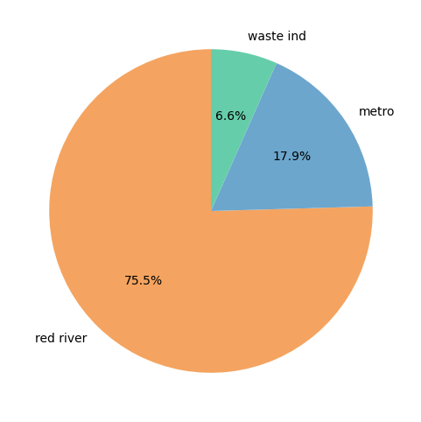
How do metro crews compare to Red River?
While metro crews missed only ¼ of the number of pickups that Red River did, without knowing the total number of locations that each crew was responsible for we can’t compare their rates of misses.
Additionally, other factors related to the locations that each crew covers may impact those rates independent of the company itself.
Trash Hauler | Missed Trash Pickup
Red River | 14,373
Metro | 3,574
Waste Industries | 1,349

Slide 7
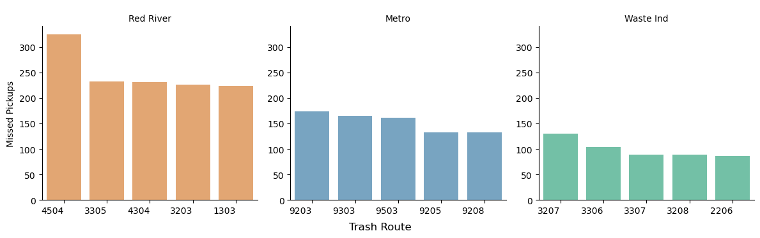
Routes with Highest Missed Pickups (By Hauler)
Multiple high-impact routes for Red River compared to the others.
Metro and Waste Industries show fewer extreme outliers, indicating more consistent route performance.
Cannot compare routes proportionally because we don’t have data on total stops or route sizes.
Still useful for identifying routes that may need operational review or resource adjustment.

Slide 8
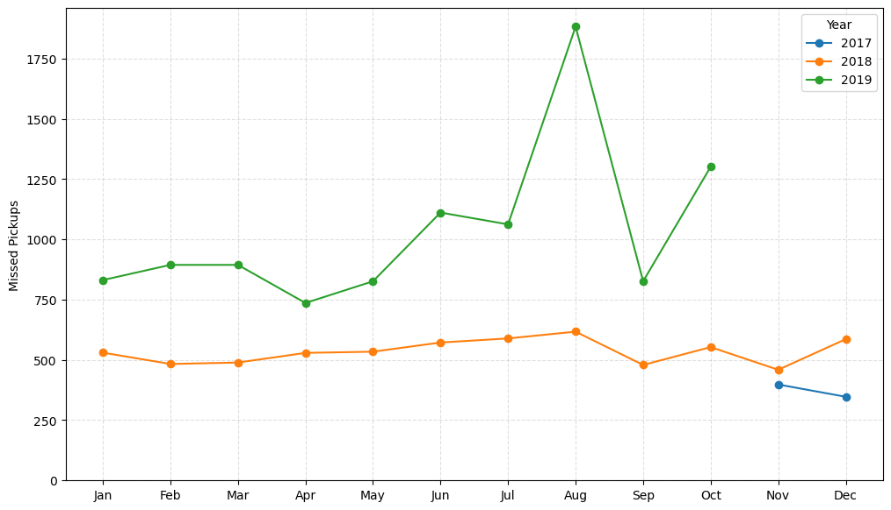
Missed pickups by Month
Shows monthly trends in missed pickups from Nov 2017 through Oct 2019.
2018 remained relatively stable, 450–600 missed pickups per month.
2019 showed a steady rise every month, with consistently higher misses in summer.
August 2019 experienced a major spike (1882 missed pickups)

Slide 9
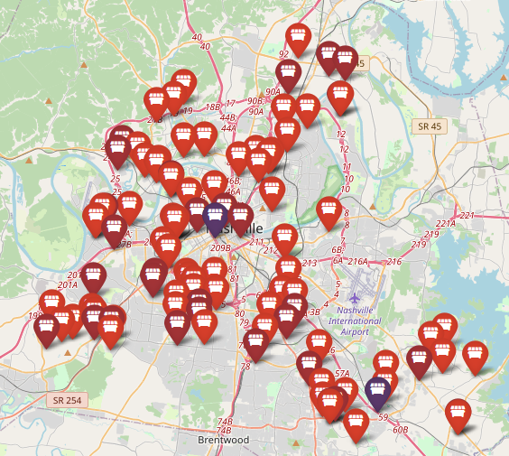
Frequently Missed Locations
Street | Missed Pickups
Old Hickory Blvd | 103
Buena Vista Pike | 92
Harding Pl | 89
Granny White Pike | 80
Clarksville Pike | 63
Old Hickory Blvd is the street with the most missed pickups – over one hundred – as well as being the location of the building with the third most misses reported.
While most addresses report missed pickups less than three times, the top-missed addresses have reported missed pickups on over 20 different dates!

Slide 10
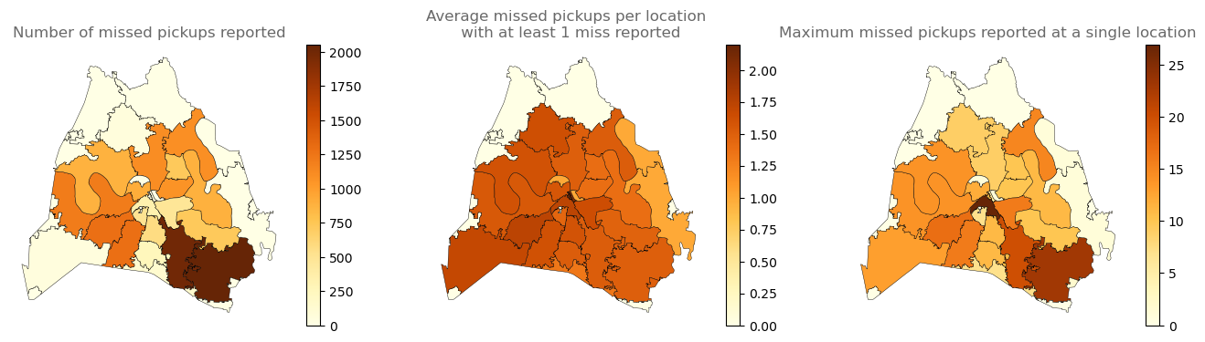
Geographic Analysis
The highest number of missed pickups are in the southeast of the city, though addresses near downtown Nashville that report missed pickups report them more frequently than in other areas.

Slide 11
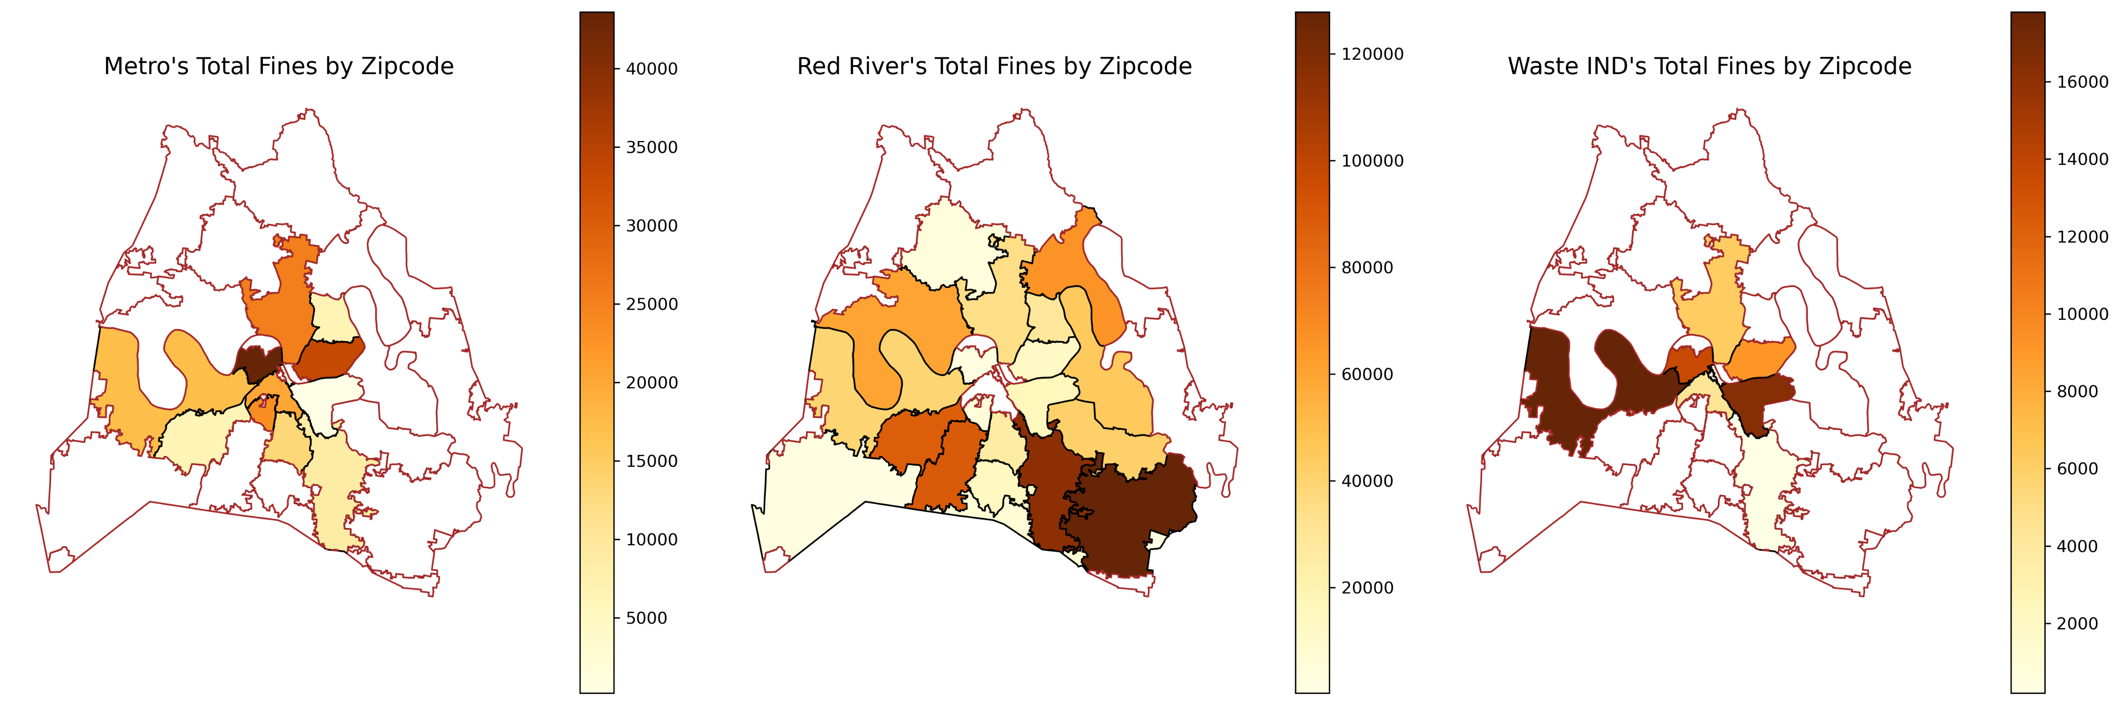
Trash Hauler Locations
Each trash hauler’s fines are focused in different areas of the city, but no trash hauler’s fines are evenly spread across their territory, possibly due to differences in population density.

Slide 12
Conclusions
While the data provided allows us to calculate possible fines to the trash hauling company, it is difficult to make comparisons about their performance for a few reasons:
The data is based on complaints reported by residents and may not accurately map to actual missed pickups.
Incorporating information about the number of locations each route and company cover would be needed to determine the rate of missed pickups.
Further exploration to ensure trash services are available equitably could also look at differences in pickup rates by council districts, average income or home price for a neighborhood, or the day of week that pickup is scheduled for.
Finally, there may be differences within the haulers, such as salary or work culture, that impact pick-up rates, rather than details about the pick-up locations.

Slide 13
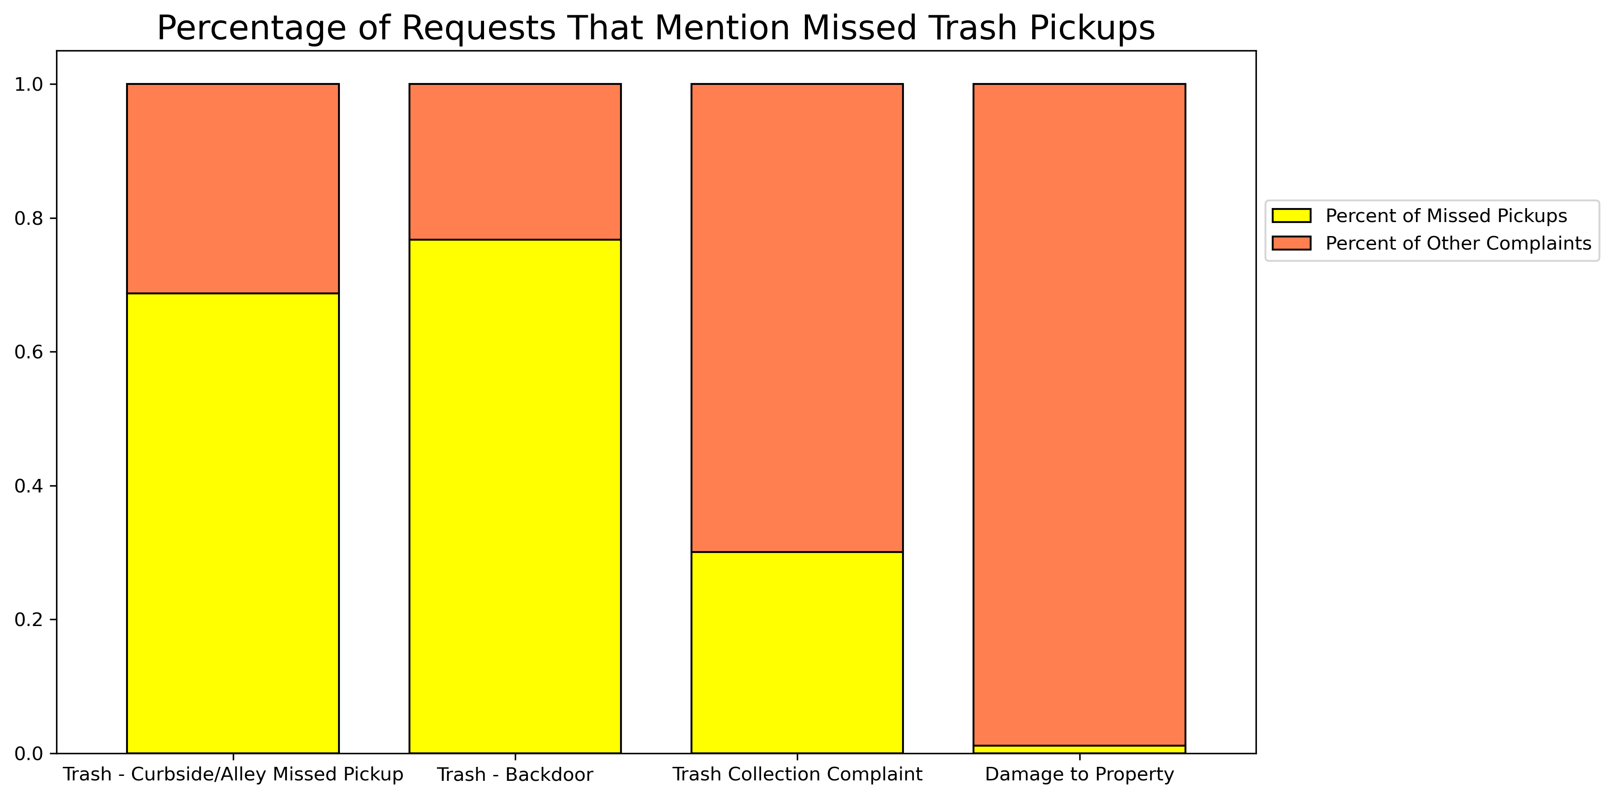
Conclusions
The request categories are inconsistently used by residents.

