Slide 1
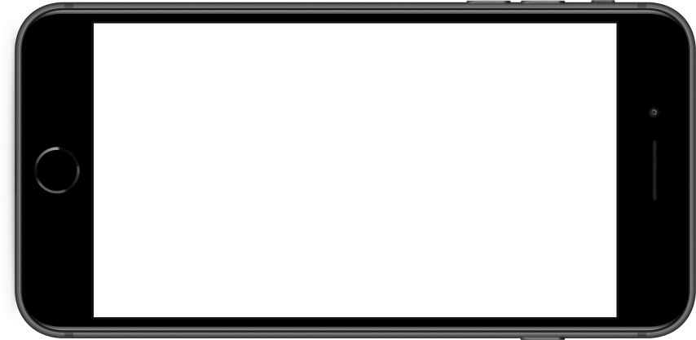
Pi Day-Valentine’s Day Themed Campaign
Goal: To purchase applications that are profitable and appropriate for Pi Day-Valentine’s Day theme campaign
Based on the parameters set for each application:
*The purchase price of the app is $25,000 or 10,000 times the market price of the app with a $1000 marketing spend per month after purchase.
*Apps are expected to generate $5000 per month from advertising and in-app purchases with 50% going to the developer and then App Trader.
*Estimating the longevity of an app solely based on the app’s current ratings

Slide 2
Pi Day-Valentine’s Day Themed Campaign
The first three applications are in line with the Pi Day theme and the fourth recommended application is for the Valentine’s Day theme campaign.
* PewDiePie’s Tuber Simulator
* Domino’s Pizza
* Geometry Dash Lite
* Solitaire
Each recommended application has met the criteria of having the highest estimated profitability, longest lifespan, highest ratings and staying on target with the campaign themes.

Slide 3
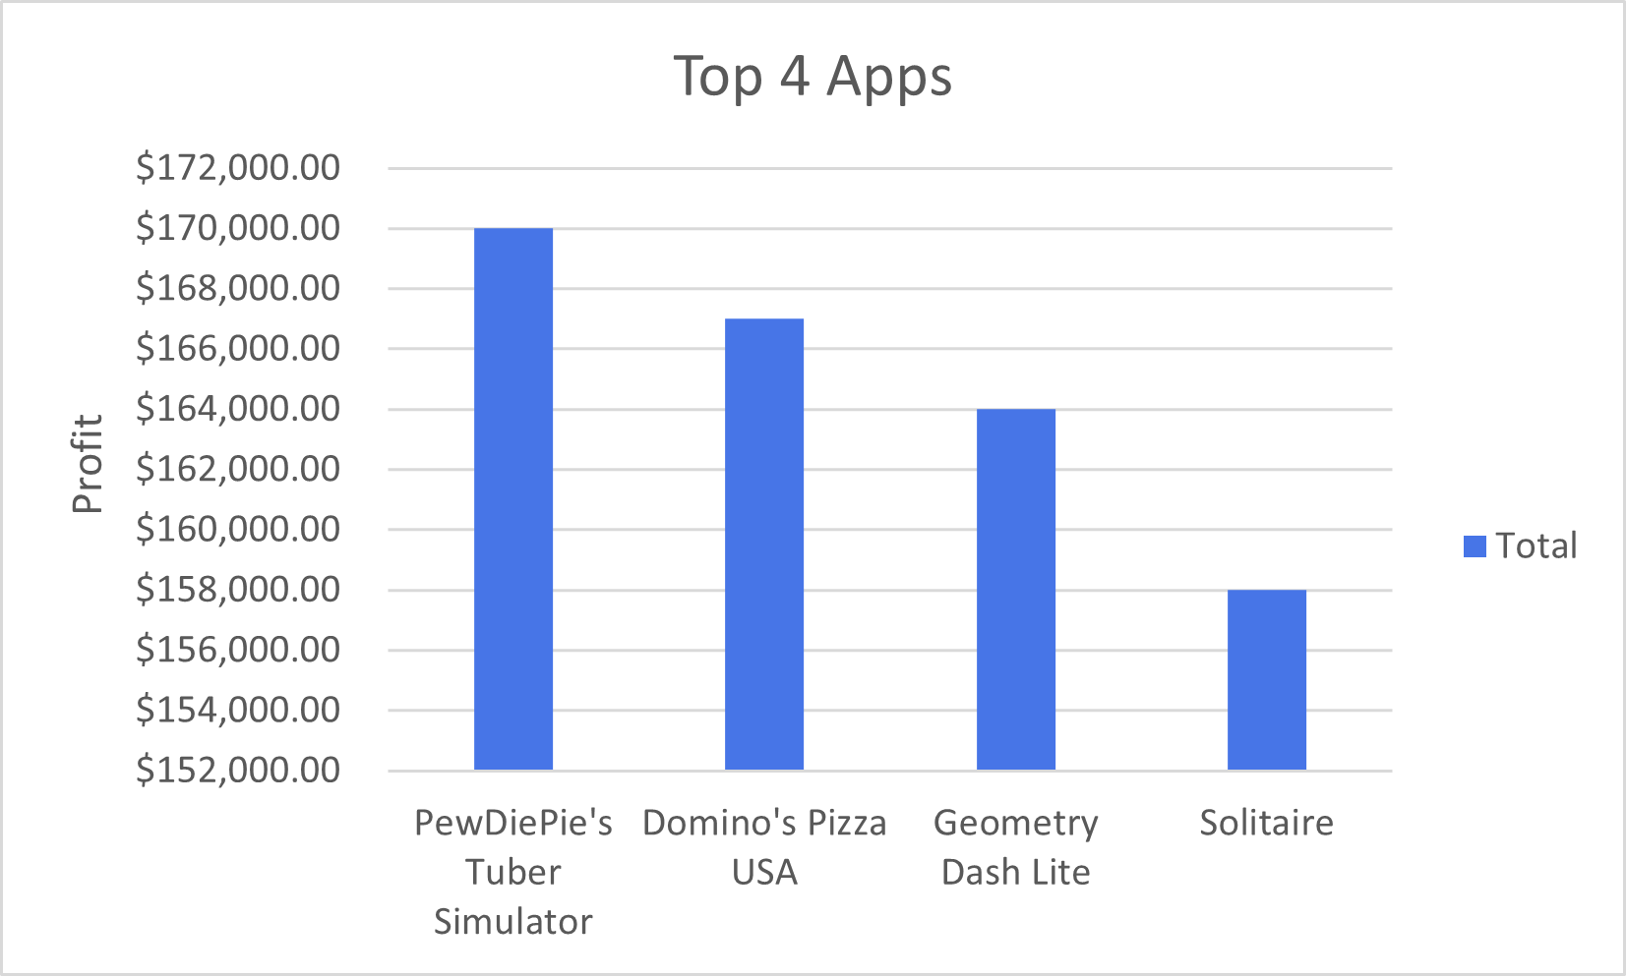
Pi Day-Valentine’s Day Themed Campaign

