Slide 1
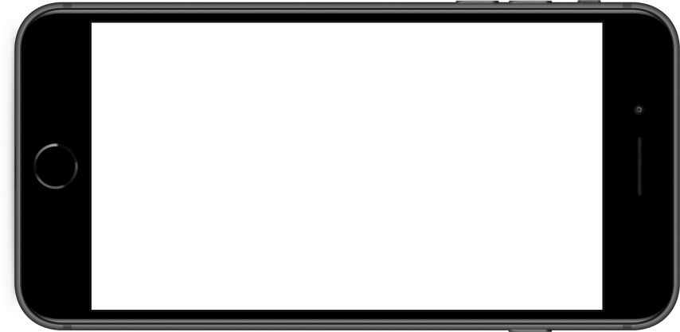

App Selection
Goal: To select applications with the highest expected ROI given a set of parameters from prior research.
Anticipated app cost is $25,000 or 10,000 times the market price of a given app.
App Trader commits to spending $1000 per month for marketing.
Marketing budget is combined for both stores, so availability in both stores is preferred.
Each app is expected to generate $5,000 per month from in-app purchases and advertising. This revenue will be split with the developer and App Trader.
Developer retains all proceeds from market sales.
Estimated lifespan is measured by rating, where a 0 rating equals 1-year and each additional .25 in rating adds 6 months.
Notes:
Guidelines.

Slide 2
Initial Selection
Goal: To narrow the list of apps to be considered.
Considering marketing budget goes farther when the application is represented in both stores, we chose to select only the applications with a presence in both stores. The total number of applications that exist in both stores is 328.
To further narrow our selection, we opted for applications with an above average life expectancy. Lifespan for a given app was estimated based on criteria from prior research. Average lifespan for an application that exists in both tables is ~110 months.
Notes:
Overall average rating for a given application was obtained by combining the ratings from each store and dividing by two. There are some instances where the ratings vary greatly between the given stores, but they fail to be considered for our selection due to other criteria.

Slide 3
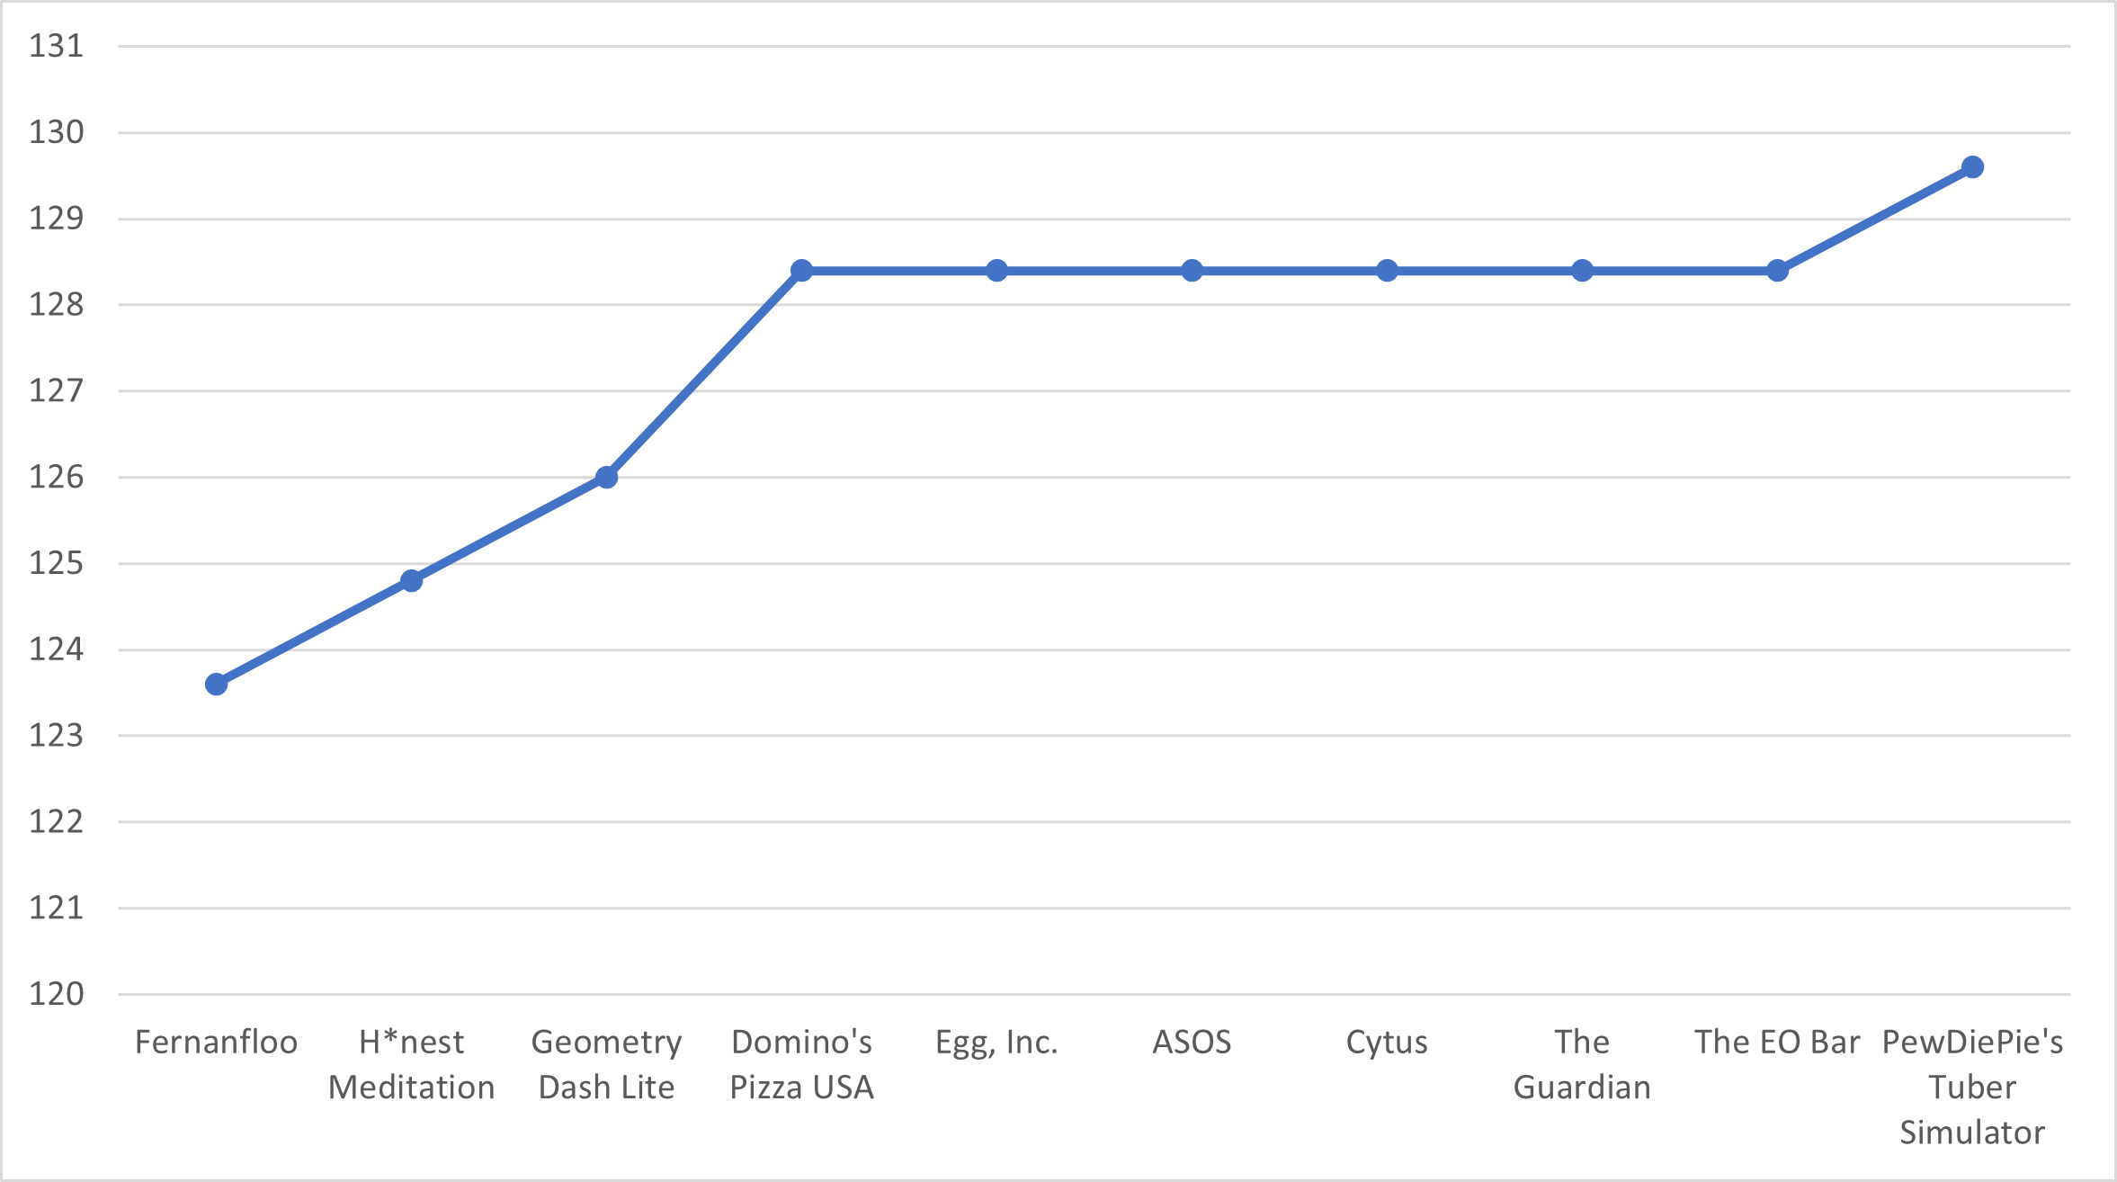
Life Expectancy
Notes:
This slide contains estimated lifespan for the top 10 applications.

Slide 4
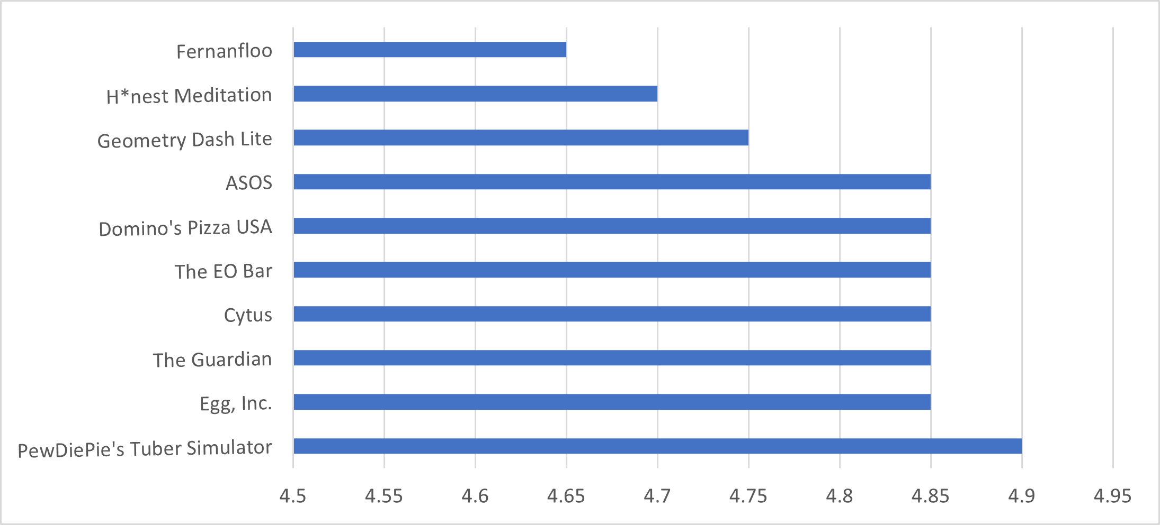
Average Rating
Notes:
This slide contains the top 10 applications from both stores by average rating.

Slide 5
Gross Profit
Goal: To estimate gross profit for a given application.
Gross Profit is the measure of a given applications lifetime revenue minus its expected purchase and marketing costs.
Lifetime revenue was calculated by multiplying the lifespan of an application in months by the monthly revenue as estimated by prior research.
Applications with the lowest purchase cost and greatest expected lifespan will generate more gross profit.
App Traders purchase cost was determined by whichever store had the highest listed price for a given application.
Applications with a store purchase cost greater than $2.50 are generally not as profitable as those at or under $2.50.
Notes:
Guidelines for determining profit.

Slide 6
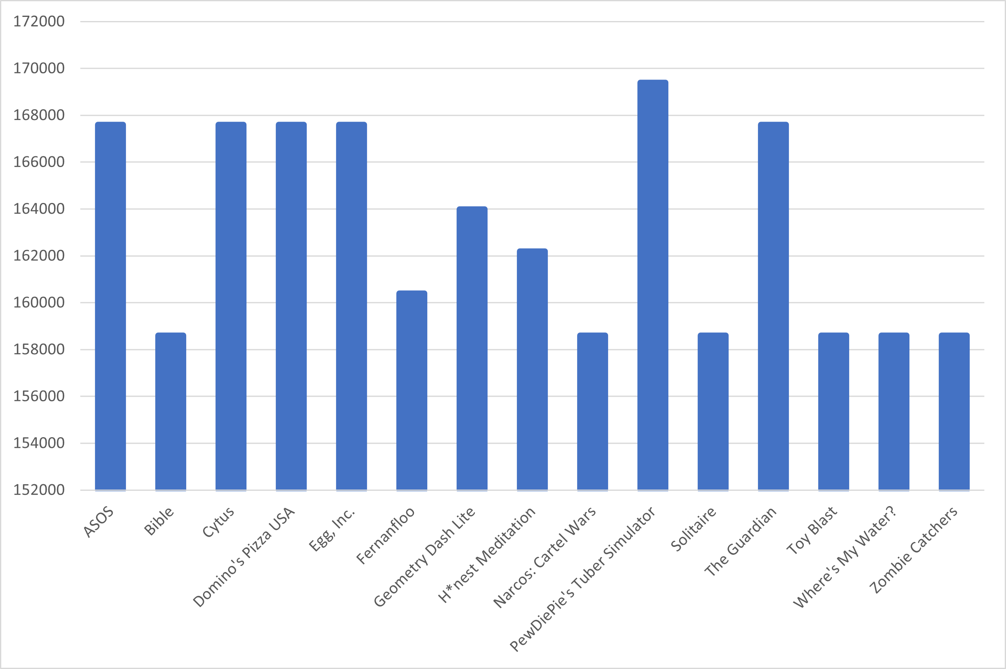
Estimated Gross Profit
Notes:
Top applications based on estimated gross profit.

Slide 7
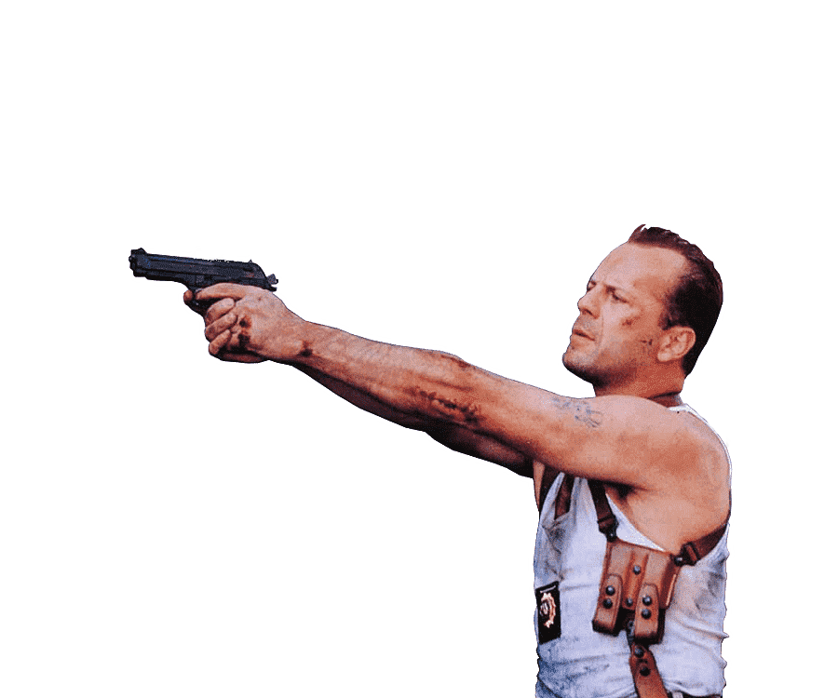
Final Selections
PewDiePie’s Tuber Simulator
ASOS
Cytus
Domino’s Pizza USA
Egg, Inc.
The Guardian
Geometry Dash Lite
Honest Meditation
Fernanfloo
Bible
Notes:
Applications for consideration, ranked by estimated gross profit.

