Slide 1
Lahman Baseball
Markus Matheny || Elizabeth Kinnard || William Prunty

Slide 2
Goals
Utilize PostgreSQL to analyze the lahman_baseball_database.
Utilize GitHub to facilitate working as a team.
Present our findings and processes in an easy-to-understand format.

Slide 3
Questions 1 & 2
What range of years for baseball games played does the provided database cover?
The database covers from year 1871 to 2016.
Find the name and height of the shortest player in the database. How many games did he play in? What is the name of the team for which he played?
The shortest player is Eddie Gaedel at 43 inches tall. He played in only 1 game for the St. Louis Browns

Slide 4
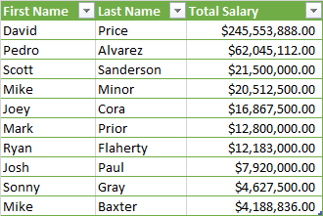
Question 3
Find all players in the database who played at Vanderbilt University. Create a list showing each player’s first and last names as well as the total salary they earned in the major leagues. Sort this list in descending order by the total salary earned. Which Vanderbilt player earned the most money in the majors?
David Price is the top earner from Vanderbilt University with a total salary of $245,553,88.00

Slide 5
Question 4
Using the fielding table, group players into three groups based on their position: label players with position OF as "Outfield", those with position "SS", "1B", "2B", and "3B" as "Infield", and those with position "P" or "C" as "Battery". Determine the number of putouts made by each of these three groups in 2016.
There were 317472 putouts in the battery position, 689431 putouts in the infield position and 285322 in the outfield position

Slide 6
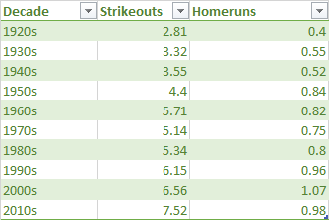
Question 5
Find the average number of strikeouts per game by decade since 1920. Round the numbers you report to 2 decimal places. Do the same for home runs per game. Do you see any trends?
Its not a perfect correlation, but both the strikeouts per game and homeruns per game have risen steadily since 1920.

Slide 7
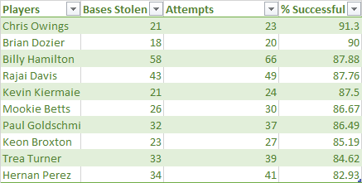
Question 6
Find the player who had the most success stealing bases in 2016, where __success__ is measured as the percentage of stolen base attempts which are successful. (A stolen base attempt results either in a stolen base or being caught stealing.) Consider only players who attempted _at least_ 20 stolen bases.
The most successful is Chris Owings, who successfully stole bases 91.3% of the time.

Slide 8
Question 7
Seattle mariners (116)
From 1970 – 2016, what is the largest number of wins for a team that did not win the world series?
LA dodgers (63)
What is the smallest number of wins for a team that did win the world series? This query will probably result in an unusually small number of wins for a world series champion – determine why this is the case. There was a strike in 1981 causing 1/3 of games to be cancelled.
ST louis Cardinals (83)
Then redo your query, excluding the problem year.
26.09%
How often from 1970 – 2016 was it the case that a team with the most wins also won the world series? What percentage of the time?

Slide 9
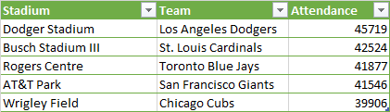
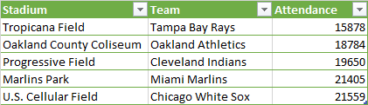
Question 8
Using the attendance figures from the homegames table, find the teams and parks which had the top 5 average attendance per game in 2016 (where average attendance is defined as total attendance divided by number of games). Only consider parks where there were at least 10 games played. Report the park name, team name, and average attendance. Repeat for the lowest 5 average attendance.
Top 5 Attendance 2016
Bottom 5 Attendance 2016

Slide 10
Question 9
Which managers have won the TSN Manager of the Year award in both the National League (NL) and the American League (AL)? Give their full name and the teams that they were managing when they won the award.
Davey Johnson
Baltimore Orioles || Washington Nationals
Jim Leyland
Detroit Tigers || Pittsburgh Pirates

Slide 11
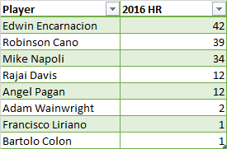
Question 10
Find all players who hit their career highest number of home runs in 2016. Consider only players who have played in the league for at least 10 years, and who hit at least one home run in 2016. Report the players' first and last names and the number of home runs they hit in 2016.

Slide 12
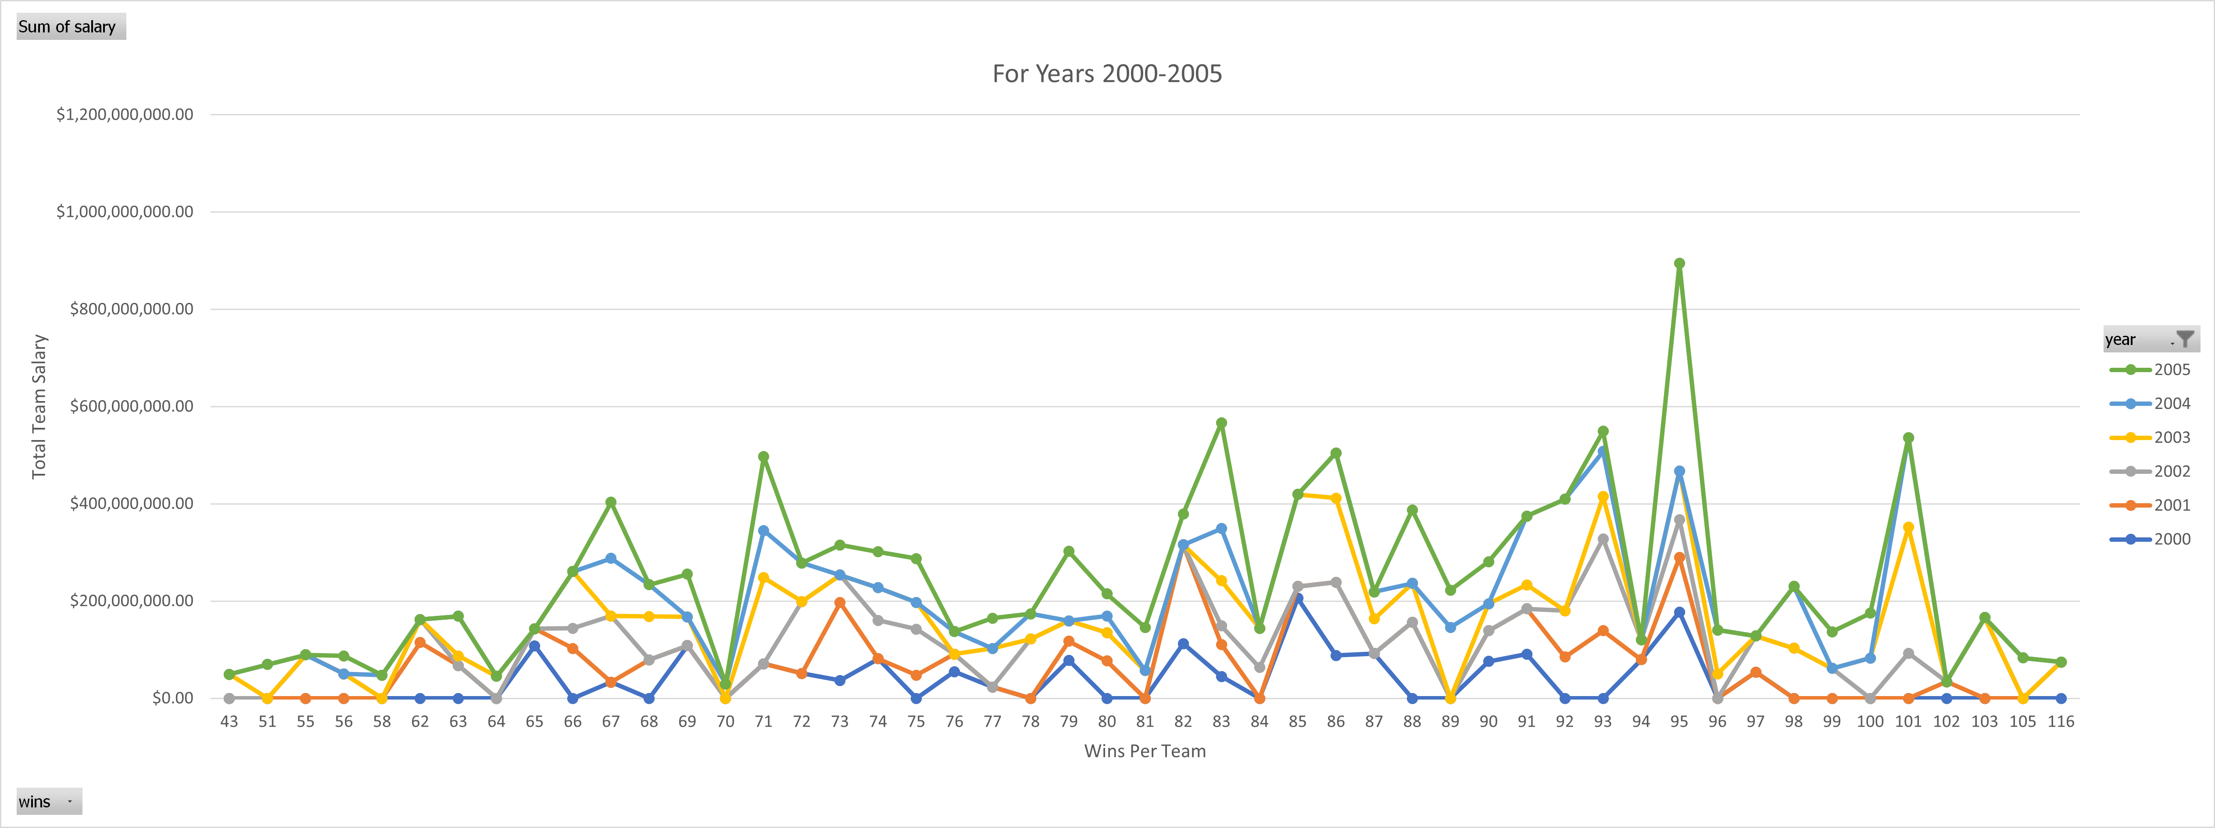
Question 11
Is there any correlation between number of wins and team salary?
Analysis suggest there is a correlation between number of wins and team salary. In this slide and the next two, you will see both a gradual increase in salaries due to inflation as well as an increase in salary relative to the number of wins.

Slide 13
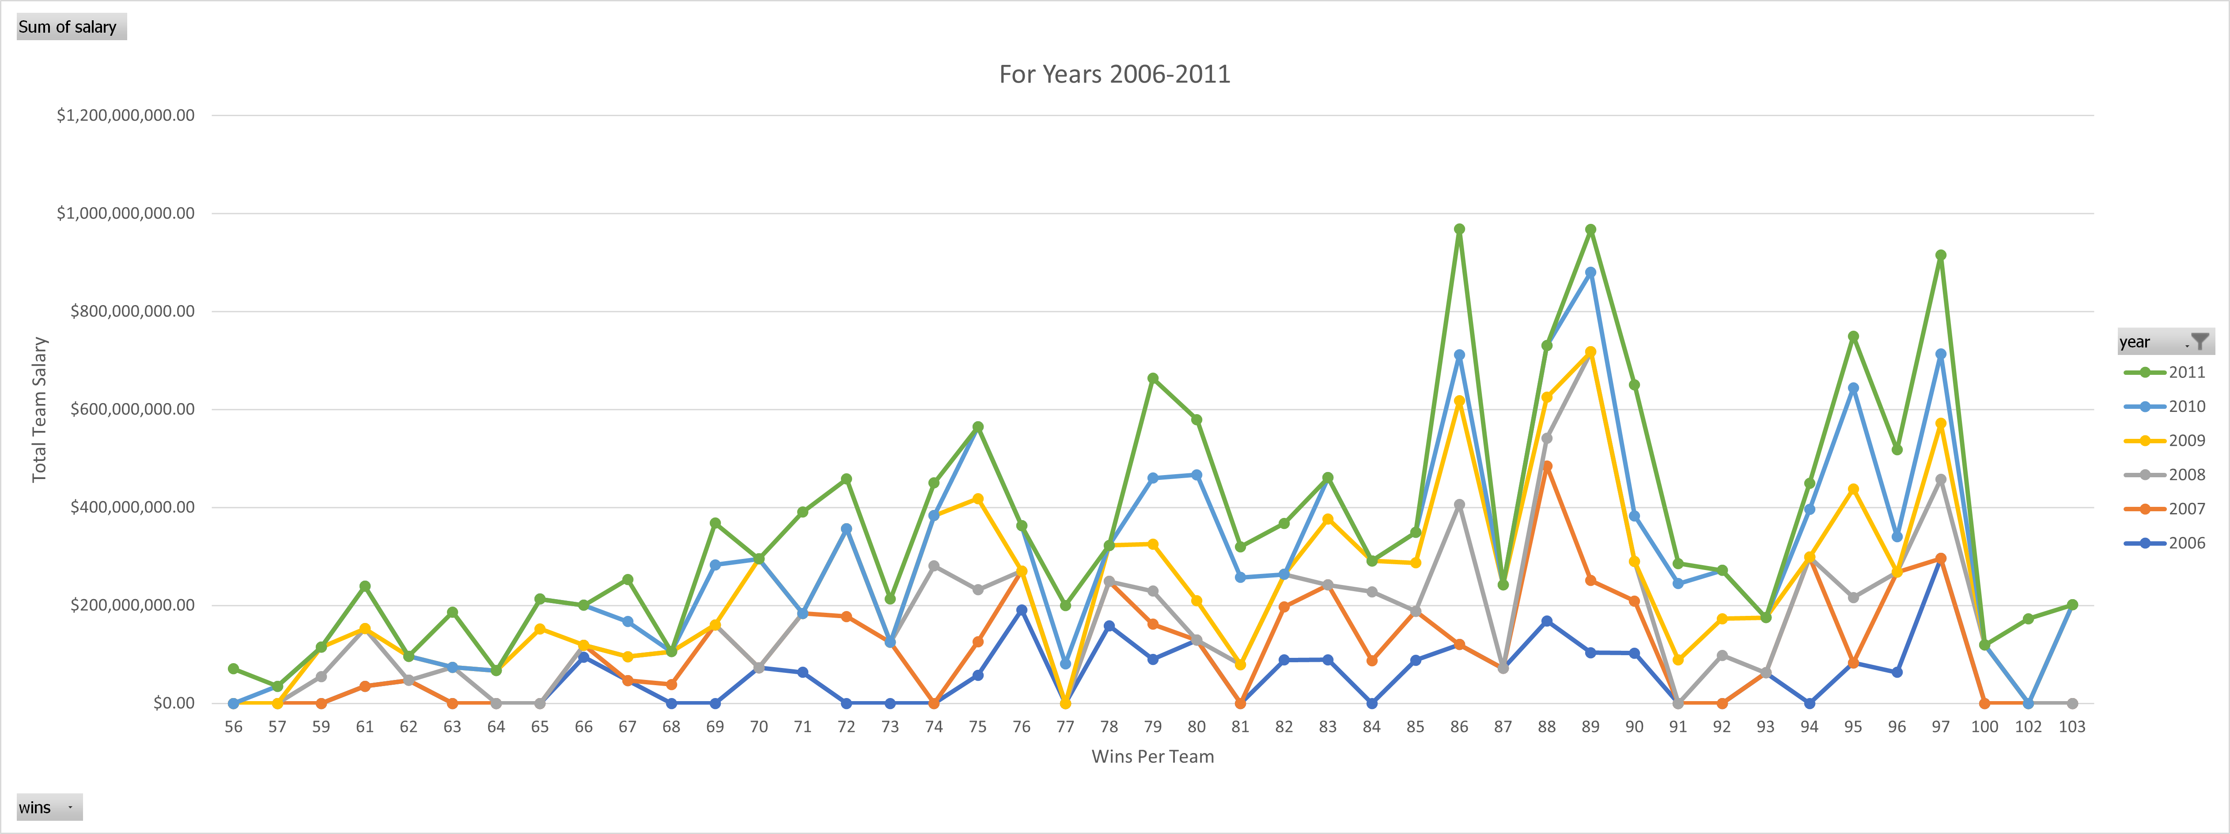
Question 11
Is there any correlation between number of wins and team salary?

Slide 14
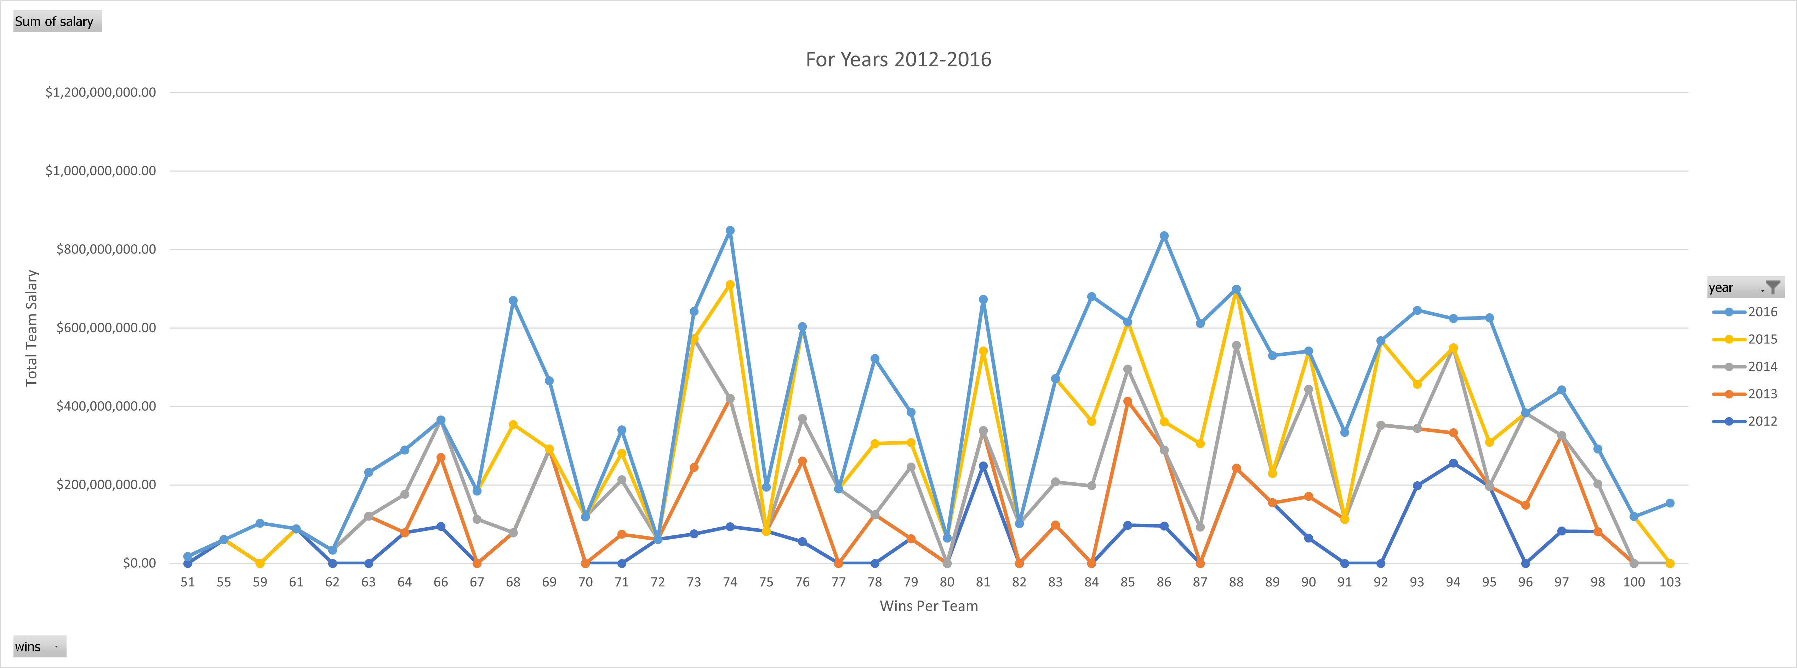
Question 11
Is there any correlation between number of wins and team salary?

Slide 15
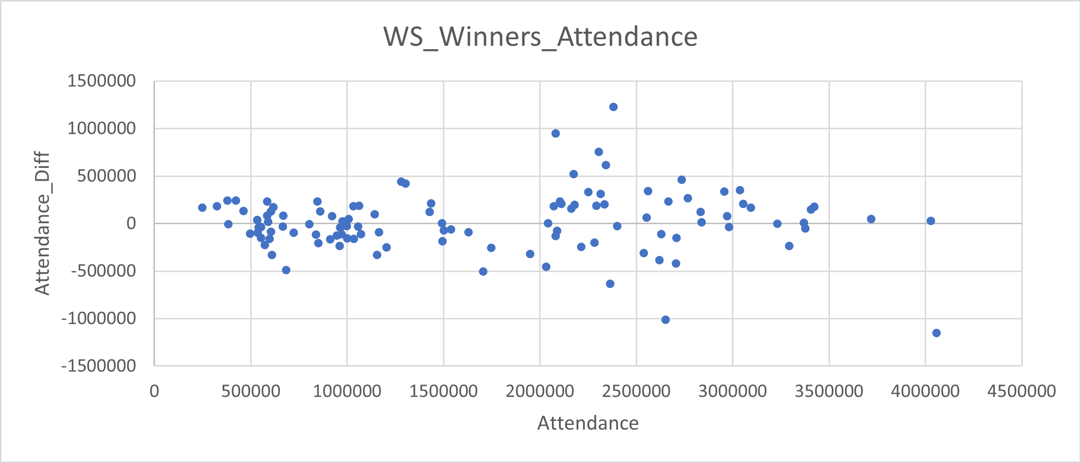
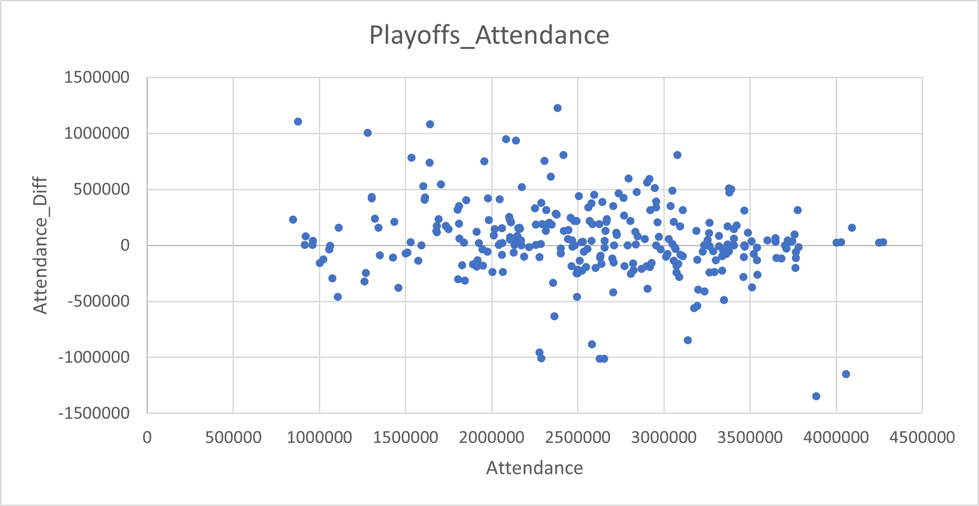
Question 12
Do teams that win the world series see a boost in attendance the following year?
Do teams that make the Playoffs see a boost in attendance the following year?
To determine if there is a correlation between winning the World Series, I first found all teams who have won the World Series and have an attendance greater than 0.
Following the initial selection, I performed a self join to add necessary information for each teams next year attendance.
From there, I created a column to find the difference between each year's attendance, exported to Excel and plotted on the above table.
From this chart, you can see there is some correlation between a World Series win and future attendance.
The same thought process was applied to teams who participated in the playoffs. The chart shows a moderate correlation between teams that made the playoffs and future attendance.
Notes:
Additionally, I investigated if there is a correlation between number of wins and average attendance at home games within a season. Calculating the correlation coefficient on average home attendance and the number of wins returns a value of .36, indicating a slight correlation.

Slide 16
Total pitchers
Question 13
It is thought that since left-handed pitchers are more rare, causing batters to face them less often, that they are more effective. Investigate this claim and present evidence to either support or dispute this claim. First, determine just how rare left-handed pitchers are compared with right-handed pitchers. Are left-handed pitchers more likely to win the Cy Young Award? Are they more likely to make it into the hall of fame?
There are 4,499 right-handed pitchers and 1,696 left-handed pitchers selected from the data.
Only players with 10 or more games pitched was selected. This does remove pitchers that only had a handful of games, but also removes non-pitchers who pitched in a couple games (such as in late extra innings).
Unsurprisingly, there are a lot more right-handed pitchers than left-handed ones.

Slide 17
Cy Young award winners
Question 13
The Cy Young Award, given to the best pitcher, has been awarded to a total of 112 players. This accounts for ties, years when the award was given to a single player, and years where the award goes to one pitcher in each league (the current format).
The award has been given to a right-handed pitcher 75 times and a left-handed pitcher 37 times. This skews slightly towards left-handed pitchers compared to our total pitchers.

Slide 18
Hall of famers
Question 13
There are a total of 74 pitchers in the Hall of Fame. This again excludes players who have pitched less than 10 games. I also only selected Hall of Famers who were specifically inducted as players, as some managers and other contributors were former players, albeit not selected for their prowess on the field.
Caveat: This does include Babe Ruth, who began his career as a pitcher before switching to an outfielder. Barring removing him specifically I didn’t see a way to filter out him and cases like him from the dataset.
There are 18 left-handed pitchers and 56 right-handed ones in the Hall of Fame. This aligns closely with our representative sample.

Slide 19
CY young, revisited
Question 13
I feel confident in the conclusion that left-handed pitchers aren’t any more likely to a higher-level of success than right-handed pitchers. However, I wanted to look at Cy Young winners more closely, since the dataset was slightly skewed to lefties compared to the representative population.
My hypothesis was that a few left-handed pitchers of a high caliber won a disproportionate amount of the Award, causing the discrepancy. To do this, I looked at pitchers who won the award multiple times.
18 pitchers won the award multiple times, 6 left-handers and 12 right-handers. 19 awards were won by these 6 lefties, and 34 by the right-handers.

Slide 20
CY Young, Single winners
Question 13
To fully look at the data to support my hypothesis, I also looked at the pitchers who only won the Cy Young one year.
The result is a total of 59 players who won the Award once. 41 of these were right-handed, 18 left. This a smaller percentage, with about 30% being left-handed and 70% being right-handed.
At this point, my hypothesis looks correct. A disproportionately large amount of Cy Young awards have been won by left-handers winning multiple times (36% of awards going to multiple winners as opposed to the 25% of total pitchers), despite the single-year Cy Young winners and multiple-year Cy Young winners having the same proportion of about 33% lefties.
It should be noted that the small sample size does seem to disproportionately favor lefties, as even the single-year winners have more left-handers than the representative population (30% to 25%).

