Slide 1

HBotix
A Medical Assistant

Slide 2
Team name-TEAM
MEMBERS
Akarsh J
Akhil M Nair
Ananthapadmanabhan R U
Krishnendu K R

Slide 3
Introduction
In the era of digital healthcare, the development of intelligent chatbots has emerged as a promising solution to provide accessible and reliable information to individuals seeking medical guidance. In this project, we introduce “H-Botix", an innovative chatbot designed to offer comprehensive information about various diseases. Leveraging open-source technologies and toolchains, we have developed MediBot to serve as a user-friendly interface for accessing vital healthcare information.

Slide 4
Problem Statement
Accessing reliable medical guidance is challenging due to limited access to healthcare professionals, overwhelming online information, and complex medical terminology. Existing solutions often lack comprehensiveness, reliability, and user-friendly interfaces, leading to misinformation and delayed treatment. To address these challenges, we propose developing MediBot, an AI-powered chatbot that provides personalized and trustworthy medical guidance in a user-friendly manner, empowering individuals to make informed decisions about their health..

Slide 5
Objectives
Comprehensive Disease Information: Provide extensive and up-to-date information about various diseases, including symptoms, causes, treatments, and preventive measures
Accessibility Through Open Source: Utilize open-source technologies, such as chainlit for the user interface, to ensure accessibility and affordability
User-Friendly Interface: Create an intuitive and interactive user interface powered by open-source tools, ensuring a seamless experience for users to navigate and access disease information effectively.
Collaboration and Transparency: Foster collaboration within the open-source community and maintain transparency in the development process, allowing for community contributions and feedback to improve Hbotix effectiveness and usability

Slide 6
Tools used
Language - Python 3
Pypdf
Langchain
Ctransformers
sentence_transformers
faiss_cpu
Chainlit
huggingface_hub
Models - llama-2-7b-chat.ggmlv3.q8_0.bin, sentence-transformers/all-MiniLM-L6-v2

Slide 7


Implementation
Text chunks
Text chunks
Text chunks
Embedding
Embedding
Embedding
Data/content
Question
Build semantic index
Question
embedding
Knowledge data
LLAMA-2
Result

Slide 8
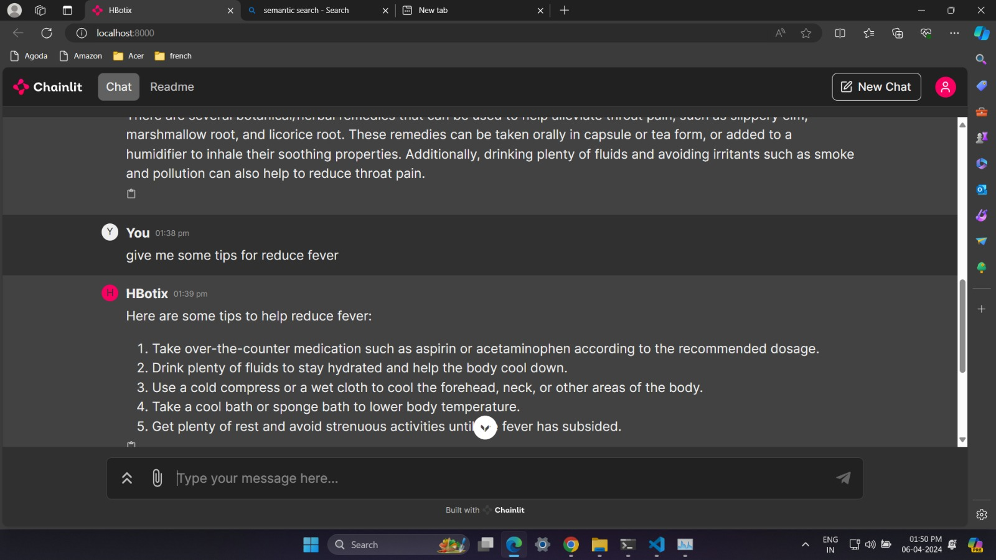

Slide 9
Future Plans
Recommendation of best doctors according to the search
Accept user feedback and suggestions
More efficient datasets to be integrated

Slide 10
Conclusion
The development of H-Botix marks a significant advancement in healthcare technology, leveraging various open-source tools like chainlit for UI and Llama-2 for backend functionalities. By embracing open-source principles, H-Botix offers accessible and reliable information about diseases, promoting transparency, collaboration, and innovation in healthcare.

Slide 11
Thank you
HBotix- Healthcare-Based Opensource Tool for Interactive eXchange
Thank You for Your Attention!
Your support fuels our commitment to advancing healthcare through technology. Together, let's shape the future of healthcare with innovation and collaboration.

