Slide 1

Ebola Outbreak 2018-19 North-Kivu, DRC Updated Risk of Future Cases
Produced on 28th February, 2019
Srinivasan Venkatramanan, Bryan Lewis, and Alex Telionis
on behalf of the
Network Systems Science & Advanced Computing Division
Biocomplexity Institute & Initiative
University of Virginia

Slide 2
Approach
Data and methods used:
Updated Population and Health Zone data
Metapopulation transmission model with human mobility for transmission projection
Case counts as reported by DRC Ministry of Health
Results:
Projected case counts for two potential scenarios
Healthzone level risk estimate for future cases

Slide 3
Datasets
Updated Population for the DRC gathered from Humanitarian Data Exchange: https://data.humdata.org/dataset/rdc-statistiques-des-populations
Update Health Zone maps via Humanitarian Data Exchange: https://data.humdata.org/dataset/democratic-republic-of-congo-health-boundaries
River Network and Road Networks via Digital Chart of the World (DCW): diva-gis.org
Combined into a single coherent travel network with novel methodology (in preparation) for travel time calculations to feed mobility model
DRC Ministry of Health as curated by Sophie Meakin and Patrick Corbett: https://github.com/sophiemeakin/ebola_drc/

Slide 4
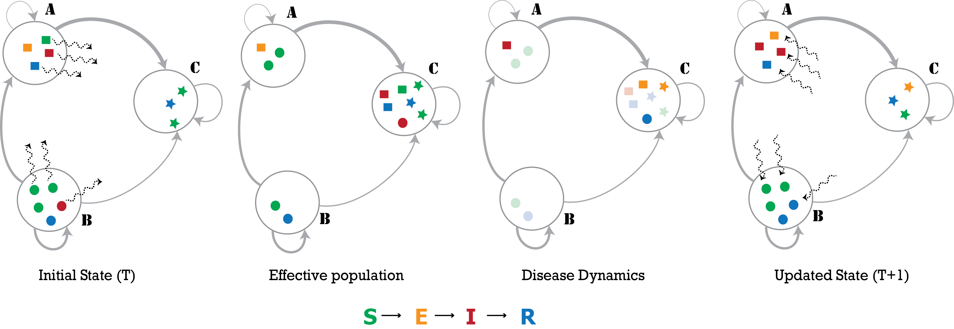
Model Description
PatchSim: Metapopulation model with gravity mobility model
The large circles represent the patches (A,B,C) in the simulation, and the grey edges represent the travel network, colors represent the disease state the individuals are in (susceptible, exposed, infected or recovered), The wavy dashed arrows show movement of individuals. Panel 1. Individuals move moved from home to another patch. Panel 2. This creates another effective population where the disease dynamics operate and individuals become ill (change from green to red) which stand out in the 3rd panel. Panel 4. Finally, the individuals return to their home patch
Notes:
The large circles represent the patches in the simulation, and the grey edges represent the
travel network, with varying thickness denoting heterogeneity in flow volumes. The sample
population shows 4 individuals in patch A (squares), 5 in patch B (circles) and 3 in patch
C (stars). The colors represent the disease state the individuals are in (susceptible, exposed,
infected or recovered). The wavy dashed arrows show movement of individuals (randomly
chosen according to outgoing edge probabilities). In the first step, individuals are moved from
their home patch to another patch (first panel), creating the effective population (second panel).
The disease dynamics may constitute an exposure event (transition from S to E), onset of
infectiousness (E to I), or recovery event (I to R). The nodes undergoing these transitions are
highlighted in third panel, where we see an onset of infectiousness in patch A, two exposures
and a recovery in patch C. Finally, the individuals return to their home patch (fourth panel).

Slide 5
Calibration Approach
Total confirmed cases from DRC Ministry of Health reports
National and 4 key health zones (Mabalako, Beni, Butembo, Katwa)
The ground truth spans 5th August 2018 to 26th February 2019.
Random search using hyperopt package
Objective function: sum of weighted absolute difference between simulated and observed case counts

Slide 6
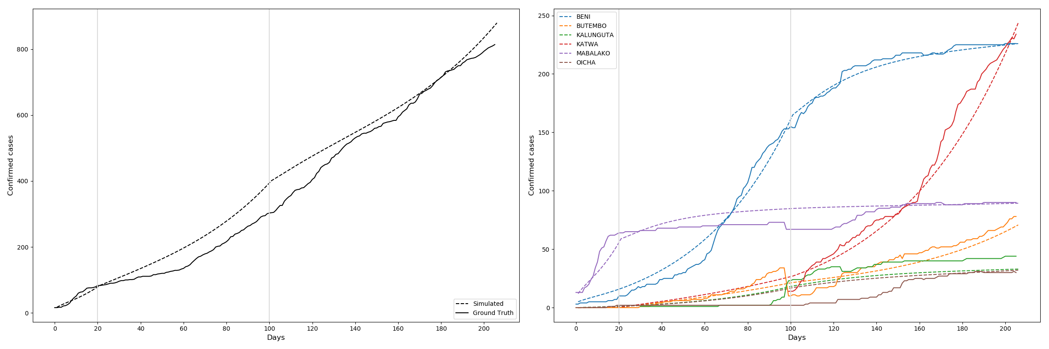
Calibration results
Stage 0
Stage 1
Stage 2
Stage 0
Stage 1
Stage 2
Day 0 = 5th August 2018

Slide 7
Case Projections & Risk calculation
Case projection: Until the 31st of March, 2019
Risk index: Proportion of future cases generated by running calibrated model beyond the last observation (26th February 2019)
Examine 3 scenarios for the future:
Scenario A: Katwa’s growth continues similar to past two months (stage 2), Butembo returns to growth phase (stage 1)
Scenario B: Katwa’s growth continues similar to past two months (stage 2), Butembo under control (stage 0)
Scenario C: Katwa experiences control similar to that of Beni

Slide 8
Total case projection results
Total confirmed cases in ground truth: 814
Total cases in each scenario: A - 1296, B - 1221, C - 980
% increase in Scenario A in comparison to ground truth: 59.28%
% increase in Scenario B in comparison to ground truth: 50.02%
% increase in Scenario C in comparison to ground truth: 20.48%
% increase in Scenario A in comparison to scenario B: 6.17%
% increase in Scenario A in comparison to scenario C: 25.87%

Slide 9
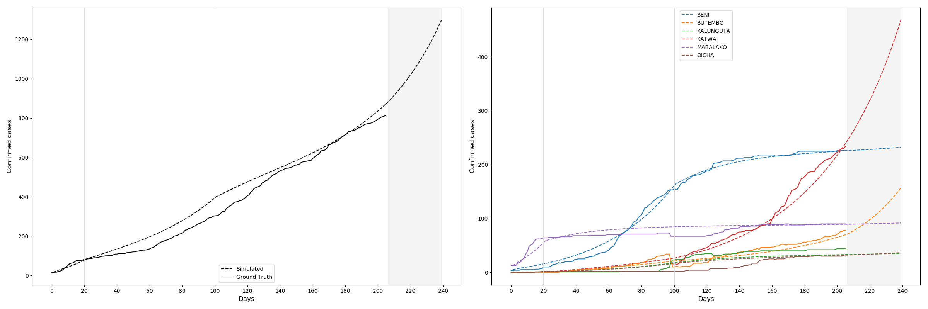
Results – Scenario A
Day 0 = 5th August 2018

Slide 10
Results – Scenario A
Health Zone | Risk Index
KATWA | 54.13%
BUTEMBO | 20.16%
VUHOVI | 2.39%
KYONDO | 2.14%
MUSIENENE | 1.98%
LUBERO | 1.84%
MASEREKA | 1.82%
BENI | 1.55%
OICHA | 1.10%
MUTWANGA | 0.96%

Slide 11
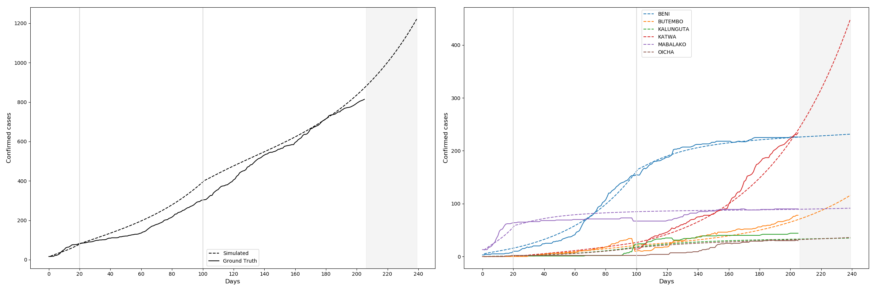
Results – Scenario B
Day 0 = 5th August 2018

Slide 12
Results – Scenario B
Health Zone | Risk Index
KATWA | 60.04%
BUTEMBO | 13.16%
VUHOVI | 2.41%
KYONDO | 2.22%
MUSIENENE | 2.05%
LUBERO | 1.90%
MASEREKA | 1.88%
BENI | 1.66%
OICHA | 1.16%
MUTWANGA | 1.00%

Slide 13
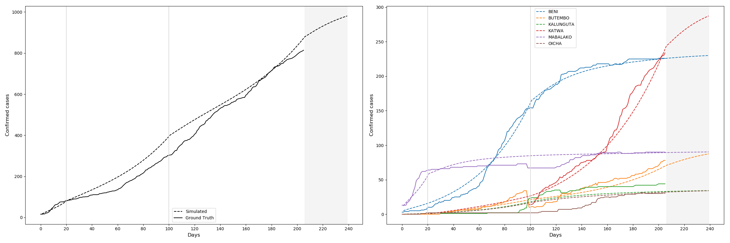
Results – Scenario C
Day 0 = 5th August 2018

Slide 14
Results – Scenario C
Health Zone | Risk Index
KATWA | 46.25%
BUTEMBO | 15.86%
BENI | 3.74%
VUHOVI | 2.85%
KYONDO | 2.74%
MUSIENENE | 2.57%
LUBERO | 2.39%
MASEREKA | 2.30%
OICHA | 1.80%
MUTWANGA | 1.41%

Slide 15
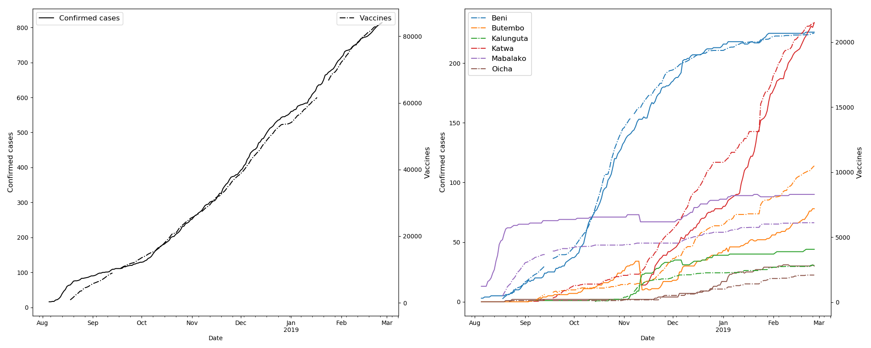
Comparing vaccine delivery to cases

Slide 16
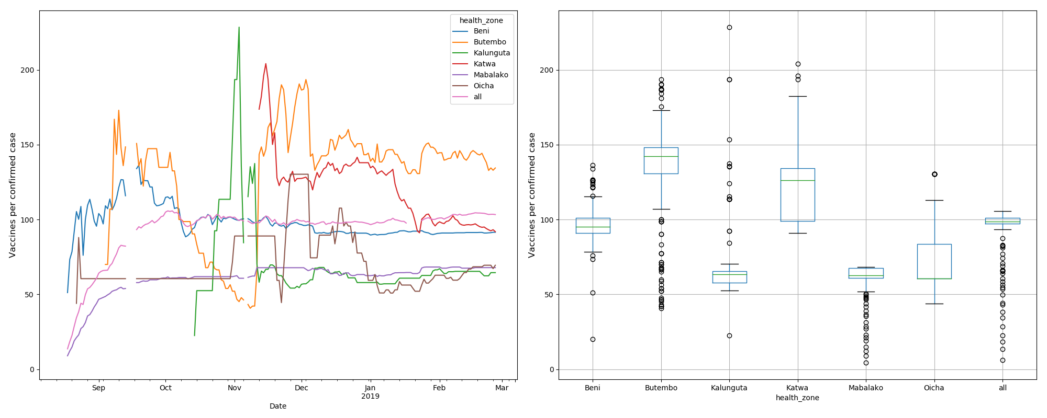
Vaccine to case ratio

Slide 17
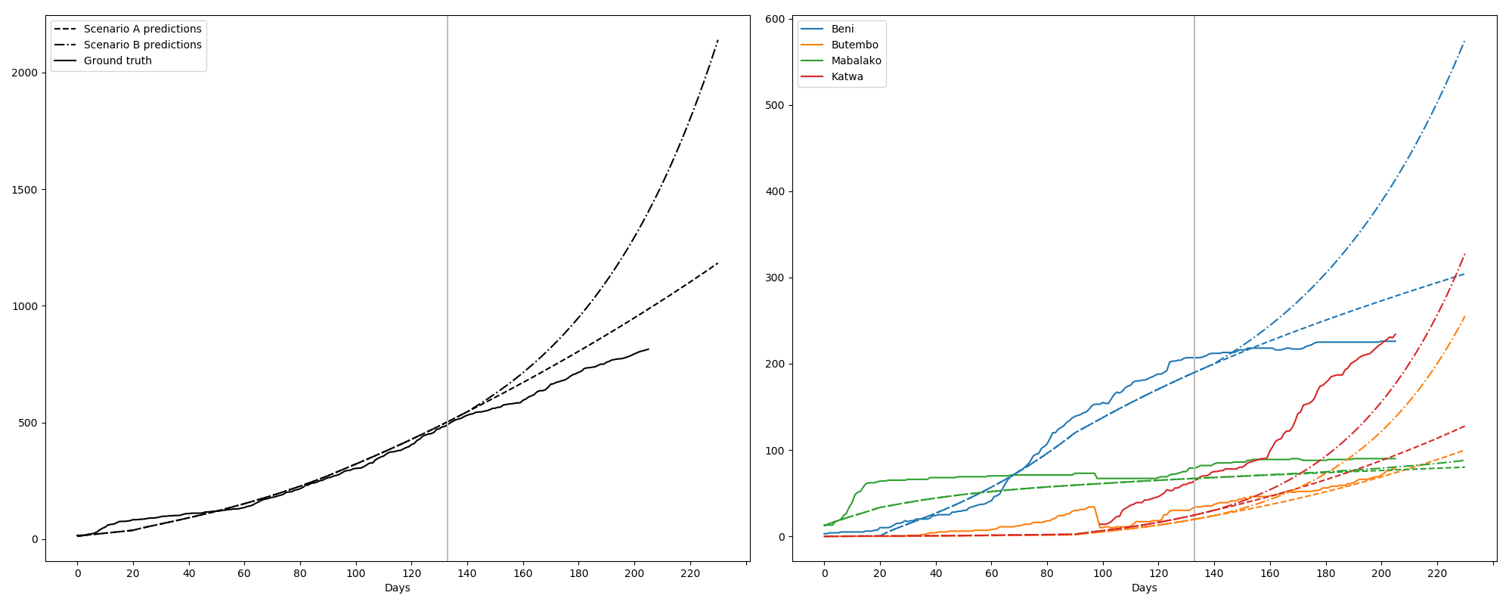
Comparing forecast from Dec 21st, 2018
Ground truth until Dec 16th, 2018
Calibration criteria: National confirmed case curve
Day 0 = 5th August 2018

Slide 18
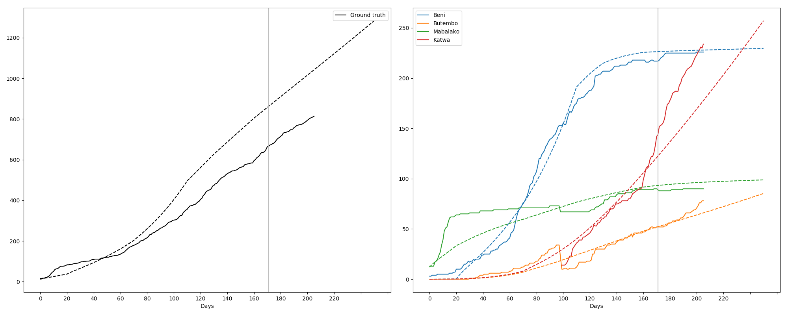
Comparing forecast from Jan 23rd, 2019
Calibration criteria: Confirmed case curves in
Mabalako, Beni, Butembo, and Katwa
Ground truth until Jan 18th, 2019
Day 0 = 5th August 2018

