Slide 1
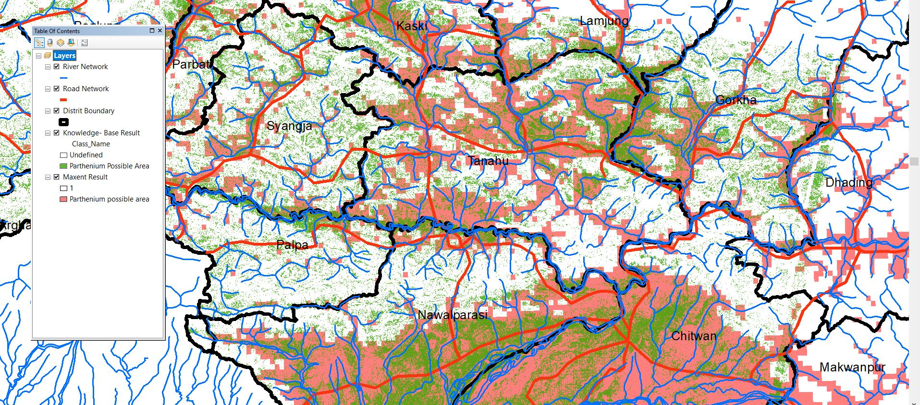
Parthenium

Slide 2
Regarding

