Slide 1
NORTH SOUTH UNIVERSITY / THESIS PROGRESS
UPDATE 03
Localizing audio and
visual deepfakes
A LAV-DF pilot toward evaluation in Bangladeshi speech
MD. FARHAN / SAYEED MORTUZA / Zawed Bin Tariq
North South University, Dhaka, Bangladesh • 3 November 2026

Slide 2
01 / RESEARCH QUESTION
Where was the clip changed?
A ten-second example illustrates the output we want for each stream.
ILLUSTRATIVE EXAMPLE
3.2–4.0 s
Audio
No visual edit
Face
0 s
2 s
4 s
6 s
8 s
10 s
The output is one audio edit, 3.2–4.0 s. The face stays genuine.
NSU / THESIS PROGRESS / UPDATE 3
02 / 10

Slide 3
02 / RESEARCH DECISIONS
What changed after the proposal?
We kept the localization question and changed how we could test it on Kaggle.
UPDATES 1–2 / PLANNED
UPDATE 3 / IMPLEMENTED
AV-Deepfake1M++
LAV-DF on Kaggle
A candidate benchmark for paired
audio and video edits.
Accessible paired clips with annotated
edit start and end times.
Pretrained speech and image encoders
Acoustic and lower-face features
Planned for a larger experiment.
Six methods trained and compared.
Bangla and Bangla–English speech remain the target for a separate evaluation.
NSU / THESIS PROGRESS / UPDATE 3
03 / 10

Slide 4
03 / DATASET
416 clips in the Kaggle pilot
We trained on 320 clips and compared six methods on 96 separate development clips.
Split | Genuine | Audio only | Visual only | Both | Total
Train | 86 | 78 | 78 | 78 | 320
Development | 25 | 24 | 24 | 23 | 96
85 edit intervals
25 genuine clips
in the 71 edited development clips. A clip can
contain more than one edit.
used to count how often a clean recording
triggered an alert.
4 invalid records excluded. We reserved 144 test records, including the 32 clips seen in the quick run.
NSU / THESIS PROGRESS / UPDATE 3
04 / 10

Slide 5
04 / METHOD
How the delay-aware model works
Both streams are placed on a common timeline, with one feature vector every 80 milliseconds.
Audio features
Spectrum and energy changes in 16 kHz mono speech.
Estimate the lag
Keep both views
Score each bin
Compare changes in energy with mouth motion at offsets up to ±400 ms.
Original features, aligned features and the confidence of the match.
Two heads output audio and visual scores. Join adjacent positive bins into intervals.
Face features
Lower-face appearance and motion at 25 frames per second.
If the lag estimate is weak, the model uses zero shift.
NSU / THESIS PROGRESS / UPDATE 3
05 / 10

Slide 6
05 / CLEAN DEVELOPMENT RESULTS
Fewer false alarms, with two fewer edits found
The clean run used genuine and edited clips with no added delay or compression.
EDITS MATCHED / OUT OF 85
35
Late fusion
36
Raw fusion
33
Delay-aware
Compared with late fusion, delay-aware fusion flagged 9 fewer genuine clips and matched 2 fewer edits.
NSU / THESIS PROGRESS / UPDATE 3
06 / 10

Slide 7
06 / MODEL COMPARISON
How all six methods compare
Raw fusion led on AP50. Delay-aware fusion had the highest interval F1 at its selected threshold.
Method | AP50 | F1 at IoU 0.50 | Edits found / 85 | Alerts / 25 genuine
Audio only | 0.137 | 0.176 | 29 | 12
Visual only | 0.045 | 0.101 | 9 | 2
Late fusion | 0.176 | 0.182 | 35 | 14
Raw fusion | 0.254 | 0.251 | 36 | 9
Alignment only | 0.055 | 0.071 | 13 | 13
Delay-aware | 0.234 | 0.258 | 33 | 5
IoU measures time overlap. AP50 ranks predicted intervals. F1 counts both false and missed intervals.
NSU / THESIS PROGRESS / UPDATE 3
07 / 10

Slide 8
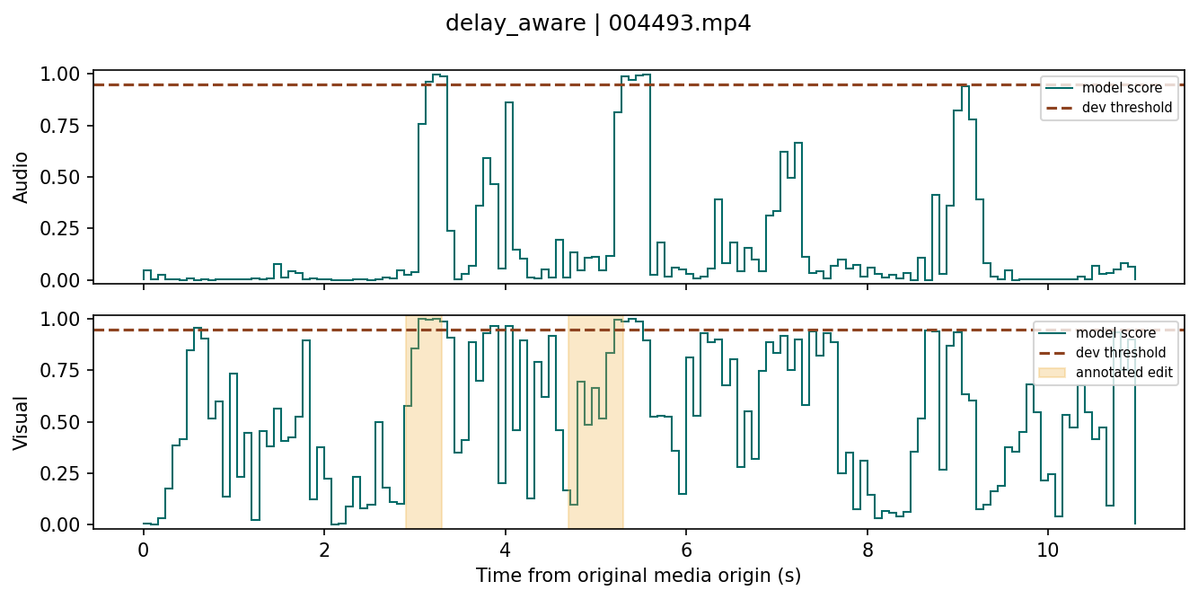
07 / ERROR ANALYSIS
The audio alarm was wrong on this clip
LAV-DF development clip 004493.mp4 • 11.072 seconds • visual-only ground truth
ANNOTATED VISUAL EDITS
2.9–3.3 s
4.7–5.3 s
AUDIO GROUND TRUTH
No audio edit. The audio score still crossed its 0.95 threshold.
Green = model score / Dashed = threshold / Shaded = labeled edit
NSU / THESIS PROGRESS / UPDATE 3
08 / 10

Slide 9
08 / NEXT EXPERIMENT
Test the effect of a known timing shift
Pair each clip with shifted versions so that the same speaker, content and original edits are compared.
01
02
03
Create pairs
Match the timelines
Compare trade-offs
Shift audio features 240 ms earlier or later. Keep a clean copy of each clip.
Use the common time span. Move the affected labels with their stream.
Compare late, raw and delay-aware fusion. Track genuine alerts and edits found.
Repeat with seeds 17, 29 and 43. Lock the model and thresholds before testing.
NSU / THESIS PROGRESS / UPDATE 3
09 / 10

Slide 10
09 / BANGLADESH EVALUATION
What would count as evidence in Bangla?
The present results come from English LAV-DF clips and one training seed.
LOCAL EVALUATION DESIGN
01
Collect consented recordings
Include Bangla and Bangla–English speech. Retain verified genuine clips.
02
Label audio and face edits separately
Record the start and end of each edit. Have a second reviewer check the labels.
03
Keep each speaker and source together
Keep originals and edited copies in one split. Evaluate only after locking the thresholds.
At the same edit recall, does lag correction reduce false alarms?
NSU / THESIS PROGRESS / UPDATE 3
10 / 10

