Slide 1
CSE299 SEC 02
ILMIAT FARHANA
1712428042
Week 10

Slide 2
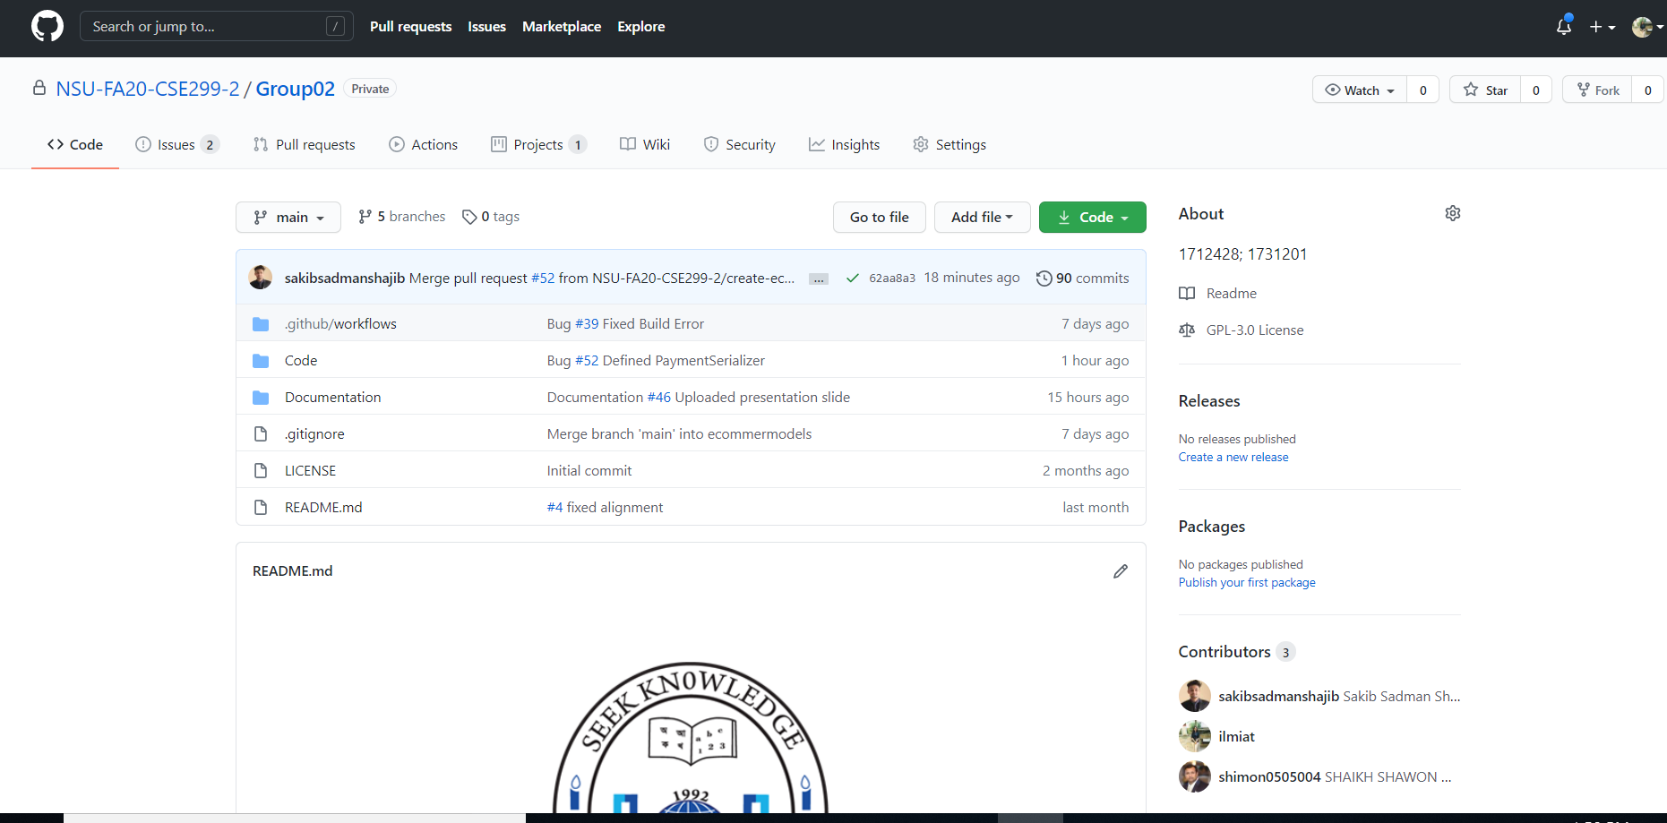
Notes:
Readme

Slide 3
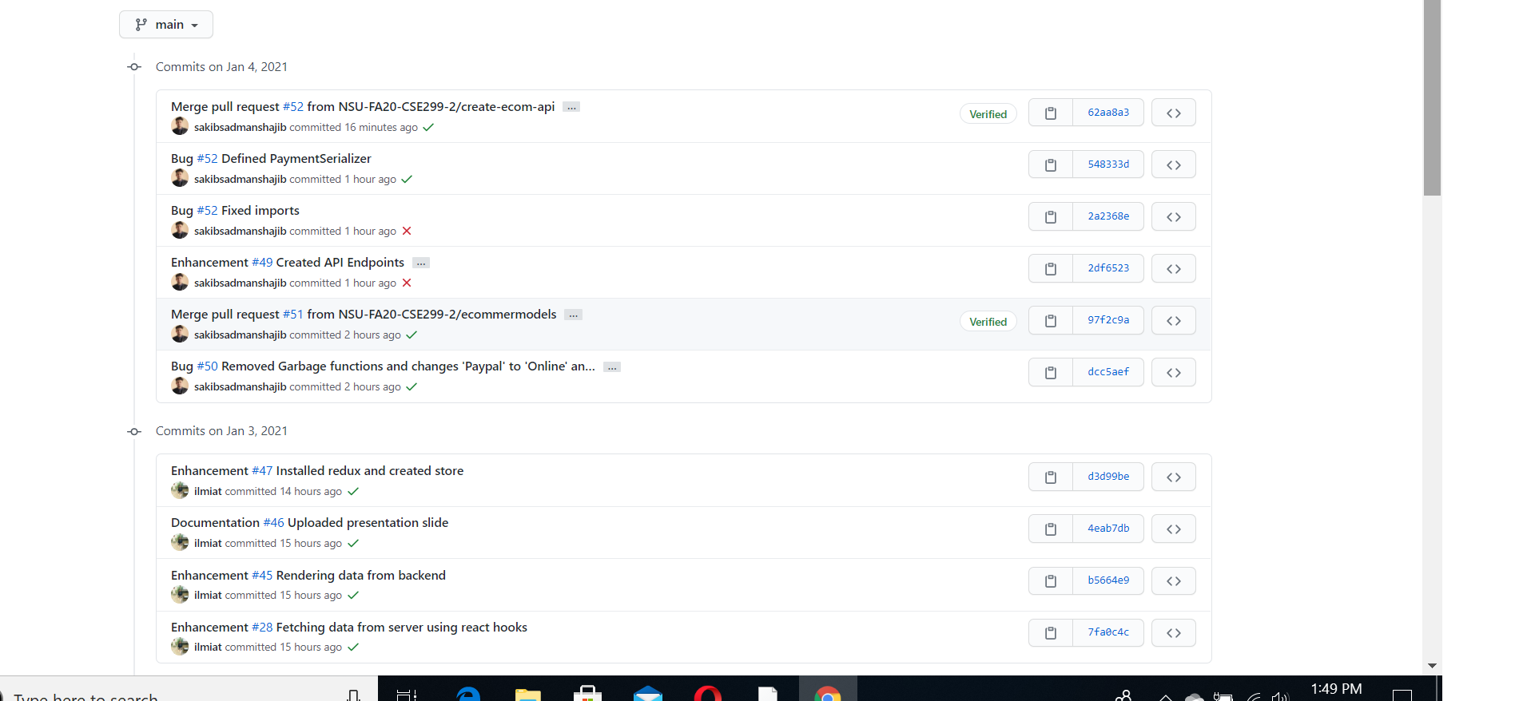
Notes:
Commits

Slide 4
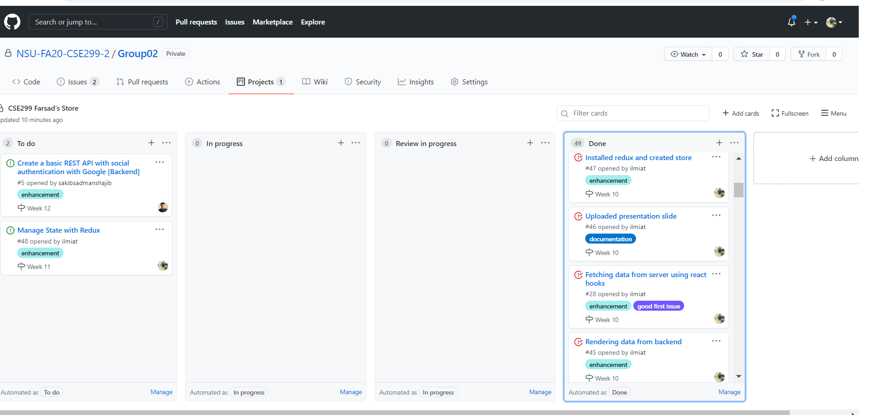
Notes:
Issueboard

