Slide 1
Week 09
Group 02

Slide 2
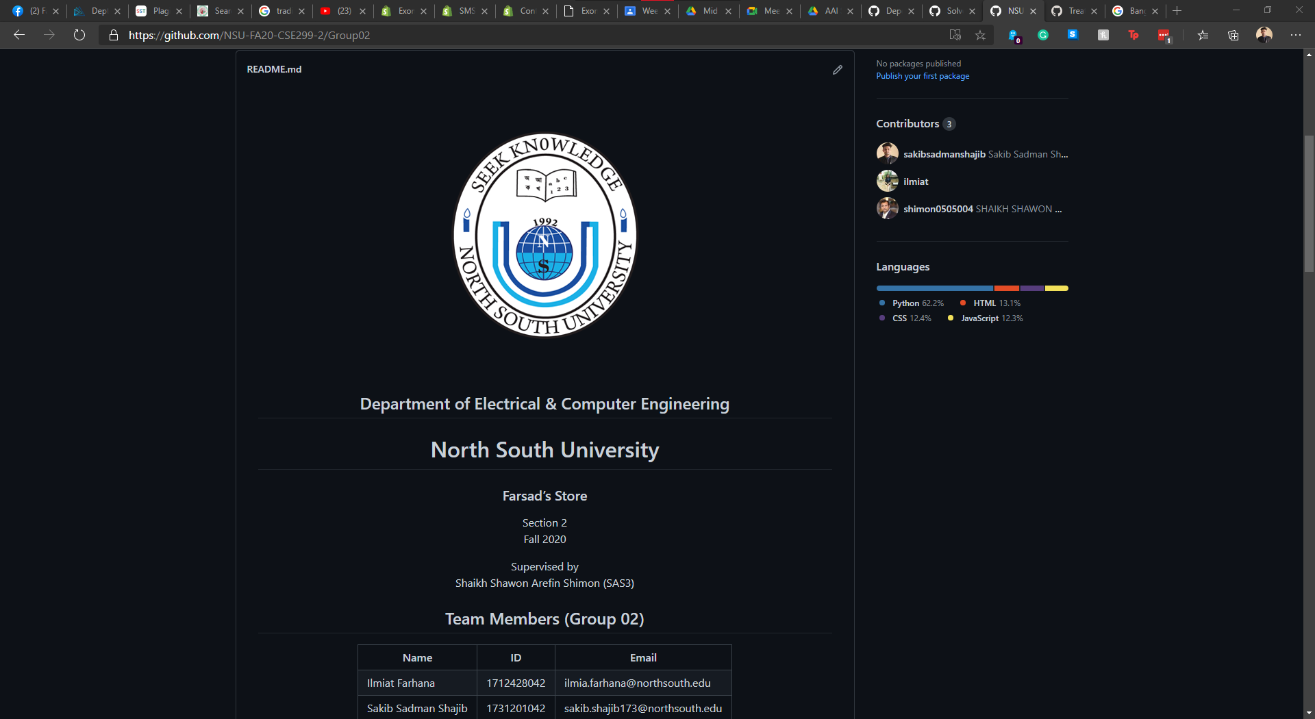

Slide 3
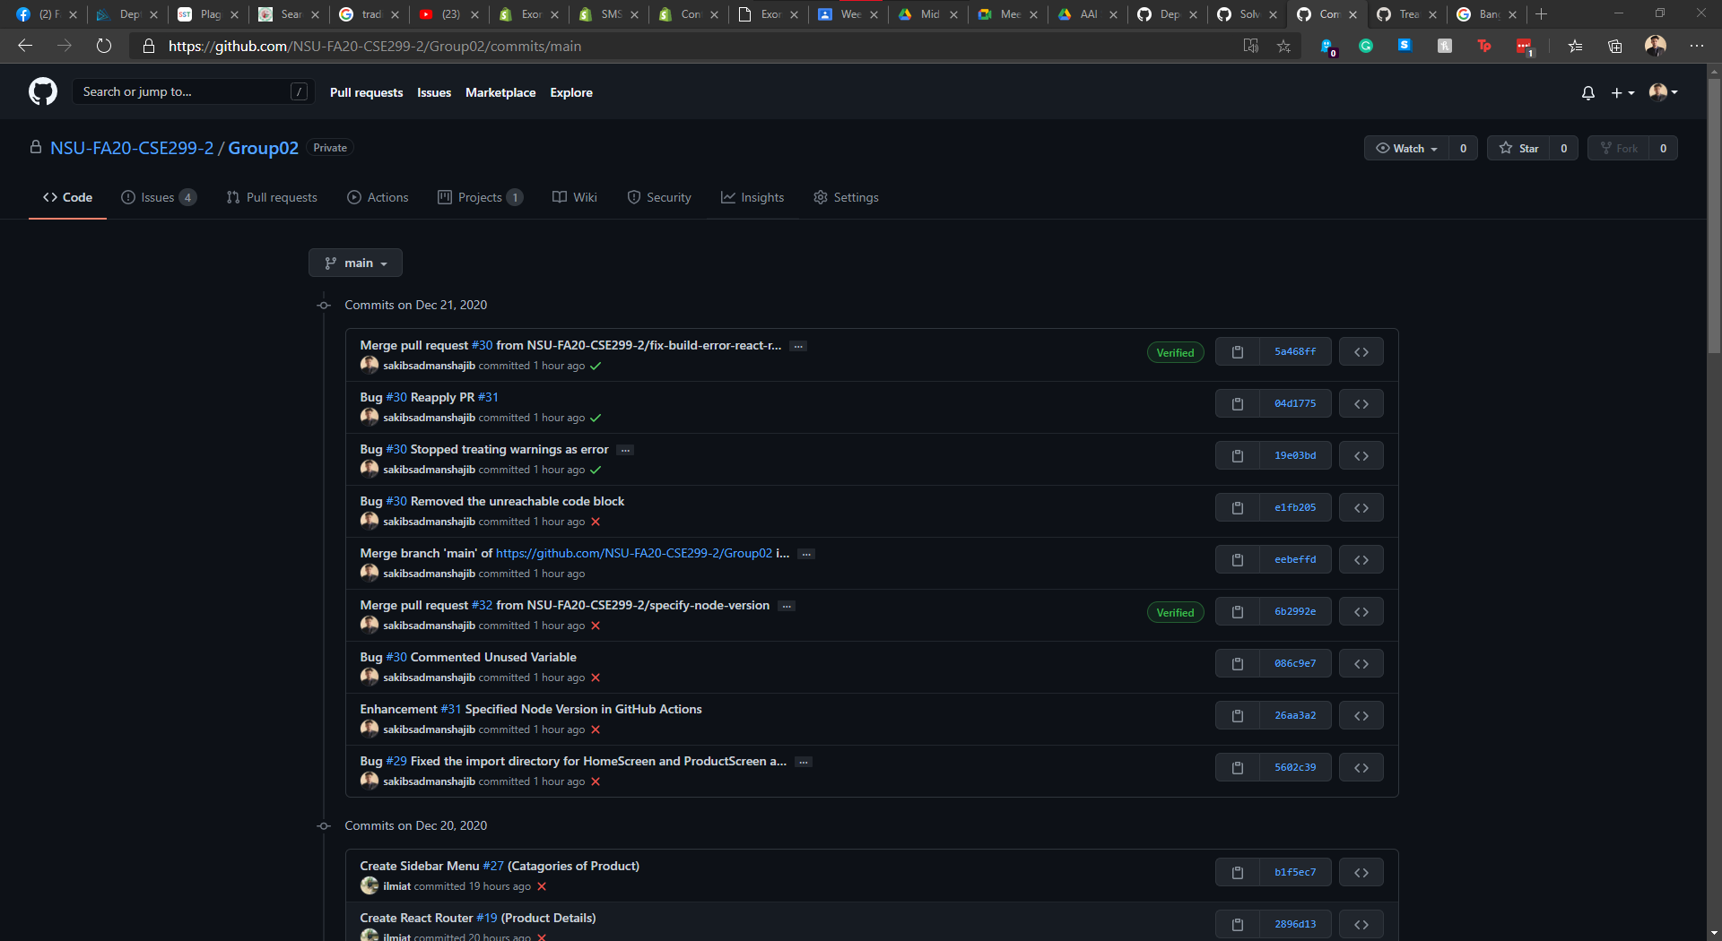

Slide 4
