Slide 1
Project Name: ONLINE CAR RENTAL SYSTEM
Course No: CSE 299 Sec: 16
Faculty: Shaikh Shawon Arefin Shimon (Sas3)
Member 1:
Name: Md Saqif Mohtasim
ID: 1530110042
Group No: 3

Slide 2
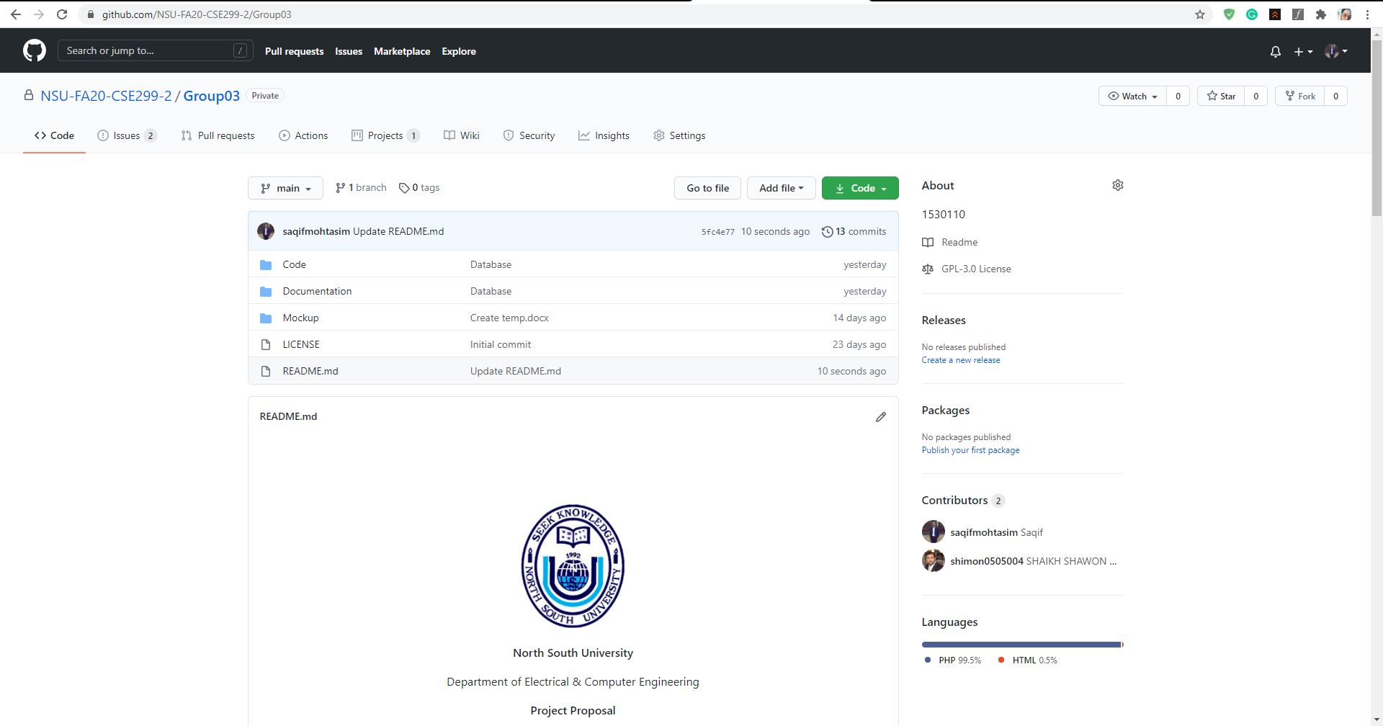
Github front page

Slide 3
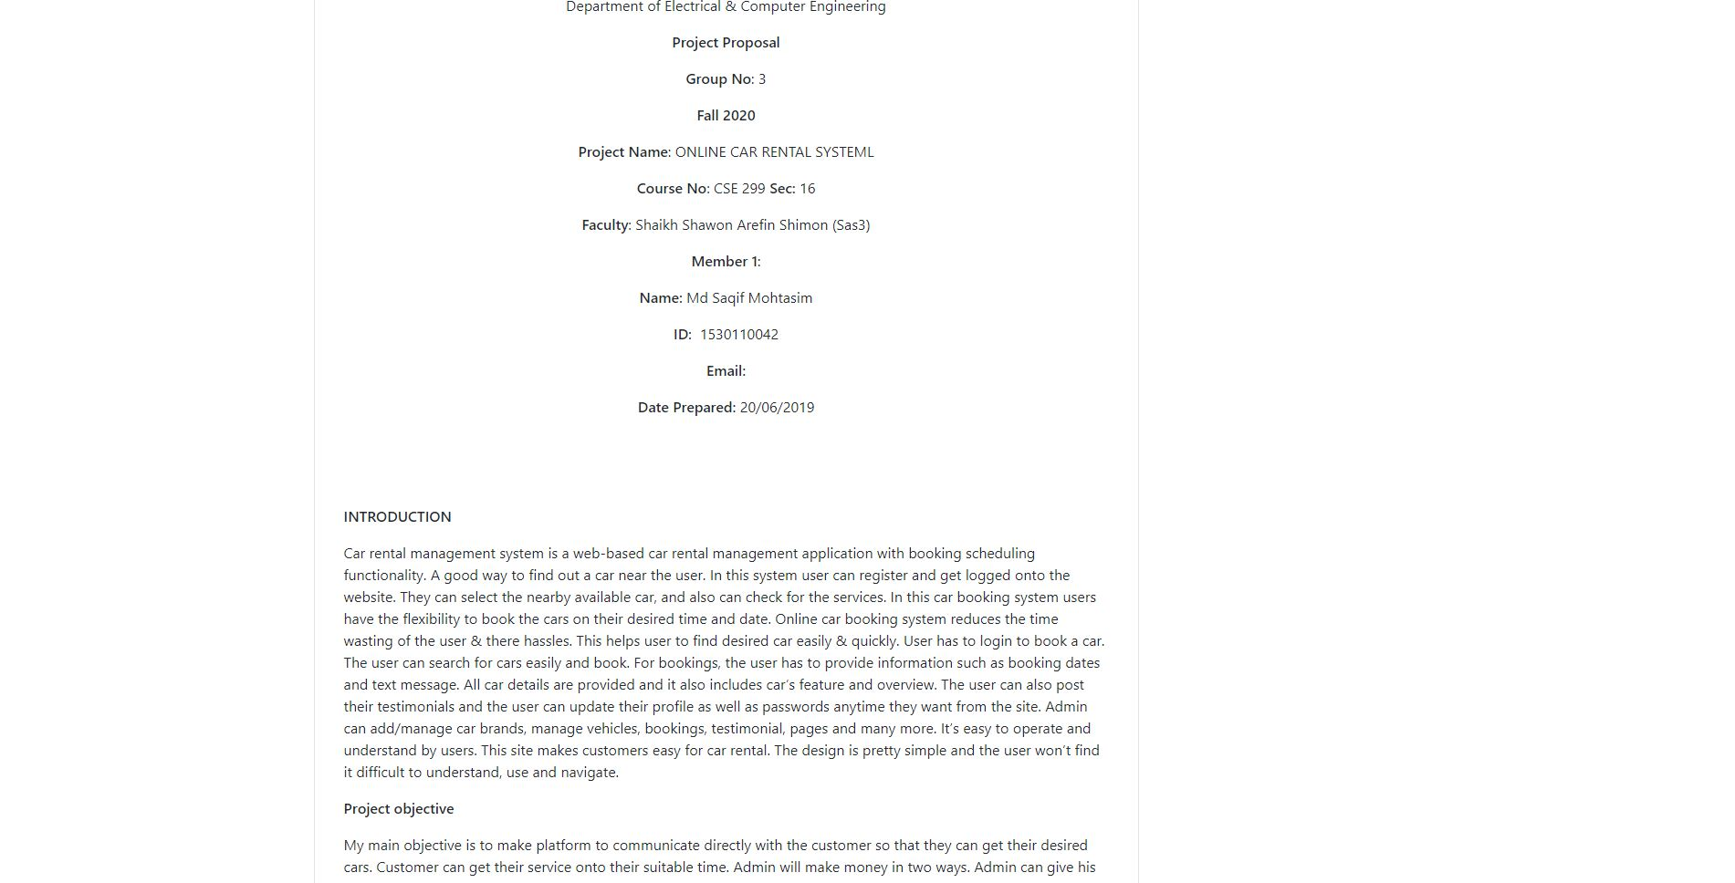

Slide 4
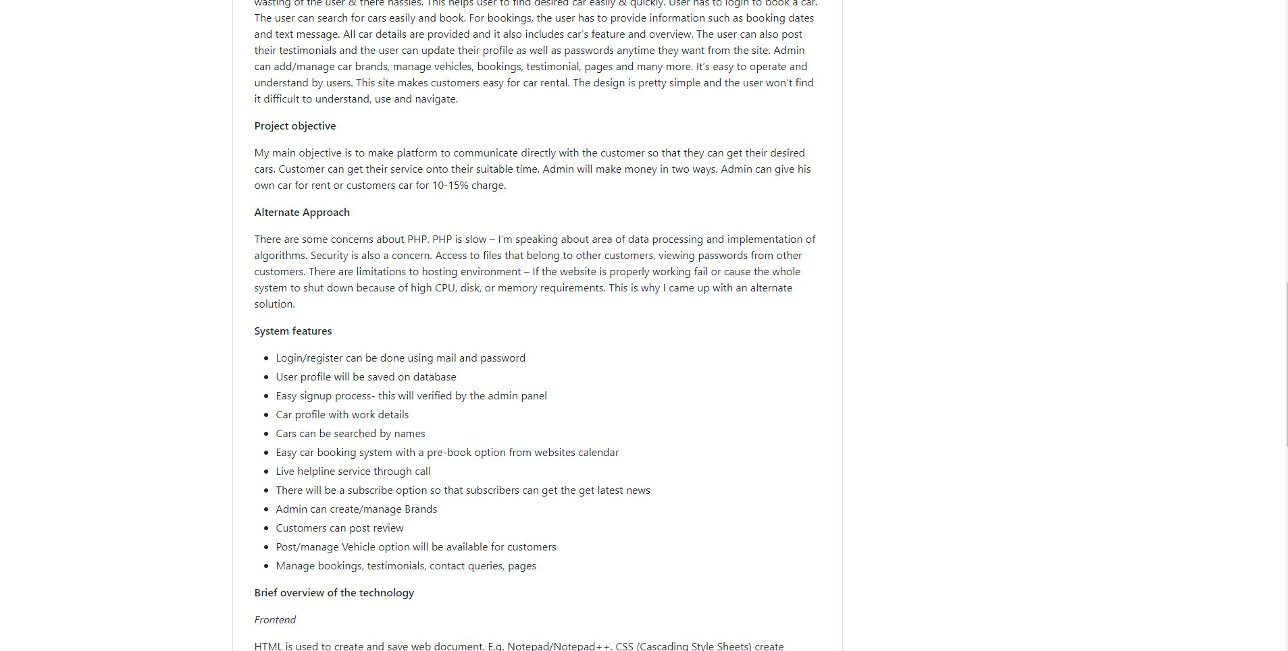

Slide 5
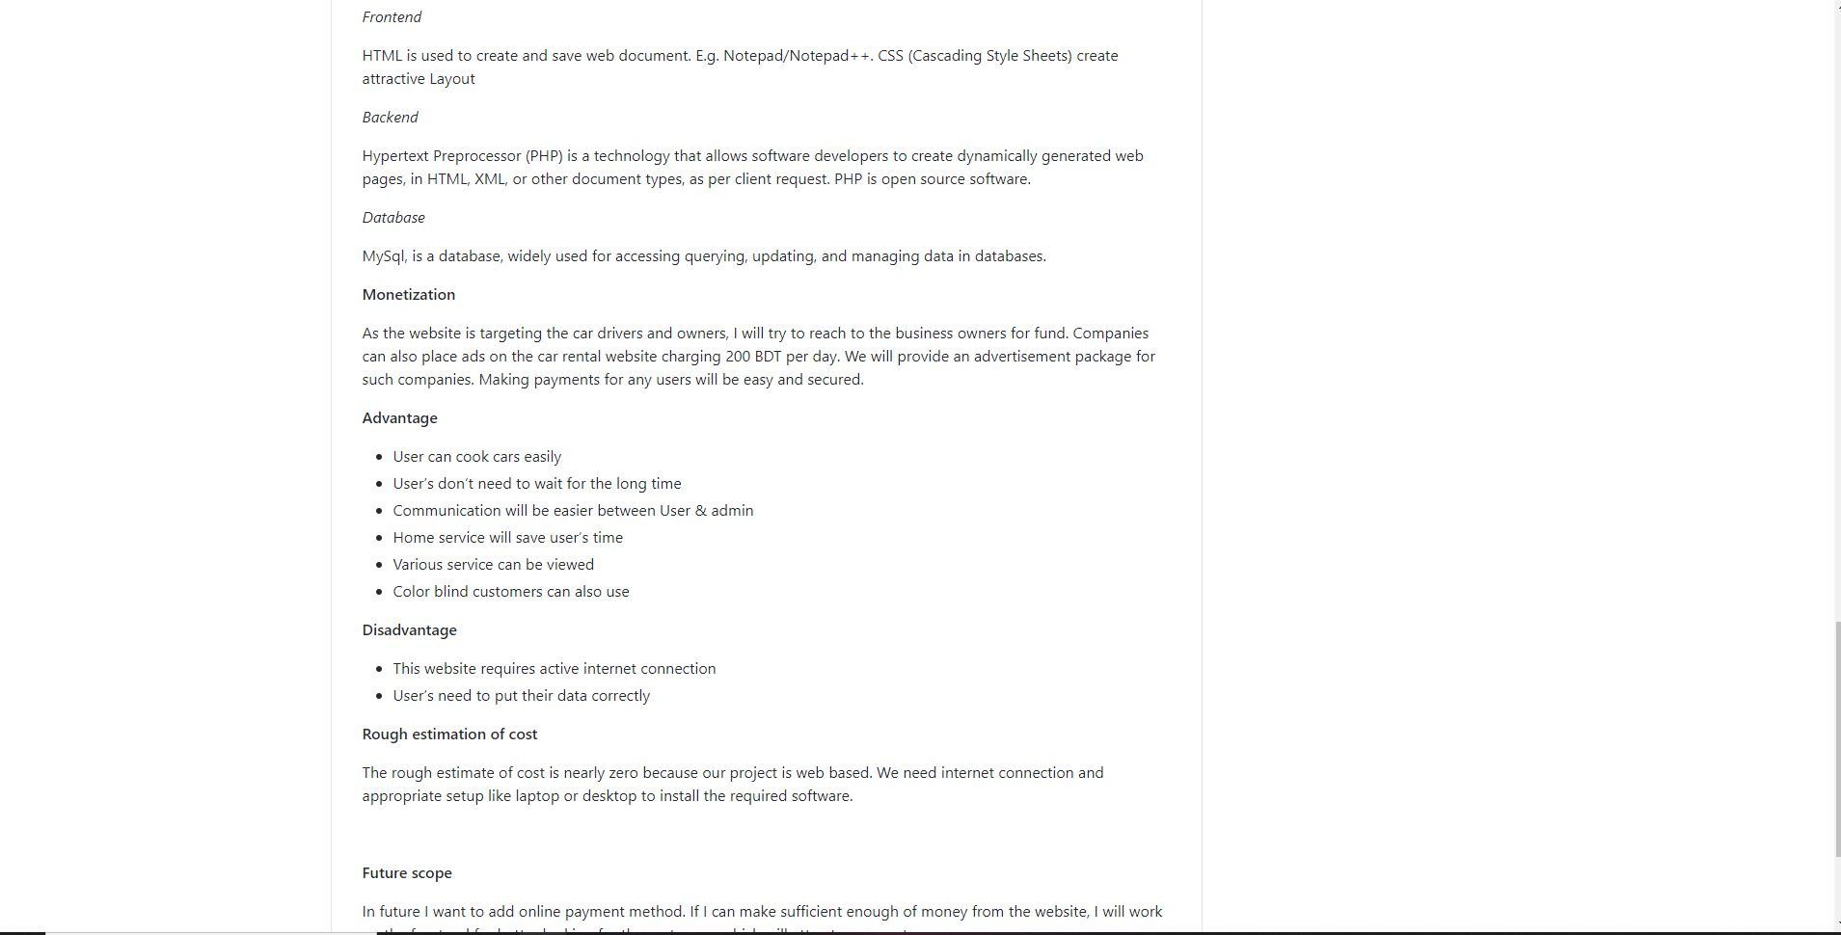

Slide 6
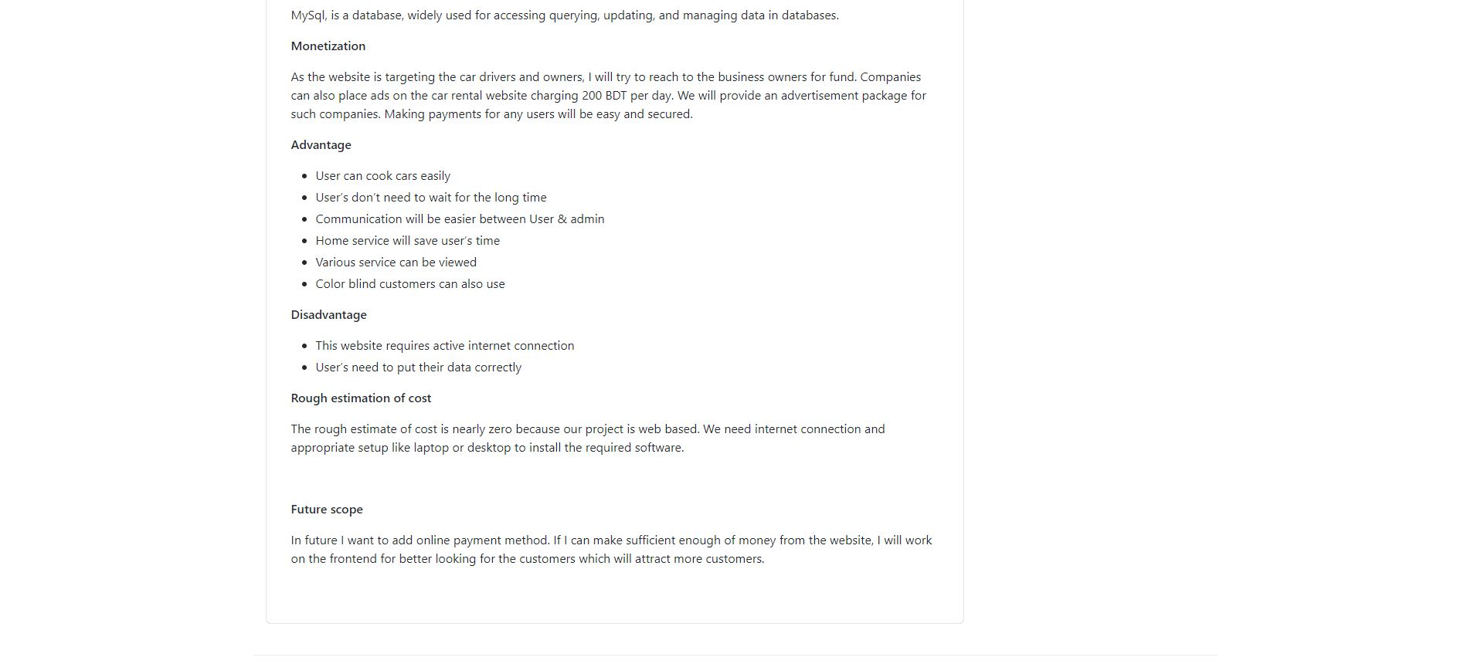

Slide 7
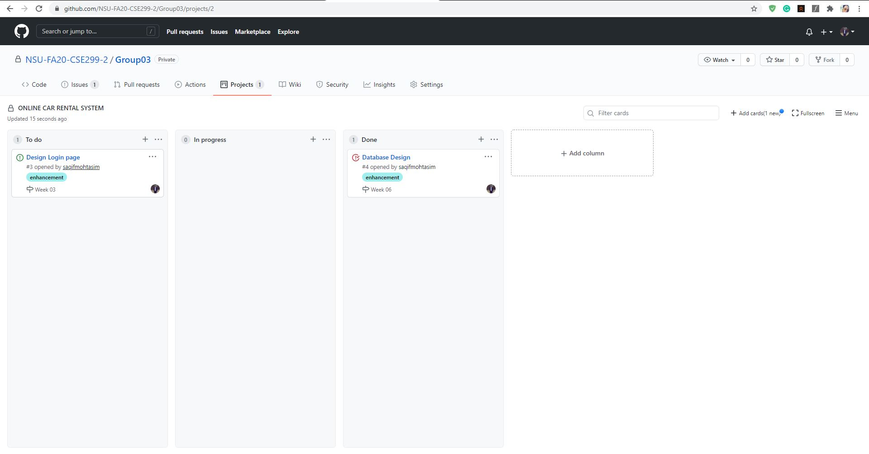
Github board

Slide 8
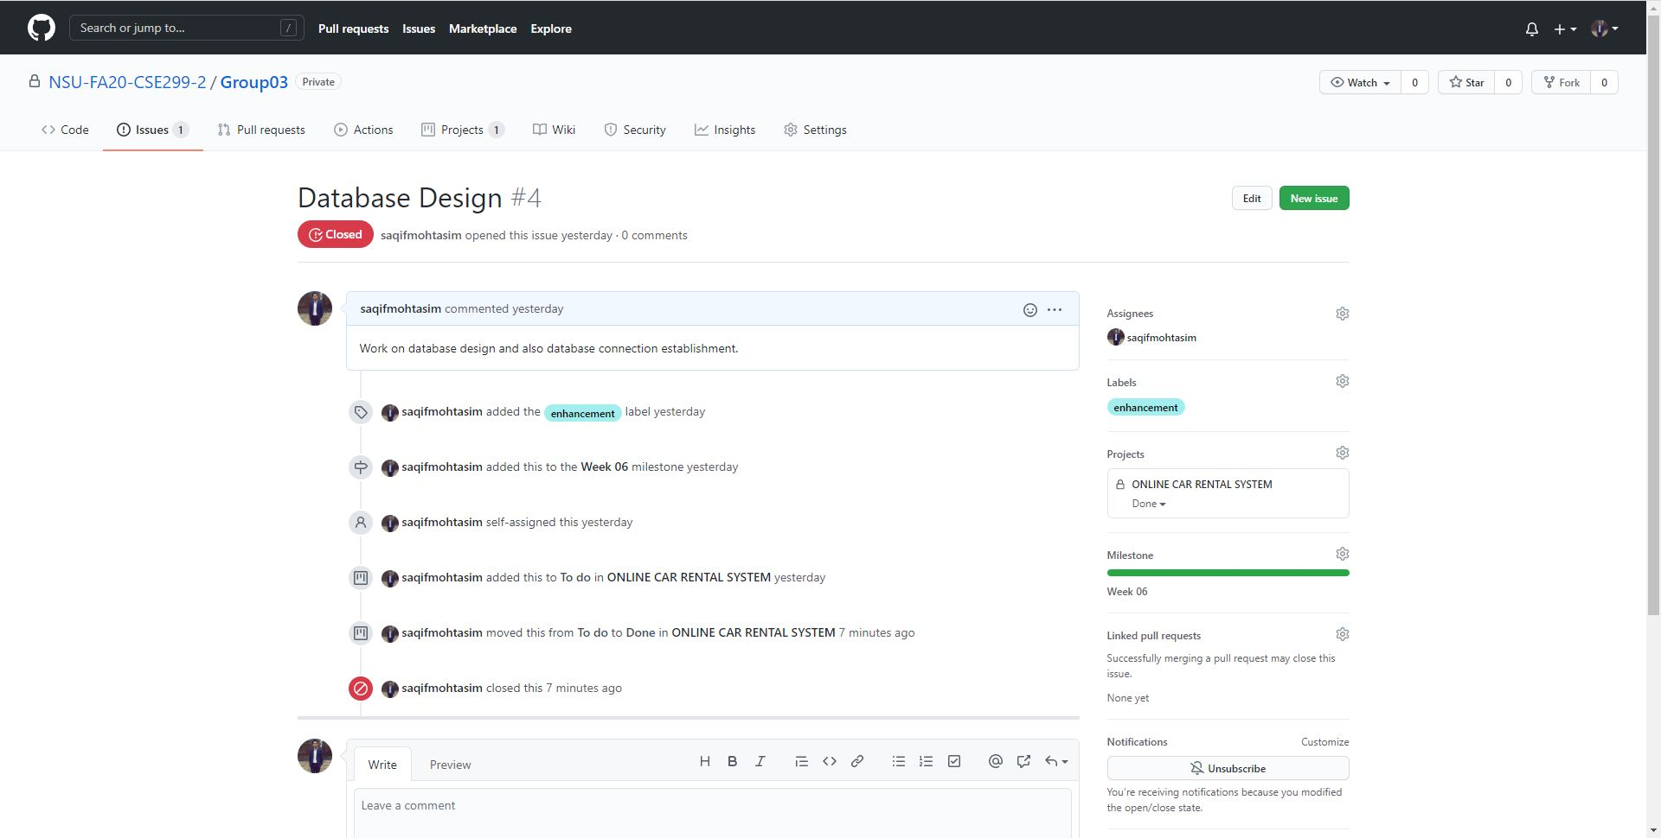
This week's commits

Slide 9
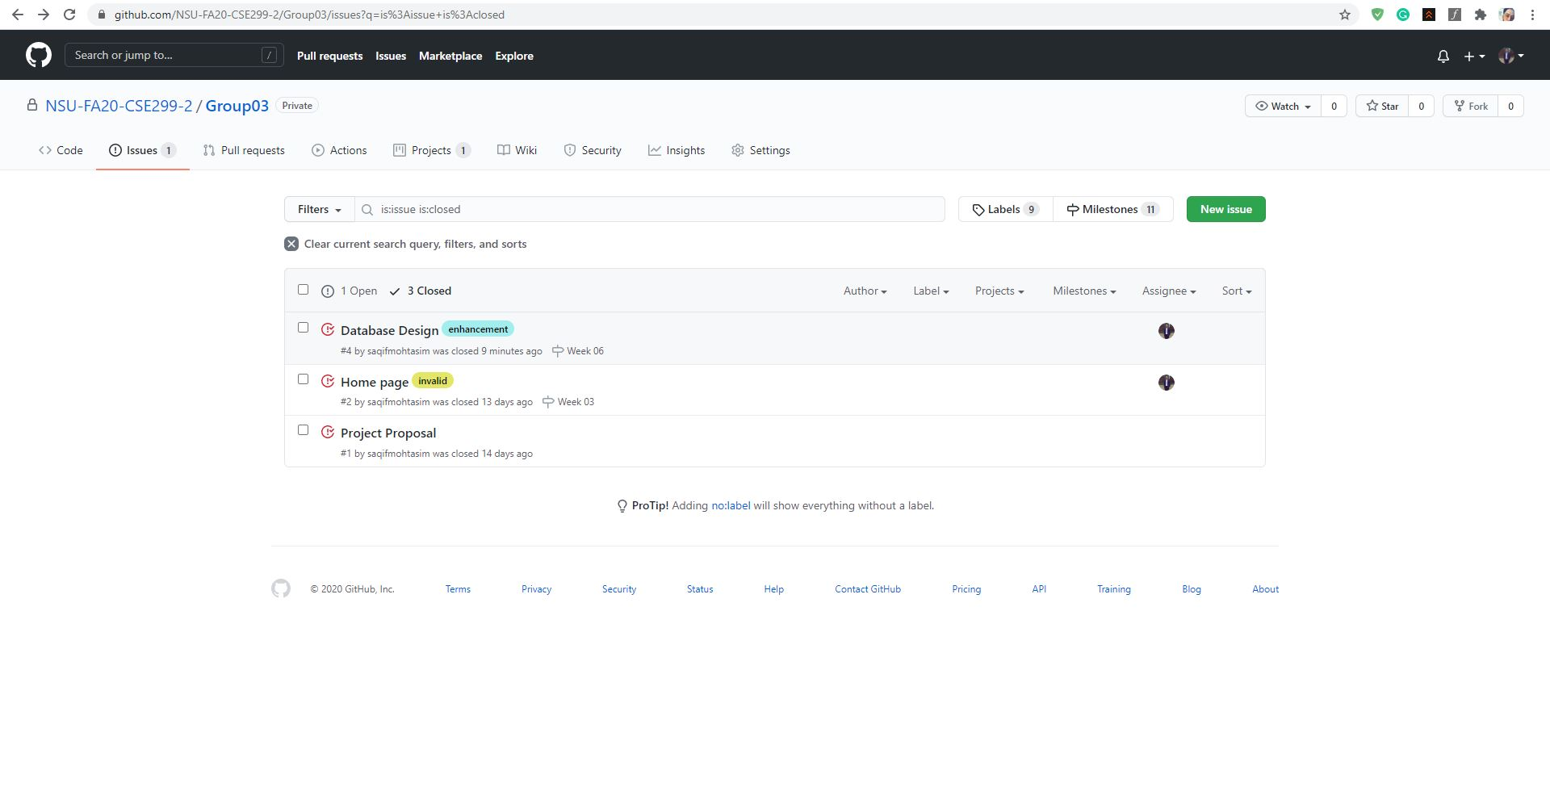
Issues

Slide 10
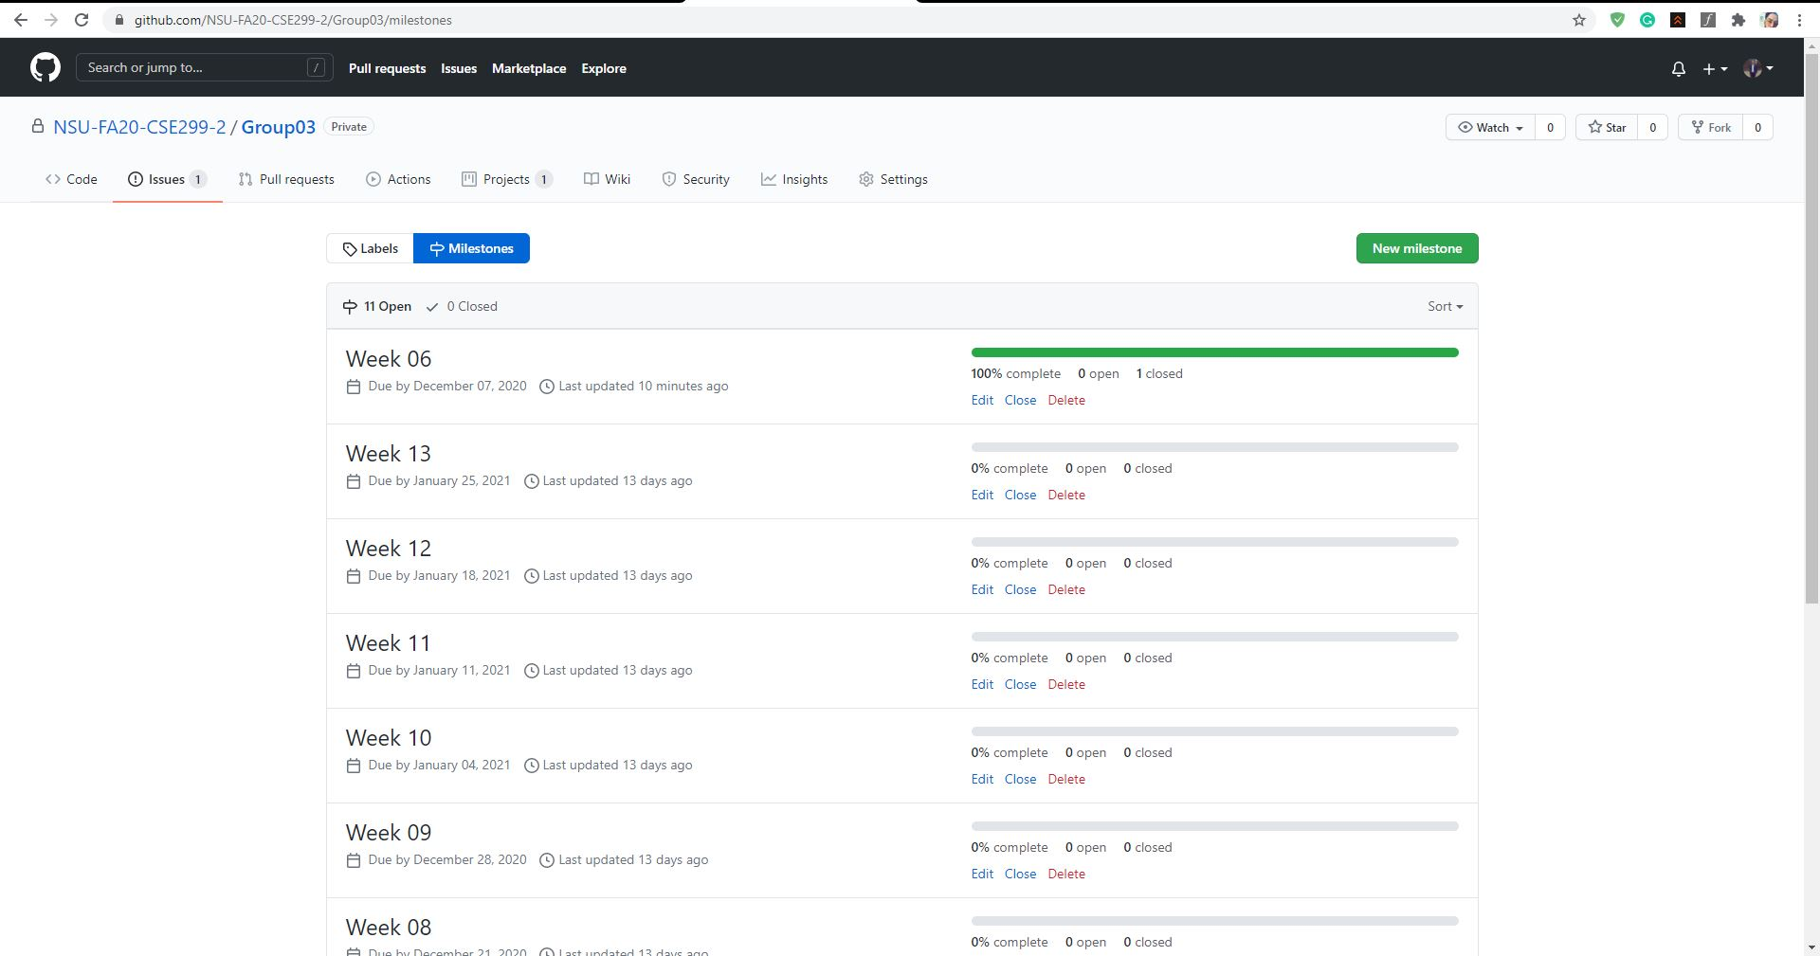
Milestones

Slide 11
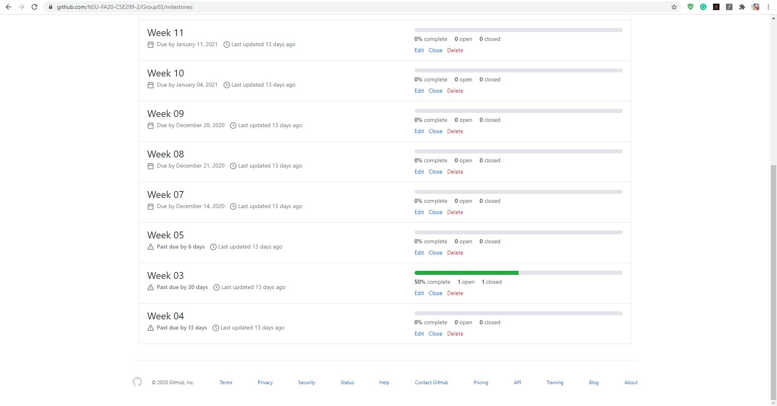

Slide 12

Local repository snapshot

Slide 13


Slide 14
End of presentation thanks

