Slide 1
Project Name: Coupon Finder
CSE299 Section- 02
By Nazia Tabassum Toma
ID: 1721536042
Group - 05

Slide 2
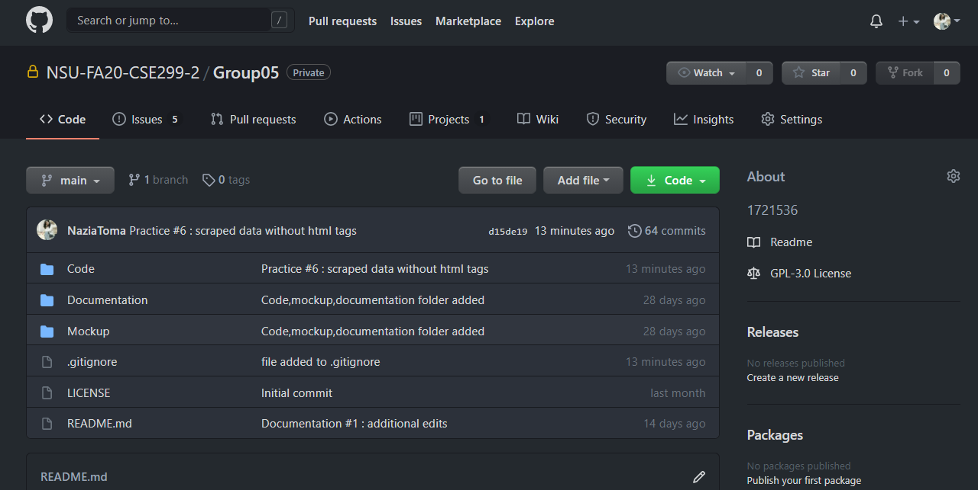
GitHub Frontpage:

Slide 3
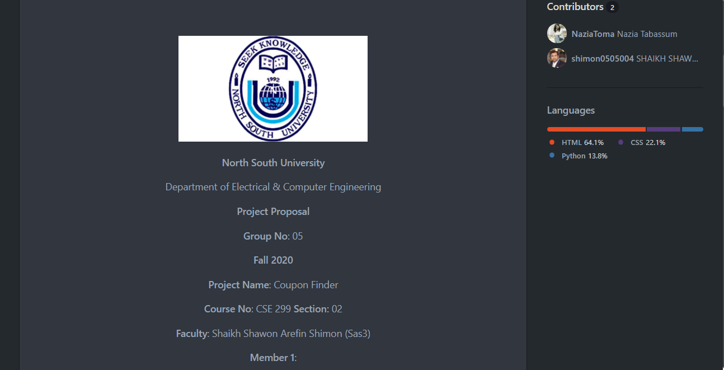
README.md :

Slide 4
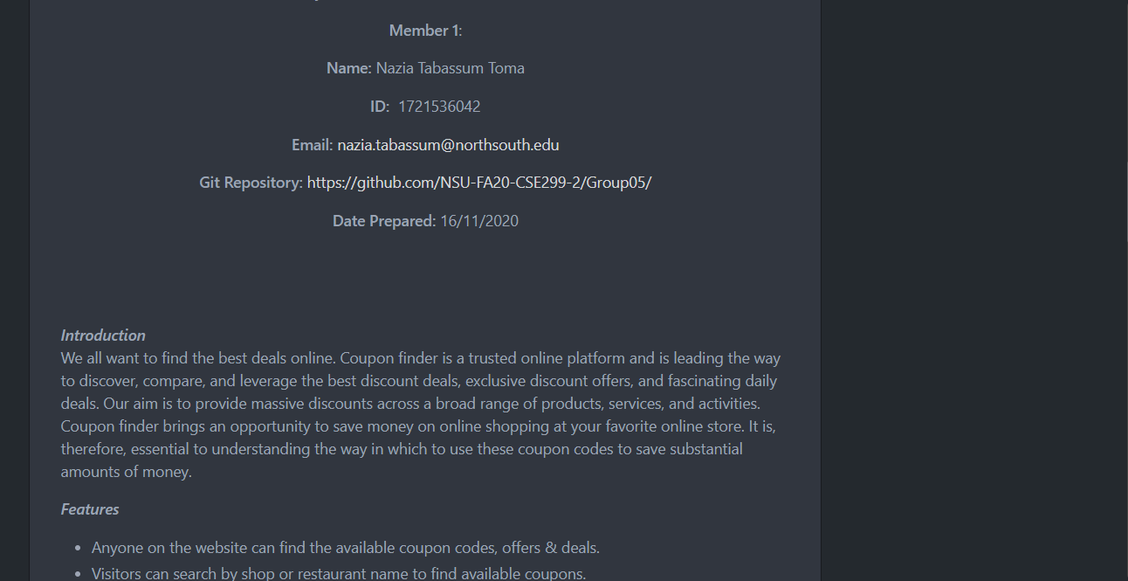
README.md: (ctd)

Slide 5
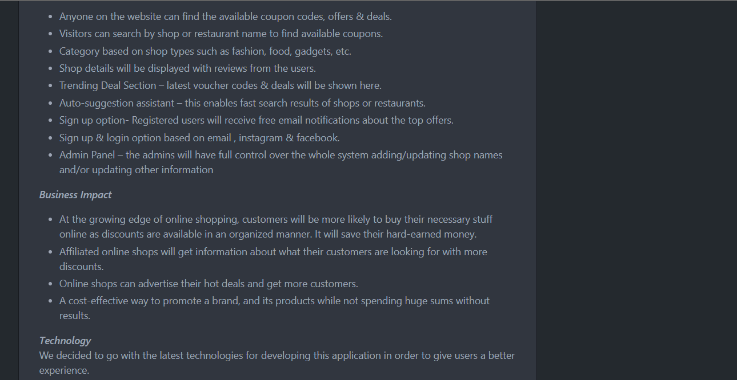
README.md: (ctd)

Slide 6
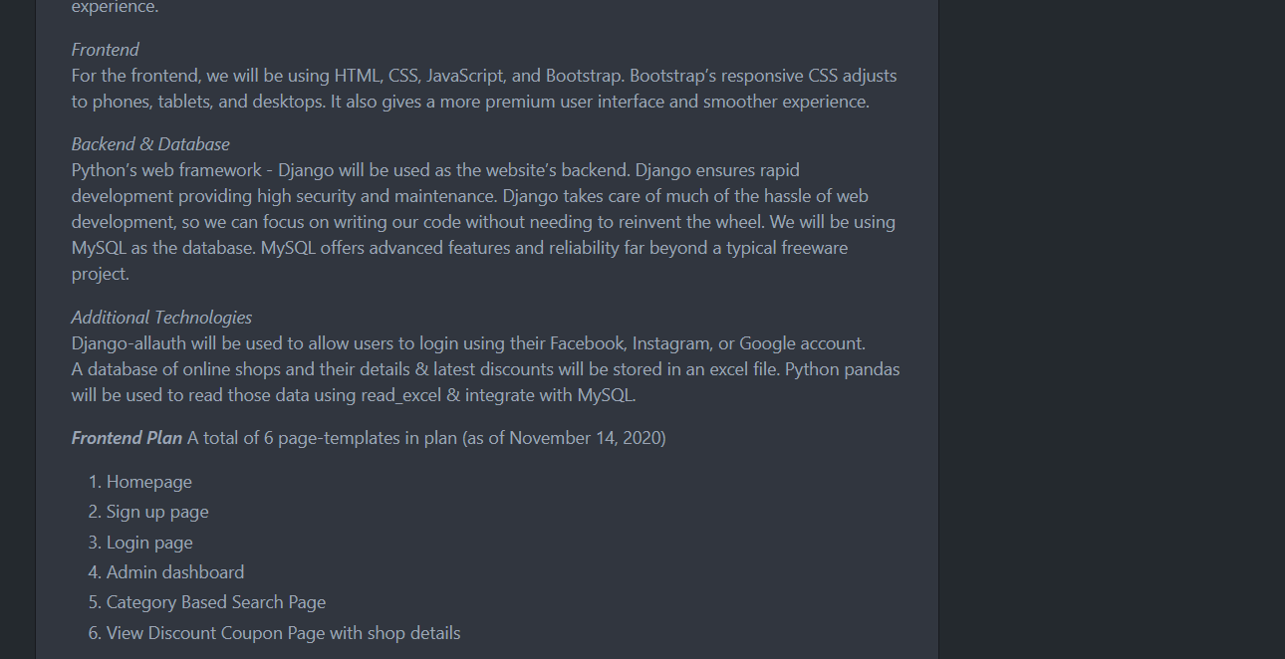
README.md: (ctd)

Slide 7
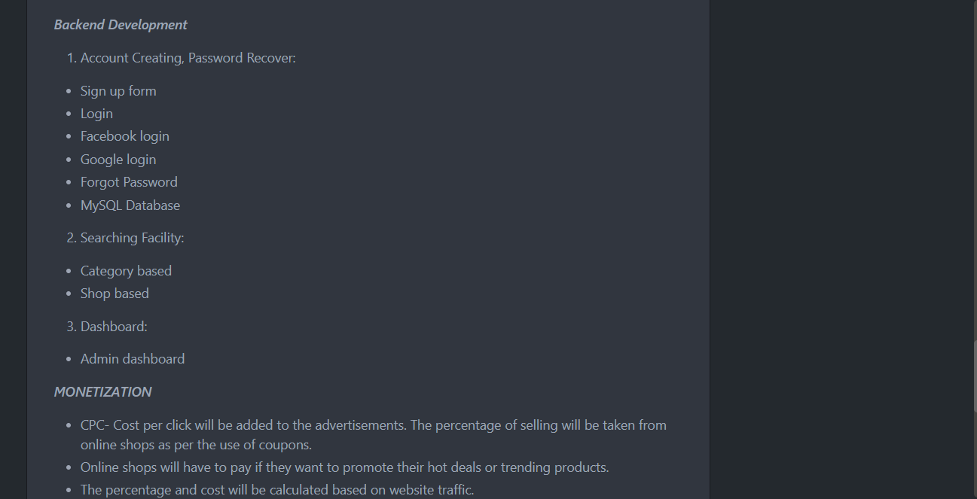
README.md: (ctd)

Slide 8
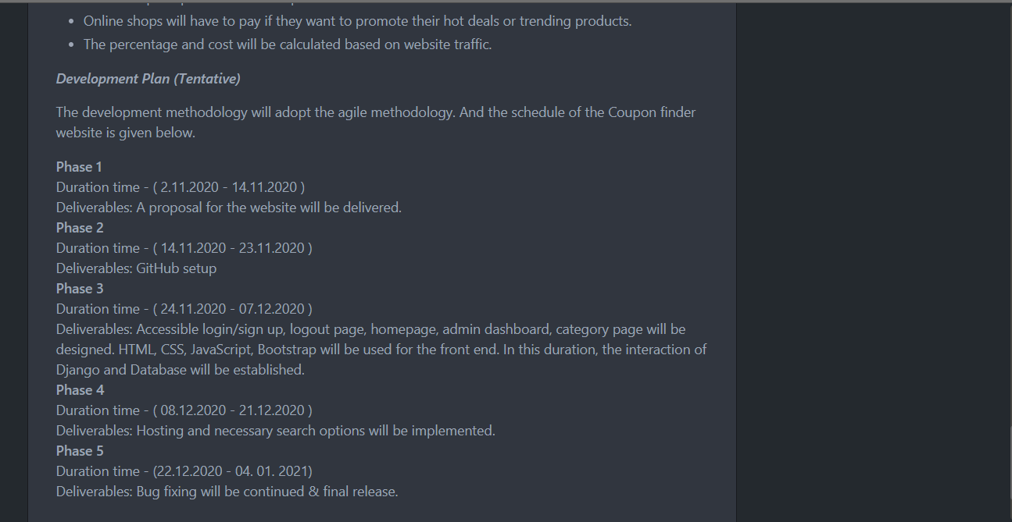
README.md: (ctd)

Slide 9
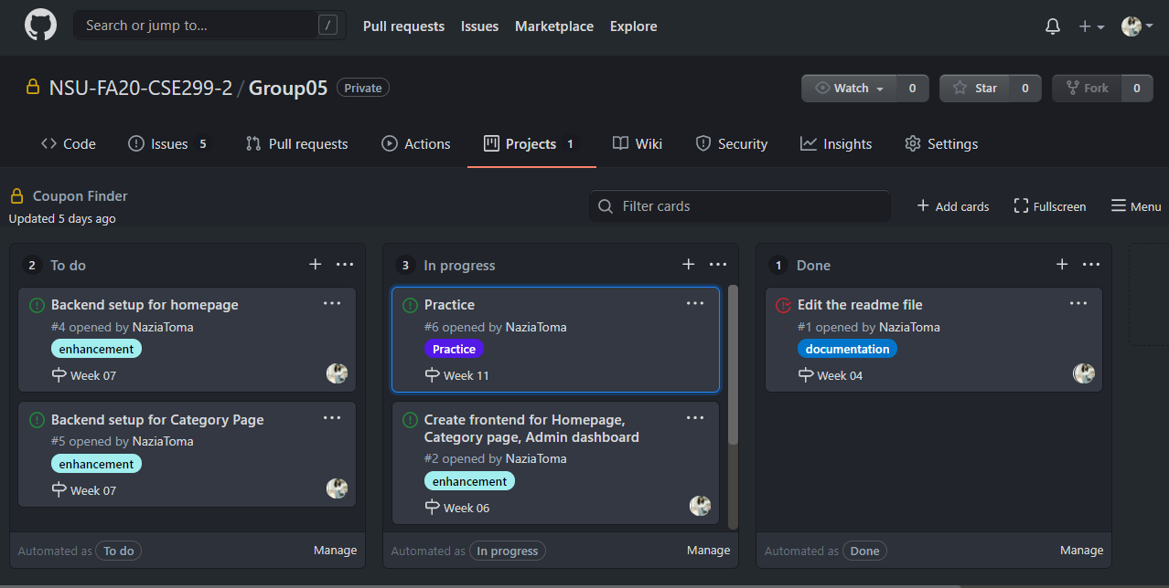
GitHub Board:

Slide 10
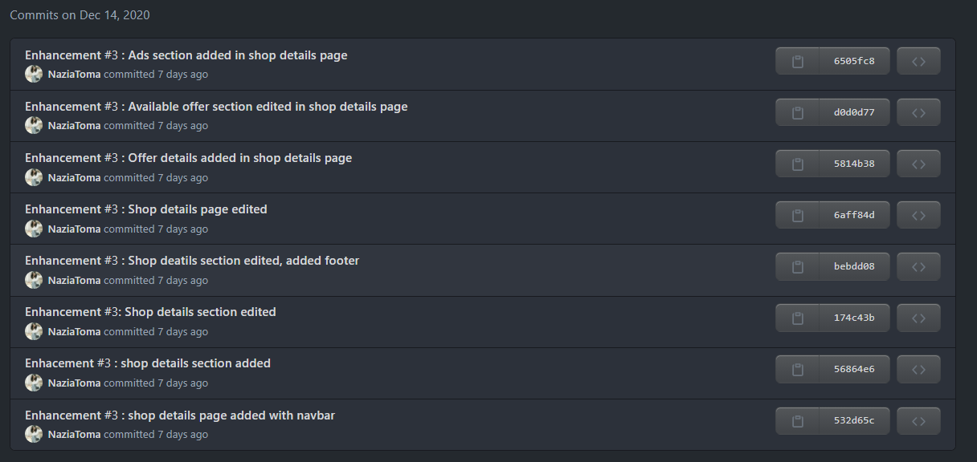
This week’s commits:

Slide 11
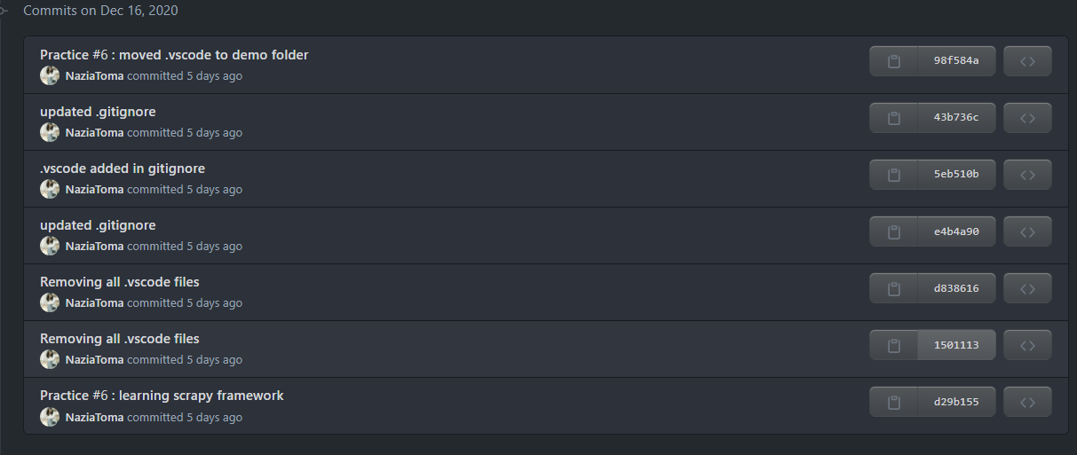
This week’s commits:(ctd)

Slide 12
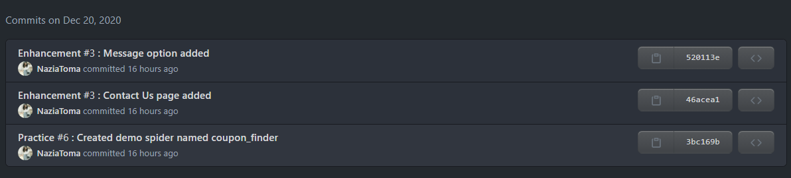
This week’s commits:(ctd)

Slide 13
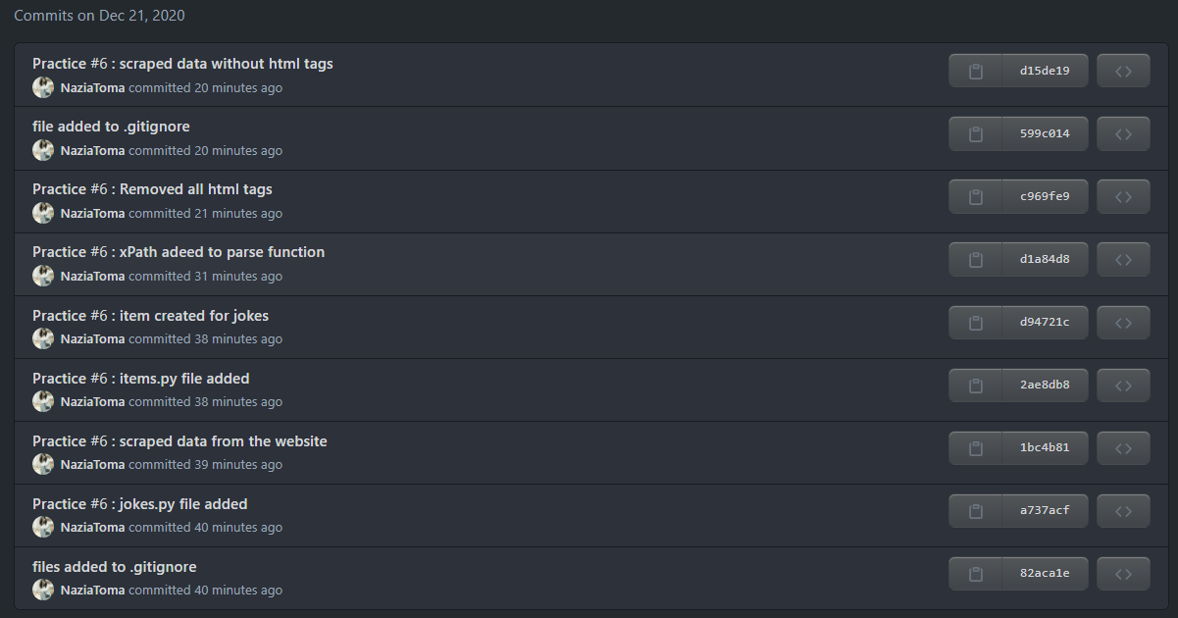
This week’s commits:(ctd)

Slide 14
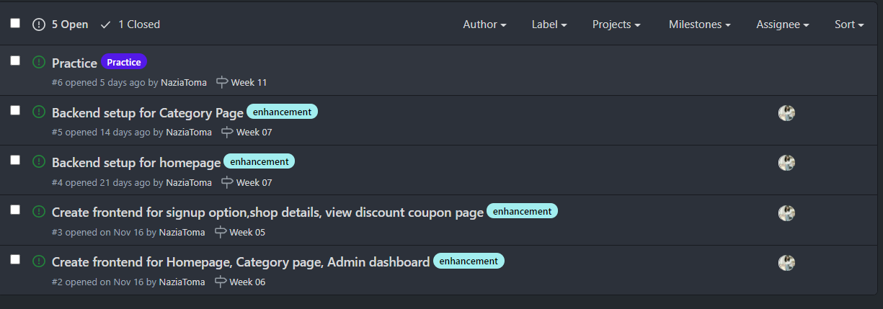
Issues:

