Slide 1
Week 06 Presentation
Course: CSE299
Section: 2
Name: Rifat Islam
ID: 173 1536 042
Group: 06
Other Group Member
Name: Ferdous Zeaul Islam
ID: 173 1136 042

Slide 2
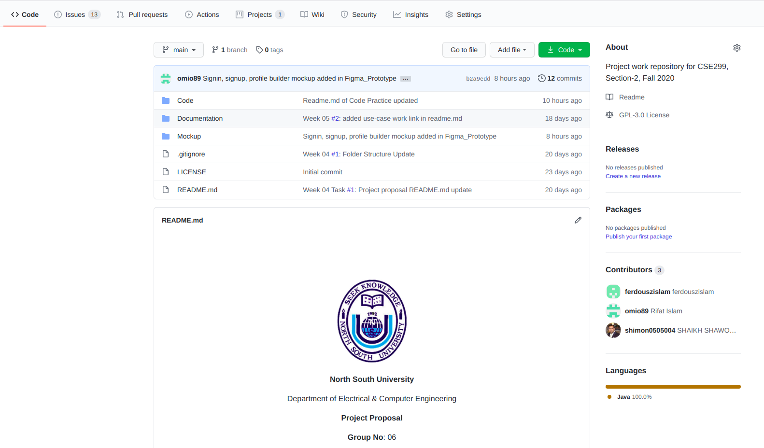
Github Front Page

Slide 3
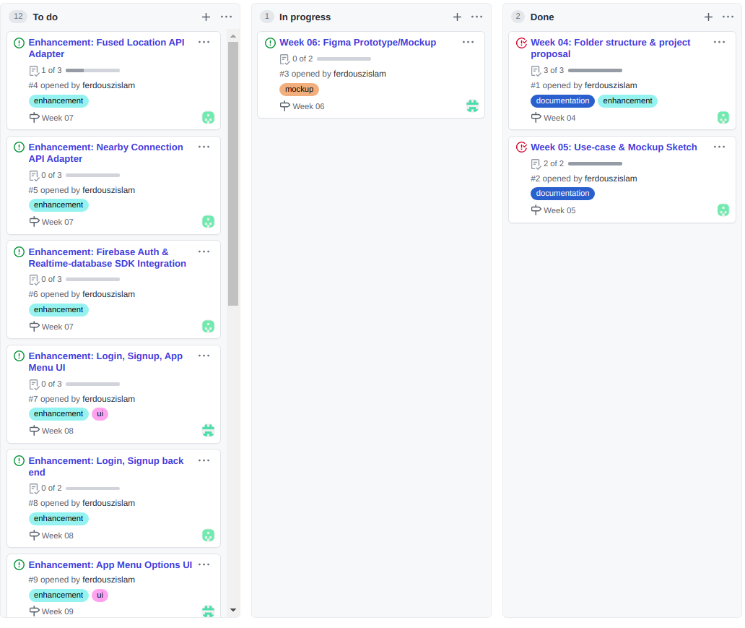
Github Board

Slide 4
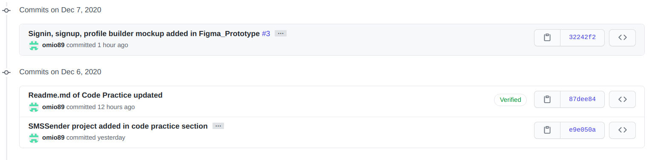
This Week’s Commits
Figma prototype
Practice- SMS sending app

Slide 5
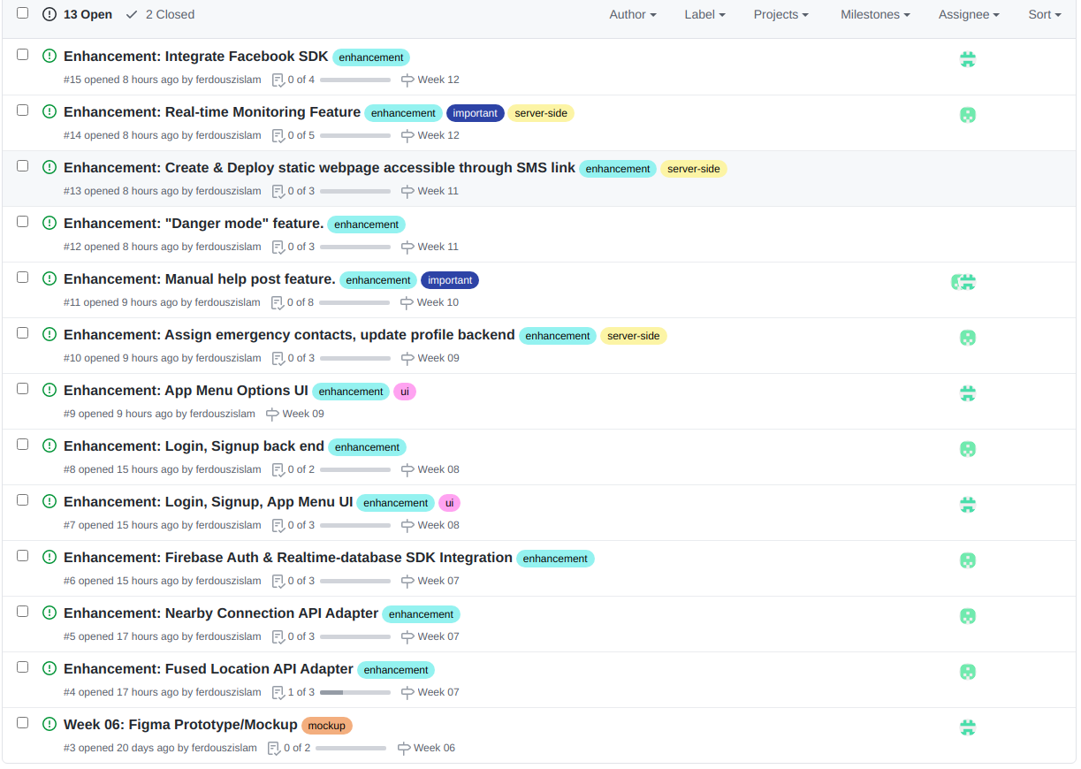
Issues (open)

Slide 6
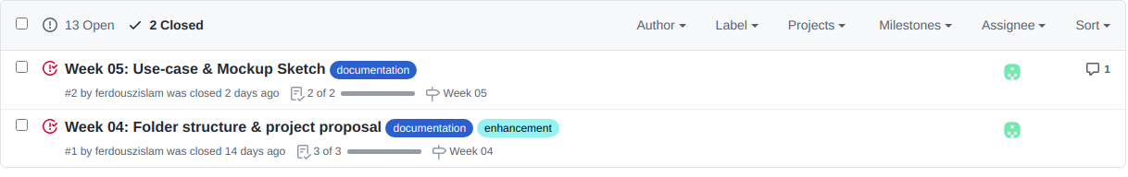
Issues (closed)

Slide 7
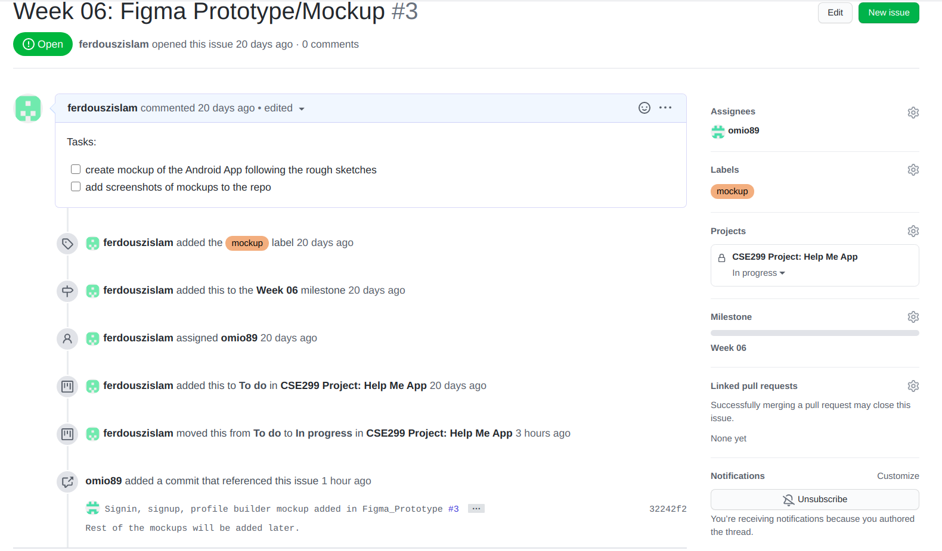
Issues (this week)
*Issue is still open.

Slide 8
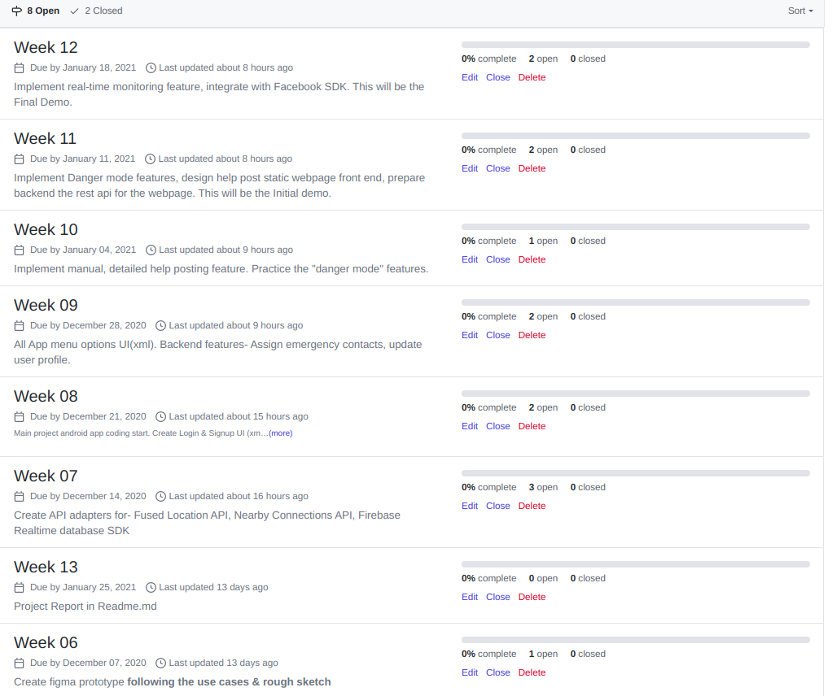
Milestones (open)

Slide 9
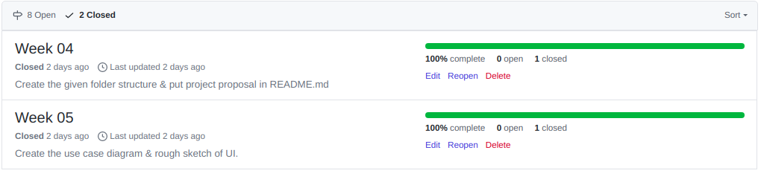
Milestones (closed)
*Week 06(this week) Milestone is still incomplete.

Slide 10
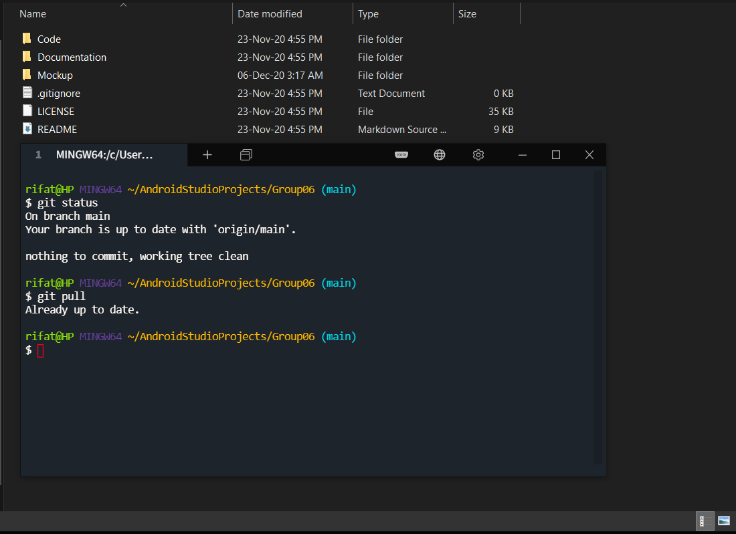
Local Repository State
*Up to date with remote, all local changes pushed to remote

Slide 11
Summary of this Week 06 Tasks
Created issues from all the features and use cases analysis
Linked the issues with weekly milestones
Incomplete Week 06 Milestone-
App Sign up, Login, Build Profile screens figma prototype created
Practice Android Project for SMS sending

