Slide 1
Week 08 Presentation
Course: CSE299
Section: 2
Group: 06
Name: Rifat Islam
ID: 173 1536 042
Other Group Member
Name: Ferdous Zeaul Islam
ID: 173 1136 042

Slide 2
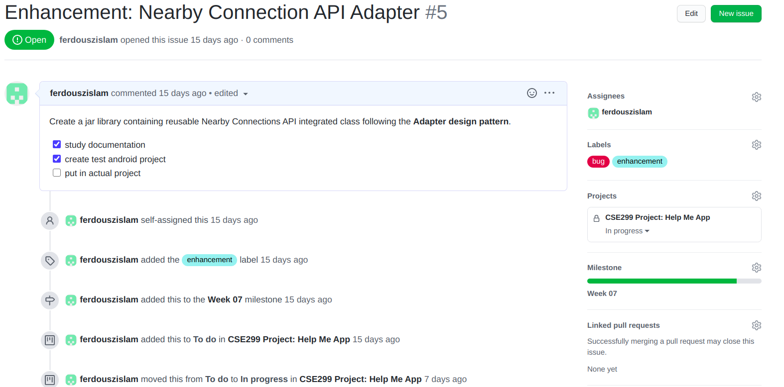
Last week(Week-7) unfinished Issue #5
*The issue was Labeled as Bug

Slide 3
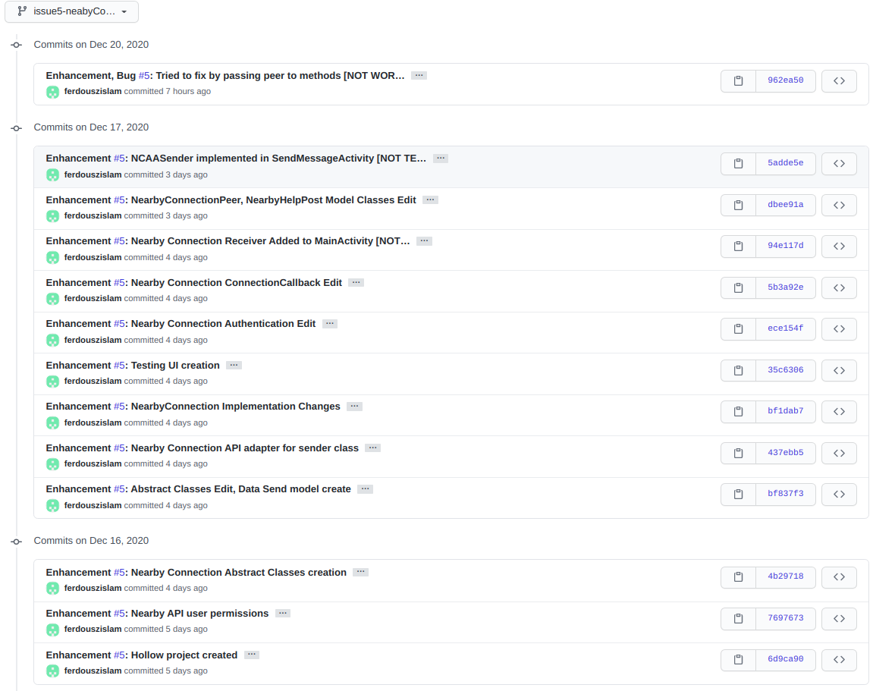
Last week’s(Week-7) unfinished issue #5 branch commits
*The issue was
Labeled as Bug

Slide 4
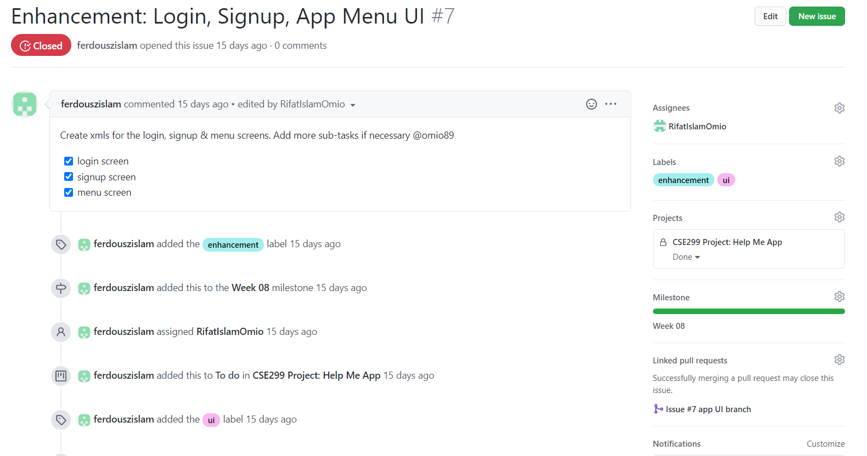
This Week’s(Week-8) Issue #7

Slide 5
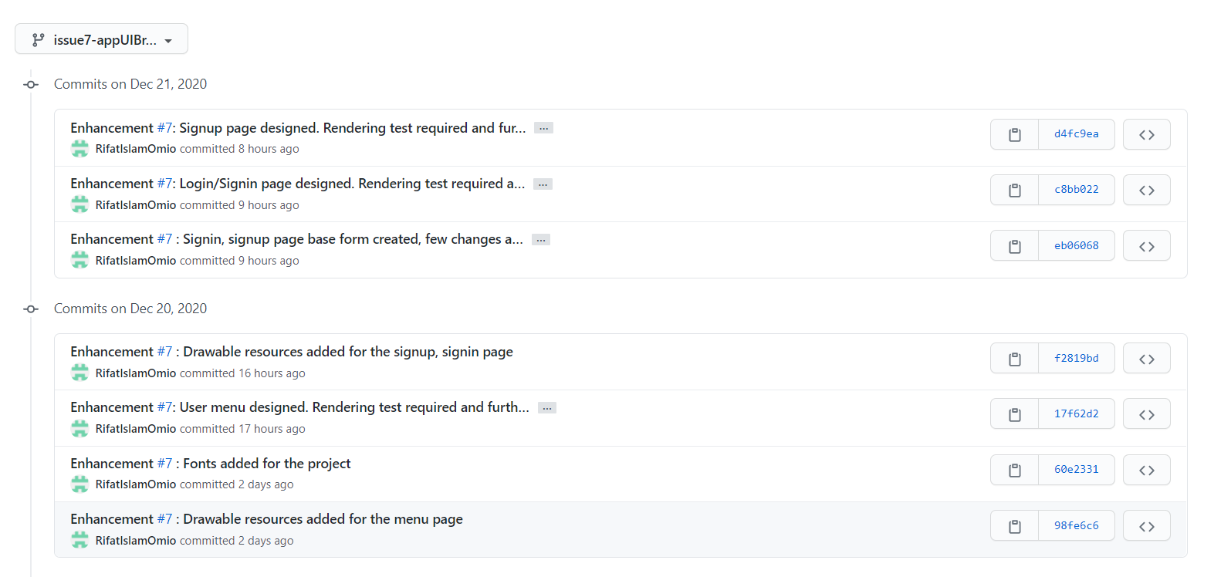
This Week’s(Week-8) Issue #7 branch commits

Slide 6
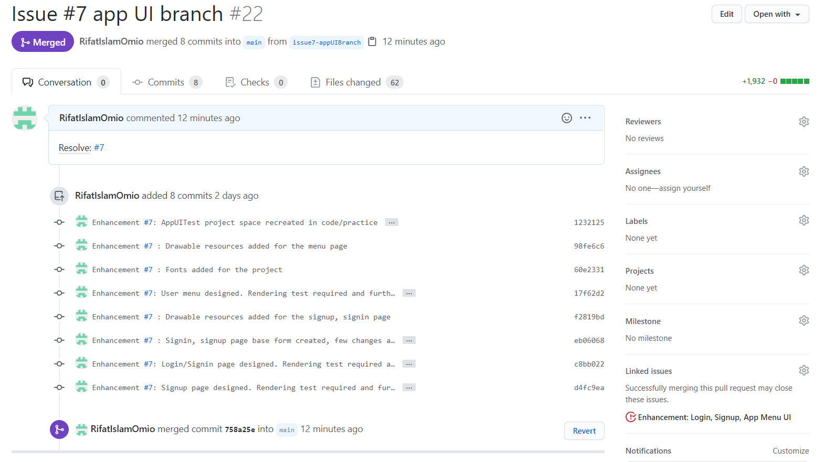
This Week’s(Week-8) Issue #7 Pull-Request

Slide 7
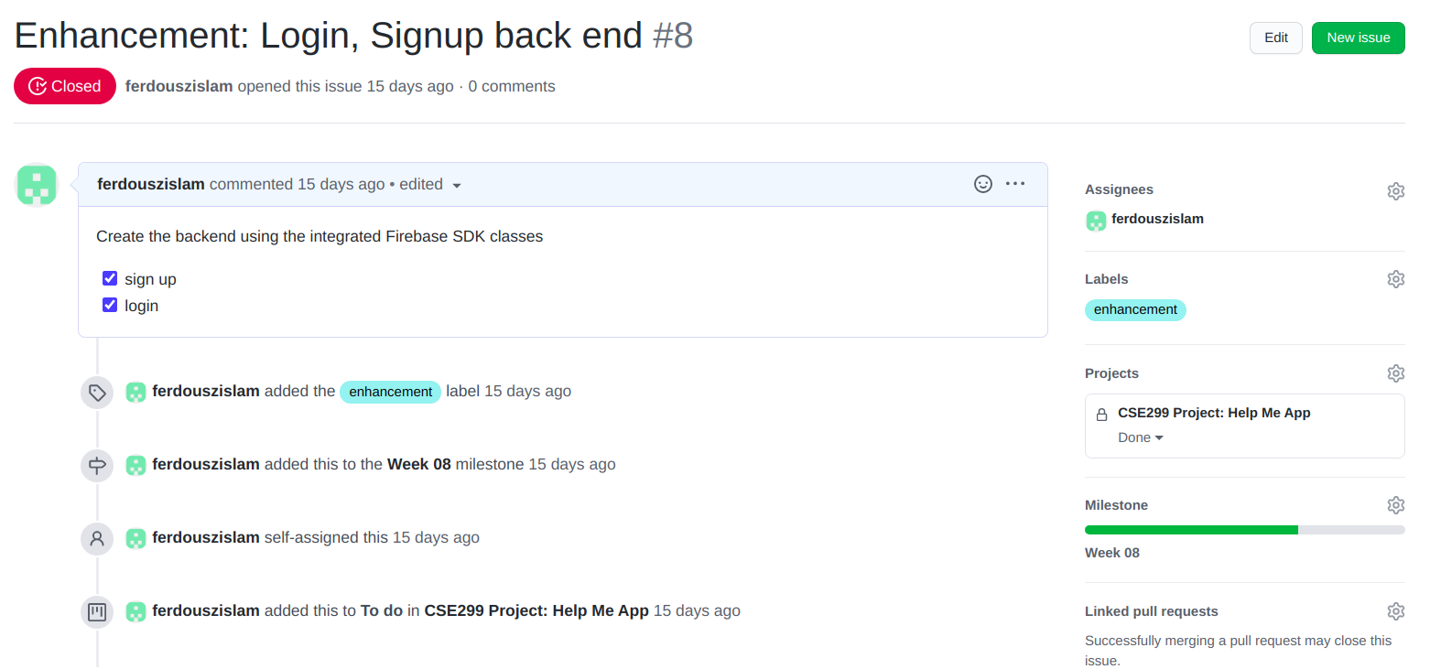
This Week’s(Week-8) Issue #8

Slide 8
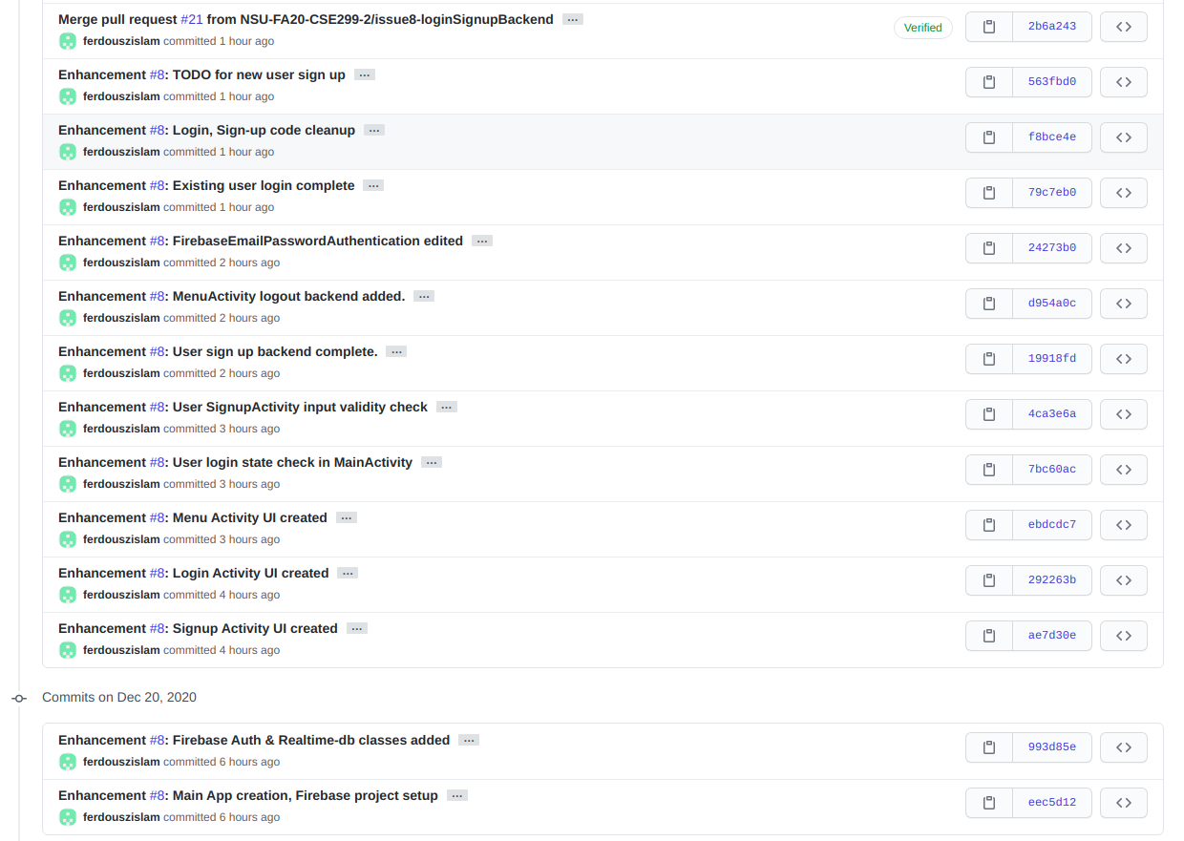
This Week’s(Week-8) Issue #8 branch commits

Slide 9
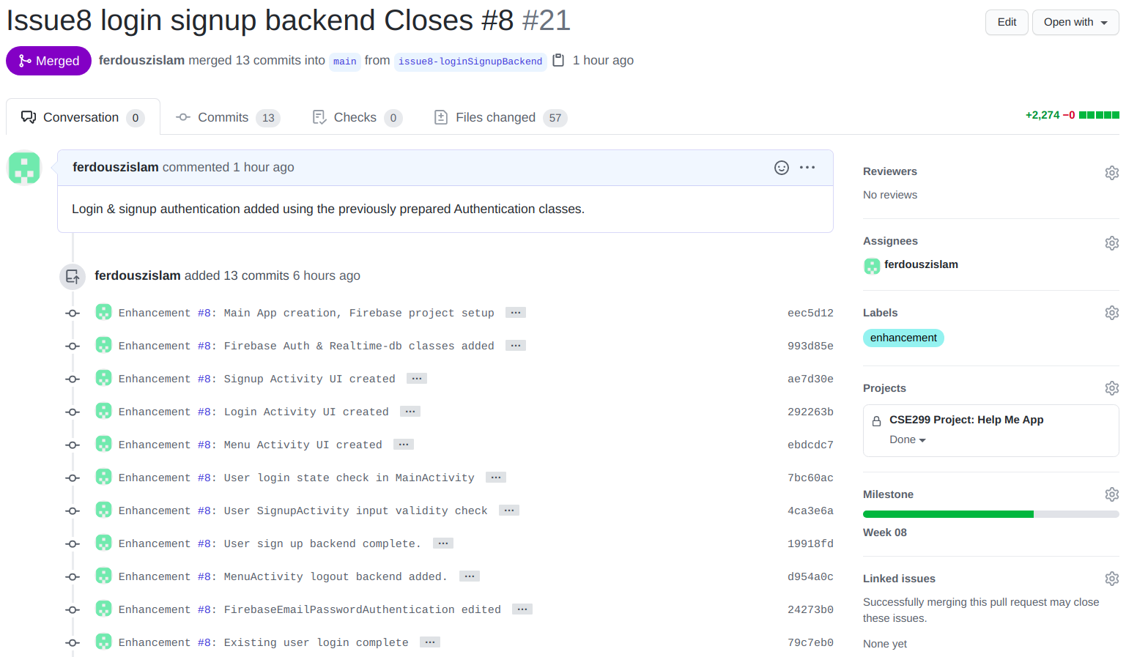
This Week’s(Week-8) Issue #8 Pull-Request

Slide 10
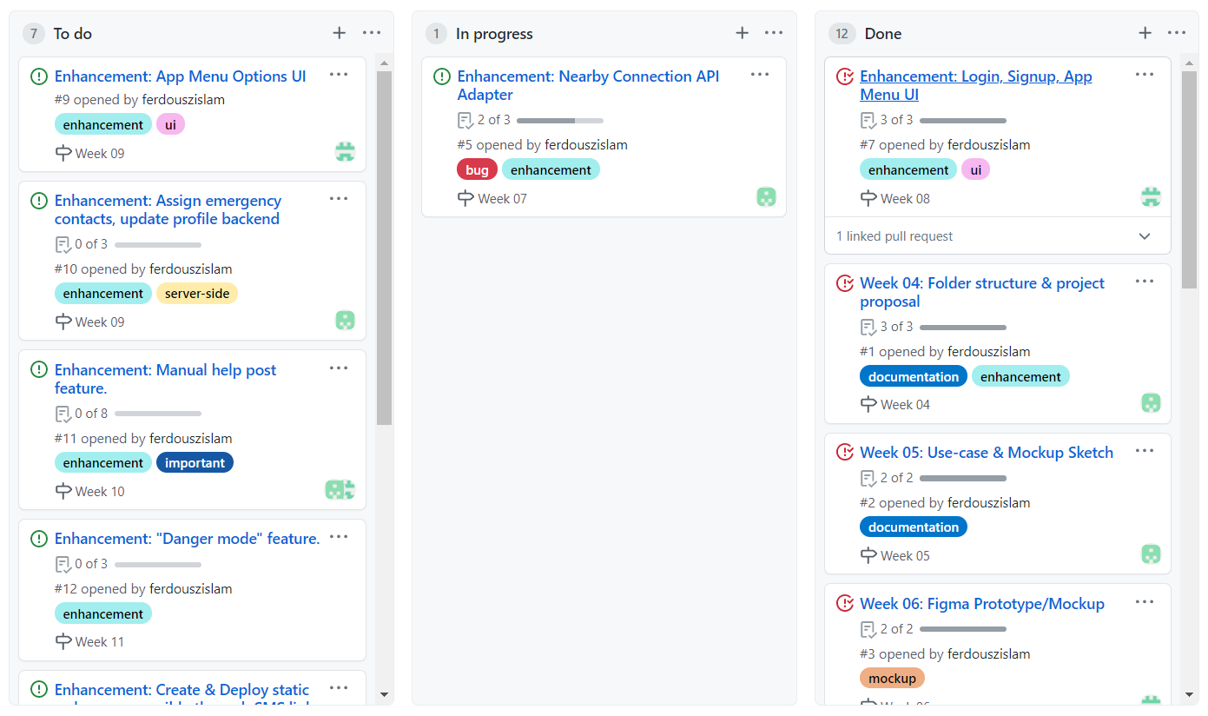
Github Project Board Status

Slide 11
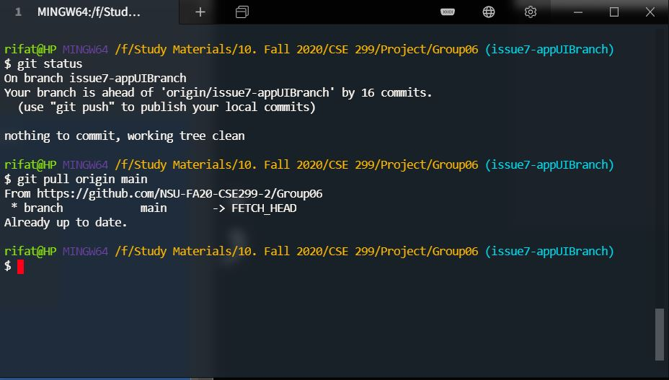
Local Repository Status
*Up to date with remote,
all local changes pushed to remote

Slide 12
Summary of this Week 08 Tasks
Unable to complete previous week’s (Week-7) pending issue #5 because of BUG.
Completed this (Week-8) Issue #7.
Completed this week’s (Week-8) Issue #8.

