Slide 1
Week 09 Presentation
Course: CSE299
Section: 2
Group: 06
Name: Rifat Islam
ID: 173 1536 042
Other Group Member
Name: Ferdous Zeaul Islam
ID: 173 1136 042

Slide 2
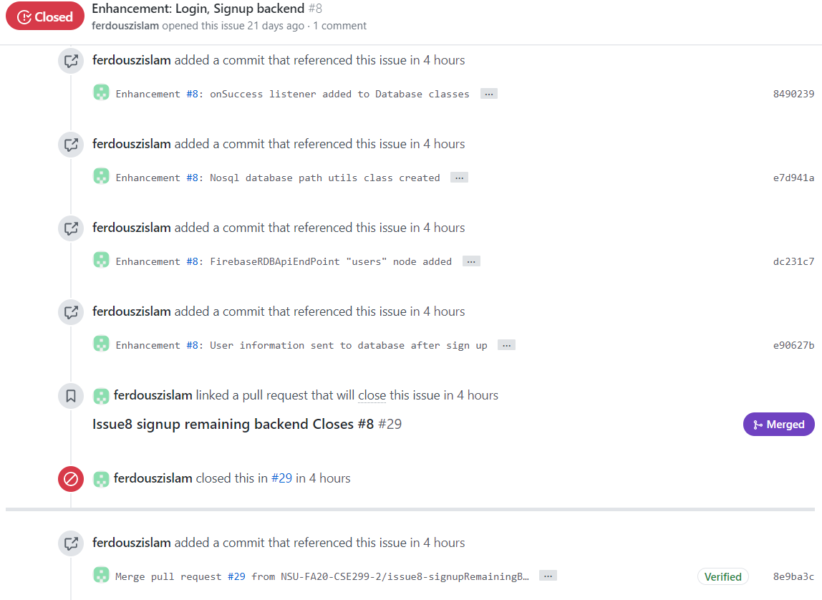
Last week’s (Week-8) remaining issue

Slide 3
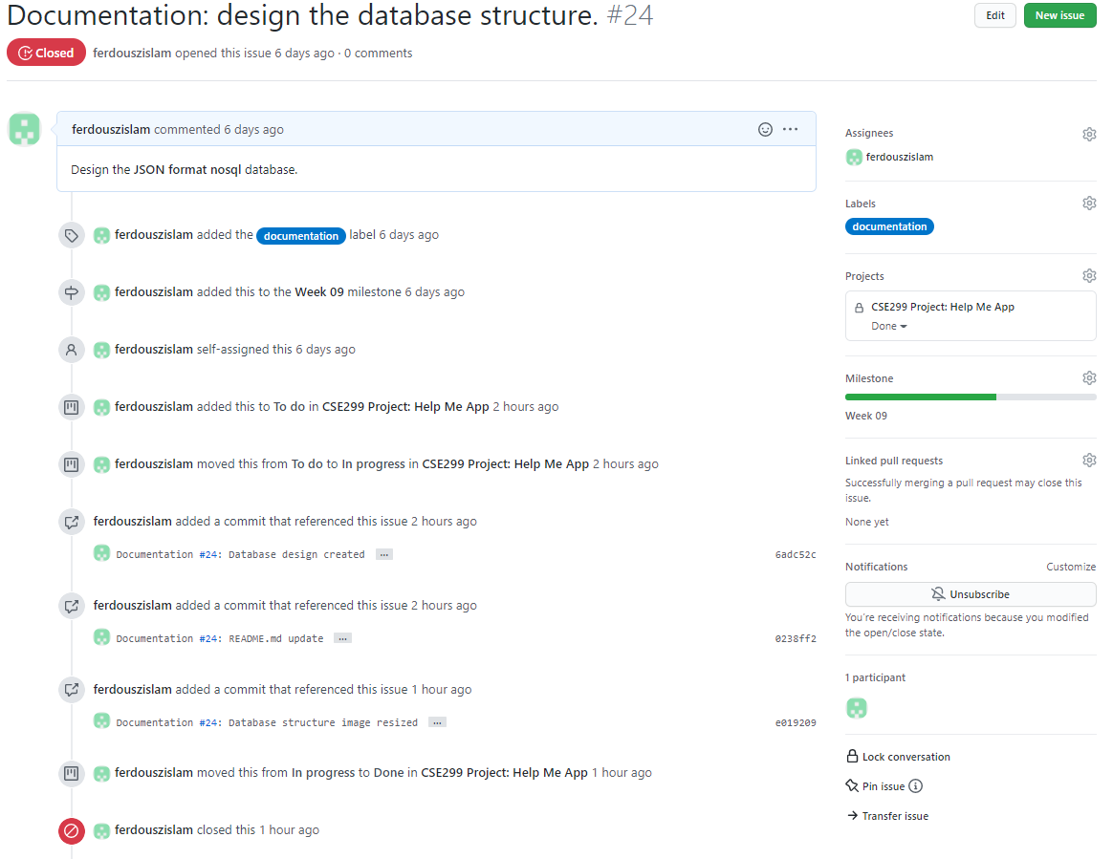
This week’s (Week-9) issue #24

Slide 4
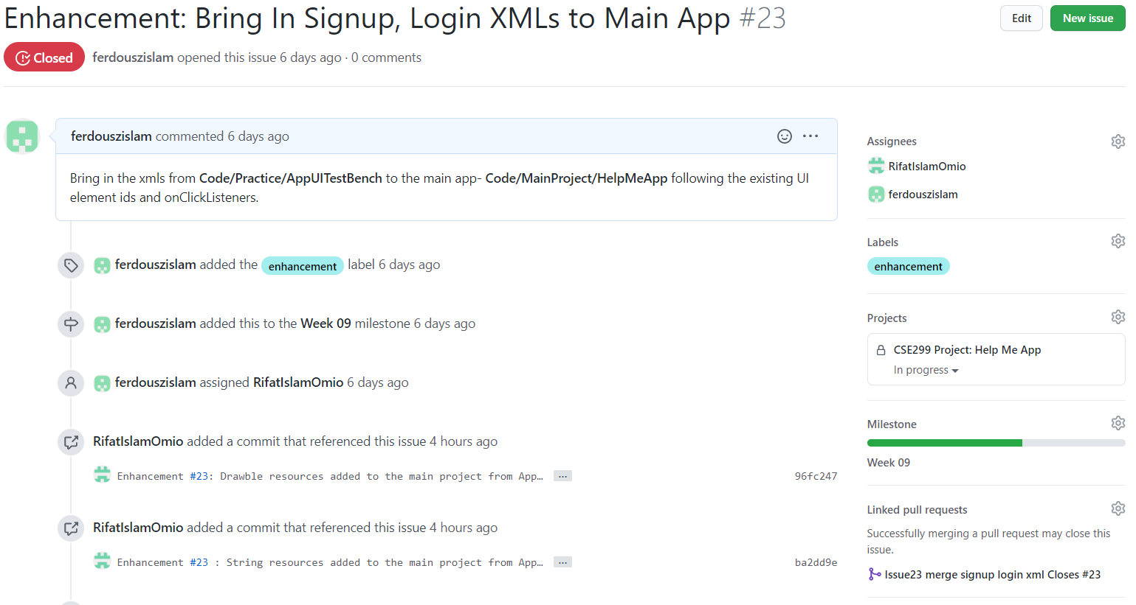
This week’s (Week-9) issue #23

Slide 5
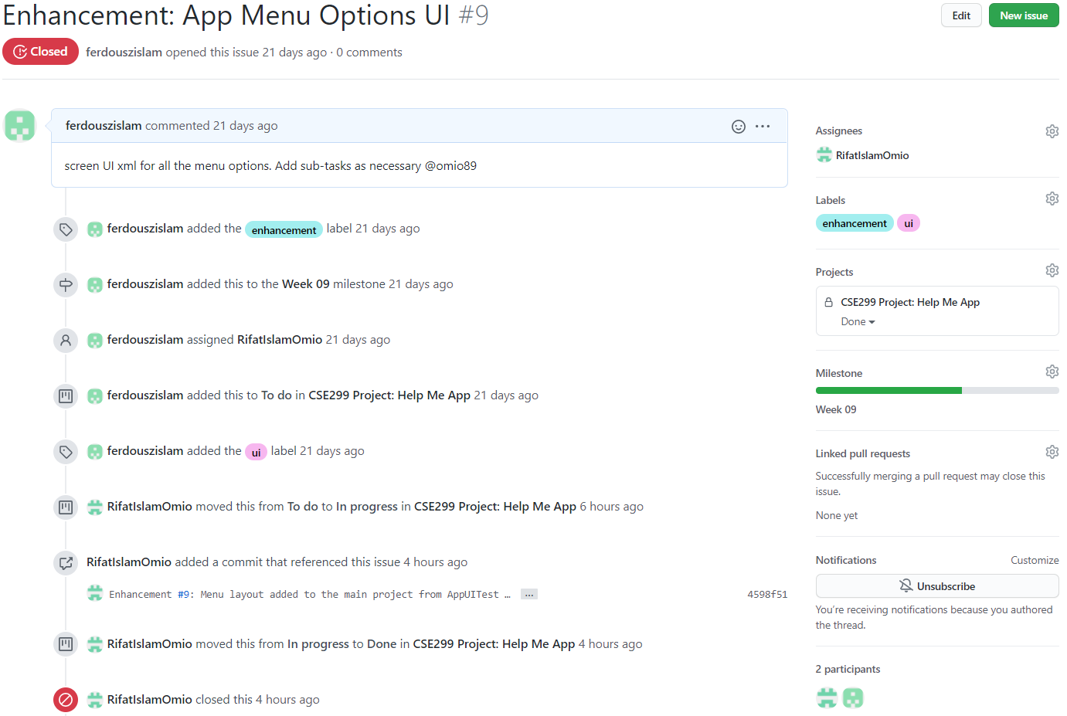
This week’s (Week-9) issue #9

Slide 6
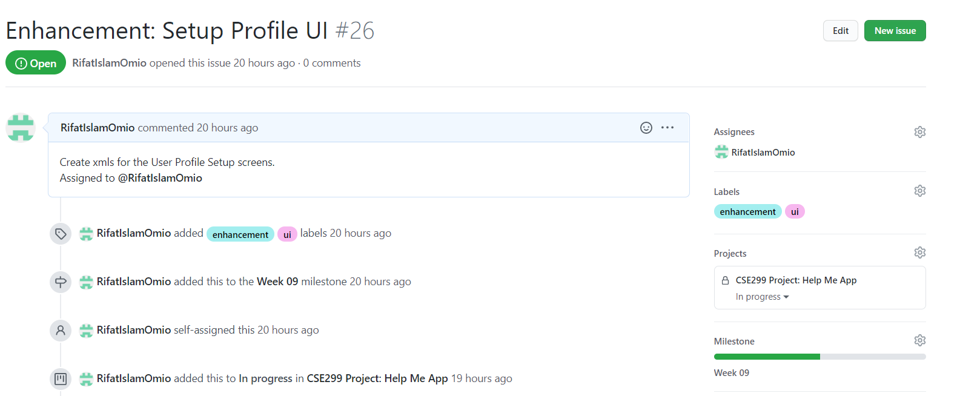
This week’s (Week-9) issue #26

Slide 7
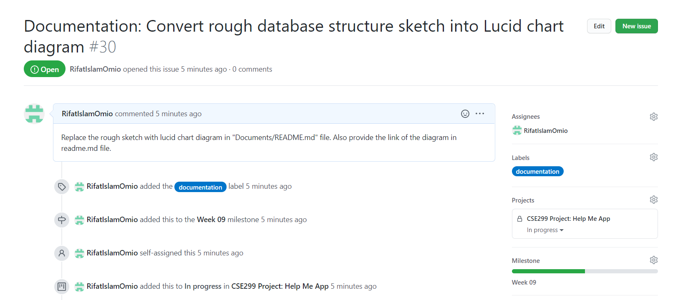
This week’s (Week-9) issue #30

Slide 8
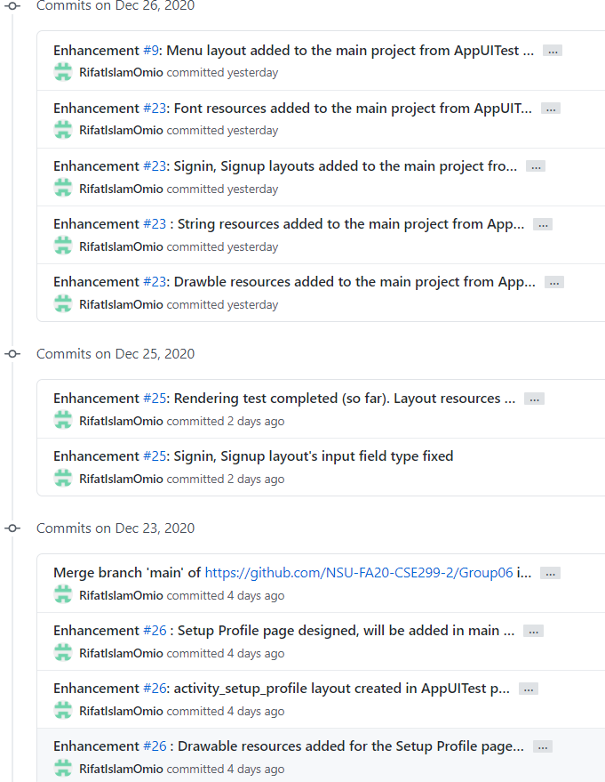
Commits (1)

Slide 9
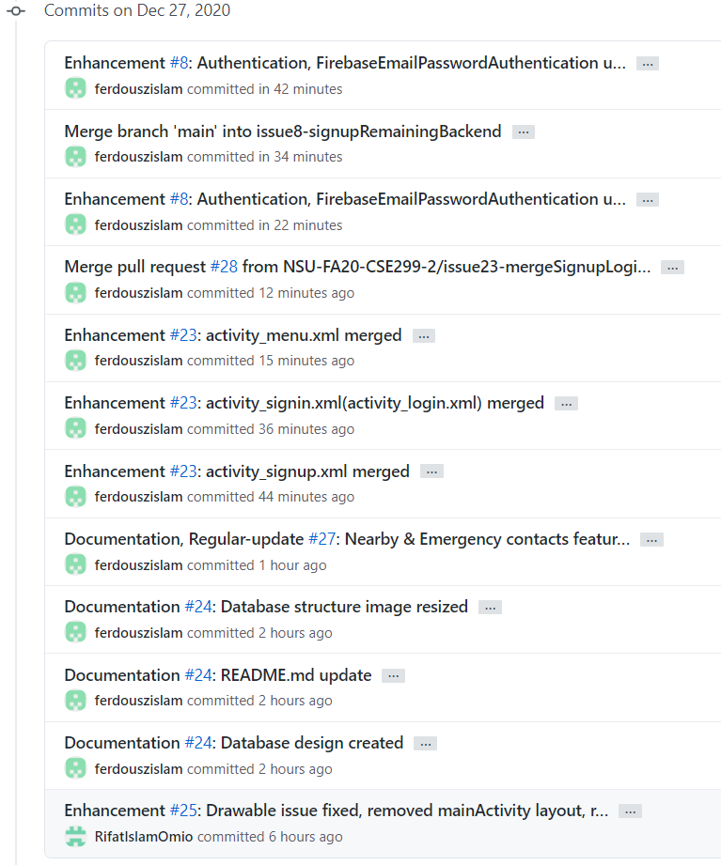
Commits (2)

Slide 10
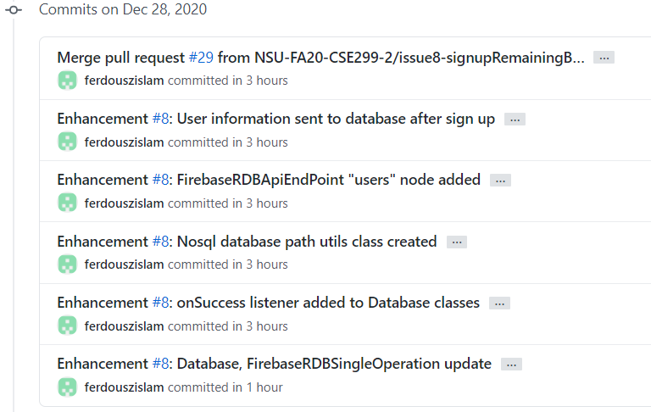
Commits (3)

Slide 11
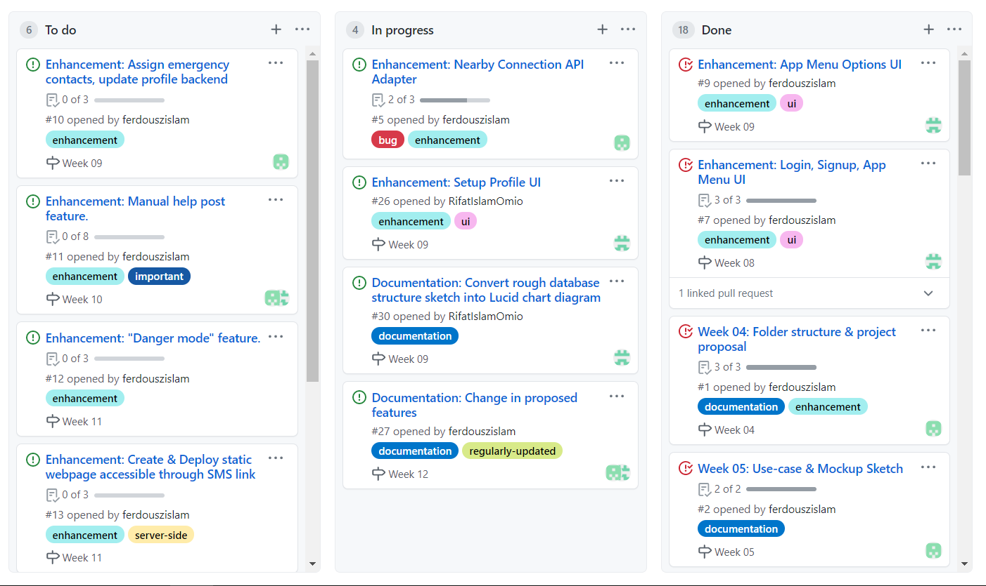
Github Project Board Status

Slide 12
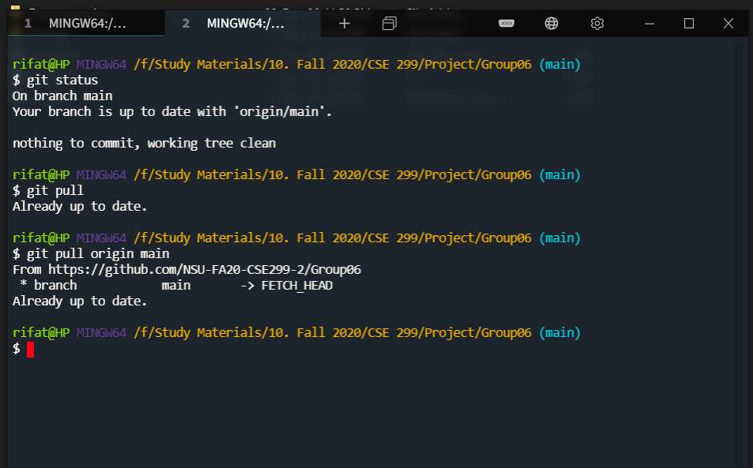
Local Repository Status

