Slide 1
Week 09 Presentation
Course: CSE299
Section: 2
Group: 06
Name: Rifat Islam
ID: 173 1536 042
Other Group Member
Name: Ferdous Zeaul Islam
ID: 173 1136 042

Slide 2
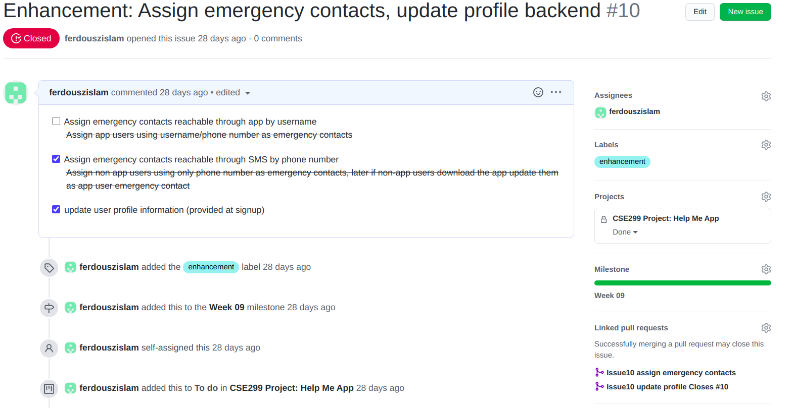
Issue #10

Slide 3
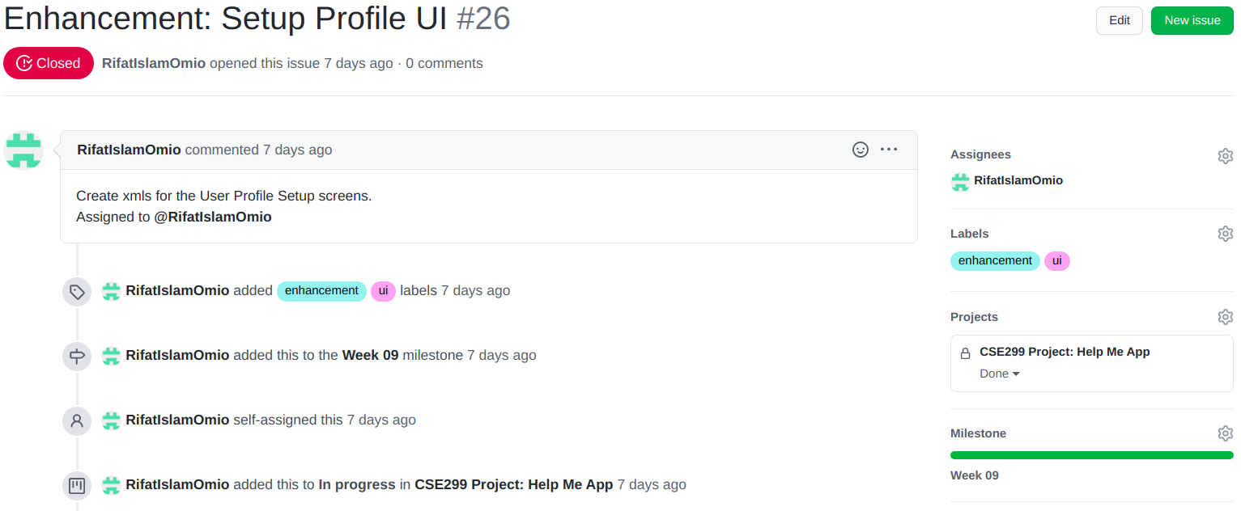
Issue #26

Slide 4
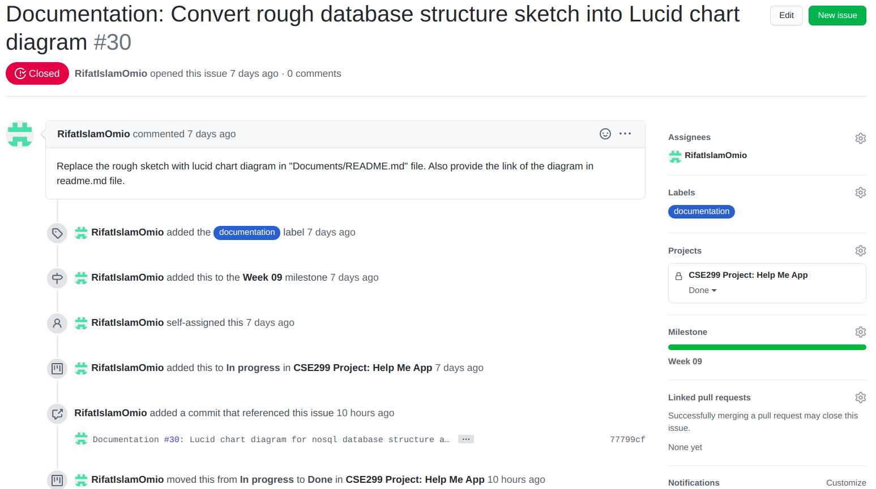
Issue #30

Slide 5
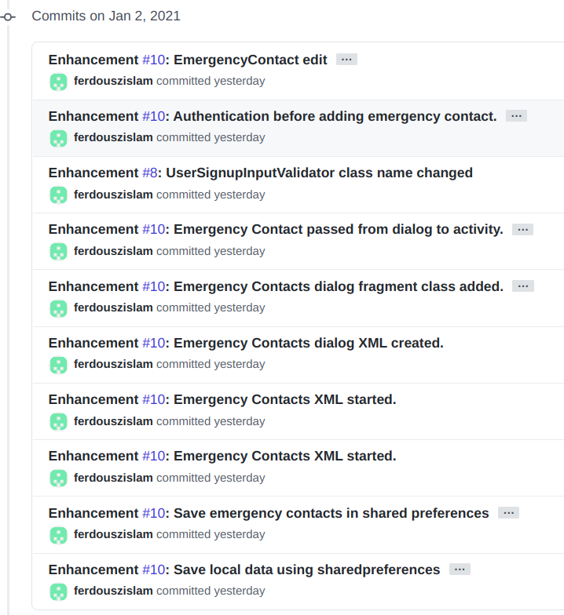
Commits (1)

Slide 6
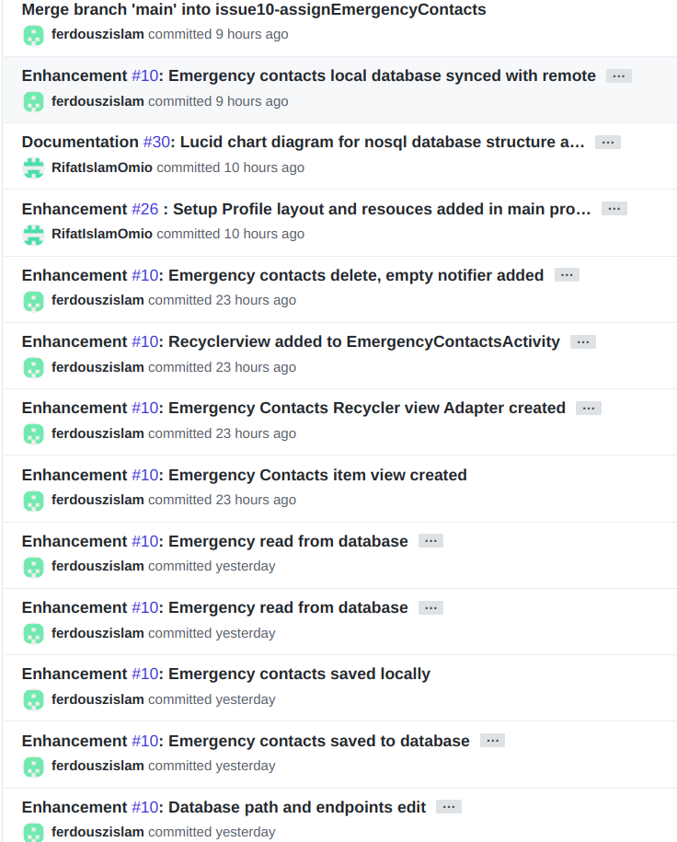
Commits (2)

Slide 7
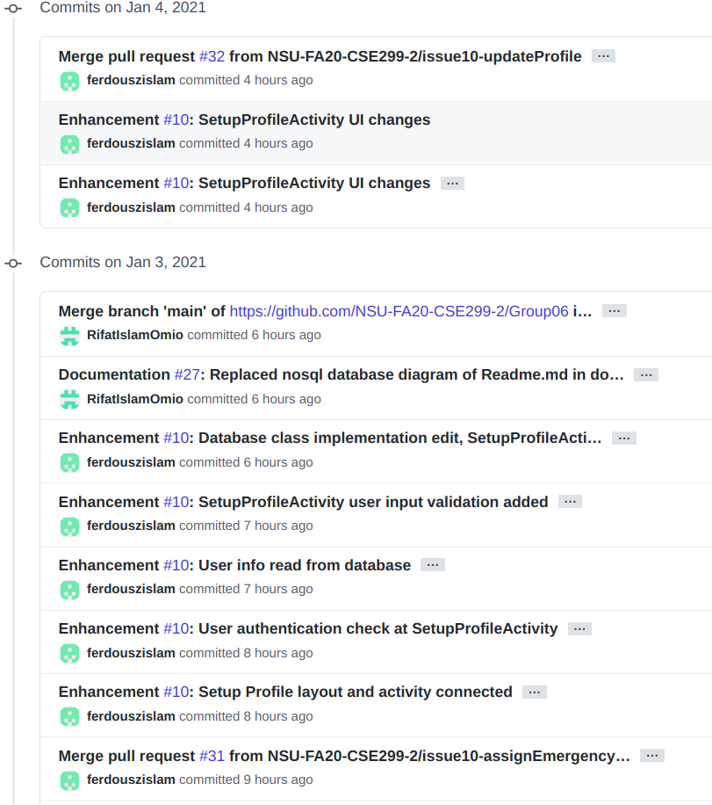
Commits (3)

Slide 8
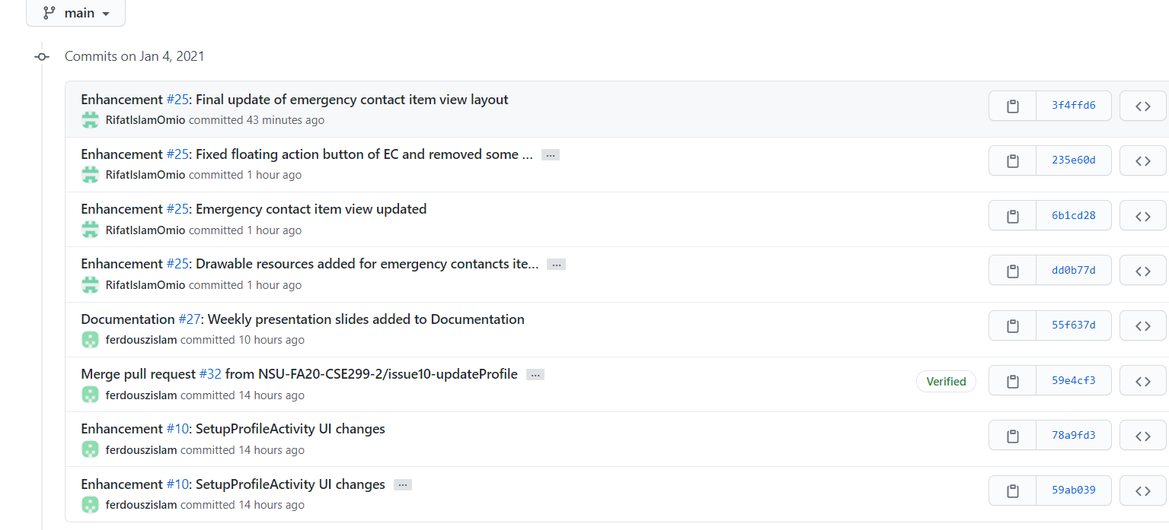
Commits (4)

Slide 9
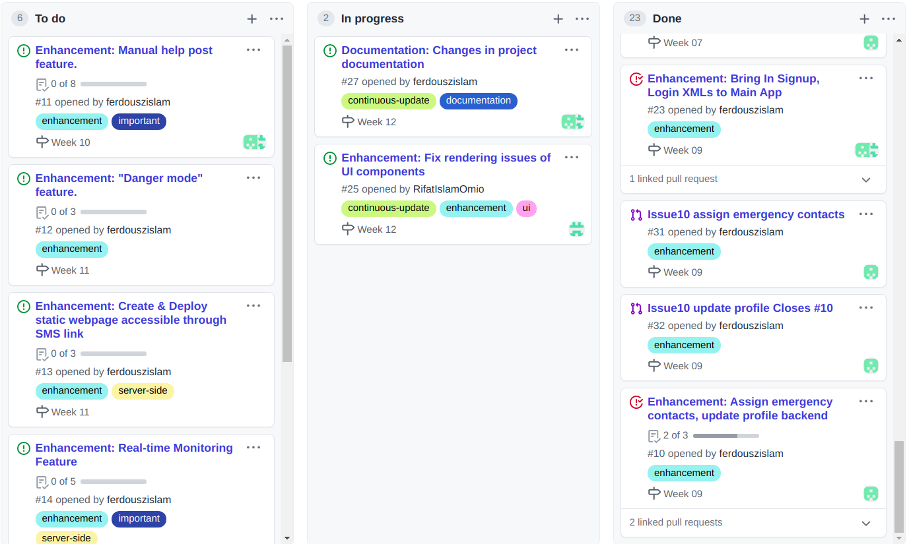
Github Project Board Status

Slide 10
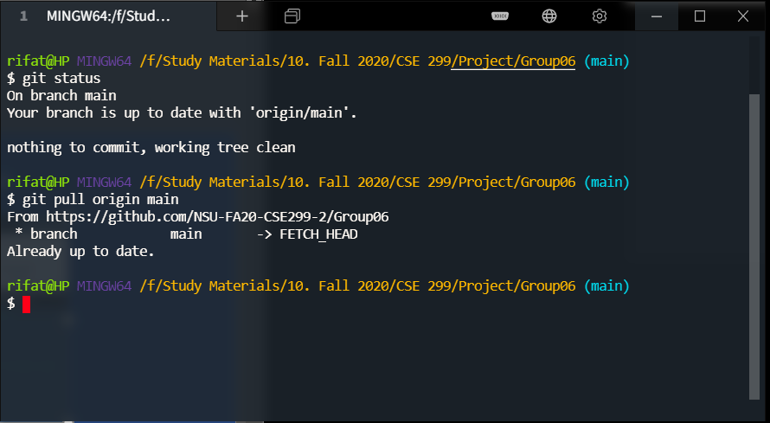
Local Repository Status

