Slide 1
IPTV Solution WEEK10 CSE299 Project
Name: G.M. Sabit Zubair ID:1520547642
Section:2 Group: 15

Slide 2
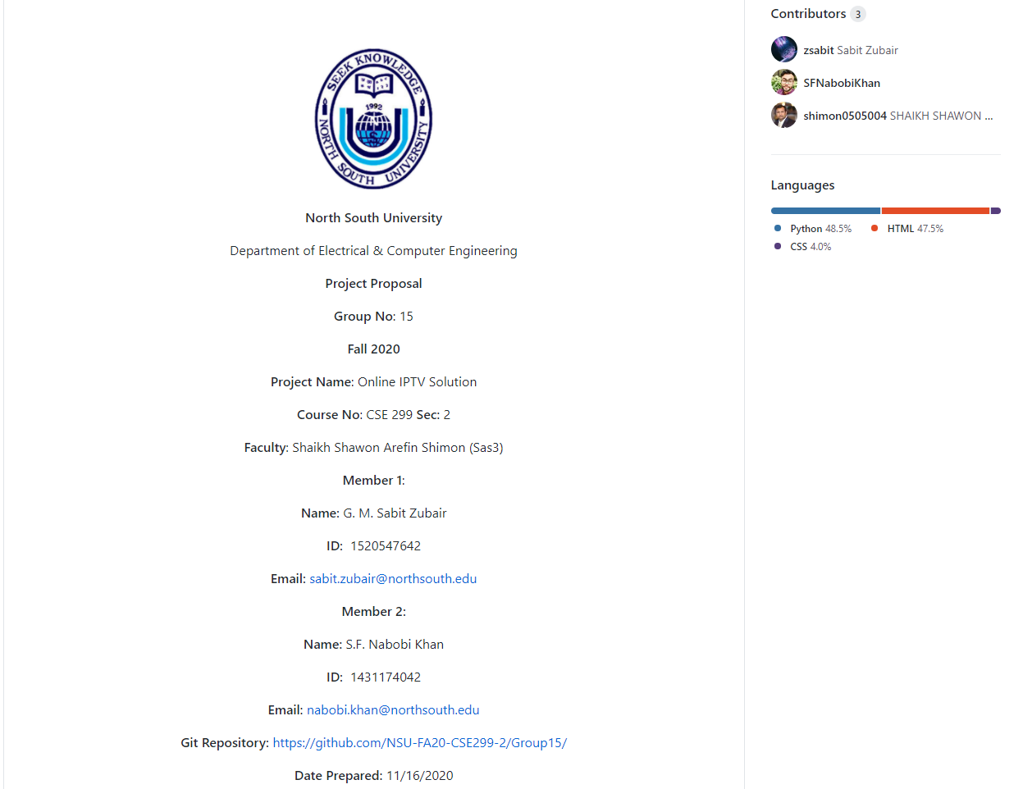
Front Page

Slide 3
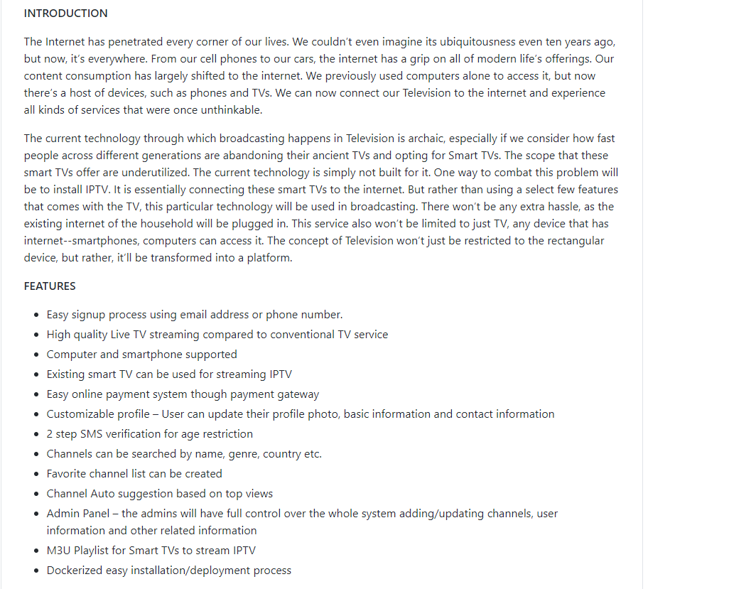
Front Page (continued)

Slide 4
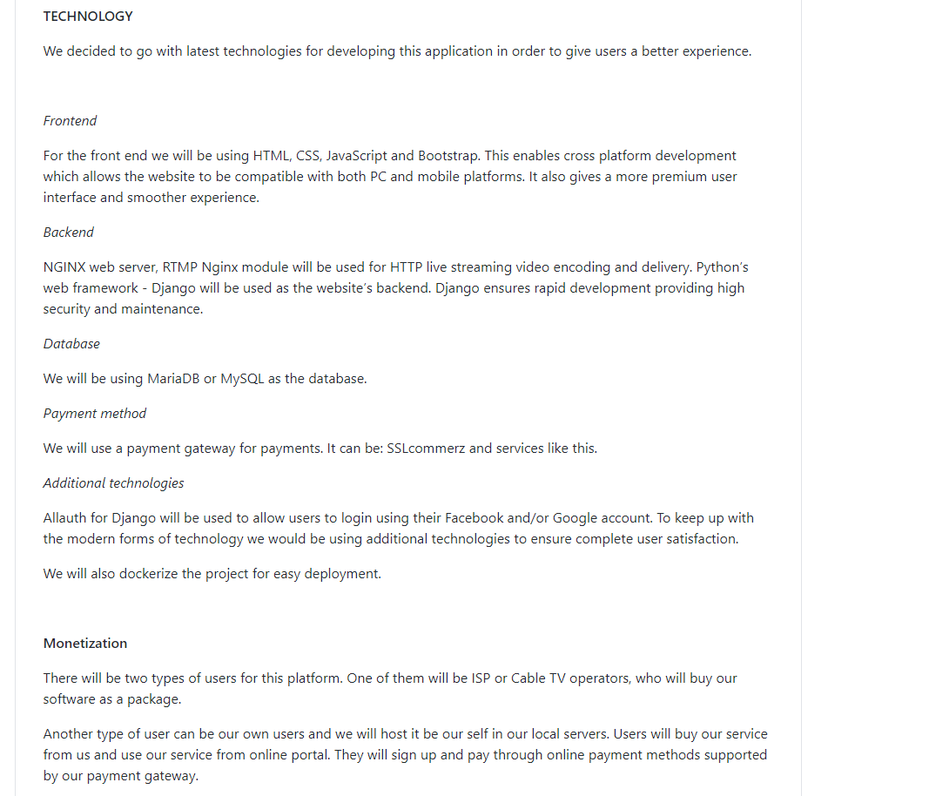
Front Page (continued)

Slide 5
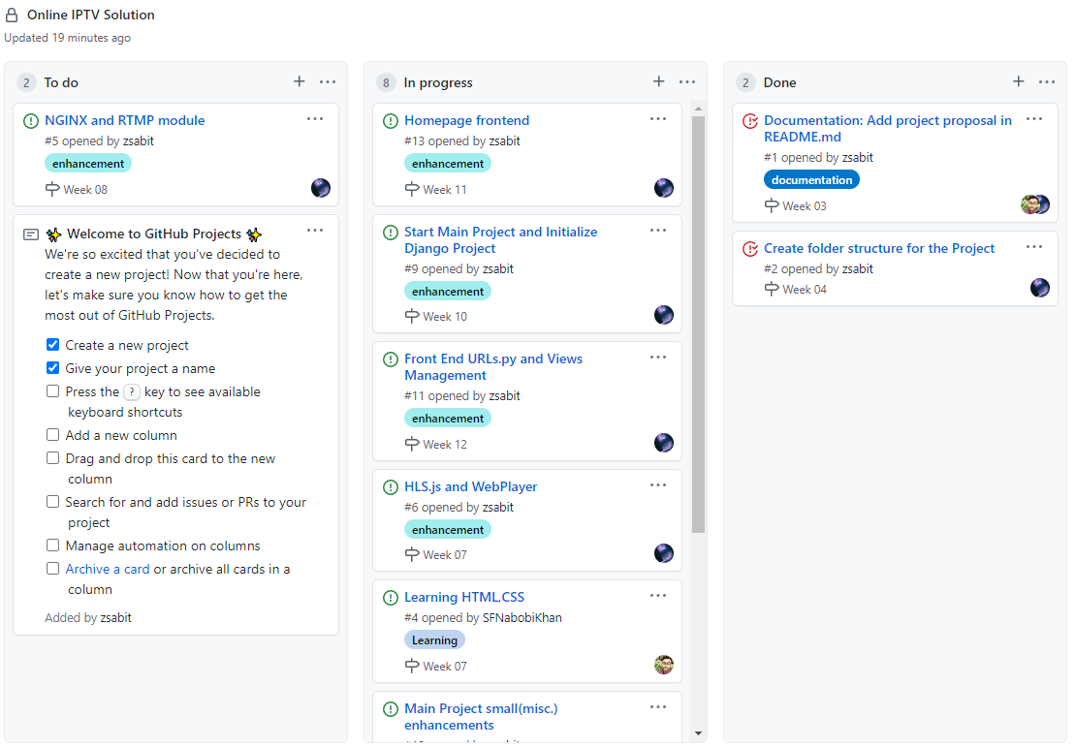
Kanban Board

Slide 6
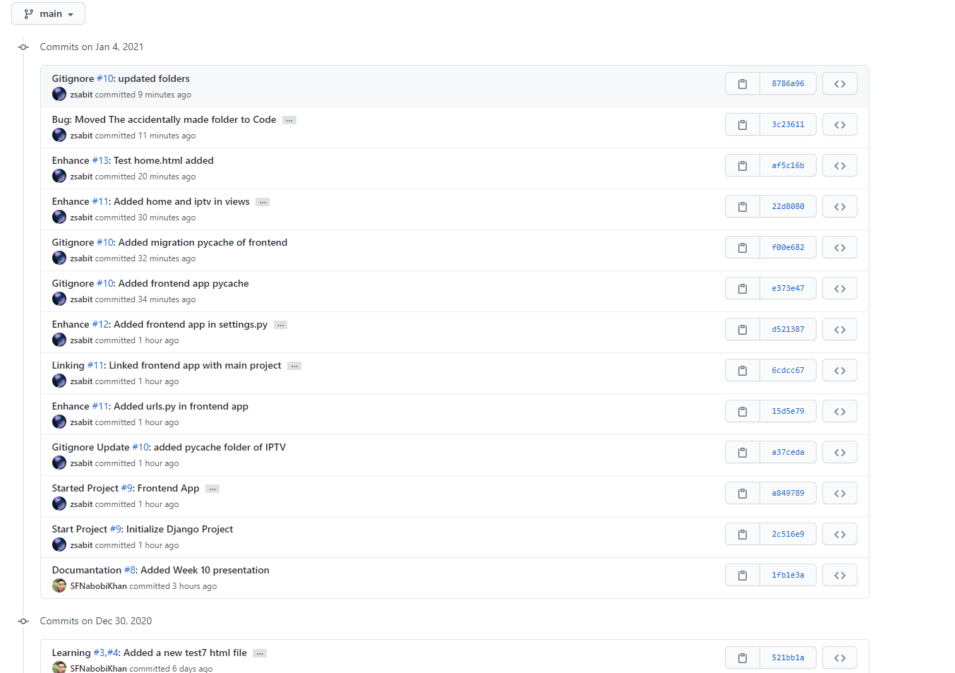
Commits

Slide 7
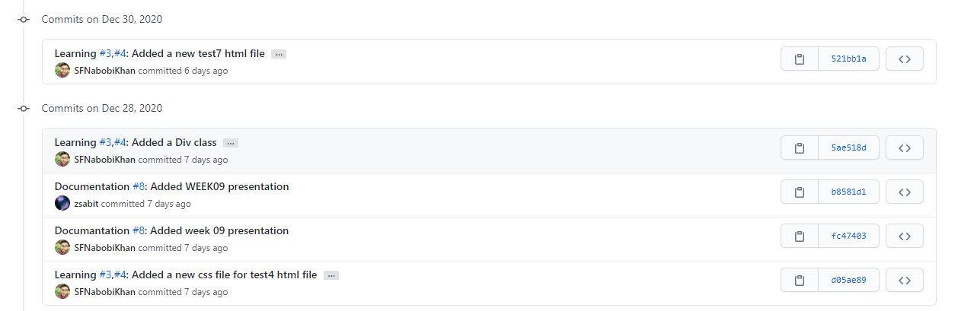
Commits(continued)

Slide 8
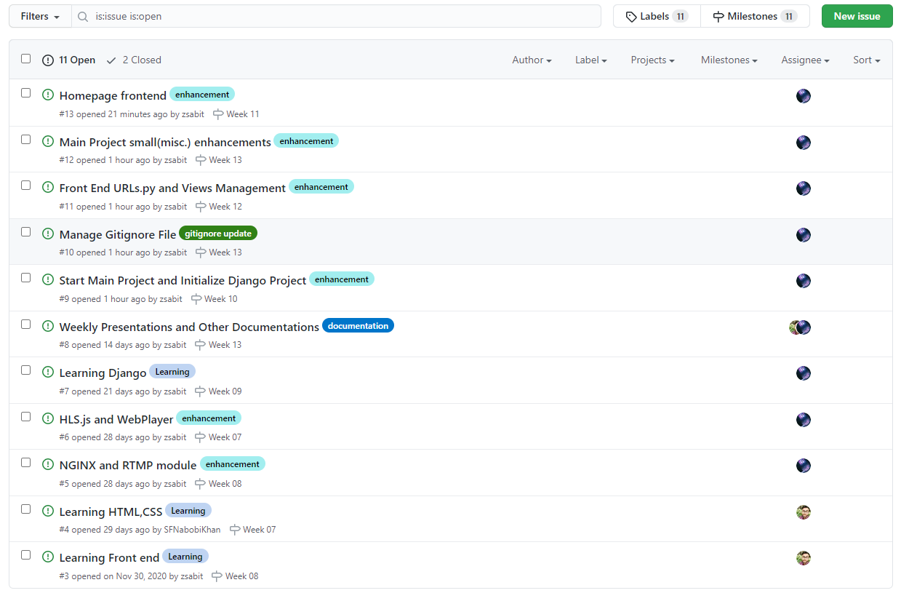
Issues

Slide 9
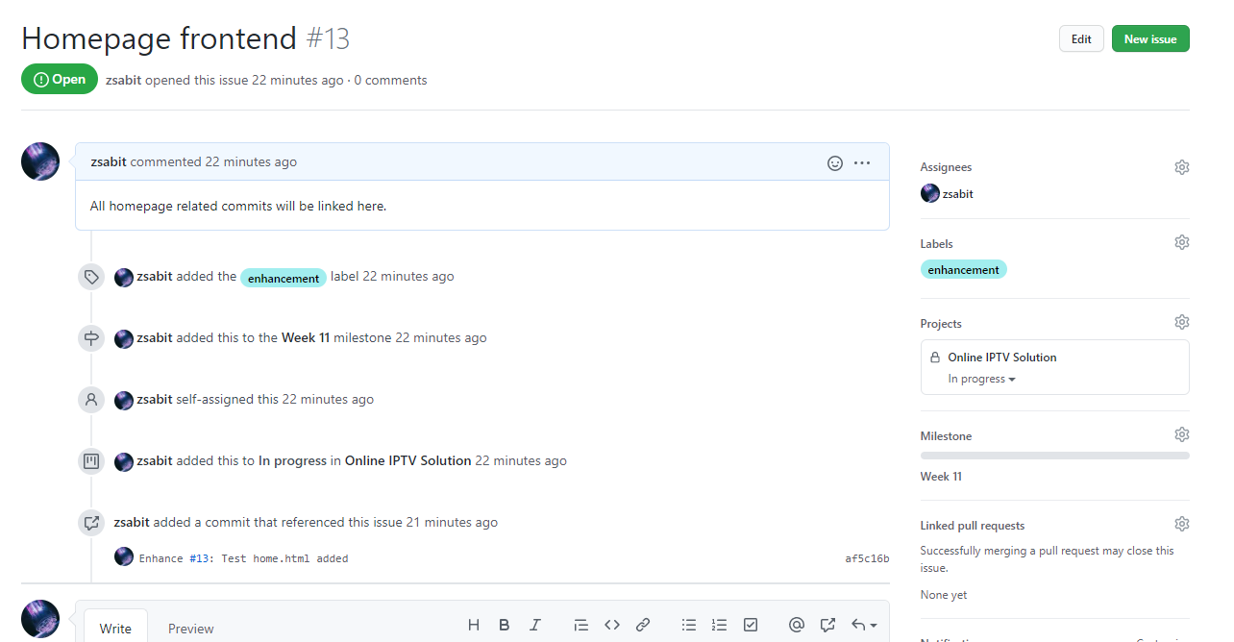
Issues(continued)

Slide 10
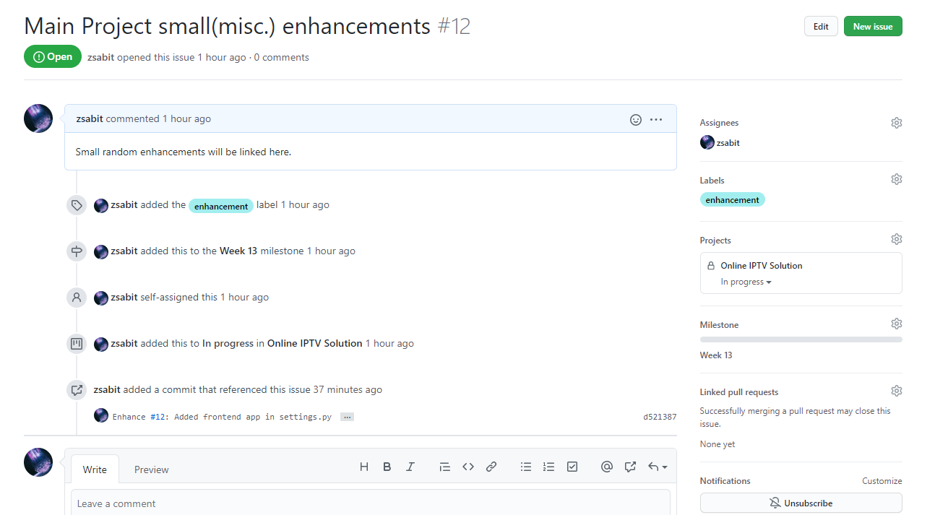
Issues(continued)

Slide 11
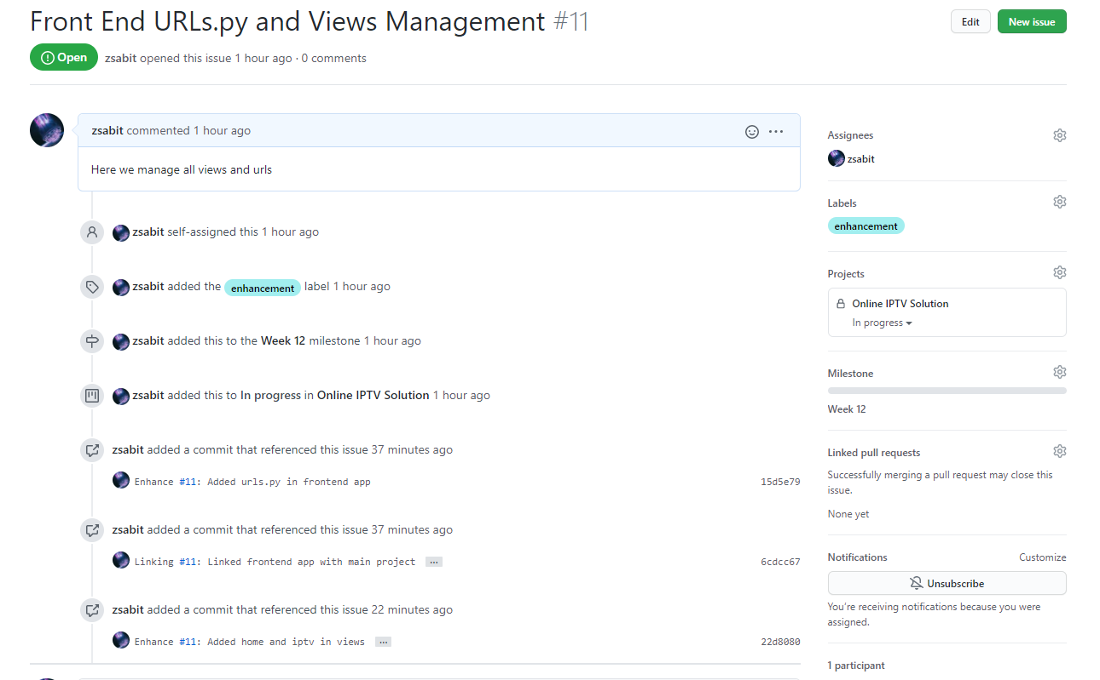
Issues(continued)

Slide 12
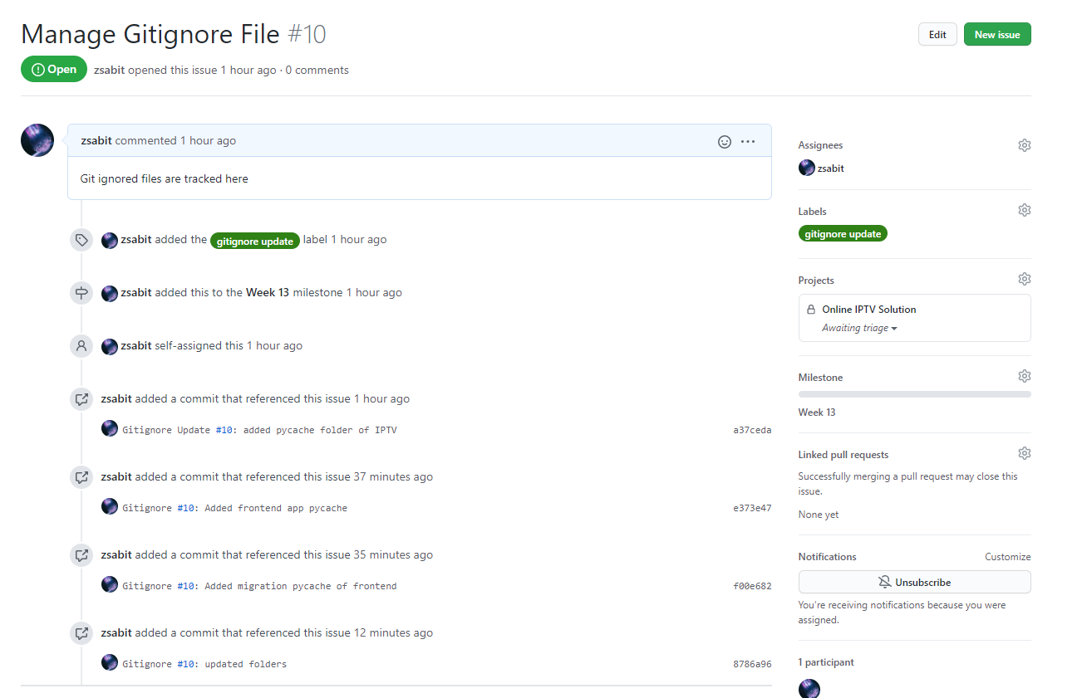
Issues(continued)

Slide 13
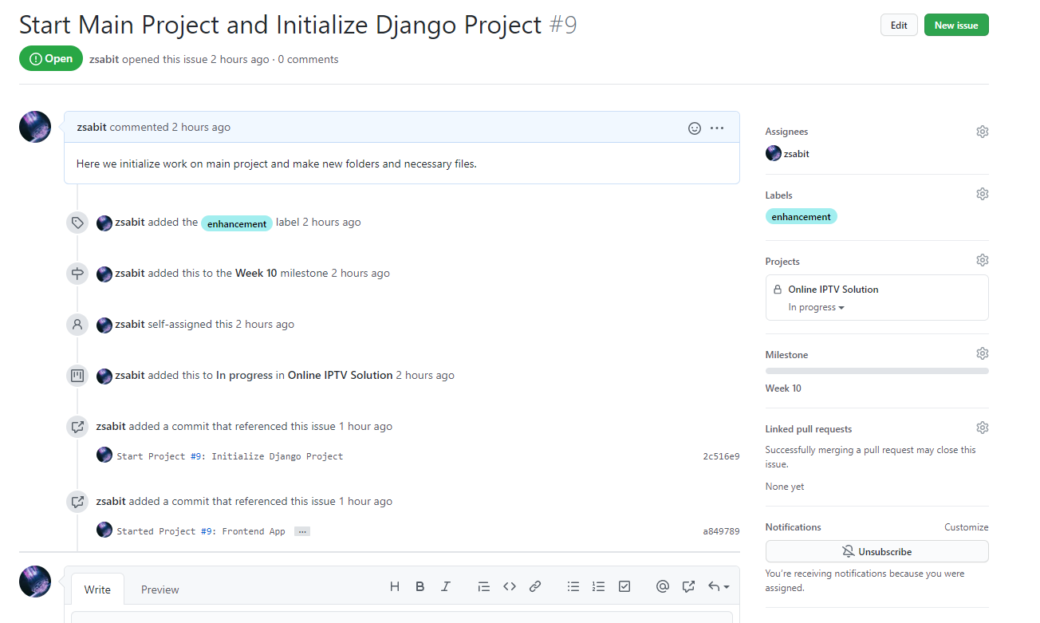
Issues(continued)

