Slide 1
CSE299
Final Presentation
Sec: 03
Group: 01
Name: Kazi Ruhol Kabir Moahhed
ID: 1721103642

Slide 2
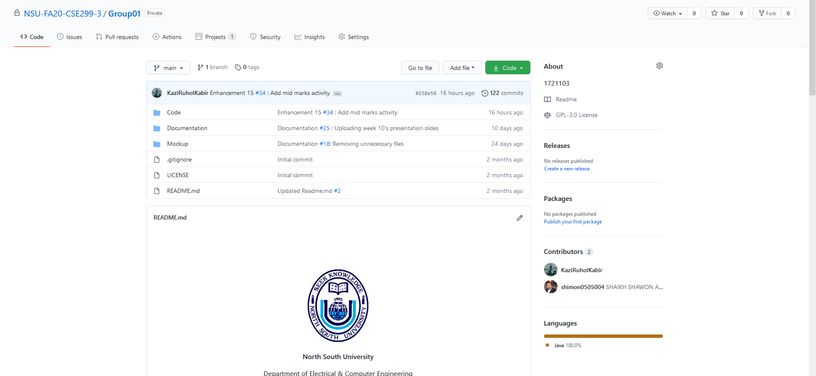
Github Front Page

Slide 3
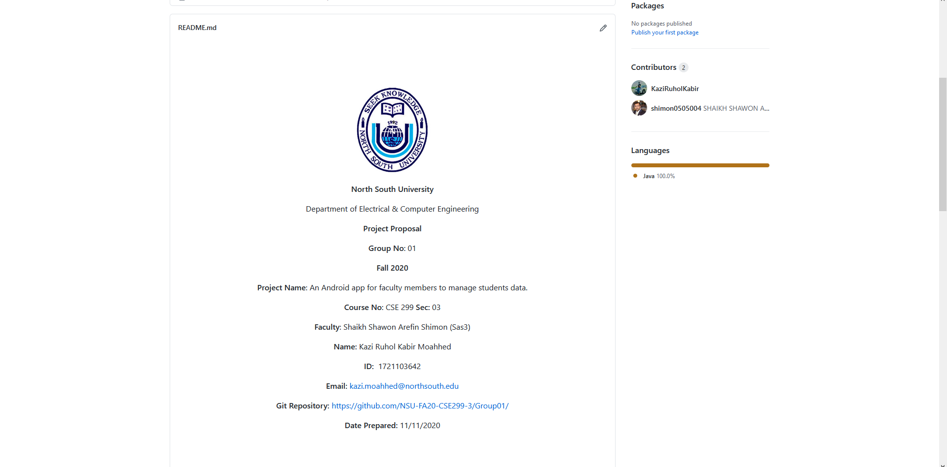
Readme.md

Slide 4
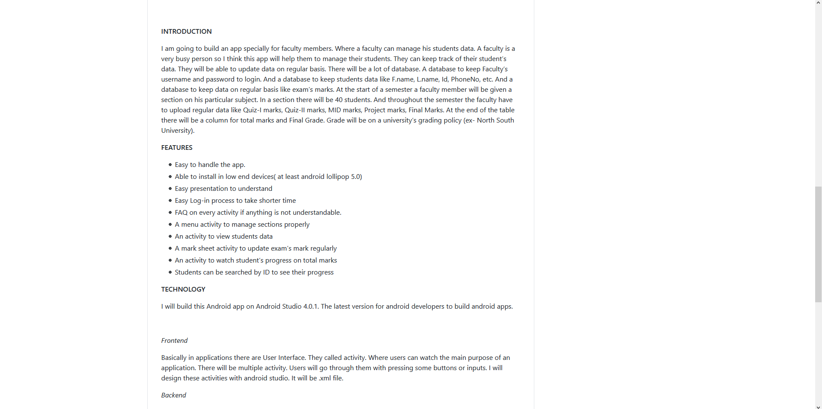
Readme.md

Slide 5
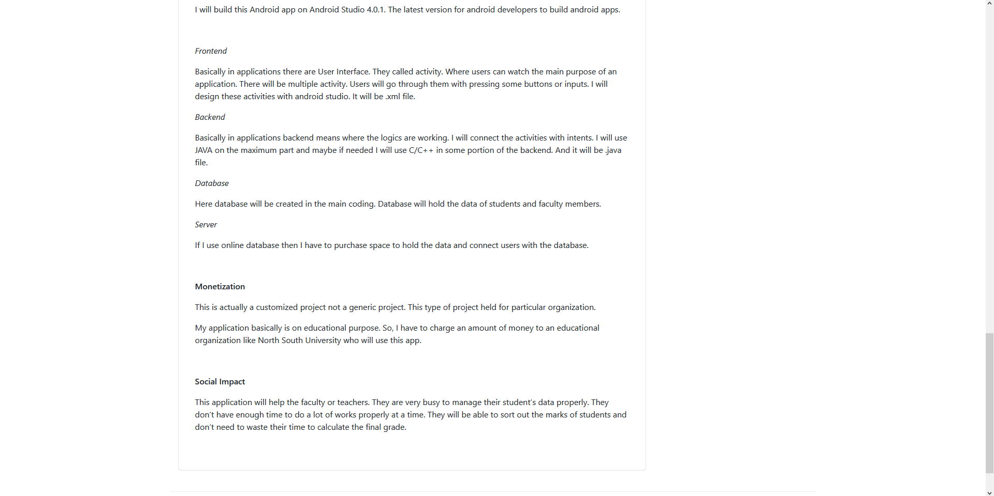
Readme.md

Slide 6
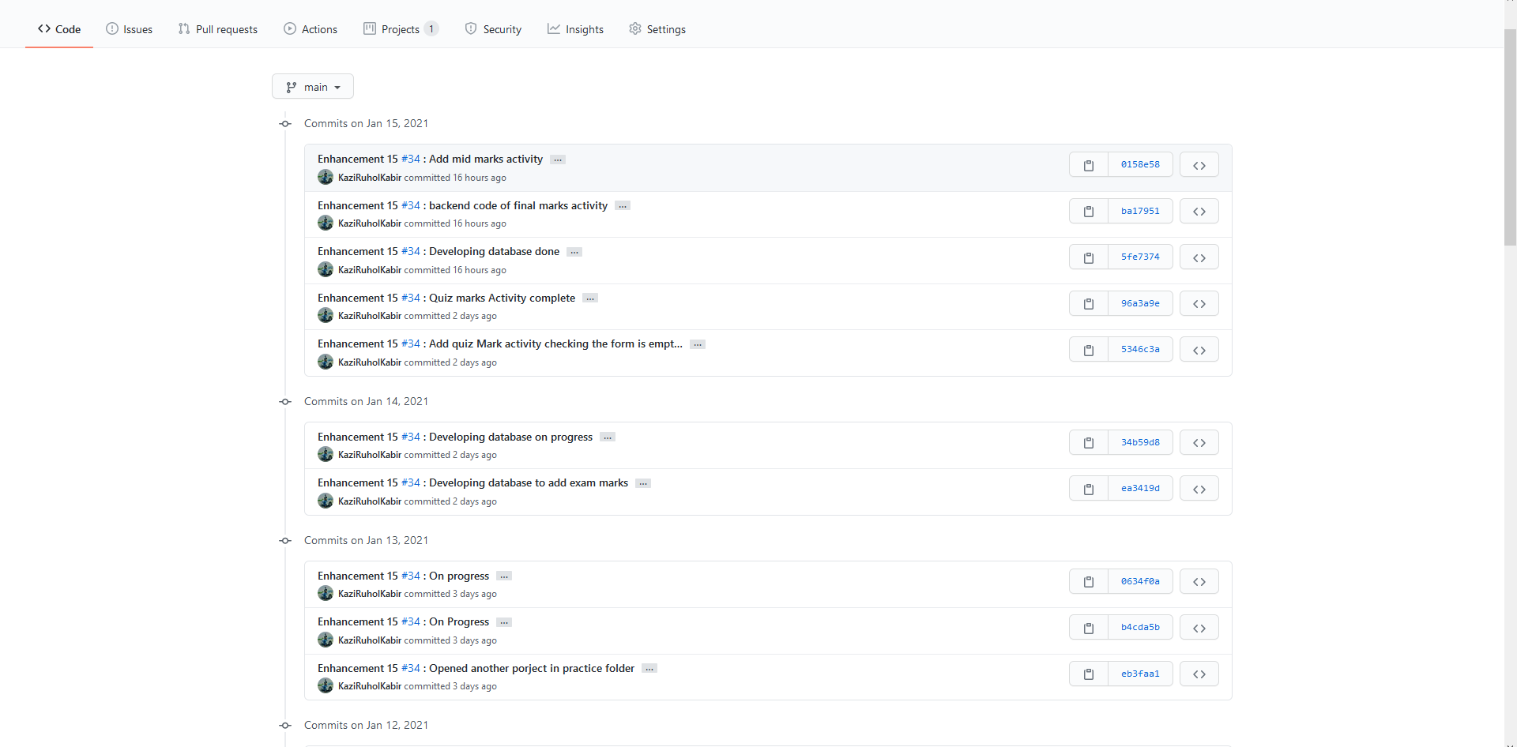
This Week’s Commits

Slide 7
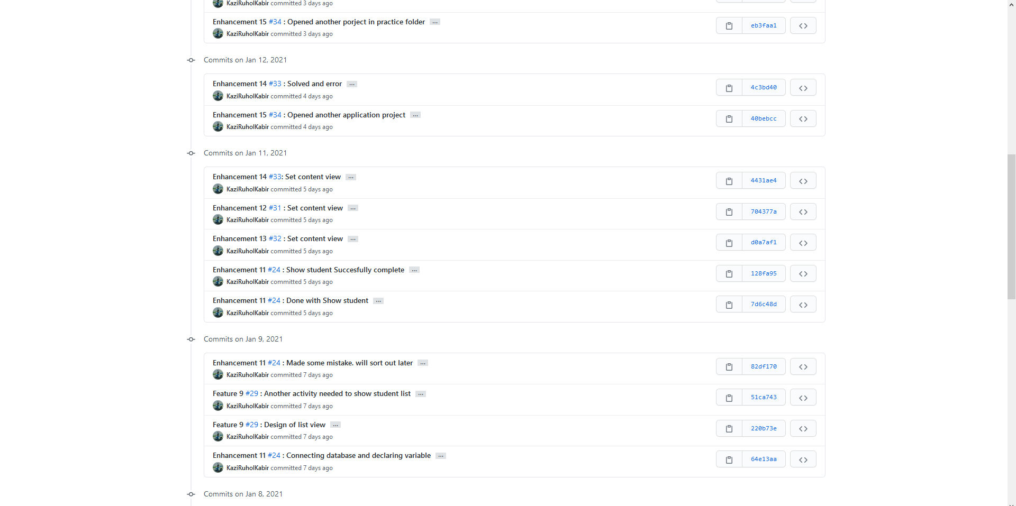
This Week’s Commits

Slide 8
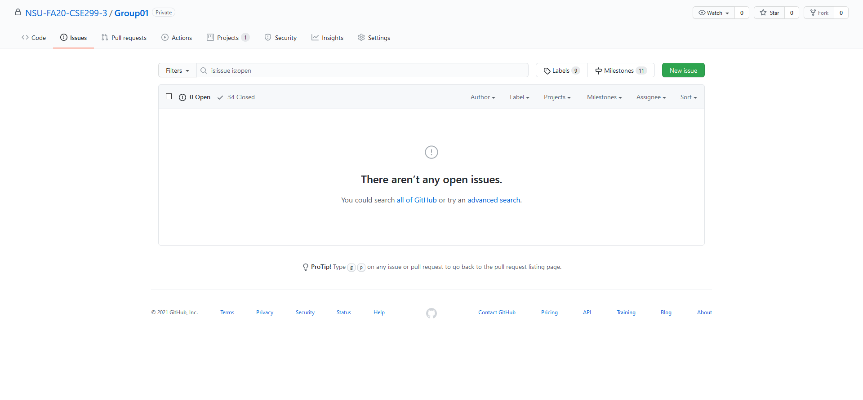
Issue- Open Issues

Slide 9
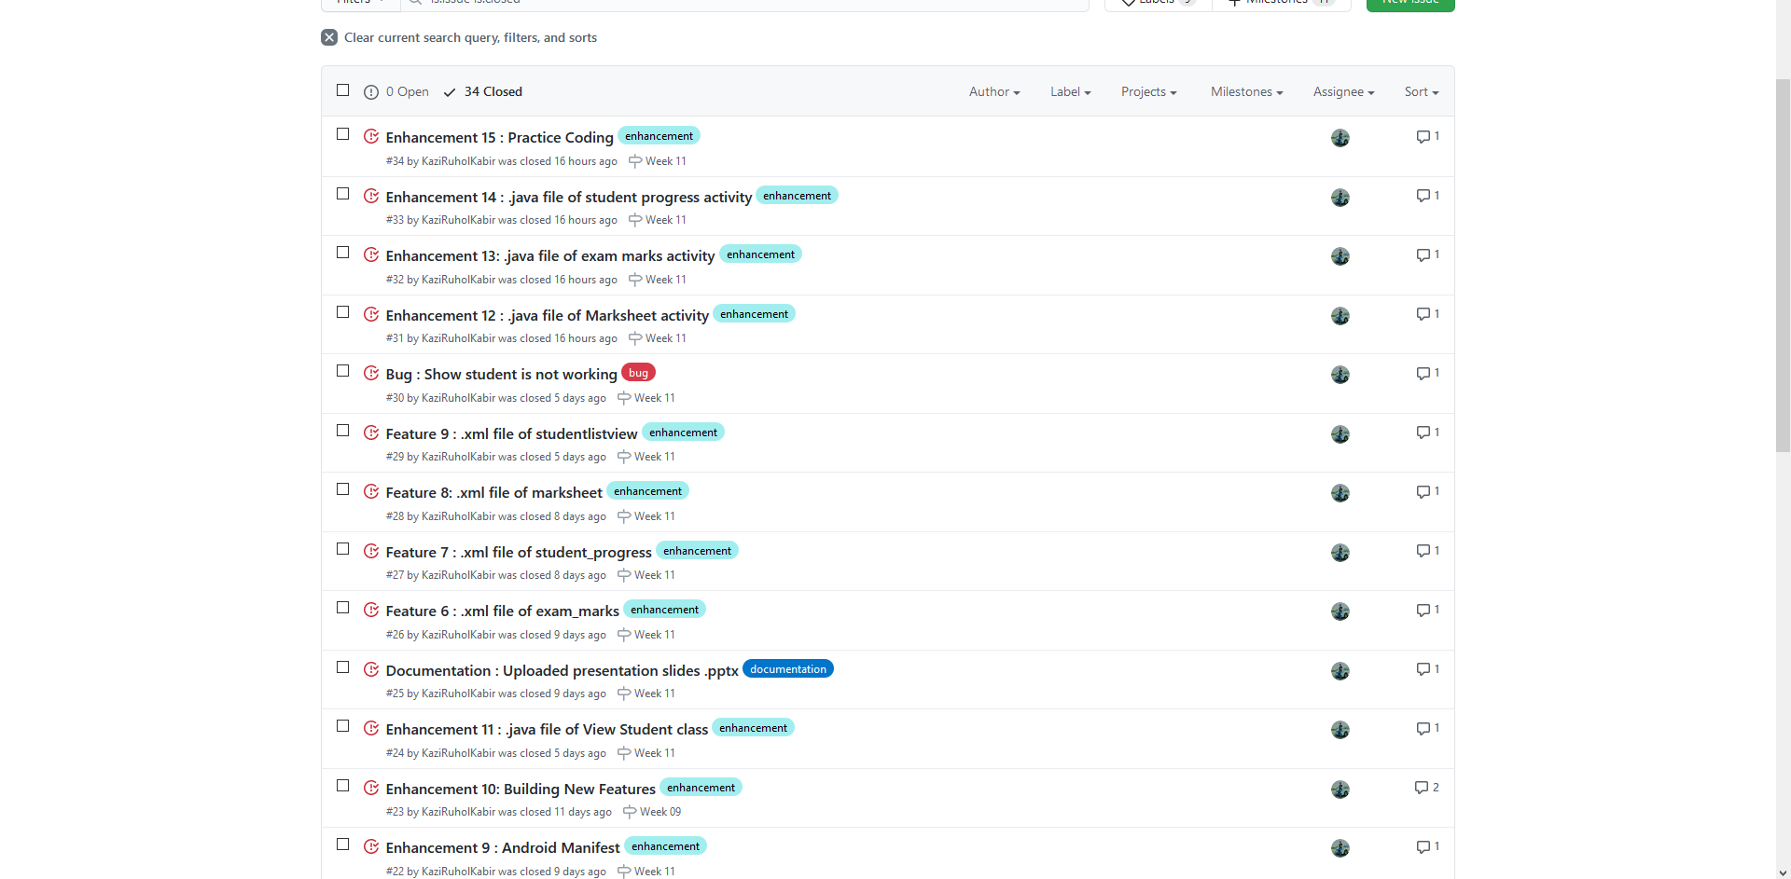
Issue- closed issues

Slide 10
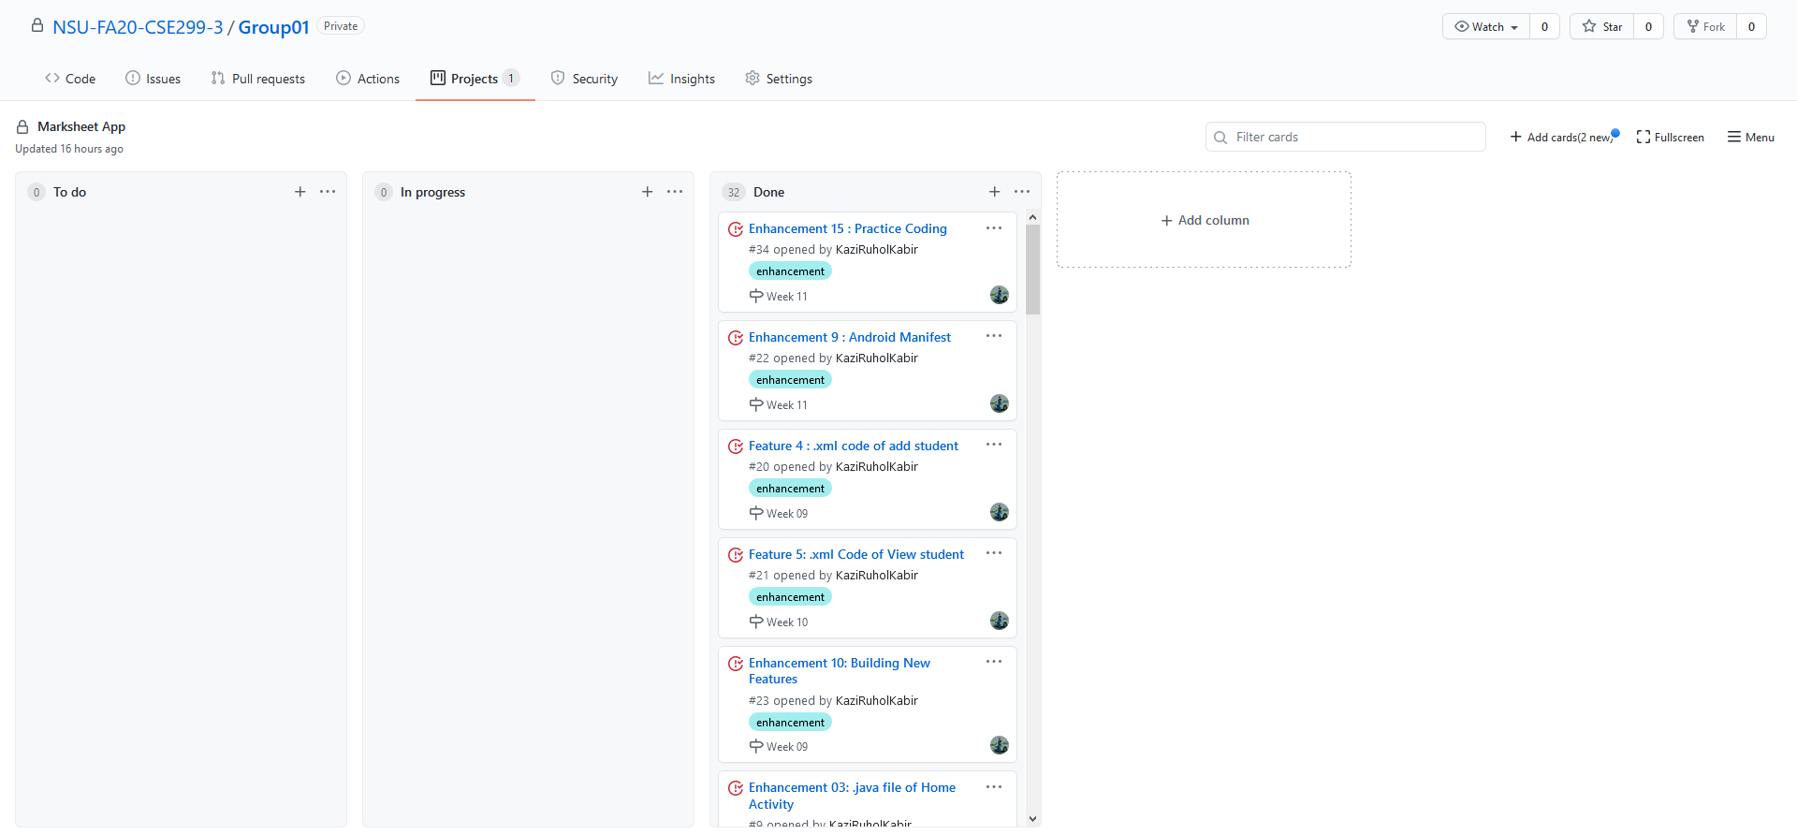
Issue Board

