Slide 1

WELCOME
Numan Talukder
This Week’s Commits
Issues
Github
Front Page
Milestones
Github Board
Local Repository
1721390642
CSE299.3 Fall2020

Slide 2
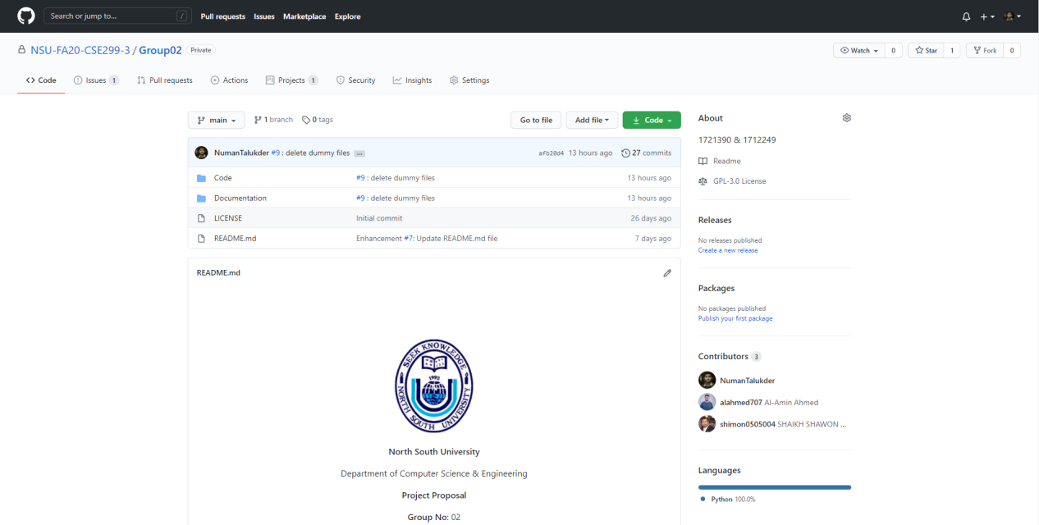
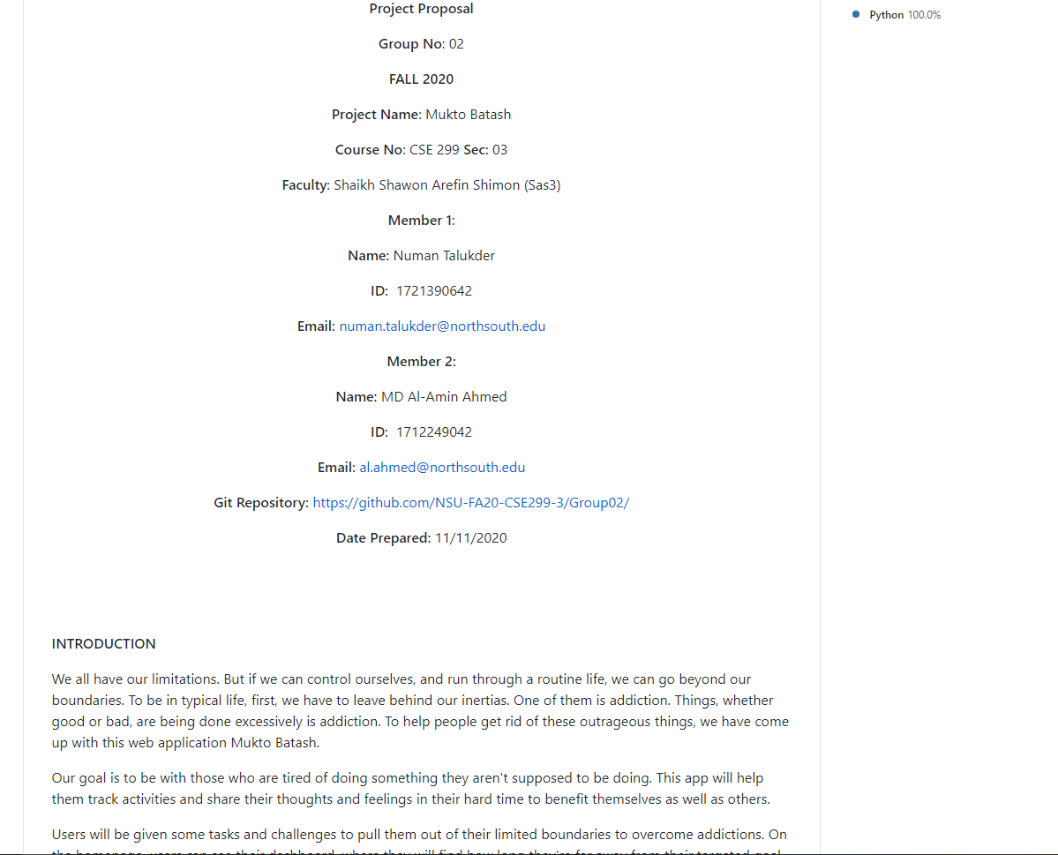
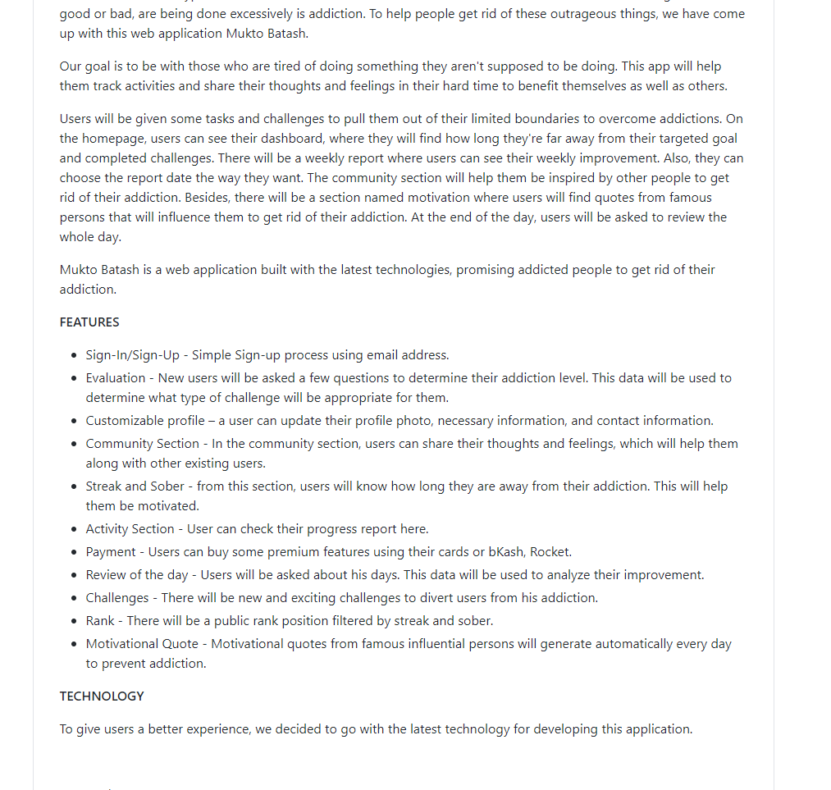
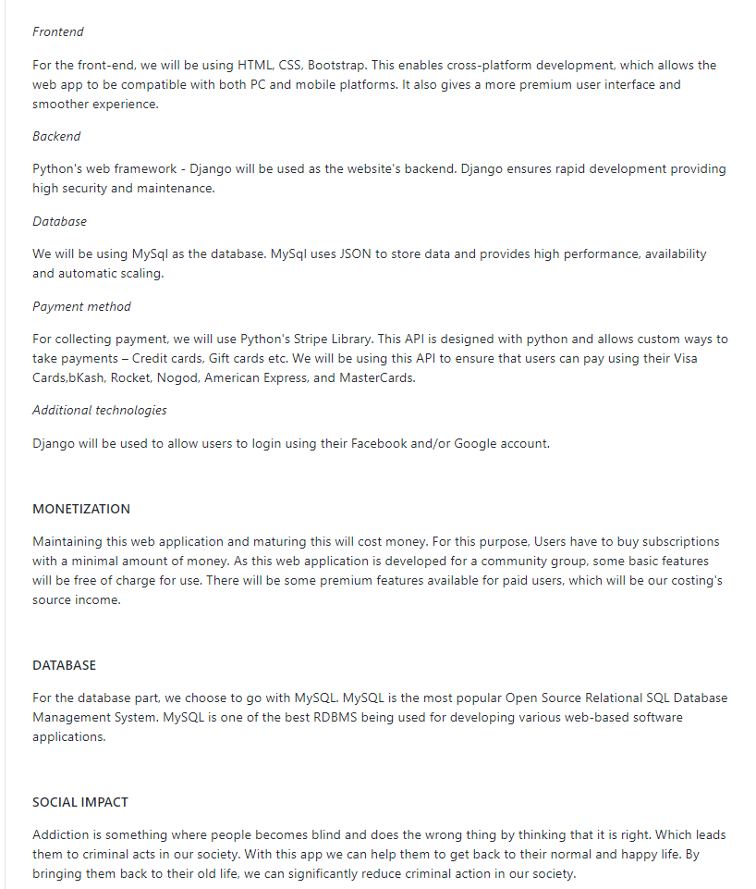
This Week’s Commits
Github
Front Page
Issues
Github Board
Milestones
Local Repository

Slide 3
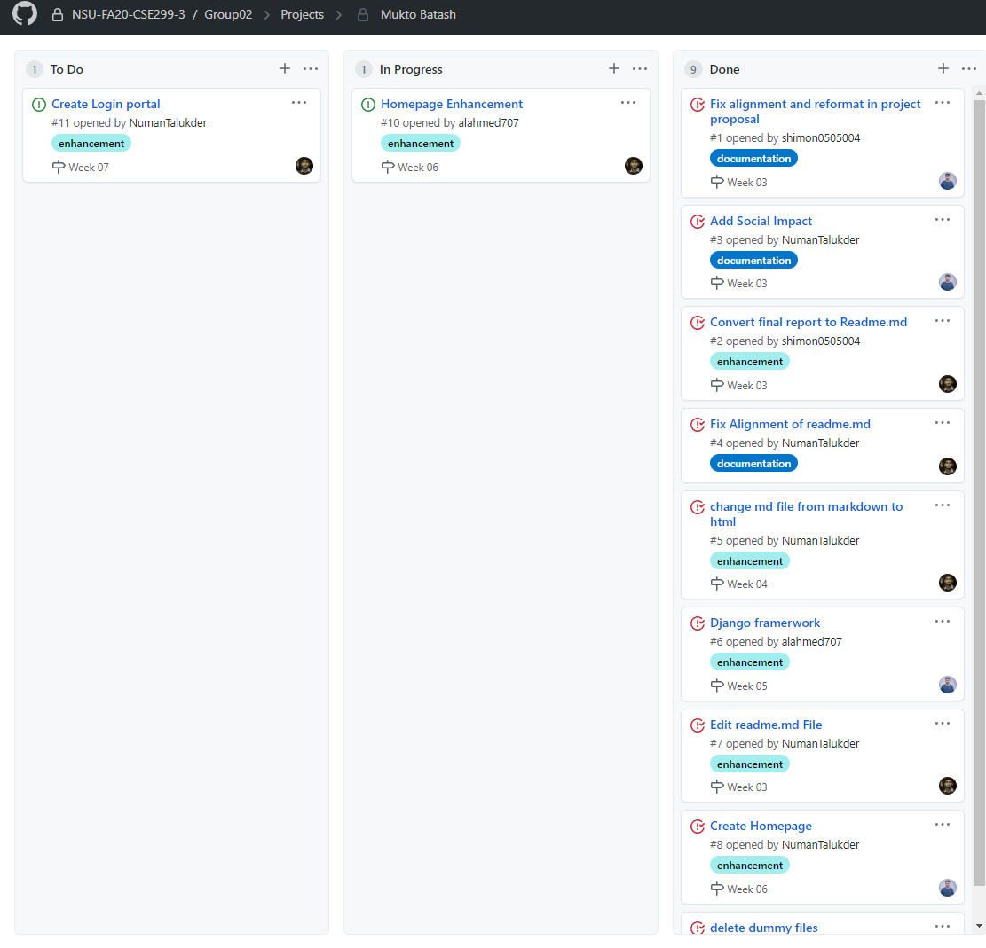
This Week’s Commits
Github
Front Page
Issues
Milestones
Github Board
Local Repository

Slide 4
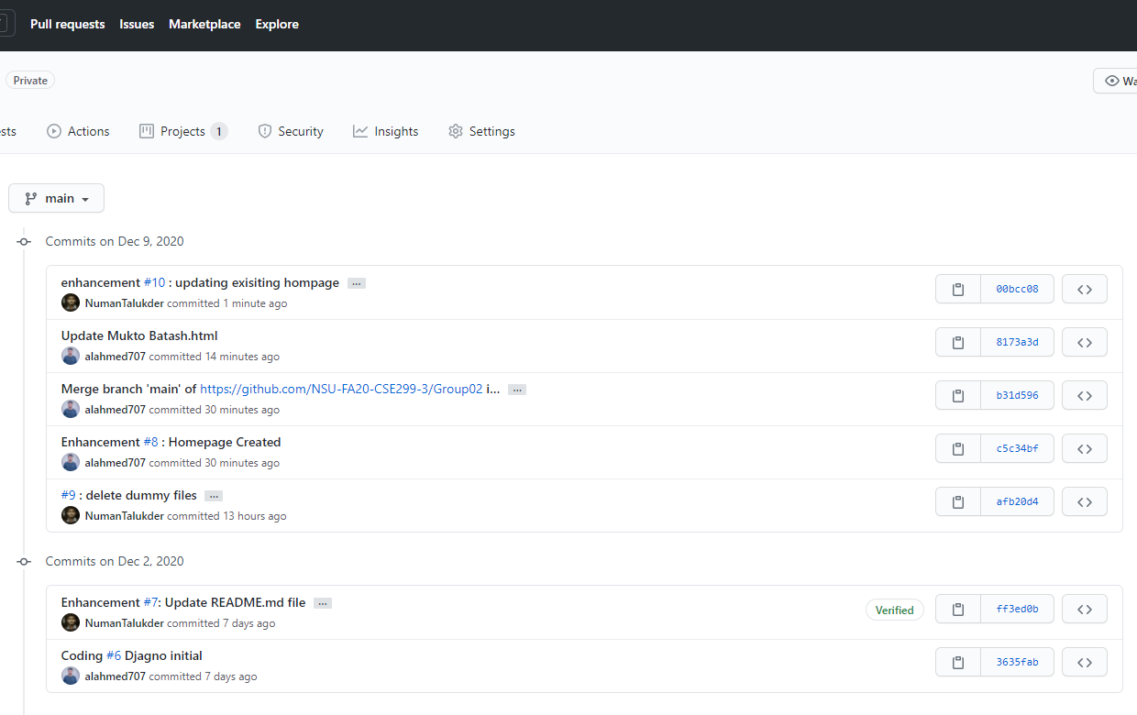
This Week’s Commits
Issues
Github
Front Page
Milestones
Github Board
Local Repositor

Slide 5
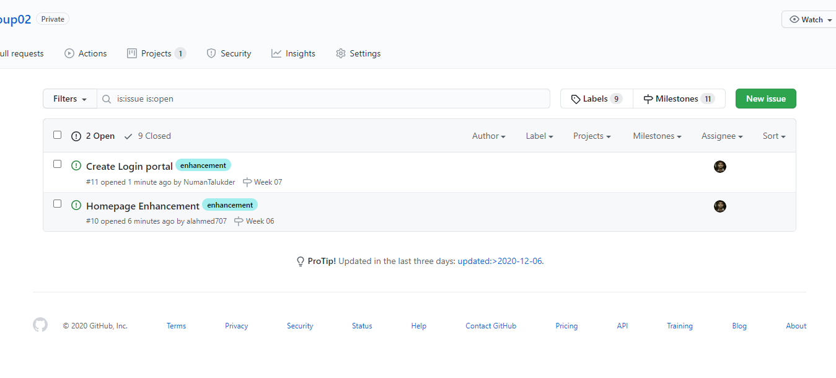
This Week Commits
Github
Front Page
Milestones
Issues
Github board
Local Repository

Slide 6
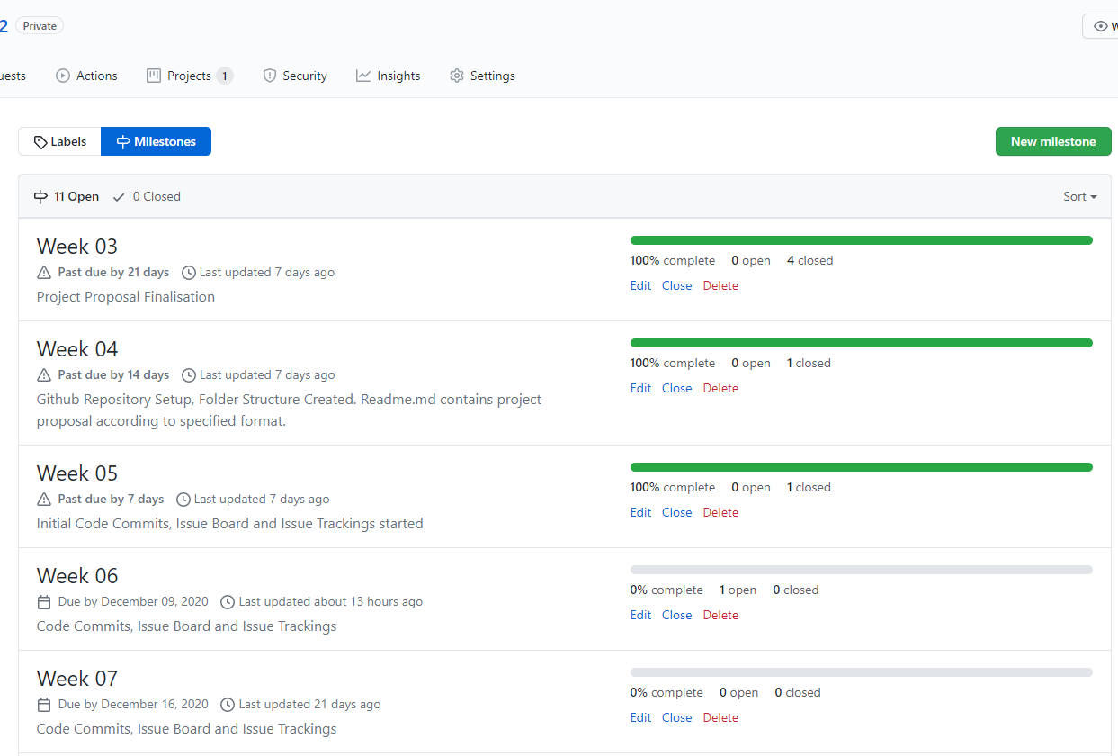
This Week’s Commits
Github
Front Page
Issues
Github Board
Local Repository
Milestones

Slide 7
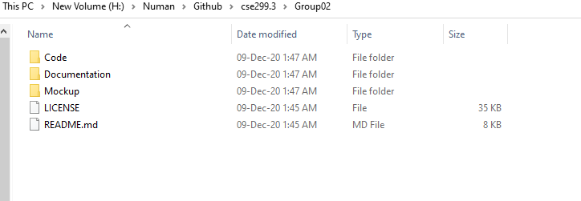
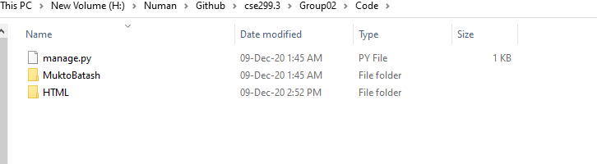
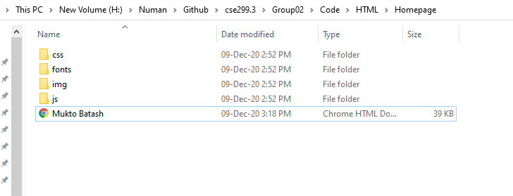
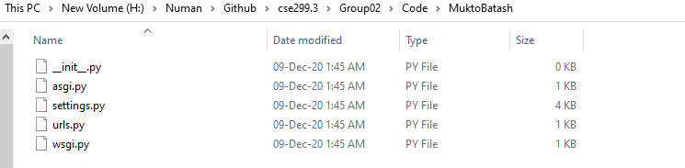
This Week’s Commits
Github
Front Page
Issues
Github Board
Milestones
Local Repository

